Slide 1






ASSISTANT X
Software Group Project Presentation

Slide 2

ASSISTANT X
OUTLINE:
Introduction
Background
Problem Statement
Basic Concepts Used
Current Applications
Hardware and Software Requirements
Features
Working
Project Planning
About Us
References

Slide 3



INTRODUCTION
What is Virtual Assistant?
What is AI Personal Assistant?
What is ChatBot?
A software or a person that can perform tasks or services for an individual based on commands and questions
An AI personal assistant is a piece of software that understands verbal or written commands and completes task assigned by the client.
A chatbot is an artificial intelligence (AI) software that can simulate a conversation (or a chat) with a user in natural language

Slide 4



BACKGROUND
COMBINATION OF CONCEPTS
FIRST VIRTUAL ASSISTENT
MAN BEHIND THE CONCEPT
Speech Recognition
Artificial Intelligence
Natural Language Processing
IBM SIMON was the first virtual personal digital assistant
It came into market in early 90s
Concept was first developed by JOSEPH WEIZENBAUM
The concept was developed in MIT in late 60s.

Slide 5
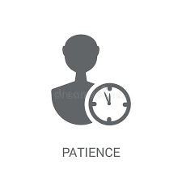


PROBLEM STATEMENT
DECREASE IN PATIENCE
AUTOMATION IS FUTURE
ERA OF SMART WORK

Slide 6
BASIC CONCEPTS USED:
NATURAL LANGUAGE PROCESSING
AUTOMATIC SPEECH RECOGNITION
ARTIFICIAL INTELLIGENCE
INTER-PROCESS COMMUNICATION

Slide 7



CURRENT APPLICATIONS:
APPLE’S SIRI
AMAZON’S ALEXA
SAMSUNG’S BIXBY

Slide 8

HARDWARE AND SOFTWARE REQUIREMENTS
SMARTPHONE
INTERNET CONNECTIVITY
ACCESS TO CAMERA,VOICE RECORDER and SENSORS
ANDROID OS

Slide 9



FEATURES
ENGAGING USER EXPERIENCE
OFFERS 24/7 SUPPORT
CHATBOT SUPPORT

Slide 10
WORKING
SPEECH TO TEXT
TEXT ANALYSING
INTERPRET COMMANDS
A piece of software will convert the Audio to Text
The text will be the sent as Input
Converted Text has no meaning to software
A piece of software will convert the text into computer understandable format
Words will be mapped to functions and parameters to create a command that computer understands
The commands will be interpreted
If necessary, it will communicate with the Internet

Slide 11
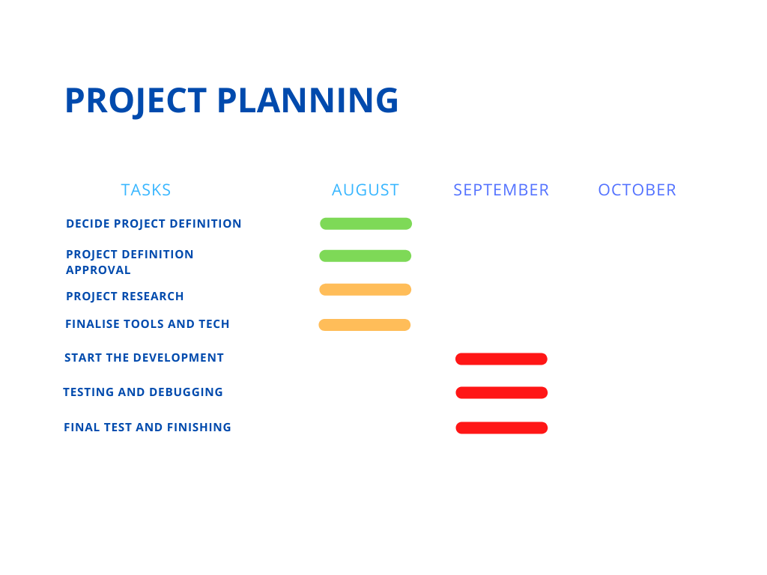
PROJECT PLANNING
LEGEND
COMPLETED
IN-PROGRESS
PENDING

Slide 12
ABOUT US

Slide 13
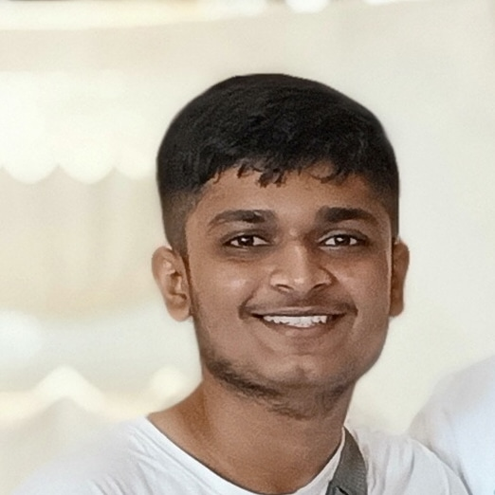
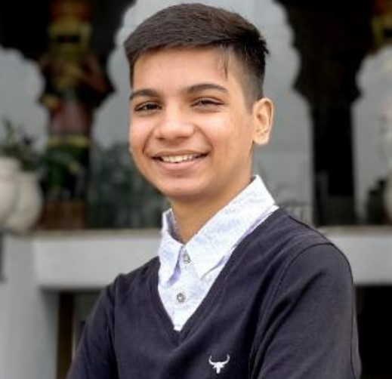
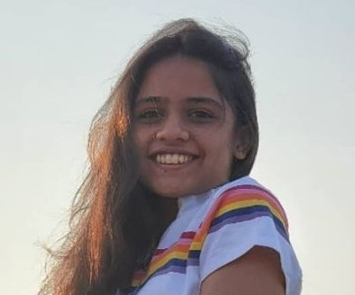
ABOUT US
PARTH PATEL
SAUMYA SHAH
SHRUTI PATEL

Slide 14
REFERENCES
TO BE UPDATED

Slide 15

Thank You

