Slide 1


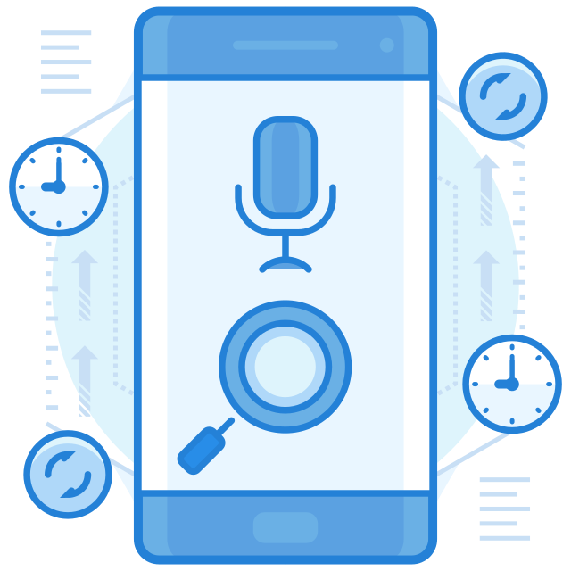

AssistantX
YOUR PERSON VOICE ASSISTANT
PARTH PATEL 19DCS098 SHRUTI PATEL 19DCS102 SAUMYA SHAH 19DCS133

Slide 2

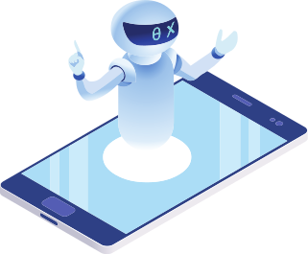
Introduction To voice Assistant
Background
Problem Statement
Basic Concepts Used
Current Applications
Hardware and Software Requirements
Features
Working
Tools and Technologies
Project Planning
About us
References
TABLE OF CONTENTS

Slide 3



INTRODUCTION
What is Virtual Assistant?
What is AI Personal Assistant?
What is ChatBot?
A software or a person that can perform tasks or services for an individual based on commands and questions.
An AI personal assistant is a piece of software that understands verbal or written commands and completes task assigned by the client.
A chatbot is an artificial intelligence (AI) software that can simulate a conversation (or a chat) with a user in natural language.

Slide 4



BACKGROUND
COMBINATION OF CONCEPS
FIRST VIRTUAL ASSISTANT
MAN BEHIND THE CONCEPT
•Speech Recognition
•Artificial Intelligence
•Natural Language Processing
•IBM SIMON was the first virtual personal digital assistant
•It came into market in early 90s
•Concept was first developed by JOSEPH WEIZENBAUM
•The concept was developed in MIT in late 60s.

Slide 5



PROBLEM STATEMENT
DECREASE IN PATIENCE
AUTOMATION IN FUTURE
ERA OF SMART WORK

Slide 6




BASIC CONCEPTS USED
ARTIFICIAL
INTELLIGENCE
AUTOMATIC SPEECH RECOGNITION
NATURAL LANGUAGE PROCESSING
INTER-PROCESS
COMMUNICATION

Slide 7


CURRENT APPLICATIONS
APPLE'S SIRI
AMAZON ALEXA
SAMSUNG BIXBY

Slide 8

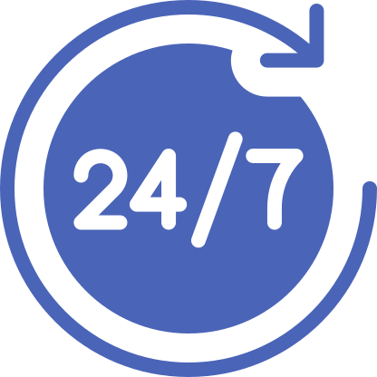

FEATURES
ENGAGING USER EXPERIENCE
OFFERS 24/7 SUPPORT
CHATBOT
SUPPORT

Slide 9
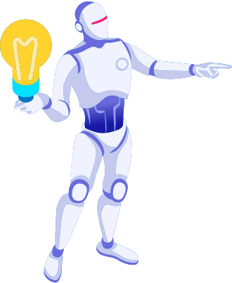
WORKING
SPEECH TO TEXT
TEXT ANALYZING
INTERPRET COMMANDS
Converted Text has no meaning to software.
A piece of software will convert the text into computer understandable format
Words will be mapped to functions and parameters to create a command that computer understands
A piece of software will convert the Audio to Text.
The text will be sent as Input
The commands will be interpreted
If necessary, it will communicate with the Internet

Slide 10

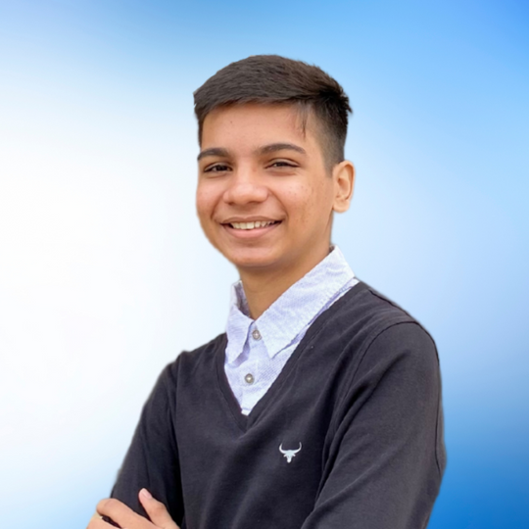

ABOUT US
PARTH PATEL
SAUMYA SHAH
SHRUTI PATEL
19DCS098
19DCS133
19DCS102

Slide 11
Jupyter notebook & Python
Artificial Intelligence
TOOLS AND TECHNOLOGIES
Voice Recognition
Language Processing

Slide 12
THANK YOU

