Slide 1
Supervised Learning
Parth Goel
parthgoel.ce@charusat.ac.in

Slide 2
Road Map
Basic concepts
Decision tree induction
Evaluation of classifiers
Naïve Bayesian classification
Naïve Bayes for text classification
Support vector machines
K-nearest neighbor
Summary

Slide 3
Why “Learn”?
Machine learning is programming computers to optimize a performance criterion using example data or past experience.
There is no need to “learn” to calculate payroll
Learning is used when:
  Human expertise does not exist (navigating on Mars),
  Humans are unable to explain their expertise (speech recognition)
  Solution changes in time (routing on a computer network)
  Solution needs to be adapted to particular cases (user biometrics)

Slide 4
What We Talk About When We Talk About“Learning”
Learning general models from a data of particular examples
Data is cheap and abundant (data warehouses, data marts); knowledge is expensive and scarce.
Example in retail: Customer transactions to consumer behavior:
  People who bought “Da Vinci Code” also bought “The Five People You Meet in Heaven” (www.amazon.com)
Build a model that is a good and useful approximation to the data.

Slide 5
An example application
An emergency room in a hospital measures 17 variables (e.g., blood pressure, age, etc) of newly admitted patients.
A decision is needed: whether to put a new patient in an intensive-care unit.
Due to the high cost of ICU, those patients who may survive less than a month are given higher priority.
Problem: to predict high-risk patients and discriminate them from low-risk patients.

Slide 6
Another application
A credit card company receives thousands of applications for new cards. Each application contains information about an applicant,
  age
  Marital status
  annual salary
  outstanding debts
  credit rating
  etc.
Problem: to decide whether an application should approved, or to classify applications into two categories, approved and not approved.

Slide 7
Machine learning and our focus
Like human learning from past experiences.
A computer does not have “experiences”.
A computer system learns from data, which represent some “past experiences” of an application domain.
Our focus: learn a target function that can be used to predict the values of a discrete class attribute, e.g., approve or not-approved, and high-risk or low risk.
The task is commonly called: Supervised learning, classification, or inductive learning.

Slide 8
The data and the goal
Data: A set of data records (also called examples, instances or cases) described by
  k attributes: A₁, A₂, … A_{k}.
  a class: Each example is labelled with a pre-defined class.
Goal: To learn a classification model from the data that can be used to predict the classes of new (future, or test) cases/instances.
Notes:
Induction is different from deduction and DBMS does not not support induction;
The result of induction is higher-level information or knowledge: general statements about data
There are many approaches. Refer to the lecture notes for CS3244 available at the Co-Op.
We focus on three approaches here, other examples:
Other approaches
Instance-based learning
other neural networks
Concept learning (Version space, Focus, Aq11, …)
Genetic algorithms
Reinforcement learning

Slide 9
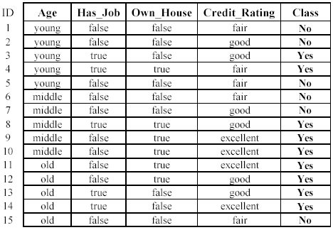
An example: data (loan application)
Approved or not

Slide 10
Training and testing
Training is the process of making the system able to learn.
No free lunch rule:
  Training set and testing set come from the same distribution
  Need to make some assumptions or bias

Slide 11
Performance
There are several factors affecting the performance:
  Types of training provided
  The form and extent of any initial background knowledge
  The type of feedback provided
  The learning algorithms used
Two important factors:
  Modeling
  Optimization

Slide 12
Algorithms
The success of machine learning system also depends on the algorithms.
The algorithms control the search to find and build the knowledge structures.
The learning algorithms should extract useful information from training examples.

Slide 13


Algorithms
Supervised learning ( )
  Prediction
  Classification (discrete labels), Regression (real values)
Unsupervised learning ( )
  Clustering
  Probability distribution estimation
  Finding association (in features)
  Dimension reduction
Semi-supervised learning
Reinforcement learning
  Decision making (robot, chess machine)

Slide 14
Learning techniques
Supervised learning categories and techniques
  Linear classifier (numerical functions)
  Parametric (Probabilistic functions)
    Naïve Bayes, Gaussian discriminant analysis (GDA), Hidden Markov models (HMM), Probabilistic graphical models
  Non-parametric (Instance-based functions)
    K-nearest neighbors, Kernel regression, Kernel density estimation, Local regression
  Non-metric (Symbolic functions)
    Classification and regression tree (CART), decision tree
  Aggregation
    Bagging (bootstrap + aggregation), Adaboost, Random forest

Slide 15

Learning techniques
Linear classifier
Techniques:
  Perceptron
  Logistic regression
  Support vector machine (SVM)
  Ada-line
  Multi-layer perceptron (MLP)
, where w is an d-dim vector (learned)

Slide 16
Learning techniques
Unsupervised learning categories and techniques
  Clustering
    K-means clustering
    Spectral clustering
  Density Estimation
    Gaussian mixture model (GMM)
    Graphical models
  Dimensionality reduction
    Principal component analysis (PCA)
    Factor analysis

Slide 17
Applications
Face detection
Object detection and recognition
Image segmentation
Multimedia event detection
Economical and commercial usage

Slide 18
An example: the learning task
Learn a classification model from the data
Use the model to classify future loan applications into
  Yes (approved) and
  No (not approved)
What is the class for following case/instance?

Slide 19
Supervised vs. unsupervised Learning
Supervised learning: classification is seen as supervised learning from examples.
  Supervision: The data (observations, measurements, etc.) are labeled with pre-defined classes. It is like that a “teacher” gives the classes (supervision).
  Test data are classified into these classes too.
Unsupervised learning (clustering)
  Class labels of the data are unknown
  Given a set of data, the task is to establish the existence of classes or clusters in the data

Slide 20
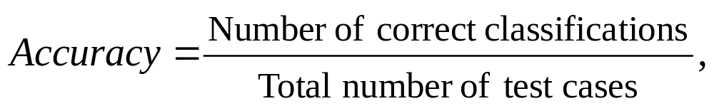
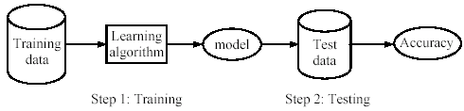
Supervised learning process: two steps
Learning (training): Learn a model using the training data
Testing: Test the model using unseen test data to assess the model accuracy

Slide 21
What do we mean by learning?
Given
  a data set D,
  a task T, and
  a performance measure M,
a computer system is said to learn from D to perform the task T if after learning the system’s performance on T improves as measured by M.
In other words, the learned model helps the system to perform T better as compared to no learning.

Slide 22
An example
Data: Loan application data
Task: Predict whether a loan should be approved or not.
Performance measure: accuracy.
No learning: classify all future applications (test data) to the majority class (i.e., Yes):
Accuracy = 9/15 = 60%.
We can do better than 60% with learning.

Slide 23
Fundamental assumption of learning
Assumption: The distribution of training examples is identical to the distribution of test examples (including future unseen examples).
In practice, this assumption is often violated to certain degree.
Strong violations will clearly result in poor classification accuracy.
To achieve good accuracy on the test data, training examples must be sufficiently representative of the test data.
CS583, Bing Liu, UIC

Slide 24
Road Map
Basic concepts
Decision tree induction
Evaluation of classifiers
Rule induction
Classification using association rules
Naïve Bayesian classification
Naïve Bayes for text classification
Support vector machines
K-nearest neighbor
Ensemble methods: Bagging and Boosting
Summary

Slide 25
Introduction
Decision tree learning is one of the most widely used techniques for classification.
  Its classification accuracy is competitive with other methods, and
  it is very efficient.
The classification model is a tree, called decision tree.
C4.5 by Ross Quinlan is perhaps the best known system. It can be downloaded from the Web.

Slide 26
The loan data (reproduced)
Approved or not

Slide 27
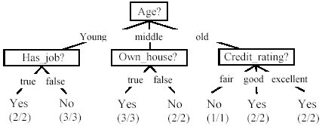
A decision tree from the loan data
Decision nodes and leaf nodes (classes)

Slide 28
Use the decision tree
No

Slide 29
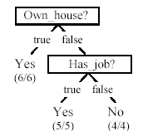
Is the decision tree unique?
No. Here is a simpler tree.
We want smaller tree and accurate tree.
  Easy to understand and perform better.
Finding the best tree is NP-hard.
All current tree building algorithms are heuristic algorithms

Slide 30

From a decision tree to a set of rules
A decision tree can be converted to a set of rules
Each path from the root to a leaf is a rule.

Slide 31
Algorithm for decision tree learning
Basic algorithm (a greedy divide-and-conquer algorithm)
  Assume attributes are categorical now (continuous attributes can be handled too)
  Tree is constructed in a top-down recursive manner
  At start, all the training examples are at the root
  Examples are partitioned recursively based on selected attributes
  Attributes are selected on the basis of an impurity function (e.g., information gain)
Conditions for stopping partitioning
  All examples for a given node belong to the same class
  There are no remaining attributes for further partitioning – majority class is the leaf
  There are no examples left

Slide 32
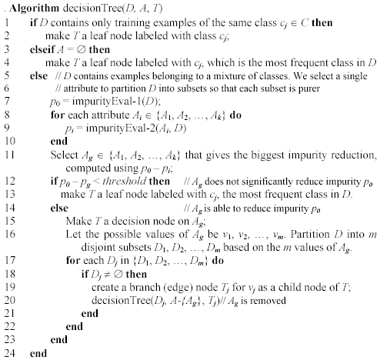
Decision tree learning algorithm
CS583, Bing Liu, UIC

Slide 33
Choose an attribute to partition data
The key to building a decision tree - which attribute to choose in order to branch.
The objective is to reduce impurity or uncertainty in data as much as possible.
  A subset of data is pure if all instances belong to the same class.
The heuristic in C4.5 is to choose the attribute with the maximum Information Gain or Gain Ratio based on information theory.
CS583, Bing Liu, UIC

Slide 34
The loan data (reproduced)
Approved or not
CS583, Bing Liu, UIC

Slide 35
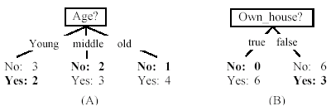
Two possible roots, which is better?
Fig. (B) seems to be better.
CS583, Bing Liu, UIC

Slide 36
Information theory
Information theory provides a mathematical basis for measuring the information content.
To understand the notion of information, think about it as providing the answer to a question, for example, whether a coin will come up heads.
  If one already has a good guess about the answer, then the actual answer is less informative.
  If one already knows that the coin is rigged so that it will come with heads with probability 0.99, then a message (advanced information) about the actual outcome of a flip is worth less than it would be for a honest coin (50-50).
CS583, Bing Liu, UIC

Slide 37
Information theory (cont …)
For a fair (honest) coin, you have no information, and you are willing to pay more (say in terms of $) for advanced information - less you know, the more valuable the information.
Information theory uses this same intuition, but instead of measuring the value for information in dollars, it measures information contents in bits.
One bit of information is enough to answer a yes/no question about which one has no idea, such as the flip of a fair coin
CS583, Bing Liu, UIC

Slide 38
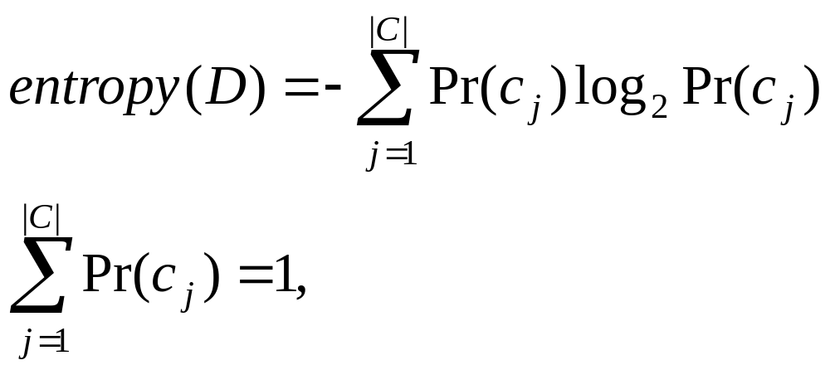
Information theory: Entropy measure
The entropy formula,
Pr(c_{j}) is the probability of class c_{j} in data set D
We use entropy as a measure of impurity or disorder of data set D. (Or, a measure of information in a tree)
CS583, Bing Liu, UIC

Slide 39
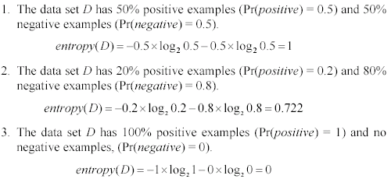
Entropy measure: let us get a feeling
As the data become purer and purer, the entropy value becomes smaller and smaller. This is useful to us!
CS583, Bing Liu, UIC

Slide 40

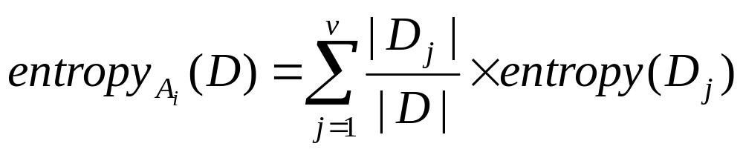
Information gain
Given a set of examples D, we first compute its entropy:
If we make attribute A_{i}, with v values, the root of the current tree, this will partition D into v subsets D₁, D₂ …, D_{v} . The expected entropy if A_{i} is used as the current root:
CS583, Bing Liu, UIC

Slide 41
Information gain (cont …)
Information gained by selecting attribute A_{i} to branch or to partition the data is
We choose the attribute with the highest gain to branch/split the current tree.
CS583, Bing Liu, UIC

Slide 42
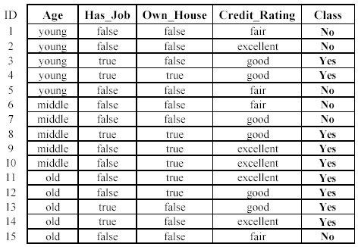
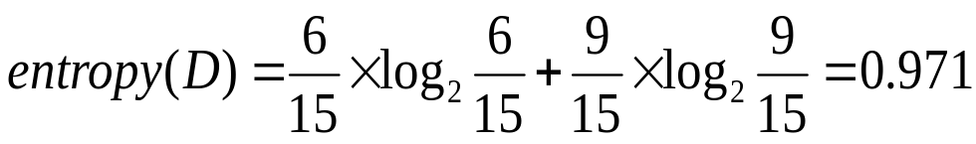
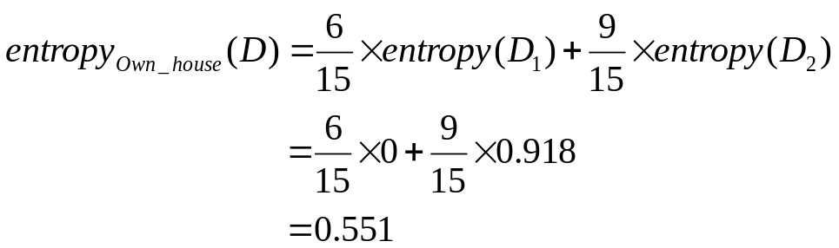
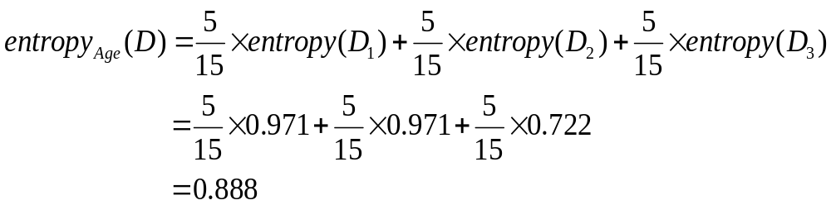
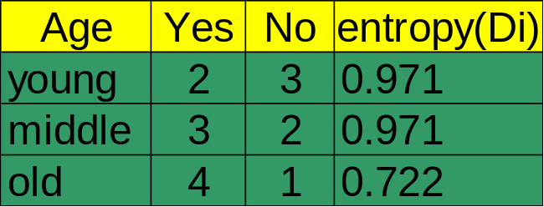

An example
Own_house is the best choice for the root.
CS583, Bing Liu, UIC

Slide 43
We build the final tree
We can use information gain ratio to evaluate the impurity as well (see the handout)
CS583, Bing Liu, UIC

Slide 44
Handling continuous attributes
Handle continuous attribute by splitting into two intervals (can be more) at each node.
How to find the best threshold to divide?
  Use information gain or gain ratio again
  Sort all the values of an continuous attribute in increasing order {v₁, v₂, …, v_{r}},
  One possible threshold between two adjacent values v_{i} and v_{i+1}. Try all possible thresholds and find the one that maximizes the gain (or gain ratio).
CS583, Bing Liu, UIC

Slide 45
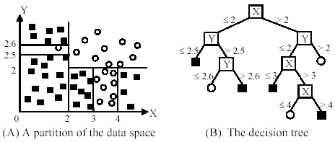
An example in a continuous space
CS583, Bing Liu, UIC

Slide 46
Avoid overfitting in classification
Overfitting: A tree may overfit the training data
  Good accuracy on training data but poor on test data
  Symptoms: tree too deep and too many branches, some may reflect anomalies due to noise or outliers
Two approaches to avoid overfitting
  Pre-pruning: Halt tree construction early
    Difficult to decide because we do not know what may happen subsequently if we keep growing the tree.
  Post-pruning: Remove branches or sub-trees from a “fully grown” tree.
    This method is commonly used. C4.5 uses a statistical method to estimates the errors at each node for pruning.
    A validation set may be used for pruning as well.
CS583, Bing Liu, UIC

Slide 47
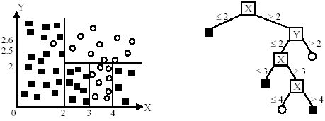
An example
Likely to overfit the data
CS583, Bing Liu, UIC

Slide 48
Other issues in decision tree learning
From tree to rules, and rule pruning
Handling of miss values
Handing skewed distributions
Handling attributes and classes with different costs.
Attribute construction
Etc.
CS583, Bing Liu, UIC

Slide 49
Road Map
Basic concepts
Decision tree induction
Evaluation of classifiers
Rule induction
Classification using association rules
Naïve Bayesian classification
Naïve Bayes for text classification
Support vector machines
K-nearest neighbor
Ensemble methods: Bagging and Boosting
Summary
CS583, Bing Liu, UIC

Slide 50
k-Nearest Neighbor Classification (kNN)
Unlike all the previous learning methods, kNN does not build model from the training data.
To classify a test instance d, define k-neighborhood P as k nearest neighbors of d
Count number n of training instances in P that belong to class c_{j}
Estimate Pr(c_{j}|d) as n/k
No training is needed. Classification time is linear in training set size for each test case.
CS583, Bing Liu, UIC

Slide 51

kNNAlgorithm
k is usually chosen empirically via a validation set or cross-validation by trying a range of k values.
Distance function is crucial, but depends on applications.
CS583, Bing Liu, UIC

Slide 52
Example: k=6 (6NN)
Government
Science
Arts
A new point
Pr(science| )?
CS583, Bing Liu, UIC

Slide 53
Discussions
kNN can deal with complex and arbitrary decision boundaries.
Despite its simplicity, researchers have shown that the classification accuracy of kNN can be quite strong and in many cases as accurate as those elaborated methods.
kNN is slow at the classification time
kNN does not produce an understandable model
CS583, Bing Liu, UIC

