Slide 1
Frames

Slide 2
Frames
A frame is a collection of attributes(usually called slots) and associated values (and possibly constraints on values) that describes some entity in world.
Set Theory provides a good basis for understanding frame systems.
Each Frame represents either a class (a set) or an instance(an element of a class).
The set of adult males is a subset of the set of people.
Pee Wee Reese is an element of the set of fielders. He is an also an element of all of the supersets of fielders, including major league baseball players and people.
Both the isa and instance relations have inverse attribute, which we call subclasses and all-instances.
Example:-
1. Person(Frame(class(set)))
Isa: Mammal
Cardinality:6,000,000,000
*handed: Right

Slide 3
Example
2. Adult-Male(Frame(class(set)))
Isa: Person
Cardinality:2,000,000,000
*height:5-10
3.ML-Baseball-Player(Frame(class(set)))(Corresponding to major league baseball player)
Isa: Adult-Male
Cardinality:624
*height:6-1
*bats: equal to handed
*batting-average: .252
*team:
*uniform-color:

Slide 4
Example
4. Fielder(Frame(class(set)))
Isa: ML-Baseball Player
Cardinality:376
*batting –average:.262
5.Pee-Wee-Reese(Frame(instance(element of set)))
Instance: Fielder
height:5-10
bats: Right
batting-average:.309
team: Brooklyn-Dodgers
uniform-color: Blue

Slide 5
Example
6. ML-Baseball-Team(Frame(class(set)))(for major league baseball team)
Isa: Team
Cardinality: 26
*team-size:24
*manager:
7. Brooklyn-Dodgers(Frame(instance(element of set)))
Instance: ML-Baseball-Team
team-size:24
manager: Leo-Durocher
players: {Pee-Wee-Reese,…}

Slide 6
Frames
Because a class represents a set, there are two kinds of attributes that can be associated with it.
These are attributes about the set itself.
There are attributes that are to be inherited by each element of the set(indicated by asterisk (*)).
A regular class is the one whose elements are individual entities
A meta class is the special class whose elements are themselves classes.

Slide 7
Frames
The most basic meta class is the Class. It represents set of all classes.
1. Class
Instance: Class
Isa: Class
*cardinality:
2. Team
Instance: Class
Isa: Class
Cardinality:{the number of teams that exist}
*team-Size:{each team has a size}

Slide 8
Frames
3. ML-Baseball-Team
Instance: Class
Isa: team
Cardinality:26{the number of teams that exist}
*team-size:24{default 24 players on a team}
*manager:

Slide 9
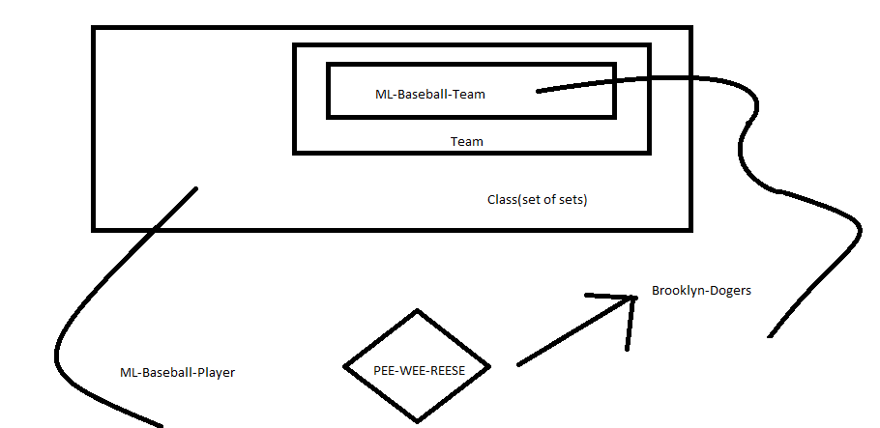
Frames

Slide 10
Frames
There are other ways in which classes can be related to each other, corresponding to ways the sets of objects in the world can be related.
One such relation is mutually-disjoint-with, which relates a class to one or more other classes that are guaranteed to have no elements in common with it.
Another important relationship is is-covered-by, which relates a class to a set of subclasses, the union of which is equal to it.
If a class is-covered-by a set S of mutually disjoint classes, then S is called a partition of the class.

Slide 11
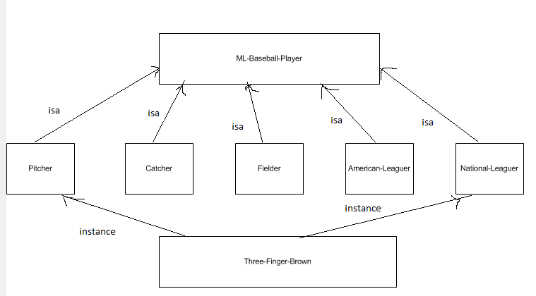
Example

Slide 12
Example
ML-Baseball-Player
Is-covered-by{Pitcher, Catcher, Fielder},{American-Leaguer, National- Leaguer}
2. Pitcher
Isa: ML-Baseball-Player
Mutually-disjoint-with: {Catcher, Fielder}
3.Catcher
Isa: ML-Baseball-Player
Mutually-disjoint-with: {Pitcher, Fielder}
4. Fielder
Isa: ML-Baseball-Player
Mutually-disjoint-with: {Catcher, Pitcher}

Slide 13
Example
5. American-Leaguer
Isa : ML-Baseball-Player
Mutually-disjoint-with: {National-Leaguer}
6. National-Leaguer
Isa : ML-Baseball-Player
Mutually-disjoint-with: {American-Leaguer}
7.Three-Finger-Brown
Instance: Pitcher
Instance: National-Leaguer

Slide 14
Slots as Full-Fledge Objects
Some of the properties we would like to be able to represent and use in reasoning include:
The classes to which the attribute can be attached, i.e., for what classes does it make sense?
For Example:- weight makes sense for physical objects but not for conceptual ones (except in some metaphorical sense)
2. Constraints on the either the type or the value of the attribute.
For Example:- the age of a person must be numeric quantity measured in some time frame, and it must be less than the ages of the person’s biological parents.
3. A value that all instances of a class must have by the definition of the class.

Slide 15
Slots as Full-Fledge Objects
4. A default value of attribute.
5. Rules of inheriting values for the attribute. The usual rule is to inherit down isa and instance links. But some attributes inherit in other ways.
For example last-name inherits down the child-of link.
6. Rules for computing a value separately from inheritance. One extreme form of such a rule is a procedure written in some procedural programming language such as LISP.
7. An inverse attribute.
8. Whether the slot is single-valued or multivalued.

Slide 16
Range Constraint
A slot is a relation. It maps from elements of its domain(the classes for which it make sense) to elements of its range(it possible values).
A slot is a set.
Slot is a metaclass. Its instances are slots(each of which is a set of ordered pairs). Associated with the metaclass are the attributes that each instance(i.e., actual slot) will inherit
Each slot, since it is a relation has a domain and range.
We represent the domain in the slot labeled domain.
We break up representation of range in two parts: 1.range( gives the class of which elements of the range must be elements
2. range-constraint:-contains a logical expression that further constrains the range to be elements of range that also satisfy the constraint.

Slide 17
Important Points to Note
If there is a value for definition(attribute), it must be propagated to all instances of the slot.
If there is a value for default(attribute), that value is inherited to all instances of the slot. Unless there is an overriding value.
The attribute transfer-through lists other slots from which values for this slot can be derived through inheritance.
The to-compute slot contains a procedure for deriving its value.
The inverse attribute contains the inverse of the slot.
And single-valued is used to mark the special cases in which the slot is a function and so can have only one value.

Slide 18
Example
Slot
Isa: class
Instance: class
*domain:
*range:
*range-constraint:
*definition:
*default:
*transfers-through:
*to-compute:
*inverse:
*singled-valued:

Slide 19
Example
Manager
Instance: Slot
Domain: ML-Baseball-Team
Range: Person
Range-constraint: $x(baseball-experience x.manager)
Default:
Inverse: manager-of
Single-valued: True

Slide 20
Example
My-manager
Instance: Slot
Domain: ML-Baseball-Team
Range: Person
Range-constraint: $x(baseball-experience x.manager)
To-compute:$x(x.team).manager
Single-valued:True

Slide 21
Example
Color
Instance: Slot
Domain: Physical Object
Range: Color-set
Transfers-through: top-level-part-of
Visual-salience: High
Single-valued: False

Slide 22
Example
Uniform-Color
isa: Slot
Domain: team-player
Range: Color-set
Range-constraint: not Pink
Visual-salience: High
Single-valued: False

Slide 23
Example
Bats
Instance: Slot
Domain: ML-Baseball-Player
Range: {Left, Right, Switch}
To-compute:$x x.handed
Single-valued: True

Slide 24
Example
Batting average
Instance: Slot
Domain: ML-Baseball-Player
Range: Number
Range-constraint: $x( 0 <= x.range-constraint <=1)
Default: .252
Single-valued: True
ML-Baseball-Player

Slide 25
Fielder-batting-average
instance: slot
isa: batting-average
domain: Fielder
range: Number
range-constraint: $x( 0 <= x.range-constraint <=1)
default: .262
single-valued: TRUE

Slide 26
ML-Baseball-Player
Bats: MUST BE{ Left, Right, Switch}

