Slide 1
Lectures on Artificial Intelligence – CS289
Standardisation of Semantic Networks
18th September 2006
Dr Bogdan L. Vrusias
b.vrusias@surrey.ac.uk

Slide 2
Contents
Advantaged and Disadvantages of Conventional Semantic Networks
Partitioned Semantic Networks
Exercises

Slide 3
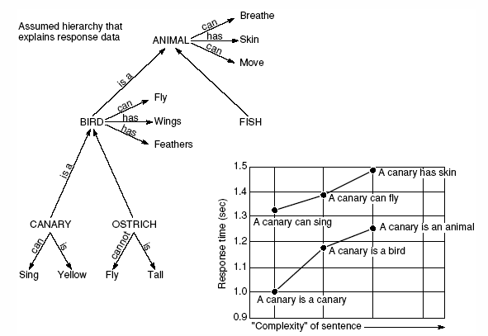
Standardisation of Network Relationships
Semantic network developed by Collins and Quillian in their research on human information storage and response times (Harmon and King, 1985)

Slide 4
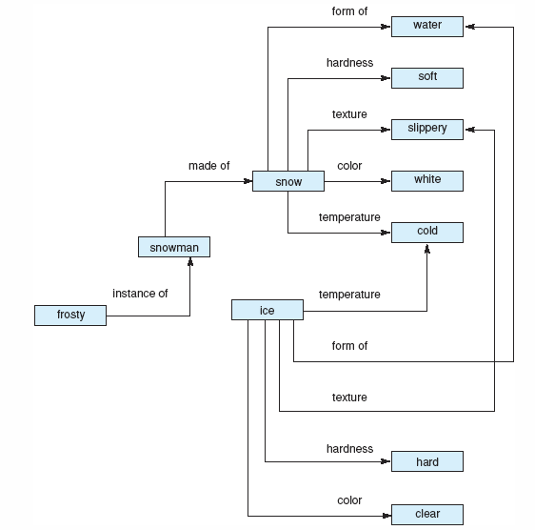
Standardisation of Network Relationships
Semantic Network representation of properties of snow and ice
E.g. What is common about ice and snow?

Slide 5
Exercises
Try to represent the following two sentences into the appropriate semantic network diagram:
  is_a(person, mammal)
  instance_of(Mike-Hall, person) all in one graph
  team(Mike-Hall, Cardiff)
  score(Spurs, Norwich, 3-1)
  John gave Mary the book

Slide 6
Solution 1
is_a(person, mammal)
instance_of(Mike-Hall, person)
team(Mike-Hall, Cardiff)
mammal
is_a
person
has_part
head
instance_of
Mike Hall
team
Cardiff

Slide 7
Solution 2
score(Spurs, Norwich, 3-1)
Game
Is_a
Spurs
Away_team
Fixture 5
Score
3 - 1
Home_team
Norwich

Slide 8
Solution 3
John gave Mary the book
Gave
Book
Action
Instance
John
Agent
Event 1
Object
Book_69
Patient
Mary

Slide 9
Advantages of Semantic Networks
Easy to visualise and understand.
The knowledge engineer can arbitrarily defined the relationships.
Related knowledge is easily categorised.
Efficient in space requirements.
Node objects represented only once.
…
Standard definitions of semantic networks have been developed.

Slide 10
Limitations of Semantic Networks
The limitations of conventional semantic networks were studied extensively by a number of workers in AI.
Many believe that the basic notion is a powerful one and has to be complemented by, for example, logic to improve the notion’s expressive power and robustness.
Others believe that the notion of semantic networks can be improved by incorporating reasoning used to describe events.

Slide 11
Limitations of Semantic Networks
Binary relations are usually easy to represent, but some times is difficult.
E.g. try to represent the sentence:
  "John caused trouble to the party".
John
who
cause
where
party
what
trouble

Slide 12
Limitations of Semantic Networks
Other problematic statements. . .
  negation "John does not go fishing";
  disjunction "John eats pizza or fish and chips";
  …
Quantified statements are very hard for semantic nets. E.g.:
  "Every dog has bitten a postman"
  "Every dog has bitten every postman"
  Solution: Partitioned semantic networks can represent quantified statements.

Slide 13
Partitioned Semantic Networks
Hendrix (1976 : 21-49, 1979 : 51-91) developed the so-called partitioned semantic network to represent the difference between the description of an individual object or process and the description of a set of objects. The set description involves quantification.
Hendrix partitioned a semantic network whereby a semantic network, loosely speaking, can be divided into one or more networks for the description of an individual.

Slide 14
Partitioned Semantic Networks
The central idea of partitioning is to allow groups, nodes and arcs to be bundled together into units called spaces – fundamental entities in partitioned networks, on the same level as nodes and arcs (Hendrix 1979:59).
Every node and every arc of a network belongs to (or lies in/on) one or more spaces.
Some spaces are used to encode 'background information' or generic relations; others are used to deal with specifics called 'scratch' space.

Slide 15
Partitioned Semantic Networks
Suppose that we wish to make a specific statement about a dog, Danny, who has bitten a postman, Peter:
  " Danny the dog bit Peter the postman"
Hendrix’s Partitioned network would express this statement as an ordinary semantic network:
S1
dog
bite
postman
is_a
is_a
is_a
Danny
agent
B
patient
Peter

Slide 16

Partitioned Semantic Networks
Suppose that we now want to look at the statement:
  "Every dog has bitten a postman"
Hendrix partitioned semantic network now comprises two partitions SA and S1. Node G is an instance of the special class of general statements about the world comprising link statement, form, and one universal quantifier
SA
General
Statement
dog
bite
postman
is_a
S1
is_a
is_a
is_a
G
form
D
agent
B
patient
P

Slide 17

Partitioned Semantic Networks
Suppose that we now want to look at the statement:
  "Every dog has bitten every postman"
SA
General
Statement
dog
bite
postman
is_a
S1
is_a
is_a
is_a
G
form
D
agent
B
patient
P

Slide 18
Partitioned Semantic Networks
Suppose that we now want to look at the statement:
  "Every dog in town has bitten the postman"
SA
dog
General
Statement
ako
town dog
bite
postman
is_a
S1
is_a
is_a
is_a
G
form
D
agent
B
patient
P
NB: 'ako' = 'A Kind Of'

Slide 19
Partitioned Semantic Networks
The partitioning of a semantic network renders them more
  logically adequate, in that one can distinguish between individuals and sets of individuals,
  and indirectly more heuristically adequate by way of controlling the search space by delineating semantic networks.
Hendrix's partitioned semantic networks-oriented formalism has been used in building natural language front-ends for data bases and for programs to deduct information from databases.

Slide 20
Exercises
Try to represent the following two sentences into the appropriate semantic network diagram:
  "John believes that pizza is tasty"
  "Every student loves to party"

Slide 21
Solution 1: "John believes that pizza is tasty"
believes
is_a
John
agent
event
object
space
pizza
tasty
is_a
is_a
object
has
property

Slide 22
Solution 2: "Every student loves to party"
General
Statement
is_a
is_a
GS1
student
party
love
form
S1
is_a
form
S2
is_a
is_a
GS2
exists
p1
receiver
l1
s1
agent

Slide 23
Closing
Questions???
Remarks???
Comments!!!
Evaluation!

