Slide 1
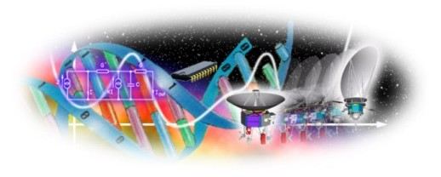
Conceptual Study of Genetic Algorithm(s) with Different Perspectives
Prepared by: Dr. Amit P. Ganatra
CHARUSAT-Changa

Slide 2
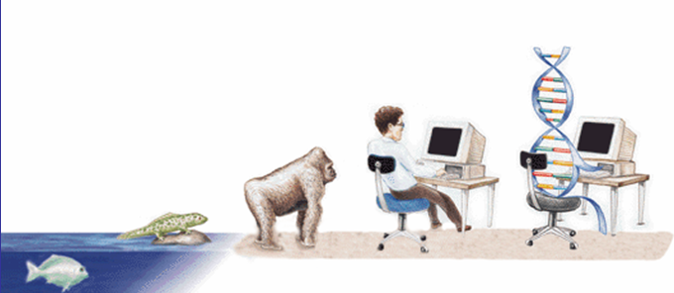
GENETIC ALGORITHM
EVOLUTIONARY PROCESS

Slide 3
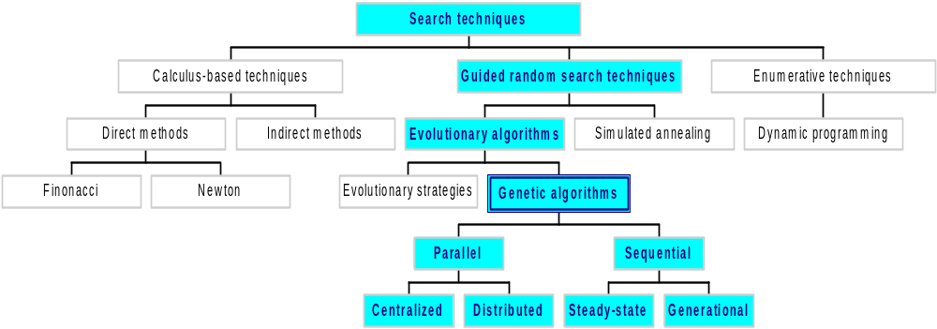
Classes of Search Techniques

Slide 4
Need Analysis
There is always a need of better Search and optimization technique in every field. But, there are very few methods that work better and faster over huge bulk of information.
The field of Genetic Algorithm is relatively untouched. Even its power is still not exploited in a proper fashion. Genetic Algorithms guarantees faster and better access to huge information in a very robust manner.

Slide 5
Objective And Scope
To find an optimal solution to a problem.
Since GAs are heuristic procedures, they are not always guaranteed to find the optimal solution,
But they are able to find very good solutions for a wide range of problems.

Slide 6
GAs Continue…
The goals of GA
To abstract and rigorously explain the adaptive process of Natural Systems.
To design artificial systems software that retains the important mechanism of natural selection.
Central theme
Robustness
Adaptation

Slide 7
Genetic Algorithm
Why Genetic Algorithms (GAs) ?
  Many real life problems cannot be solved in polynomial amount of time using deterministic algorithm.
  Sometimes near optimal solutions that can be generated quickly are more desirable than optimal solutions which require huge amount of time
  Problems can be modeled as an optimization one.

Slide 8
Genetic Algorithm
Randomized search, optimization and machine learning technique
Based on the mechanics of Natural Selection and Natural Genetics.
Darwinian natural selection: only those organisms survive and reproduce which are fit for their environment.
Can also solve NP-hard problems.
The algorithm is so versatile that it can be used in any field.

Slide 9
What are NP-hard Problems?
Any Problem that involves the identification of an optimal(min/max) value of a given cost function is known as optimization problem.
Algo. with property “the result of every operation is uniquely defined”-are termed deterministic algo.
A problem is NP-hard if and only if satisfiability reduces to problem
The satisfiability prob. is to det. whether a formula is true for some assignment of truth values to the variables.

Slide 10
Continue..
Examples of difficult problems, which cannot be solved in “traditional” way, are NP problems.
But there are many important tasks, for which it is very difficult to find a solution, but once we have it, it is easy to check the solution. This fact led to NP-complete problems.
A problem is NP-complete if and only if problem is NP-hard and belongs to NP.

Slide 11
Hard Combinatoric Search Problems
These are problems where the search space is vast.
The space is so vast that it can be considered impossible to find the optimal solution.
An example is the Travelling Salesman Problem (TSP).

Slide 12
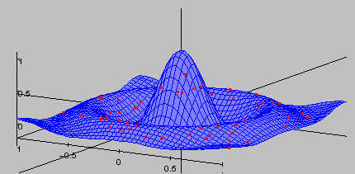
Sample Search Space
A randomly generated population of individuals will be randomly distributed throughout the search space

Slide 13
What is Search Space?
The space of all feasible solutions is called search space (state space)
Each point in the search space represents one feasible solution
Each feasible solution can be “marked” by its value or fitness for the problem
We are looking for our solution, which is one point (or more) among feasible solutions

Slide 14
TSP: An Example
Consider 4 cities a, b, c and d. A salesman needs to visit all 4 cities and return home to city a.
In which order should he/she visit the cities in such a way that the total distance is minimised?
All possible configurations have to be considered to find the optimal solution. For our example the possible solutions are:
a, b, c, d | a, b, d, c | a, c, d, b
a, d, b, c | a, d, c, b | a, c, b, d
As we can see for N cities there are (N -1)! possible configurations.

Slide 15
TSP: An Example (cont)
When N is small (like in our example) its very easy to find the optimal solution. However, when N becomes large the need for a computer becomes useful!
If we assume a computer can evaluate 10¹⁰ configurations in 1 second, how long would it take to evaluate all the possible solutions of N?

Slide 16
TSP: An Example (cont)
Number of time taken to evaluate all
Cities Configurations
16 130 Secs
17 0.58 Hrs
18 9.8 Hrs
20 140 Days
25 1,967,428 Yrs

Slide 17
Now We See The Problem!!!
Nearly 2m years for just 25 cities! This exponential growth in computation time makes enumeration of all possible solutions a non-starter.
Is there a method of finding a good sub-optimal solution?

Slide 18
Genetic Algorithm(s)
Genetic Algorithms are good at
taking large, potentially huge
search spaces and navigating
them, looking for optimal
combinations of things, solutions
you might not otherwise find in a
lifetime.
Genetic algorithms (GA) are a
computational paradigm inspired
by the mechanics of natural
evolution, including survival of the fittest, reproduction, and mutation.

Slide 19
Genetic Algorithm
Developed by John Holland, University of Michigan (1970’s)
Early names: J. Holland, K. DeJong, D. Goldberg

Slide 20
GA Roots
Based on concepts from biology, especially evolution (natural selection and genetics).
Variables are represented as genes on a chromosome e.g. 10101001.
GAs feature a group of candidate solutions (population) on the response surface. Through natural selection and the genetic operators, mutation and recombination, chromosomes with better fitness are found.
Probabilistic search method based on the mechanics of Darwin’s natural selection

Slide 21
The Biology of Genetics
Members of same species share similar sets of genes.
Two members of the same species mate to recombine specific areas of their chromosomes into a new genotype.
Phenotype is solution given by the genotype - Phenotypes will survive based on their fitness for the environment. Fit individuals are more likely to produce offspring than less fit individuals (natural selection).
Over time less beneficial genes are eliminated from gene pool

Slide 22
Genetic Algorithms (GAs)
GAs are inspired by living nature.
Evolution of species is driven by natural selection and the genetic operators of mutation,reproduction and inversion. All of which can be considered a parallel search process.
Perhaps we can tackle hard combinatoric search problems by mimicking the natural processes of evolutionary search.

Slide 23
Genetic Algorithms: Motivation
Evolution is, a method of searching for “solutions”. Organisms well able to survive and reproduce in their environment.
GAs are easily parallelized.
GAs are based on a robust method for adaptation within biological systems.
A simulated population of randomly selected individuals is generated then allowed to evolve.

Slide 24
Motivation
Inspired by evolution in living organisms
“Survival of the fittest”
“Fitter” individuals in the population preferred to reproduce to create new generation

Slide 25
Other algorithms inspired by nature
Neural networks – neurons in brain
Simulated annealing – physical properties of metals
GA, NN have partly overlapped application areas – pattern recognition, ML, image processing, expert systems

Slide 26
GAs: Representation of the Problem
The term chromosome is used to describe a legal solution to the problem. It is composed of a string of genes.
In GA literature chromosomes are usually represented by a string of bits e.g. 101011.
Each bit is effectively a gene.

Slide 27
GAs: Initial Population
Once a representation has been decided it is then necessary to create an initial population with which to begin the search.
This can be created randomly or use some specific information.

Slide 28
Introduction
Population of individuals
  Individual is feasible solution to problem
Based on their fitness, parents are selected to reproduce offspring for a new generation
  New generation has same size as old generation; old generation dies
Offspring has combination of properties of two parents
If well designed, population will converge to optimal solution

Slide 29
Biological Background
Chromosomes: - a candidate solution to a problem, often encoded as a bit string. Serves as model for the organism.
Genes: - Within the chromosomes are individual genes. Each gene encodes a particular protein thereby encodes a specific feature of the individual, that encode a particular element of the candidate solution
Trait: - Each gene encodes a trait. For example, a person's eye colour is dictated by a specific gene.
Alleles: - An allele is a bit sting is either 0 or 1; Possible settings for a trait (e.g. blue, brown).

Slide 30
Population
Chromosomes could be:
  Bit strings (0101 ... 1100)
  Real numbers (43.2 -33.1 ... 0.0 89.2)
  Permutations of element (E11 E3 E7 ... E1 E15)
  Lists of rules (R1 R2 R3 ... R22 R23)
  Program elements (genetic programming)
  ... any data structure ...
population

Slide 31
Concepts of GAs
Each gene represents some parameter of the solution state and the allele is the assigned value for that entry
A population is formed from multiple chromosomes
A generation is created by initializing a single population (usually random values)
The members of the population are evaluated by a fitness function
Chromosomes with the highest fitness are allowed to reproduce to create the next generation of solutions through crossover and mutation
This process of reproduction is continued until some stopping condition is met

Slide 32
Genetic Algorithm
Genetic Algorithms examine biological computation with multiple goals, scientific understanding and potential application among them.
As we look around us; we see many wonders in nature. Creatures can repair themselves, guide themselves, reproduce themselves with a robustness.

Slide 33
Genetic Algorithm
GA technique differs from traditional algorithm development in that a solution ``grows'' rather than being designed by someone.
This typically means that we can't necessarily understand the solution that the process generates.

Slide 34
Genetic Algorithm
In addition, GA have been used in many other innovative ways, for instance, creating new indicators based on existing ones, selecting good indicators, to evolve optimal trading systems and to complement other techniques such as fuzzy logic.
There are four stages in the genetic search process: initialization, evaluation and selection, crossover and mutation.

Slide 35
Genetic Algorithm
In the initialization stage, a population of genetic structures which are randomly distributed in the solution space is selected as the starting point of the search.
In the second stage, each structure is evaluated using a fitness function and assigned a fitness value.
On the basis of their relative fitness values, structures in the current population are selected for reproduction.

Slide 36
Genetic Algorithm
The selected structures are recombined using crossover, with two complementary search functions.
First, it provides new points for further testing of structures already present in the population; Secondly, it introduces instances of new structures into the population.
A mutation operator, which arbitrarily alters one or more components of a selected structure, provides the means for introducing new information into the population.

Slide 37
Continue…
Fitness – The measure of goodness of a solution. (e.g. the function value of a solution in an optimization problem).
Selection – The Darwinian selection mechanism to eliminate bad solutions in a population.
Population – A pool of solutions represented as binary strings (chromosomes) that undergo
-- crossover (mutually among themselves randomly)
-- mutation (randomly)
Note – crossover and mutation destroy old solutions
Elitism – Some elite (good) solutions are carried onto the next generation without being destroyed. It is considered to be a good strategy.

Slide 38
Basic Steps
Coding the problem
Determining “fitness”
Selection of parents for reproduction
Recombination to produce new generation

Slide 39
Design Issues
Goldberg’s principles of coding (building block hypothesis):
  Related genes should be close together
  Little interaction between genes
Is it possible, (and if yes, how) to find coding schemes that obey the principles?
If not, can the GA be modified to improve its performance in these circumstances?

Slide 40
Determining fitness
Fitness function
Varies from problem to problem
Usually returns a value that we want to optimize
Example: Strength / Weight ratio in a civil engineering problem
Unimodal / Multimodal fitness functions – Multimodal: several peaks

Slide 41
Fitness Function
Purpose
Parent selection (test our chromosomes for suitability.)
Measure for convergence
Should reflect the value of the chromosome in some “real” way
Next to coding the most critical part of a GA
Depending on the problem we can either maximise or minimize this function. e.g. For the TSP we want to minimize the distance travelled.

Slide 42
GA key concepts and mechanisms
Based on the concepts of “survival of the fittest”
Solutions are encoded in chromosomes
A population is formed from multiple chromosomes
The members of the population are evaluated by a fitness function
Chromosomes with the highest fitness are allowed to reproduce
Focus is rather on adaptation to the environment than just learning

Slide 43
Selection – Roulette Wheel
Want to maintain an element of randomness but ‘fix’ the selection so that fitter individuals have better odds of being chosen.
Assign areas on a number line relative to each individuals fitness.
Generate a random number within the range of the number line.
Determine which individual occupies that area of the number line.
Choose that individual.

Slide 44
Roulette Wheel Selection –Example
Chromosome # Fitness
1 15.3089
2 15.4091
3 4.8363
4 12.3975
4
3
2
1
Spin
2
1
2
4
Mating Pool

Slide 45
GAs: Selection
Chromosomes are selected from the population for reproduction.
Based on Darwinian evolution. Thus, the fitness of an individual is proportional to the probability that it will reproduce effectively.
Hence, selection is based on fitness. The higher an individual’s fitness, the more chance it has of being selected.

Slide 46
Definition and Process
Genetic algorithm: an iterative procedure maintaining a population of structures that are candidate solutions to specific domain challenges. The viability of each chromosome is measured with a fitness function.
Each candidate solution is called a chromosome
Chromosomes can copy themselves, mate, mutate
Use specific genetic operators - reproduction, crossover and mutation.
Each algorithmic iteration produces a new generation

Slide 47
Genetic algorithm
Solutions “evolve”, via trial and error
Suitable for very complex applications
Consists of population, individuals, chromosome strings, genes, and a fitness function to define application characteristics

Slide 48
Selection
Individuals selected to recombine and produce offspring
Selection of parents based on “Roulette Wheel” algorithm
Fitter parents may get selected multiple times, not-so-fit may not get selected at all
Child can be less fit than parents, but such a child will probably “die out” without reproducing in the next generation.

Slide 49
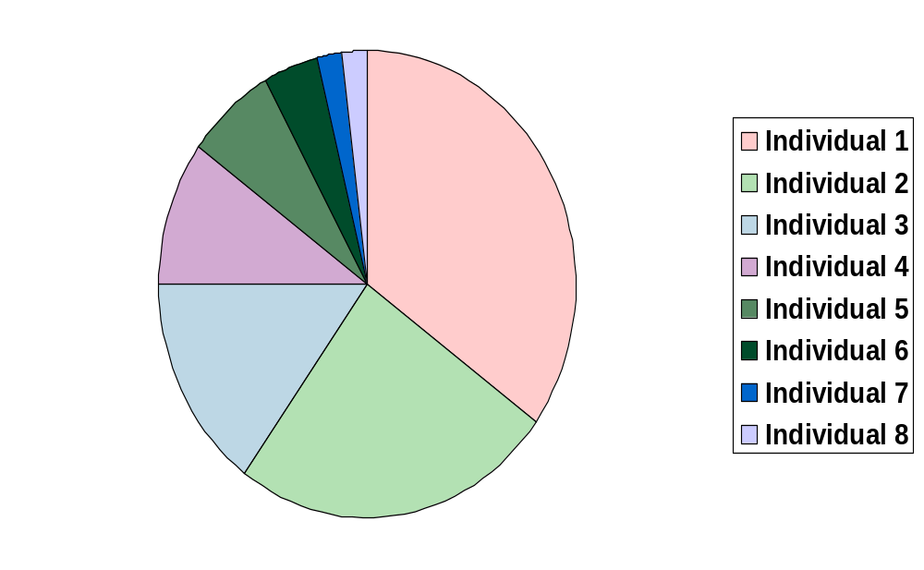
Roulette Wheel selection

Slide 50
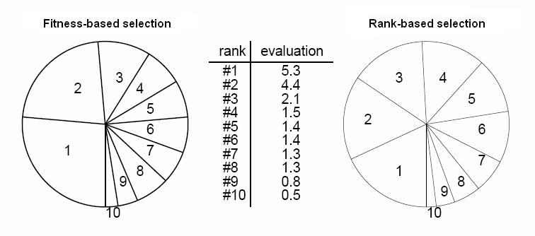
Selection - variations
Fitness-based v/s rank-based

Slide 51
Terminology
Begin with a population of individuals. Each individual represents a solution to the problem we are trying to solve.
A data structure describes the genetic structure of the individual. (Assume this is a string of 0’s and 1’s).
In genetics, the strings are called chromosomes and the bits are called genes.
The string associated with each individual is its genotype
Selection is based on fitness of individuals

Slide 52
The Genetic Algorithm
Each evolving population of individuals is called a generation.
Given a population of individuals corresponding to one generation, the algorithm simulates natural selection and reproduction in order to obtain the next generation.
System learns to adapt to changes.

Slide 53
Three basic operations
Reproduction:
  Individuals from one generation are selected for the next generation
Crossover:
  Genetic material from one individual is exchanged with genetic material from another individual
Mutation:
  Genetic material is altered

Slide 54
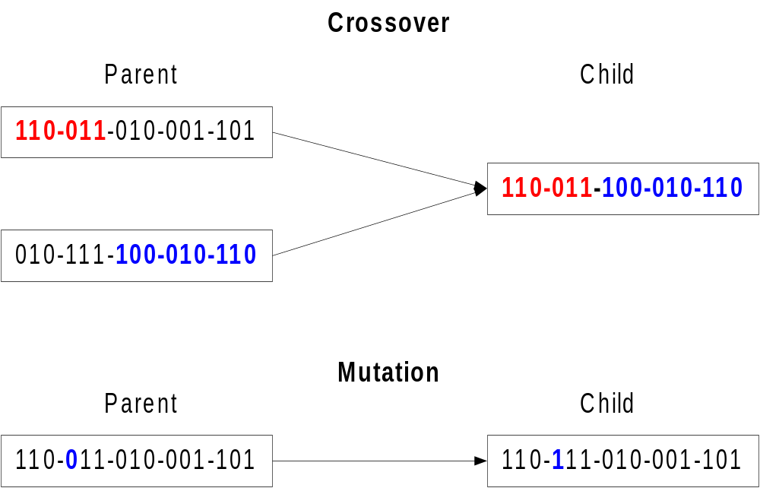
Genetic Algorithm

Slide 55
Parameters of GA
Crossover Probability
Mutation Probability
Population Size
Number of Generations

Slide 56
Example of General GA Procedure
Selection, crossover, and mutation operations
Generation n
13
11
4
9
1 1 0 1
1 0 1 1
0 1 0 0
1 0 0 1
Reproduction
1 1 0 1
1 0 1 1
1 0 1 1
1 0 0 1
Crossover
1
0 1 1
1
1 0 1
1 0
0 1
1 0 0 1
1 1
Mutation
1
0 11
0
1 0 1
1 0 1 1
0 0
1 0 0 1
1 1
Generation n+ 1
11
5
8
11

Slide 57
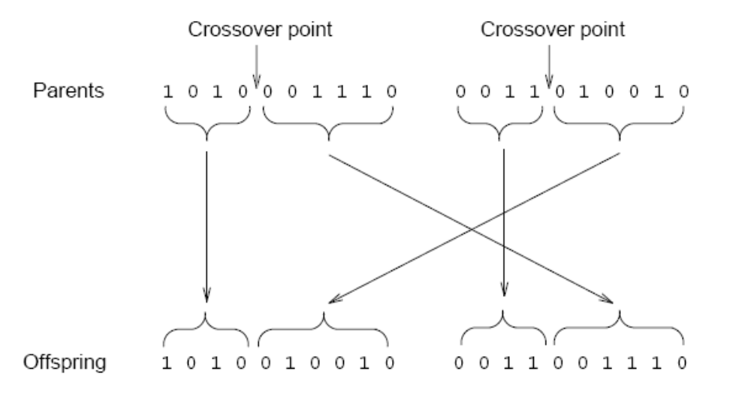
Recombination - Crossover
Crossover probability (typically 0.6 < CP < 1)
If no crossover, child is identical to parent

Slide 58
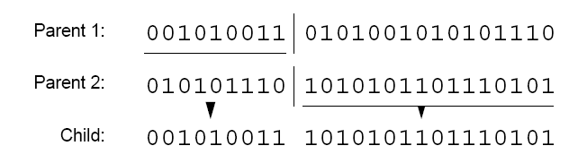
Crossover – variations (1)
One-point crossover

Slide 59
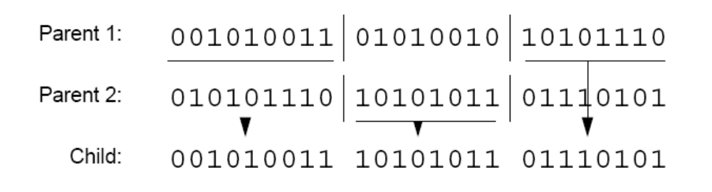
Crossover – variations (2)
Two-point crossover

Slide 60
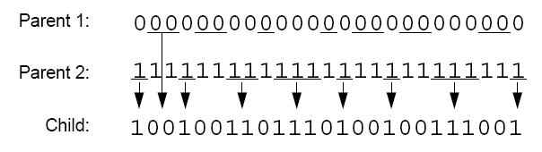
Crossover – variations (3)
Uniform crossover

Slide 61
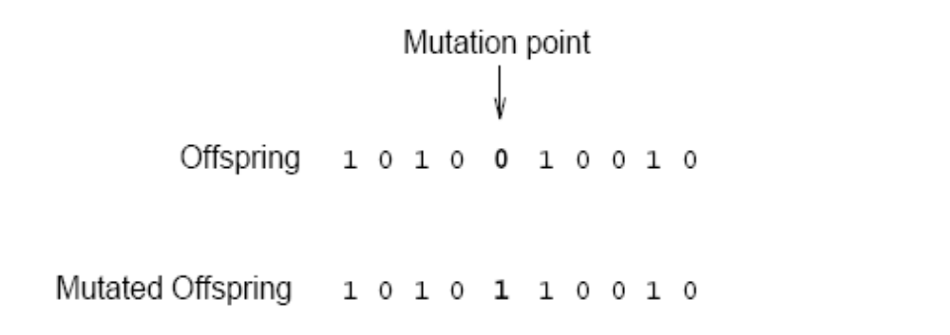
Recombination - Mutation
Crossover – rapidly searches a large problem space
Mutation – allows more fine-grained search

Slide 62
Convergence
Gene convergence: when 95% of the population has the same value for that gene
Population convergence: when all the genes reach convergence

Slide 63
Outline of the Basic Genetic Algorithm
[Start] Generate random population of n chromosomes (suitable solutions for the problem)
[Fitness] Evaluate the fitness f(x) of each chromosome x in the population
[New population] Create a new population by repeating following steps until the new population is complete

Slide 64
Outline of the Basic Genetic Algorithm
[Selection] Select two parent chromosomes
from a population according to their fitness (the better fitness, the bigger chance to be selected) The idea is to choose the better parents.
[Crossover] With a crossover probability cross over the parents to form a new offspring (children). If no crossover was performed, offspring is an exact copy of parents.
[Mutation] With a mutation probability mutate new offspring at each locus (position in chromosome).

Slide 65
Outline of the Basic Genetic Algorithm
[Accepting] Place new offspring in a new
population
[Replace] Use new generated population for a further run of algorithm
[Test] If the end condition is satisfied, stop, and return the best solution in current population
[Loop] Go to step 2

Slide 66
Coding
GA in nature | GA in CS
Genes | Parameters of solution
Chromosome = collection of genes | Chromosome = concatenated parameter values
Genotype = set of parameters represented in the chromosome
Phenotype = Finished “construction” of the individual (values assigned to parameters)

Slide 67
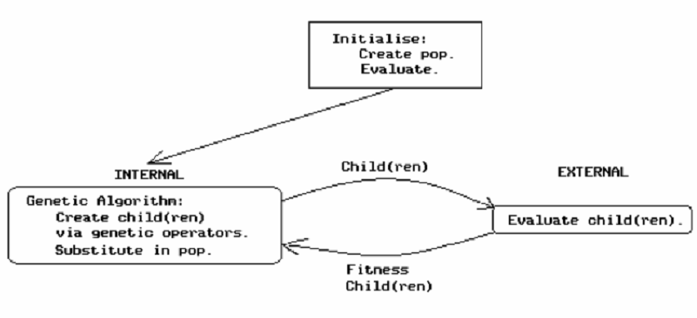
Generic Model for
Genetic Algorithm (1)

Slide 68
Generic Model for
Genetic Algorithm (2)
BEGIN /* genetic algorithm */
generate initial population
WHILE NOT finished DO
BEGIN
compute fitness of each individual
IF population has converged THEN
finished := TRUE
ELSE
  /* reproductive cycle */
  apply genetic operators to produce children
END
END
END

Slide 69
Components of a GA
A problem to solve, and ...
Encoding technique (gene, chromosome)
Initialization procedure (creation)
Evaluation function (environment)
Selection of parents (reproduction)
Genetic operators (mutation, recombination)
Parameter settings (practice and art)

Slide 70
Simple Genetic Algorithm
{
  initialize population;
  evaluate population;
  while TerminationCriteriaNotSatisfied
  {
    select parents for reproduction;
    perform recombination and mutation;
    evaluate population;
  }
}

Slide 71
Algorithm of standard GA
40
100
30
70
Create initial
population
Calculate
fitness
Select parents
Create children

Slide 72
Architecture of the Genetic Algorithm
Data
Best solution found so fare
Initialization
Initial Population
Evaluate Chromosomes
Evaluated Population
Next Generation
Select Chromosomes
Mutate Chromosomes
Candidate Next Generation
Candidate Next Generation
Crossover Chromosomes

Slide 73
The GA Cycle of Reproduction
children
reproduction
modification
modified
children
parents
population
evaluation
evaluated children
deleted
members
discard

Slide 74
Reproduction
children
reproduction
parents
population
Parents are selected at random with selection chances biased in relation to chromosome evaluations.

Slide 75
Chromosome Modification
Modifications are stochastically triggered
Operator types are:
  Mutation
  Crossover (recombination)
children
modification
modified children

Slide 76
Operators and Definitions
In binary GA s crossover is performed by swapping a part of binary strings between two solutions at a randomly chosen cross-site with some probability. It is a binary operator.
Crossover is a critical feature
It greatly accelerates search early in evolution of a population
  It leads to effective combination of schemata (subsolutions on different chromosomes)

Slide 77
Mutation
Mutation – Conversion of proteins from one to another.
In Binary GA , mutation is performed by converting some random bit of a binary string into its complementary bit (ie a 1 to a 0 or vice versa) with some probability. It is a unary operator.
Mutation will help prevent the population from stagnating. It adds “fresh blood” to a population of solutions to a problem. It adds diversity.

Slide 78
Genetic operators for the creation of children
Crossover: portions of strings of the two parents are exchanged
Mutation: the value of one bit (gene) is changed at random
Permutation: the order of a portion of the chromosome is reversed
Addition/deletion: one gene is added to/removed from the chromosome

Slide 79
Evaluation
The evaluator decodes a chromosome and assigns it a fitness measure
The evaluator is the only link between a classical GA and the problem it is solving
modified
children
evaluated
children
evaluation

Slide 80
Deletion
Generational GA:
entire populations replaced with each iteration
Steady-state GA:
a few members replaced each generation
population
discarded members
discard

Slide 81
Mutation: Local Modification
Before: (1 0 1 1 0 1 1 0)
After: (0 1 1 0 0 1 1 0)
Before: (1.38 -69.4 326.44 0.1)
After: (1.38 -67.5 326.44 0.1)
Causes movement in the search space
(local or global)
Restores lost information to the population

Slide 82
Analysis of GA
the algorithm is started on a problem, runs for a preset number of generations/iterations or until some termination condition is met, and the current best solution or solutions examined.
The examination provides a ranking of current solutions, if there are more than one.

Slide 83
Analysis continue…
The sequence of generated solutions (history) provides information on what the algorithm considers important in coming up with the current solution set.
When combined with knowledge about a particular algorithm's assumptions about search spaces, the algorithms history can furnish a designer with information needed to answer questions about a solution.

Slide 84
Analysis continue…
Analysis of the building blocks and the path taken by a GA through a search space provides a powerful mechanism for explaining the solutions generated by a GA
Results of the explanation can be used to guide post-processing in order to improve results in case of premature convergence

Slide 85
Analysis continue…
Start at identifying, extracting, organizing, and storing domain knowledge garnered while searching in a poorly-understood domain.
During the course of future searches, this knowledge can be used and added to, tuning the algorithm for this particular space.

Slide 86
Analysis continue…
Genetic or other blind search algorithms can be used as explorers of poorly understood domains, with the side effect of inducing a domain model during the course of search.
Initially, in such a system, there would be little knowledge and much searching. With increasing knowledge, in subsequent searches, the population of a genetic algorithm would be seeded with individuals hypothesized to be close to the required solution

Slide 87
Analysis continue…
Combining fitness prediction with hamming average prediction indicates how much progress is possible with a GA along with bounds on how much remaining work can be done.
The predicted average fitness indicates how much progress is possible, but it is the predicted hamming average that denotes the remaining work

Slide 88
Overview of Performance
So, even after one iteration, with no knowledge except for the relative fitness value, the GA has begun to quickly converge on the optimum value.
Considering the GA knows nothing about the problem space in which it searches. It is effectively blind.

Slide 89
Overview of Performance
Yet, just by examining a measure of goodness, having a large number of points to examine simultaneously and having a large amount of randomization thrown in, the GA efficiently searches the problem space for possible answers.
After couple of iterations we get the correct answer .Hence in this way Genetic Algorithms just help us out in a lot of ways and in many fields.

Slide 90
A Simple Example
The Optimization Problem: -
The problem is simply stated. Maximizing the function
Y = f(X)= X^2

Slide 91
Selecting the Fitness Factor
We just select the fitness factor as: -
Fitness Factor: f_{i} f
We just select the create a random parents as : -
₁₃ ₋ ₀₁₁₀₁
₂₄ ₋ ₁₁₀₀₀
₀ ₈ ₋ ₀₁₀₀₀
₁₉ ₋ ₁₀₀₁₁

Slide 92
Selection
String | X Value | f(x) | Relative Fitness Value | Nr of Selections
01101 | 13 | 169 | 0.14 | 1
11000 | 24 | 576 | 0.49 | 2
01000 | 8 | 64 | 0.06 | 0
10011 | 19 | 361 | 0.31 | 1
Sum |  | 1170 | 1.0 | 4

Slide 93
Selection(Contd.)
String Population
11000
10011
11000
01101

Slide 94
Crossing Over
Mating Pool Strings | New Population
0110|1 1100|0 | 01100 11001
10|011 01|101 | 10101 01011

Slide 95
Final Mating Pool
String Population | x Value
01100 | 12
11001 | 25
10101 | 21
01011 | 11

Slide 96
Crossover
One-point crossover
Two-point crossover
Uniform crossover

Slide 97
Parameters to Set
Number of initial solutions to generate
Number of offspring to generate
Number of parents and offspring to keep for the next generation
Mutation probability (very low)
Probability distribution of crossover point occurrence
Parameters depend on problem being solved
Determined by trial and error

Slide 98
The power of GAs
It is the fitnesses that drive the evolution
A GA can evolve a system of enormous complexity, well beyond what a human being can conceive of or design.
This greater complexity can often lead to performance levels beyond what human engineers are capable of.

Slide 99
Keys to the success of a GA
1.Data structures for
Genes
Chromosomes
Population
2.Fitness evaluation function
3. An excellent collection of training data

Slide 100
Genetic Algorithm: Why does it work?
Children carry parts of their parents’ data
Only “good” parents can reproduce
Children are at least as “good” as parents?
No, but “worse” children don’t last long
Large population allows many “current points” in search
Can consider several regions at once

Slide 101
GAs-Randomized Search
GAs are not simply random search algorithms, Random search algorithms can be inherently inefficient due to the directionless nature of their search.
GAs are not directionless.
They use past knowledge to direct the search

Slide 102
Why the GA is interesting
Does not require any knowledge of how to get a solution for the problem to be solved.
Advantage to provide near-optimal solutions to problems that do not have an algorithmical solution.
The genetic algorithm is also easy to put to use: the "engine" is shared; there is little problem-specific code to write.

Slide 103
Issues for Genetic Algorithms
Choosing basic implementation issues:
  representation
  population size, mutation rate, ...
  selection, deletion policies
  crossover, mutation operators
Termination Criteria
Performance, scalability
Solution is only as good as the evaluation function (often hardest part)

Slide 104
Benefits of Genetic Algorithms
Concept is easy to understand
Modular, separate from application
Supports multi-objective optimization
Good for “noisy” environments
Always an answer; answer gets better with time
Inherently parallel; easily distributed
Easily exploit previous or alternate solutions

Slide 105
Benefits of Genetic Algorithms (cont.)
Many ways to speed up and improve a GA-based application as knowledge about problem domain is gained
Easy to exploit previous or alternate solutions
Flexible building blocks for hybrid applications
Substantial history and range of use
Evolutionary technique … adaptive to changes

Slide 106
GA - Plus points
Robust: Wide range of problems can be tackled
“Acceptably good” solutions in “acceptably quick” time
Explore wide range of solution space reasonably quickly
Combination of Exploration and Exploitation
Hybridizing existing algorithms with GAs often proves beneficial

Slide 107
GA - shortcomings
Need not always give a globally optimum solution!
Probabilistic behaviour

Slide 108
Disadvantages
Require large number of response (fitness) function evaluations.
Configuration is not straightforward.
Have trouble finding the exact global optimum.
These can be slower than other techniques due to computational time.
The GA can generate some chromosomes that do not represent valid solutions.

Slide 109
Limitations
For large problems, memory requirement is high.
Not exact result every time, so multiple runs required
No comparative good results, when specific heuristics available.

Slide 110
Genetic algorithms and other search procedures
GAs work with a coding of the parameter set, not the parameters themselves.
GA search from a population of points, not a single point.
Gas use payoff (objective function) information, not derivatives or other auxiliary knowledge.
GAs use probabilistic transition rules, not deterministic rules.

Slide 111
The Robustness of the GA
Problem independent nature due to encoding of the solution rather then working directly on solution.
Parallel work on solutions rather then search by single solution so as to up gradation of whole population and thus finding Global minima rather then local minima.
Self-repair and Self-guidance

Slide 112
When to Use a GA
Alternate solutions are too slow or overly complicated.
Need an exploratory tool to examine new approaches.
Want to hybridize with an existing solution.
Benefits of the GA technology meet key problem requirements.
No mathematical analysis is available.
Traditional search methods fail.
Domain knowledge is scarce or expert knowledge is difficult to encode to narrow the search space.

Slide 113
GAs: What We Need?
Decide what constitutes a viable part of a solution (what are our genes?).
Decide how to determine fitness of a solution.
A method to select chromosomes from population for mating or mutation.
Decide on a data structure to represent the chromosome.
Choose a technique to mutate the chromosome & to enable crossover.
Choose a technique to reinsert children into population

Slide 114
Experimenting With Genetic Algorithms
Be sure you have a reasonable “goodness” criterion
Choose a good representation (including methods for crossover and mutation)
Generate a sufficiently random, large enough population
Run the algorithm “long enough” & Find the “winners” among the population

Slide 115
Randomized Algorithms
Guided random search technique
Uses the payoff function to guide search
Genetic Algorithms (GAs)
GA
Efficiency
Specialized Algo.
Problems
P
Specialized algorithms – best performance for special problems
Genetic algorithms – good performance over a wide range of problems

Slide 116
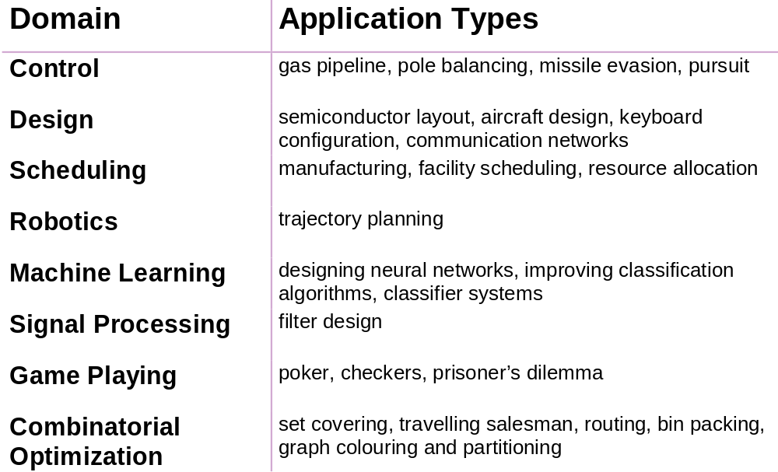
Some GA Application Types

Slide 117
When GAs applied to very large problems, they fail in two aspects
They scale rather poorly (in terms of time complexity)
The solution quality degrades rapidly.

Slide 118
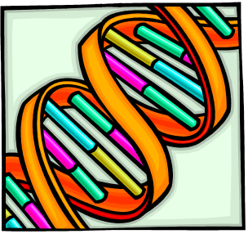
Summary
Are global optimization methods
Biologically inspired
Find global optima without relying on gradients
Are robust and often provide surprisingly good results fast
Useful for optimizing highly complex cost functions with large numbers of parameters
Require very little information about a problem
Useful for problems that involve searching parameter spaces in which there are many local minima
Only a cost function is required, no derivatives
Ideal parallel search procedure

Slide 119
Conclusions
Genetic algorithm - an artificial intelligence system that mimics the evolutionary, survival-of-the-fittest process to generate increasingly better solutions to a problem.
‘Genetic algorithms are rich - rich in application across a large and growing number of disciplines.’

Slide 120
Thank You…

