Slide 1
Semantic Nets, Frames, World Representation

Slide 2
Knowledge Representation as a medium for human expression
An intelligent system must have KRs that can be interpreted by humans.
– We need to be able to encode information in the knowledge base
without significant effort.
We need to be able to understand what the system knows and how it draws its conclusions.
Notes:
Predicate calculus and semantic nets can denote objects in the domain only
by using simple symbols. Other representatons, such as frames, let us define
complex structures by encapsulating multiple features and attributes
to indicate a single object in the domain.

Slide 3
Knowledge Representation
Logic (prepositional, predicate)
Network representation
Semantic nets
Structured representation
Frames
Issues in KR
Hierarchies, inheritance, exceptions
Advantages and disadvantages
Notes:
In building a knowledge base, a programmer must select the significant objects and relations in the domain and map these into a formal language. The resulting program must contain sufficient knowledge to solve problems in the domain, it must make correct inferences from this knowledge, and it must do so efficiently.

Slide 4
Semantic Networks
First introduced by Quillian back in the late-60s
M. Ross Quillian. "Semantic Memories", In M. M. Minsky, editor, Semantic
Information Processing, pages 216-270. Cambridge, MA: MIT Press, 1968
Semantic network is simple representation scheme which uses a graph of labeled nodes and labeled directed arcs to encode knowledge
Nodes – objects, concepts, events
Arcs – relationships between nodes
Graphical depiction associated with semantic networks is a big reason for their popularity

Slide 5
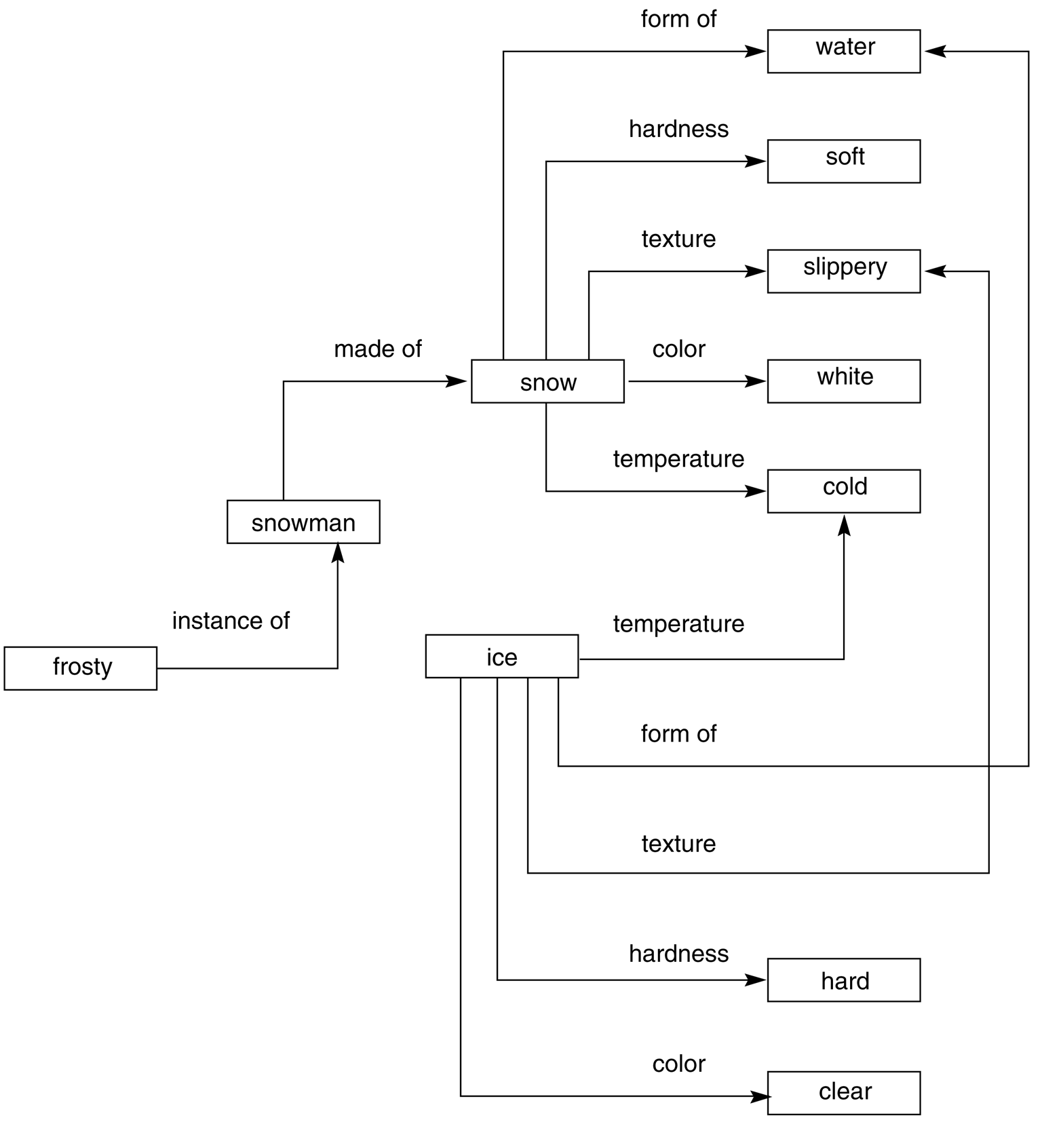
A brief look at semantic networks
A semantic network is an irregular graph that has concepts in vertices and relations on arcs.
Relations can be ad-hoc, but they can also be quite general, for example, “is a” (ISA), “a kind of” (AKO), “an instance of”, “part of”.
Relations often express physical properties of objects (colour, length, and lots of others).
Most often, relations link two concepts.

Slide 6
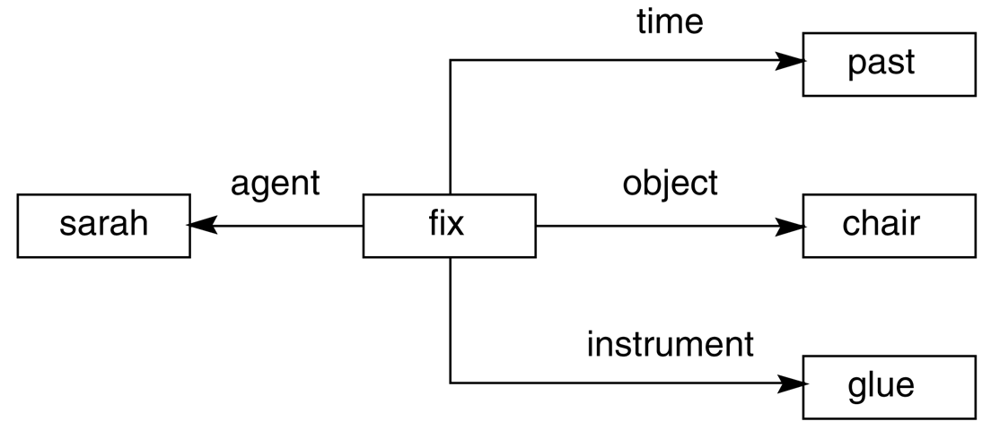
... semantic networks (2)
General semantic relations help represent the meaning of simple sentences in a systematic way.
A sentence is centred on a verb that expects certain arguments.
For example, verbs usually denotes actions (with agents) or states (with passive experiencers, for example, “he dreams” or “he is sick”).

Slide 7
Nodes and Arcs
Arcs define binary relations which hold between objects denoted by the nodes.
Sue
mother
John
age
5
mother (john, sue)
age (john, 5)
wife (sue, max)
age (max, 34)
…
wife
age
father
husband
34
Max

Slide 8
Non-binary relations
We can represent the generic give event as a relation involving three things:
A giver
A recipient
An object
Mary
recipient
GIVE
giver
John
object
book

Slide 9
Inheritance
Inheritance is one of the main kind of reasoning done in semantic nets
The ISA (is a) relation is often used to link a class and its superclass.
Some links (e.g. haspart) are inherited along ISA paths
The semantics of a semantic net can be relatively informal or very formal
Often defined at the implementation level
Animal
isa
Bird
hasPart
Wings
isa
Robin
isa
isa
Rusty
Red

Slide 10
Multiple Inheritance
A node can have any number of superclasses that contain it, enabling a node to inherit properties from multiple parent nodes and their ancestors in the network. It can cause conflicting inheritance.
Nixon Diamond
(two contradictory inferences from the same data)
Person
P ? !P
subclass
subclass
pacifist
Quaker
Republican
non-pacifist
Q
R
N
instance
instance
Nixon

Slide 11
Example

Slide 12
Advantages of Semantic nets
Easy to visualize
Formal definitions of semantic networks have been developed.
Related knowledge is easily clustered.
Efficient in space requirements
Objects represented only once
Relationships handled by pointers

Slide 13
Disadvantages of Semantic nets
Inheritance (particularly from multiple sources and when exceptions in inheritance are wanted) can cause problems.
Facts placed inappropriately cause problems.
No standards about node and arc values

Slide 14
Conceptual Graphs
Conceptual graphs are semantic nets representing the meaning of (simple) sentences in natural language
Two types of nodes:
Concept nodes; there are two types of concepts, individual concepts and generic concepts
Relation nodes(binary relations between concepts)
GO
NEW YORK
JOHN
Who
Where
How
BUS

Slide 15
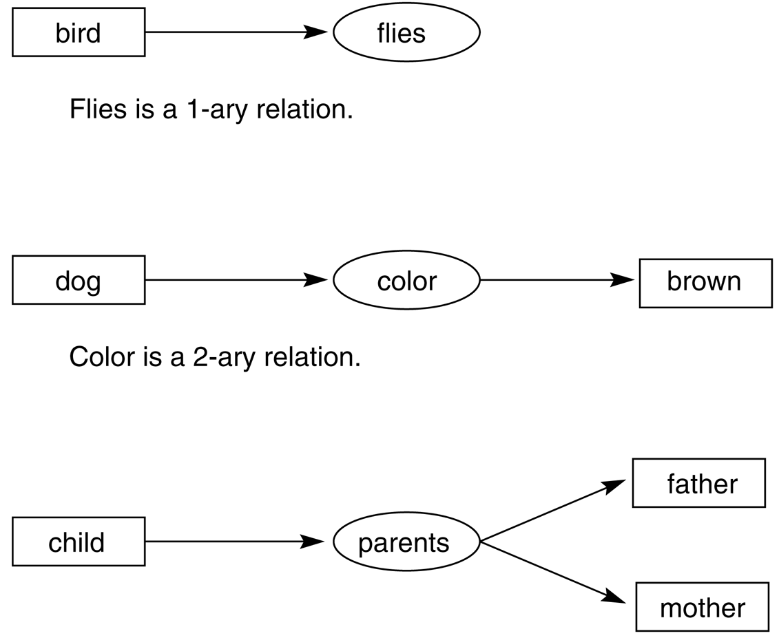
Conceptual graphs
John Sowa created the conceptual graph notation in 1984. It has substantial philosophical and psychological motivation.
It is still quite a popular knowledge representation formalism, especially in semantic processing of language, and a topic of interesting research.
Conceptual graphs can be expressed in first-order logic but due to its graphical form it may be easier to understand than logic.
Parents is a 3-ary relation.

Slide 16
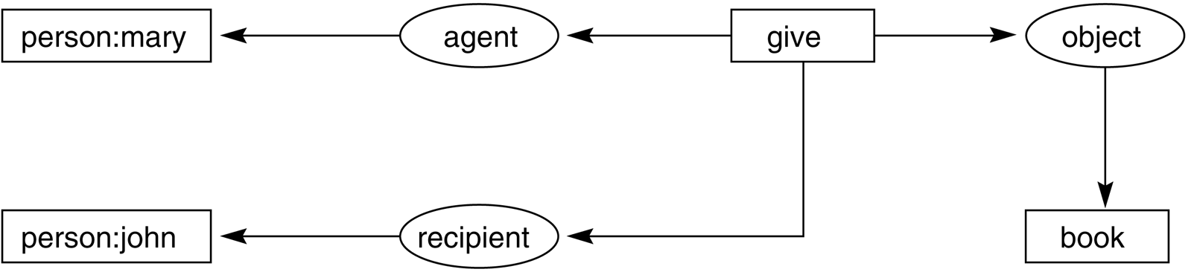
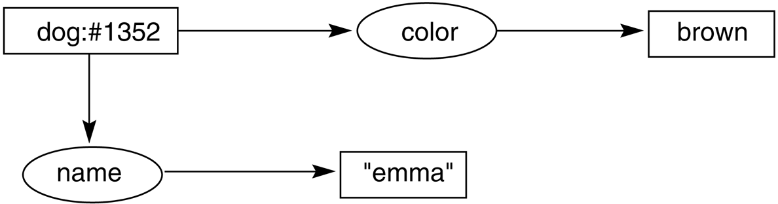
Conceptual graphs (2)

Slide 17
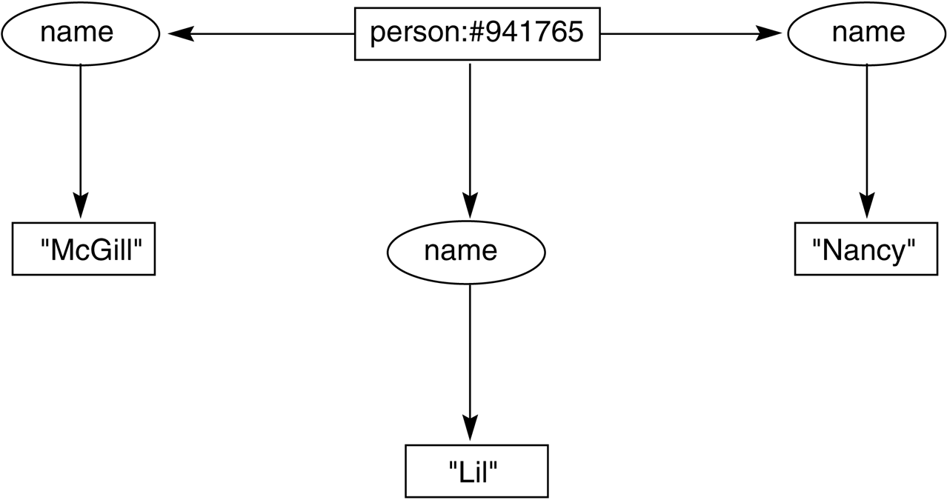

Conceptual graphs (3)
Her name was Magill, and she called herself Lil, but everyone knew her as Nancy.
Lil

Slide 18
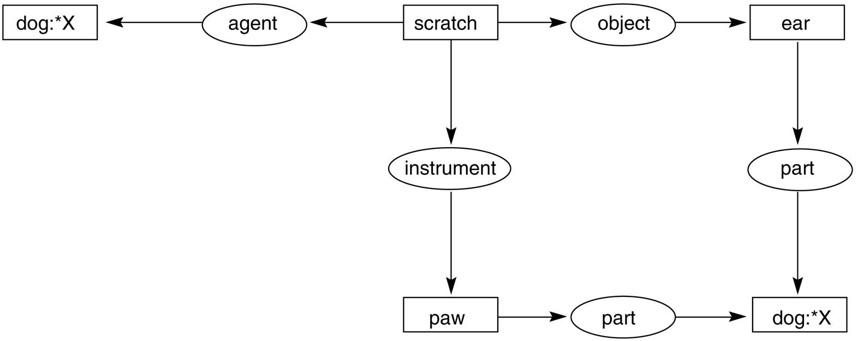
Conceptual graphs (4)
Variables allow us to express the identity of an individual.

Slide 19
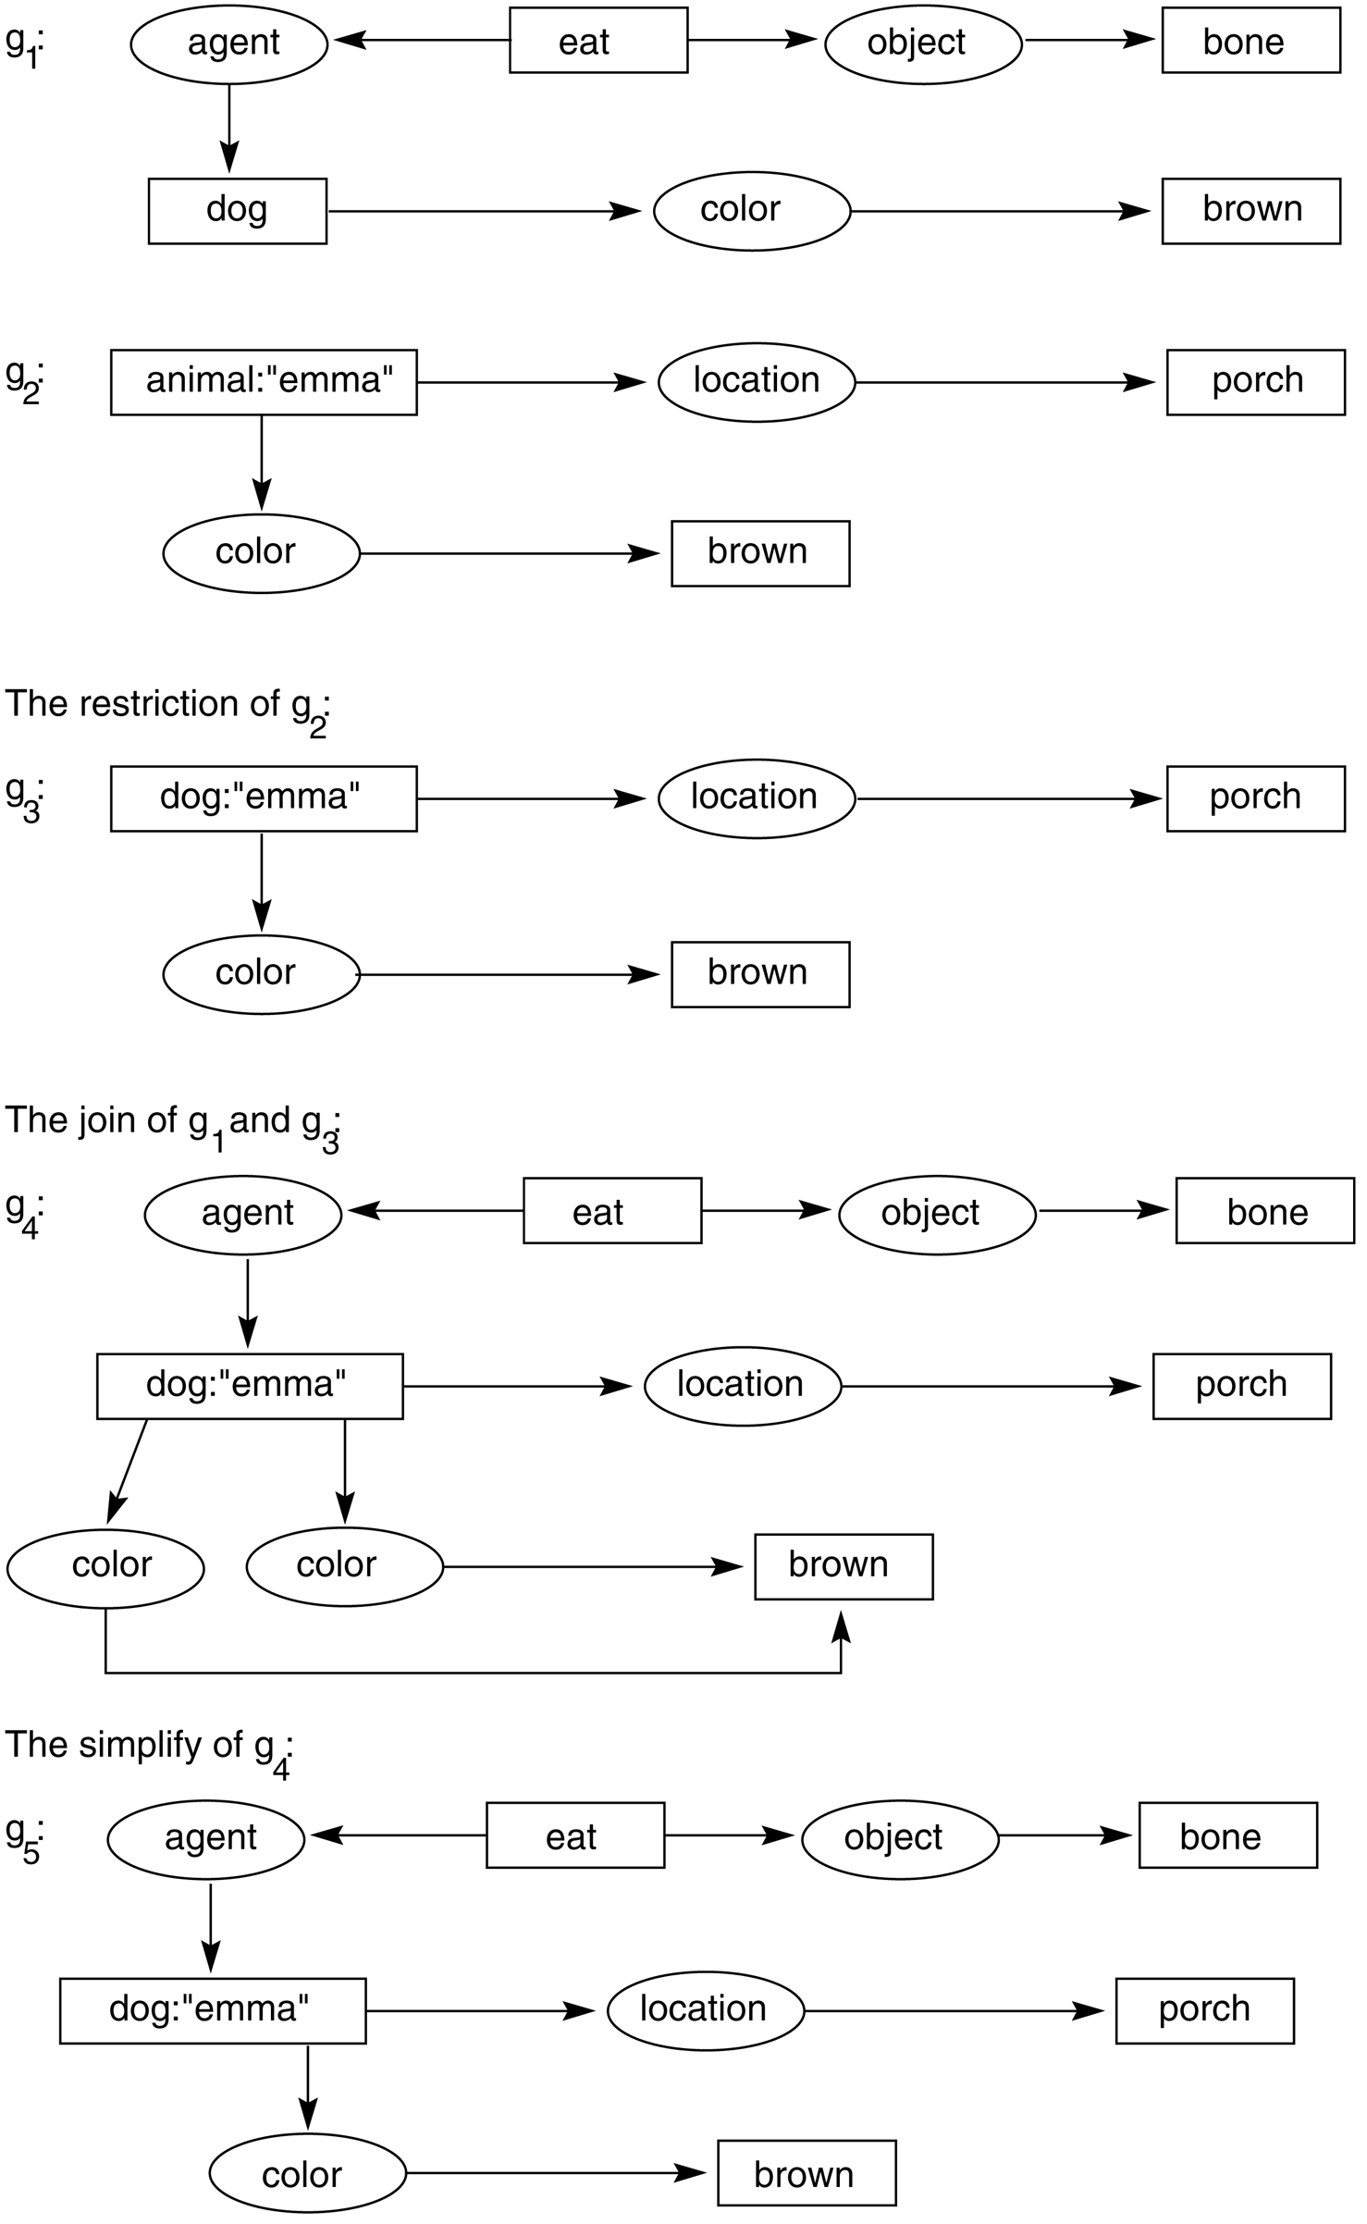
Conceptual graphs (5)
Specialization and type hierarchy
dogs are animals
(g₁) A brown dog eats a bone.
(g₂) ... Emma, the brown animal on the porch...
(g₃) ... Emma, the brown dog on the porch...
(g₄) Emma, the brown dog on the porch, eats a bone.
The challenge is to get this from text!

Slide 20
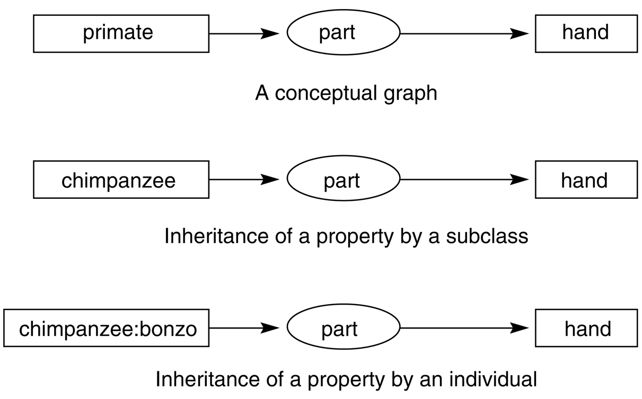
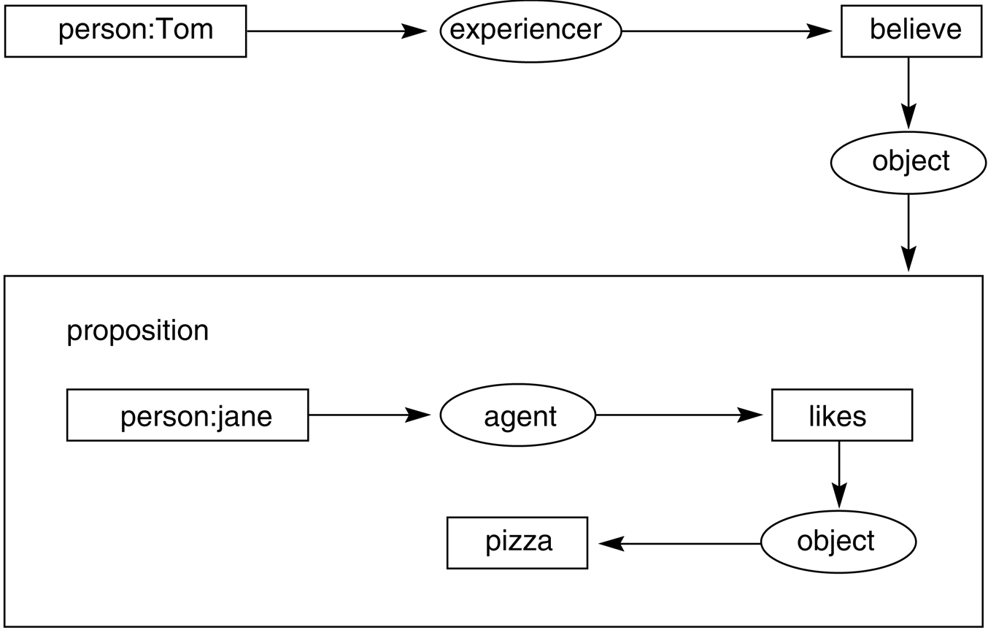
Conceptual graphs (6)
Beyond first-order logic
Inheritance

Slide 21
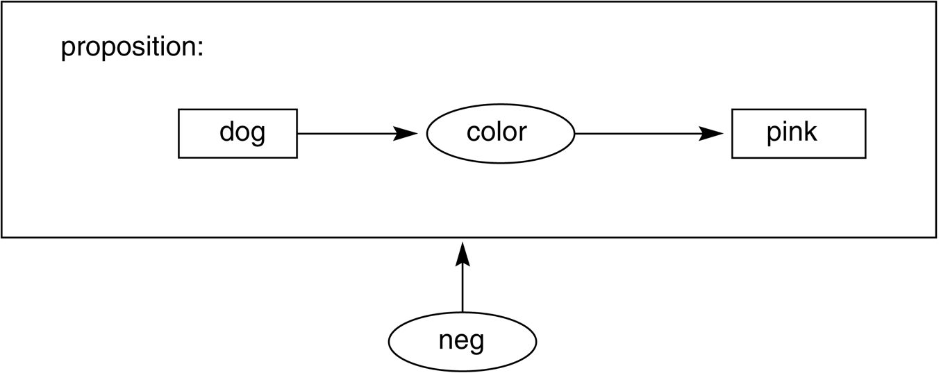
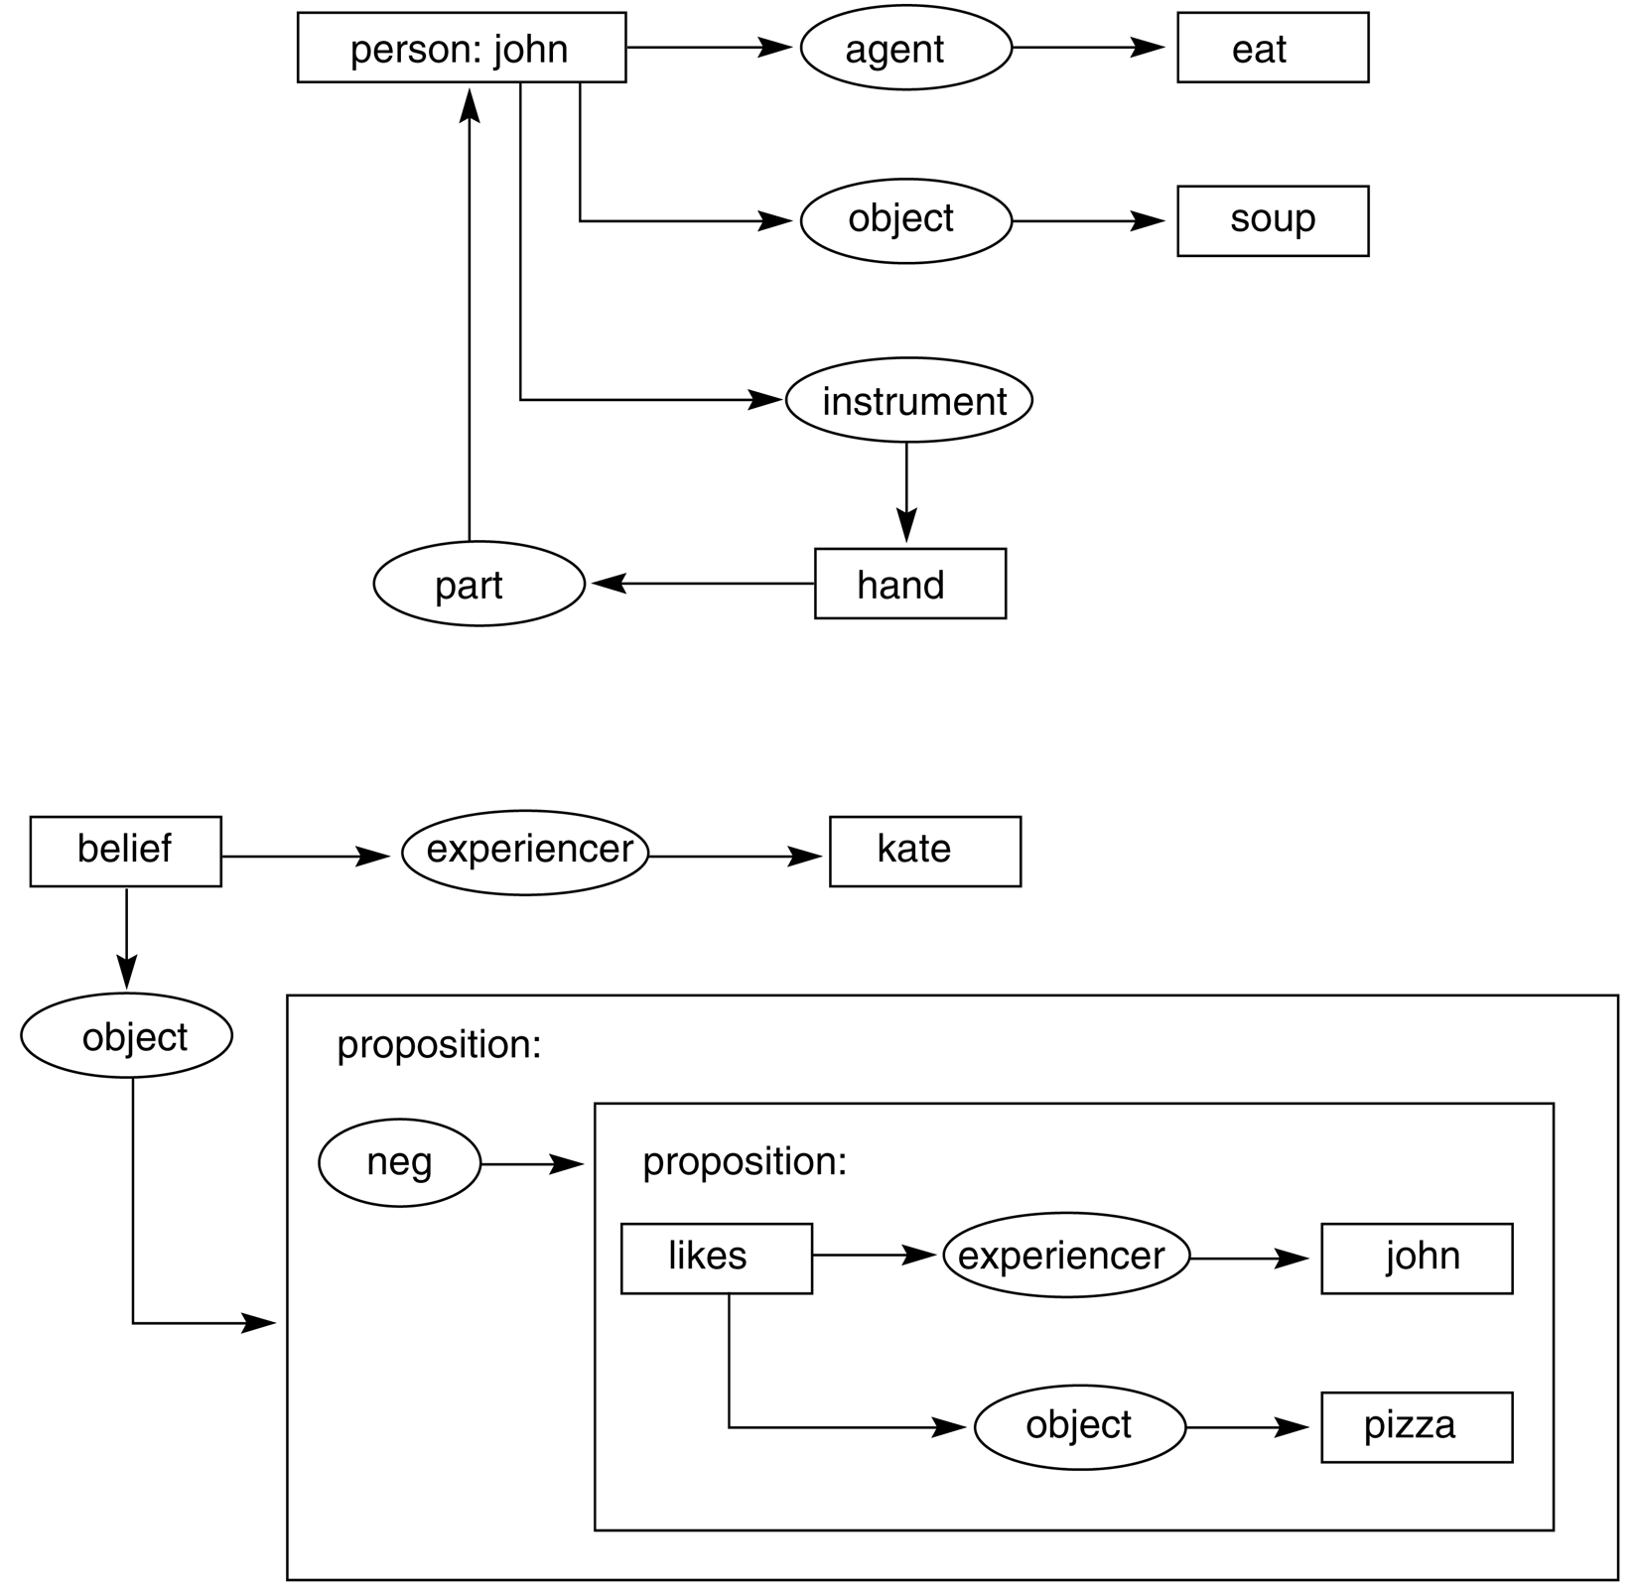
Conceptual graphs (7)
Negation and quantification
Two simple puzzles

Slide 22
Frames
Frames – semantic net with properties
A frame represents an entity as a set of slots (attributes) and associated values
A frame can represent a specific entry, or a general concept
Frames are implicitly associated with one another because the value of a slot can be another frame
Book Frame
Slot → Filler
Title → AI. A modern Approach Author → Russell & Norvig Year → 2003
3 components of a frame
frame name
attributes (slots)
values (fillers: list of values, range, string, etc.)

Slide 23
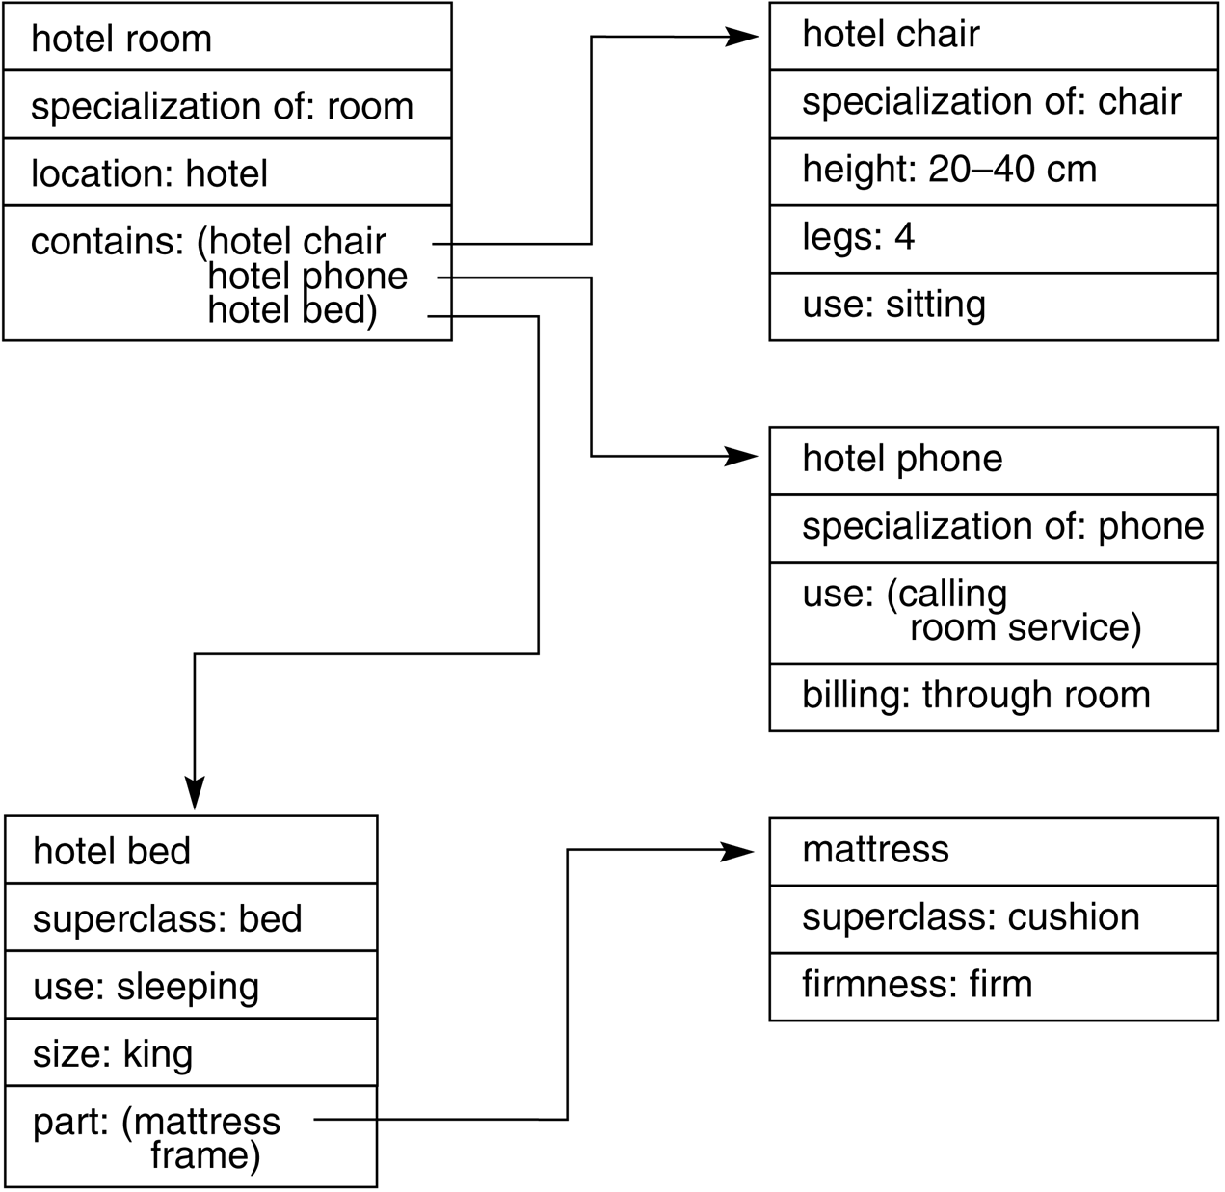
Frames and frame systems
A frame represents a concept;
a frame system represents an organization of knowledge about a set of related concepts.
A frame has slots that denote properties of objects. Some slots have default fillers, some are empty (may be filled when more becomes known about an object).
Frames are linked by relations of specialization/generalization and by many ad-hoc relations.

Slide 24
Features of Frame Representation
More natural support of values then semantic nets (each slots has constraints describing legal values that a slot can take)
Can be easily implemented using object-oriented programming techniques
Inheritance is easily controlled

Slide 25
Inheritance
Similar to Object-Oriented programming paradigm
Hotel Chair
what → chair height →20-40cm legs → 4
Hotel Room
what → room where →hotel contains→ hotel chair hotel phone hotel bed
Hotel Phone
what → phone billing → guest
Hotel Bed
what → bed size →king part → mattress
Mattress
price → 100$

Slide 26
Modern Data-Bases combine three approaches: conceptual graphs, frames, predicate logic (relational algebra)

Slide 27
Benefits of Frames
Makes programming easier by grouping related knowledge
Easily understood by non-developers
Expressive power
Easy to set up slots for new properties and relations
Easy to include default information and detect missing values

Slide 28
Drawbacks of Frames
No standards (slot-filler values)
More of a general methodology than a specific representation:
Frame for a class-room will be different for a professor and for a maintenance worker
No associated reasoning/inference mechanisms

Slide 29
Description Logic
There is a family of frame-like KR systems with a formal semantics
KL-ONE, Classic
A subset of FOL designed to focus on categories and their definitions in terms of existing relations. Automatic classification
Finding the right place in a hierarchy of objects for a new description
More expressive than frames and semantic networks
Major inference tasks:
Subsumption
Is category C1 a subset of C2?
Classification
Does Object O belong to C?

Slide 30
KL-ONE (Brachman, 1977)
Bi-partite view of knowledge representation
1. Descriptions
2. Assertions
Entities can be “described” without making any particular assertions about them
Descriptions are made from other descriptions using a very small set of operators

Slide 31
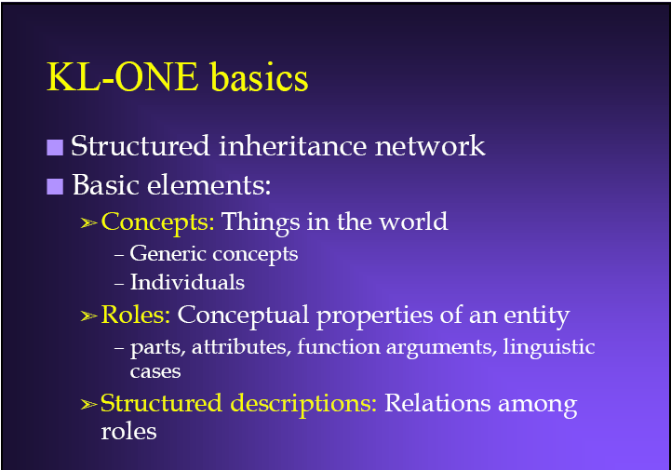

Slide 32
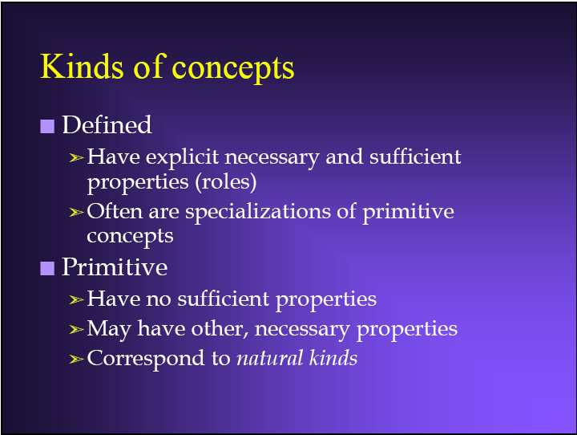

Slide 33
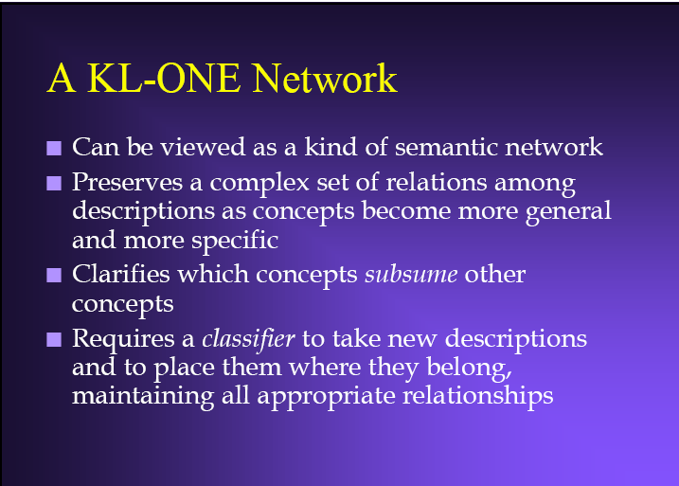

Slide 34
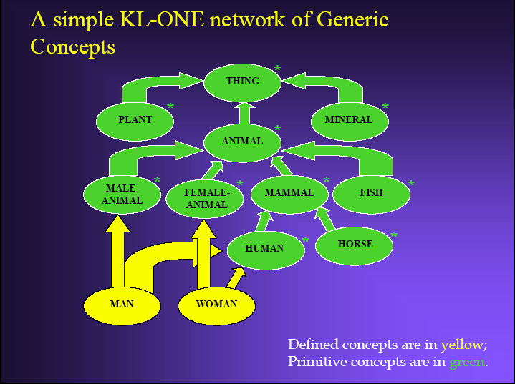

Slide 35
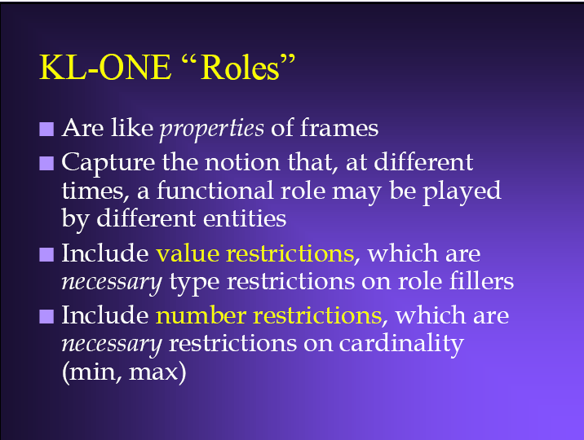

Slide 36
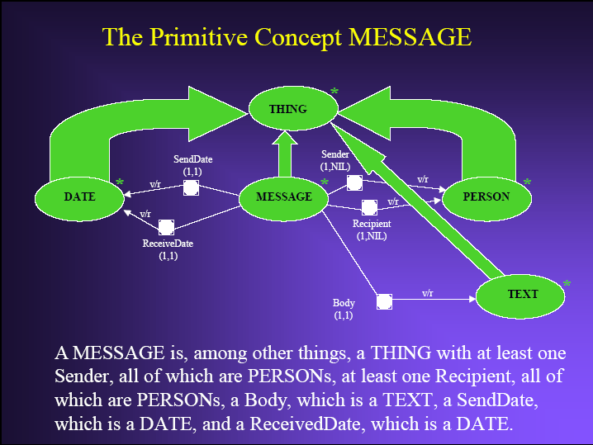

Slide 37
CYC
A knowledge engineering effort
Encoding of large amounts of knowledge about the everyday world
1984-present
A person century of effort
10⁶ general concepts and axioms

Slide 38
Example Assertions
You have to be awake to eat.
You can usually see people’s noses but not their hearts.
Given two professions, either one is a specialization of the other or they are likely to be independent.
You cannot remember events that have not happened yet.
If you cut a lump of peanut butter in half, each half is also a lump of peanut butter; but if you cut a table in half, neither half is a table.

Slide 39
Contexts
Heart surgery
Total darkness
Fiction
Ephemeral: indexicals
Default context

Slide 40
Why we can’t use natural language
The police arrested the demonstrators because they feared violence.
The police arrested the demonstrators because they advocated violence.
The box is in the pen.
The pen is in the box.
Mary poured the water into the tea kettle; when it whistled, she poured the water into her cup (for translation to Japanese)

Slide 41
Representing Terms
1000 different occupations
Assertion that each occupation is independent
A surgeon is a doctor
Masons are builder
NOT surgeons are rarely masons
Atomic concepts
Somewhere between promiscuity and perspicacity

Slide 42
Ontology
CYC and others: shareable ontologies
Available for many different applications to use
Semantic web
An ontology describes the set of representational terms
Provides definitions
Carves up the world

Slide 43
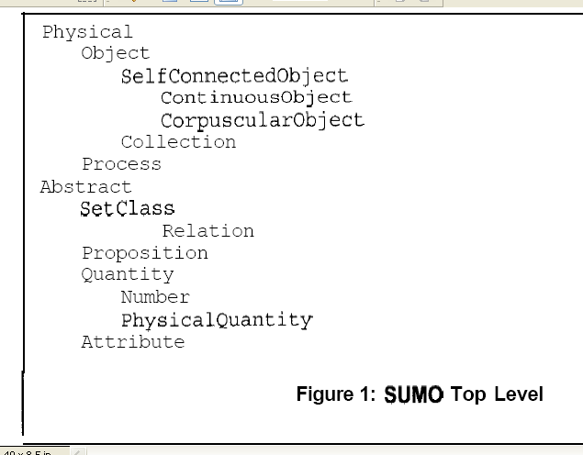

Slide 44
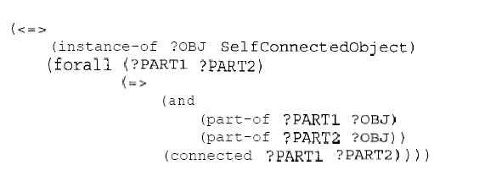
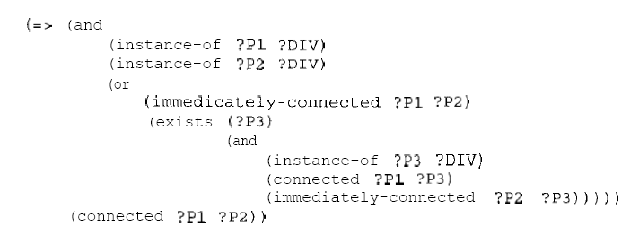
Connected:

Slide 45
Two Case Studies
Physical quantities, units of measure, and algebra for engineering models
An ontology for sharing bibliographic data

Slide 46
Bibliographic Data
What concepts do we need to know about?

Slide 47
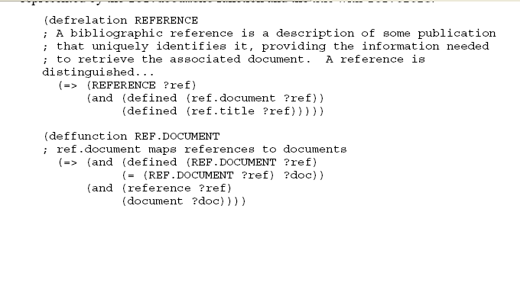
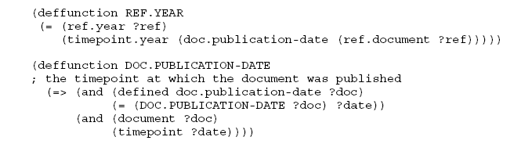

Slide 48
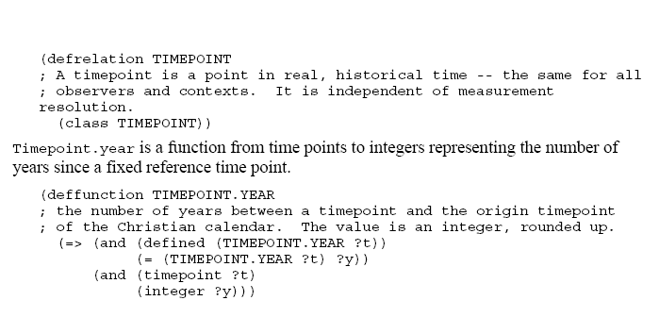

Slide 49
Rational
Why are documents distinct from references?
Why distinguish publishers and authors?
Why represent time points?
=> integrity constraints
=> independence from the data

Slide 51
OVERFLOW
Semantic nets: originally developed for mapping sentences (NLP). Example with Shank’s graphs.

