Slide 1

GOAL
“The moment you put a timeline on your dream it becomes GOAL.”
Parth Patel
19DCS098
HS 131.02
Notes:
To use this title animation slide with a new image simply 1) move the top semi-transparent shape to the side, 2) delete placeholder image, 3) click on the picture icon to add a new picture, 4) Move semi-transparent shape back to original position, 5) Update text on slide.

Slide 2
INTRODUCTION
What is Goal Setting?
The process of identifying something that you want to accomplish and establishing measurable goals and timeframes
What is GOAL?
A goal is a desired result that a person plans to commits and takes initiative to achieve it.
Why Goal Setting?
It gives long term vision.
It gives motivation.
It helps to push ourself to max potential.

Slide 3

Types
Short Term Goals
A short term is something you want to achieve and accomplish in near future
Achieving 10.0 CGPA in Exam
Losing 5 Kgs of weight
Long Term Goals
A long term goal is something you want to achieve in long term.
Get a Master’s Degree
To own a house
“Setting Goals is the first step in turning the
invisible into visible.”

Slide 4
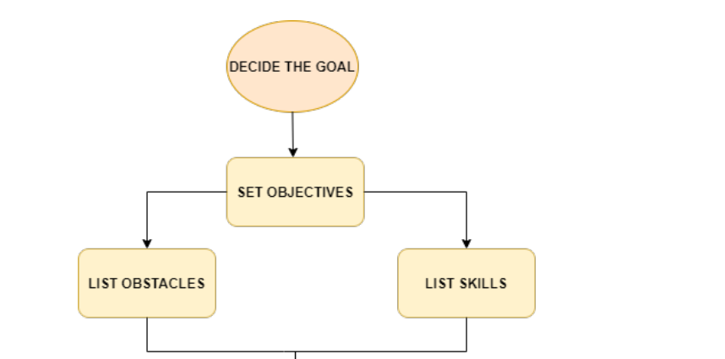
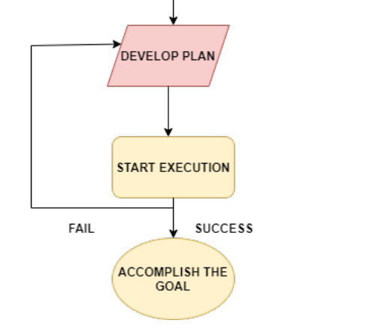
HOW TO ?

Slide 5
Goal is not just about identifying what you want to achieve but also about how you will achieve it.
CONCLUSION

Slide 6
“Don’t Dream to be something but rather work to do something.”
— Honorable Prime Minister,
Narendra Modi
THANK YOU!

