Slide 1

GOAL
“The moment you put a timeline on your dream it becomes GOAL.”
Parth Patel
19DCS098
HS 121.02
Notes:
To use this title animation slide with a new image simply 1) move the top semi-transparent shape to the side, 2) delete placeholder image, 3) click on the picture icon to add a new picture, 4) Move semi-transparent shape back to original position, 5) Update text on slide.

Slide 2
INTRODUCTION
What is Goal Setting?
The process of identifying something that you want to accomplish and establishing measurable goals and timeframes
What is GOAL?
A goal is a desired result that a person plans to commits and takes initiative to achieve it.
Why Goal Setting?
It gives long term vision.
It gives motivation.
It helps to push ourself to max potential.

Slide 3

Types
Short Term Goals
A short term is something you want to achieve and accomplish in near future
Achieving 10.0 CGPA in Exam
Losing 5 Kgs of weight
Long Term Goals
A long term goal is something you want to achieve in long term.
Get a Master’s Degree
To own a house
“Setting Goals is the first step in turning the
invisible into visible.”

Slide 4
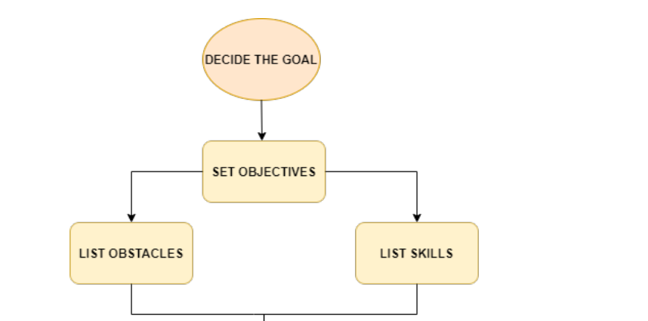
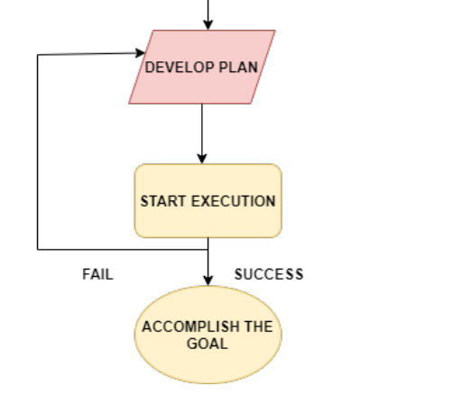
HOW TO ?

Slide 5
Goal is not just about identifying what you want to achieve but also about how you will achieve it.
CONCLUSION

Slide 6
What I learned from the Subject?
1
2
3
4
5
Importance of GOAL Setting
Different Problem needs different Approach
The power of imagination much more than expected
How change in perspective can change the whole result
Importance of Creativity and why Problem solving techniques are important in life.

Slide 7
“Don’t Dream to be something but rather work to do something.”
— Honorable Prime Minister,
Narendra Modi
THANK YOU!

