Slide 1

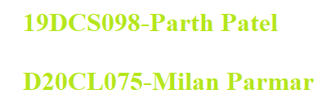

PT 192 OHS & Ergonomics
IT-BPO Industries

Slide 2


TIMELINE
Glimpses of IT industry
Glimpses of BPO Industry
What is OHS?
Ergonomics issues in the industry
Why Ergonomics issues are prevalent?
Pie-Chart
Ergonomics issue
Important Issues
Risks Analysis
Solution
PT 192 OHS & Ergonomics

Slide 3



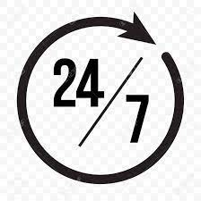

Glimpses of IT Industry:
Pillar Industry
Young Workforce
Robust Demand
24/7 Work
Industrial Impact
Contribution around 7.7% to the country’s GDP
35% Workforce are in age group of 18-25 and
41% in 25-30
Approx. 10% growth expected YoY.
IT industry runs 24/7 whole year around to support various functions.
Impact of IT is observed World-wide.

Slide 4



Glimpses of BPO Sector:
Fastest Growing Sector
24/7 Work
Stressed Job
BPO Industry creates highest number of jobs worldwide every year.
Like IT industry, BPO industry also runs 24/7.
BPO is one of the most stressed challenged sector.

Slide 5




What is OHS?
A multidisciplinary field concerned with the safety, health, and welfare of people at occupation
The goal of OHS in industry is to foster a safe and healthy occupational environment
develops working cultures in a direction which supports health and safety at work and in doing so also promotes a positive social climate and smooth operation and may enhance productivity of the undertakings

Slide 6

Ergonomics Issues in the Industry

Slide 7



Why Ergonomics Issues are prevalent?
High Intensity Work
Stressed Work-style
Lack of Awareness
Most employees are having high intensity work involving certain body movements.
Majority of Employees have reported of having stressed work culture.
Most of the employees are unaware about the potential damage of not taking OHS seriously.

Slide 8
Ergonomics Issues
Body Posture Problems
Shift Work Syndrome
Eye Strain
Poor Workstation Design
Non-adjustable Chair
Prolonged Sitting
Long working hours
Highly repetitive typing
Odd work schedule
High Work Demand
Night-shifts
Weekend Work
Stress
Glare
Inappropriate monitor height
Poor Lighting Conditions
Reduced Blinking Rate

Slide 9
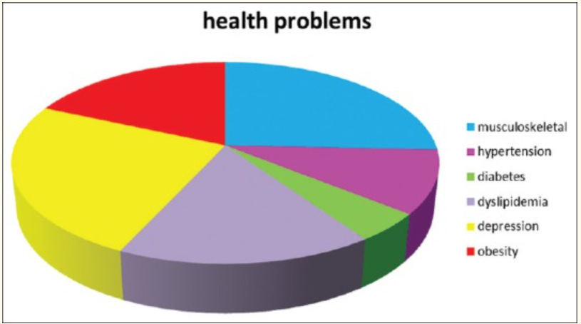
Pie-Chart:
These are some common issues faced in IT and BPO industries

Slide 10
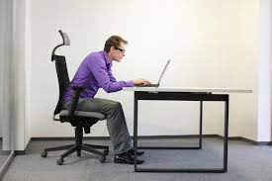
ISSUES:
HAZARDS:
Posture is incorrect.
Back is straight but makes almost 30 deg. Angle with seat
So, whole weight of body is on the back.
This posture make cause serious back issue.
SOLUTION:
The chair is ergonomically apt.
The back should be rested on the backrest of the chair
It will also prevent from Eye strain.

Slide 11
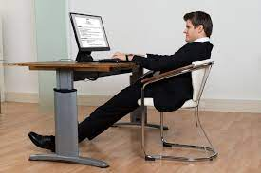
ISSUES(cont.)
HAZARDS:
The back is too much reclined
The position of legs is inappropriate
The thighs can have serious damage.
Fingers might get strain.
SOLUTION:
Thigh should be parallel to floor.
The elbow should be above the desk level.
The back should make almost right angle with floor.

Slide 12
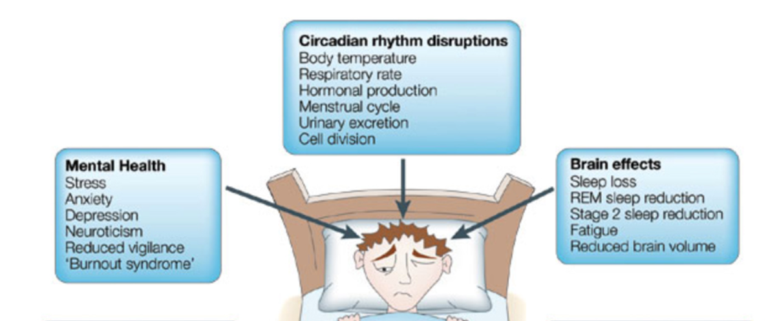
ISSUES(cont.)

Slide 13
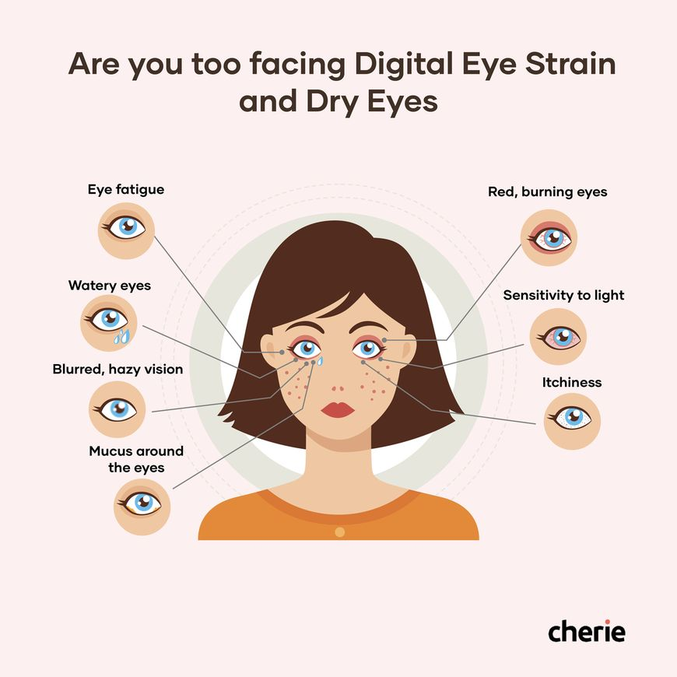
ISSUES(cont.)

Slide 14
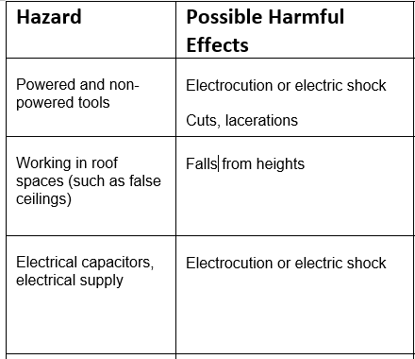
ISSUES(cont.)

Slide 15
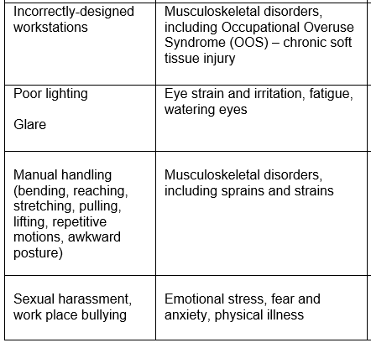
ISSUES(cont.)

Slide 16
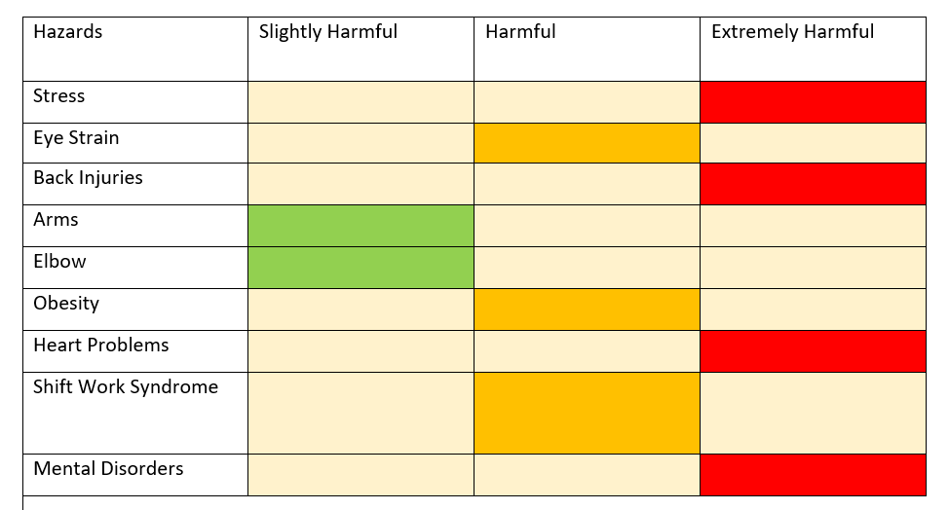
Risks:

Slide 17
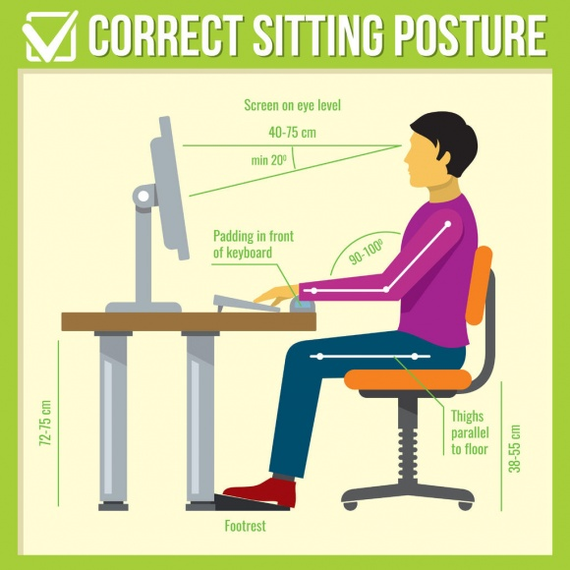
SOLUTION

Slide 18
Work Citied:
Pie Chart- Google-images
Work Postures-https://www.businessballs.com/health-and-wellbeing/posture-and-workstation-ergonomics/
Sleep Work Syndrome-https://www.sleepfoundation.org/shift-work-disorder/symptoms#:~:text=Shift%20work%20sleep%20disorder%20is,am%20and%206%20pm1.
Eye Strain-https://www.johnoconnor.co.nz/digital-eye-strain/
http://ergonomictrends.com/common-workplace-ergonomic-issues/
https://www.postureg.com/maintain-good-posture-working-computer/

Slide 19

Summary
We learned the ergonomics and health issues faced in IT and BPO industry
We also covered why the issues are prevalent
We went through some of the common but alarming issues faced in the industry
We learnt how to prevent the issues and make the IT and BPO industry more ergonomically soundful
PT 192 OHS & Ergonomics

Slide 20

Thank You

