Slide 1
Introduction to finite difference method
General principles, stability, precision

Slide 2
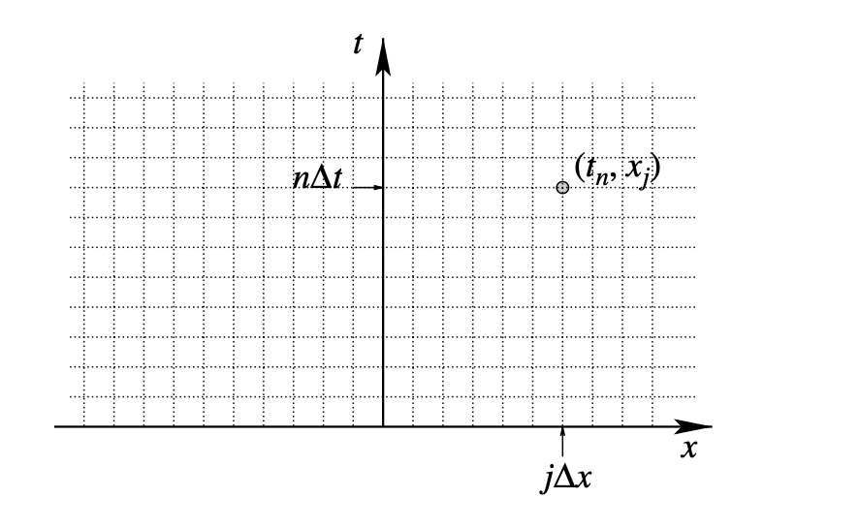
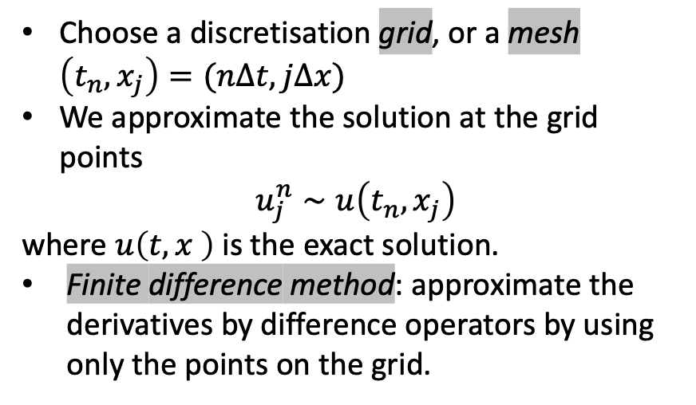
General principles
Choose a discretisation grid, or a mesh $\left(t_{n},x_{j}\right)=(nΔt, jΔx)$
We approximate the solution at the grid points
$u_{j}^{n}∼u\left(t_{n},x_{j}\right)$
where $u\left(t,x \right)$ is the exact solution.
Finite difference method: approximate the derivatives by difference operators by using only the points on the grid.

Slide 3
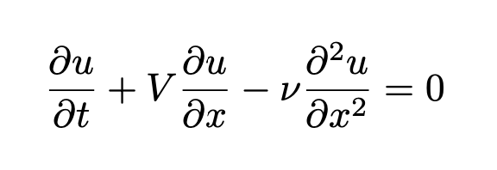
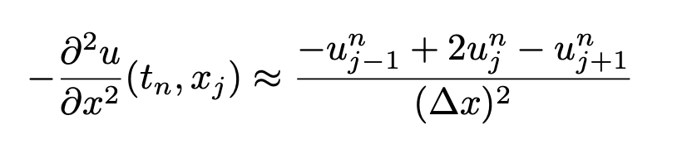
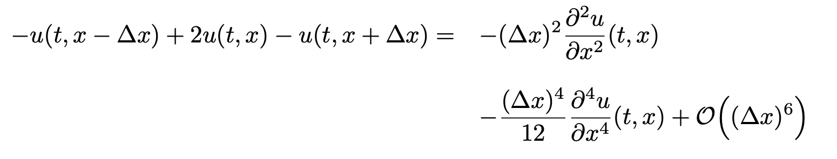
Approximation of derivatives
In the convection diffusion equations we have 3 derivatives to approximate. (1 in time, 2 in space)
Second order derivative approximation using Taylor series

Slide 4
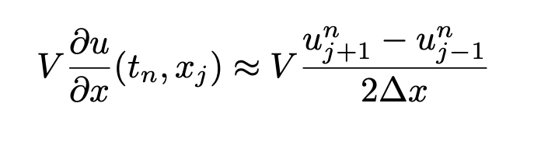
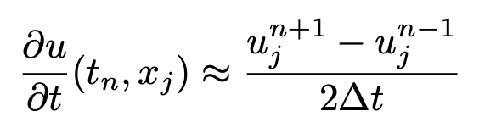
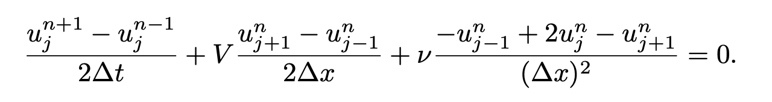
1st order derivatives – Richardson scheme
Centered approximations of first order derivatives lead to the Richardson scheme
It seems a natural scheme but cannot compute solutions! Centered time approximations are not good for advection diffusion problems!

Slide 5
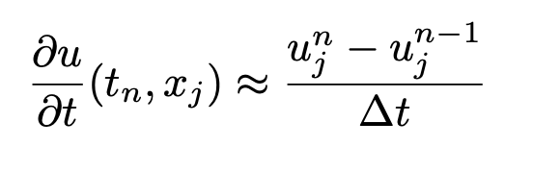
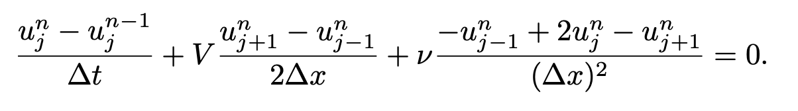
Backward Euler scheme (implicit)
Backward approximation in time (we go back in time) and centered in space

Slide 6
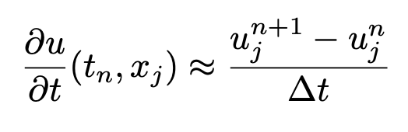
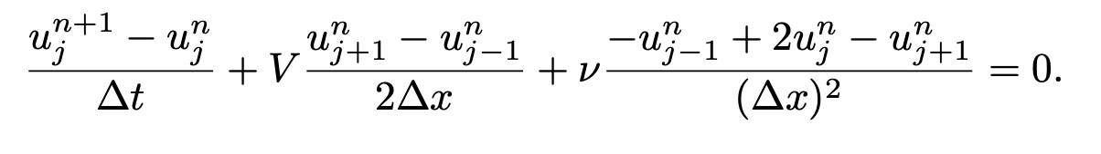
Forward Euler scheme (explicit)
Forward approximation in time (we go forward in time) and centered in space

Slide 7
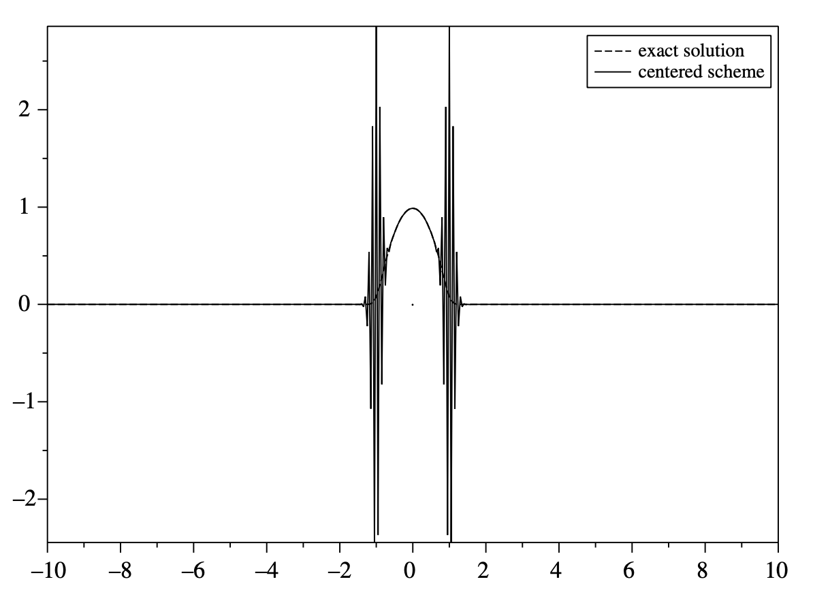
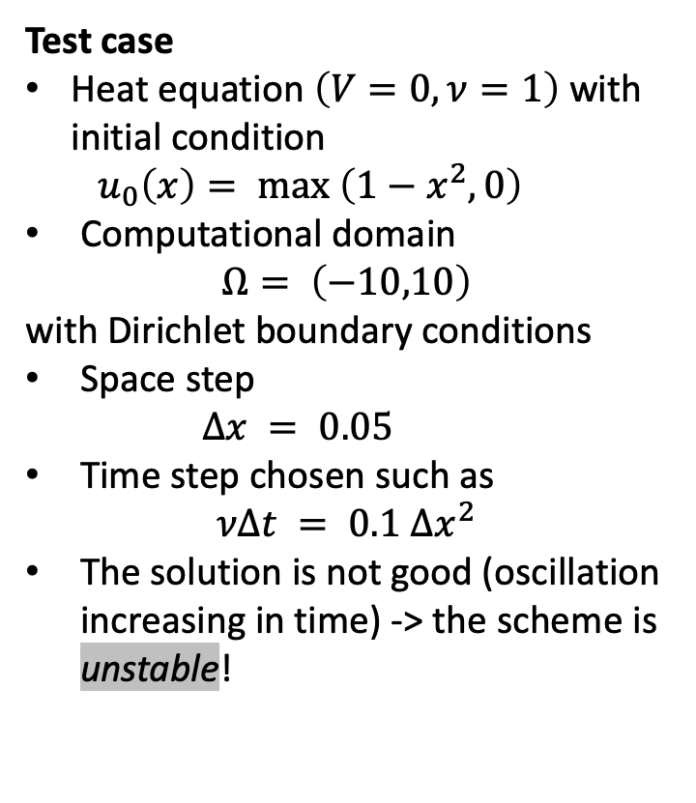
Numerical result – centred scheme (Richardson)
Test case
Heat equation $\left(V=0,ν=1\right)$ with initial condition
$u_{0}\left(x\right)= max \left(1−x^{2},0\right)$
Computational domain
$Ω= \left(−10,10\right)$
with Dirichlet boundary conditions
Space step
$Δx = 0.05$
Time step chosen such as
$$νΔt = 0.1 Δx^{2}$$
The solution is not good (oscillation increasing in time) -> the scheme is unstable!

Slide 8
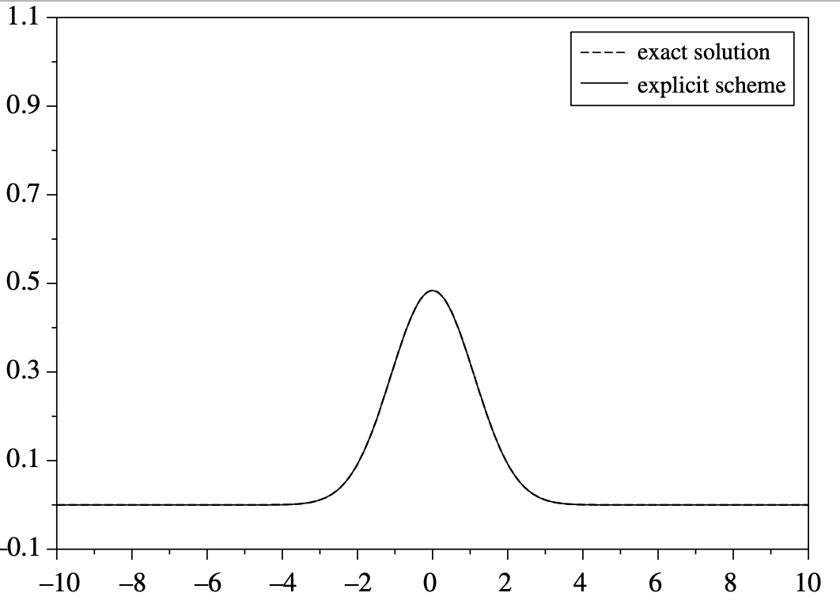
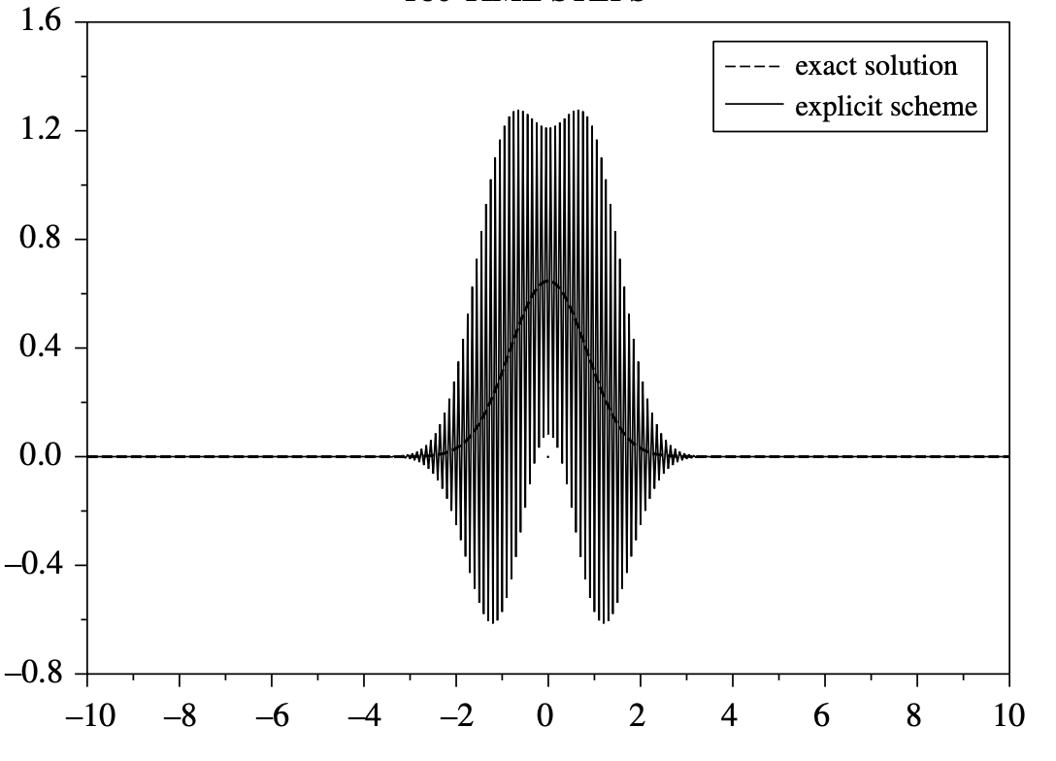
Numerical result – explicit scheme (forward Euler)
The CFL number $\frac{νΔt}{Δx^{2}}$ is a measure of stability
CFL = 0.4 (stable)
CFL = 0.51 (unstable)

Slide 9
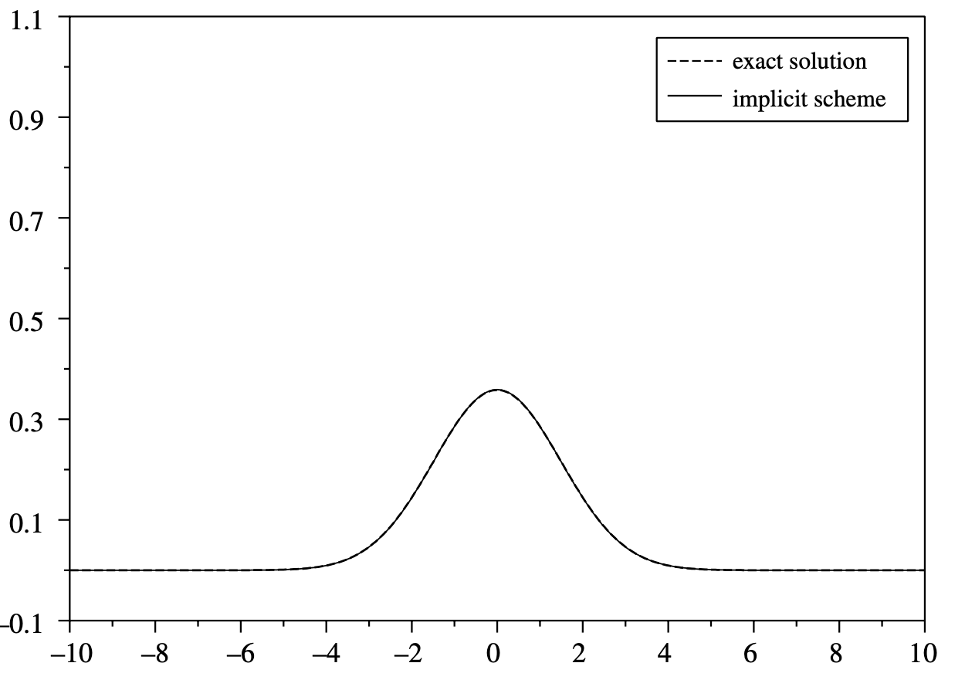
Numerical result – explicit scheme (forward Euler)
The implicit scheme is always stable!
Here CFL = 2!
Unlike the centered scheme which is always unstable.

Slide 10
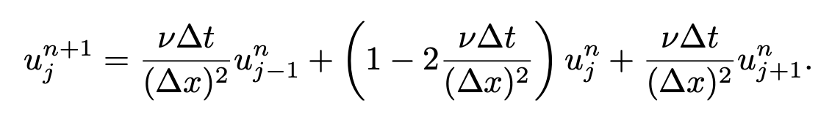
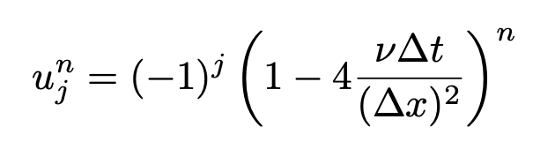
Stability and discrete maximum principle
Q: Is there a relation with the discrete maximum principle? Rewrite the scheme
A: Yes. By re-writing the scheme, we see that if $CFL≤\frac{1}{2}, u_{j}^{n+1}$ is a convex combination of $u_{j}^{n},u_{j−1}^{n}$, $u_{j+1}^{n}$.
Discrete maximum principle: if the IC is bounded $m ≤u_{j}^{0}≤M$ then $m ≤u_{j}^{n}≤M,∀n≥0, j∈Z$
If $CFL>\frac{1}{2}$, for $u_{j}^{0}={\left(−1\right)}^{j}$, the general solution below is unbounded.

Slide 11
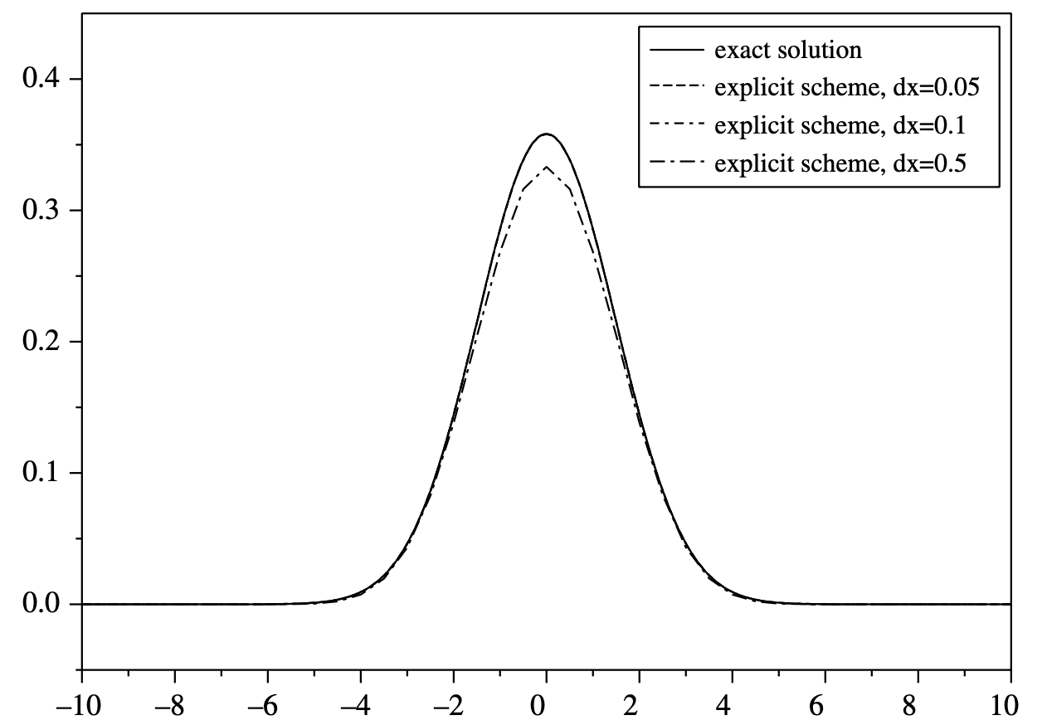
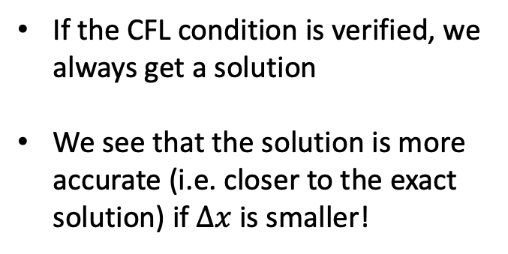
Numerical validation - precision
If the CFL condition is verified, we always get a solution
We see that the solution is more accurate (i.e. closer to the exact solution) if $Δx$ is smaller!

Slide 12
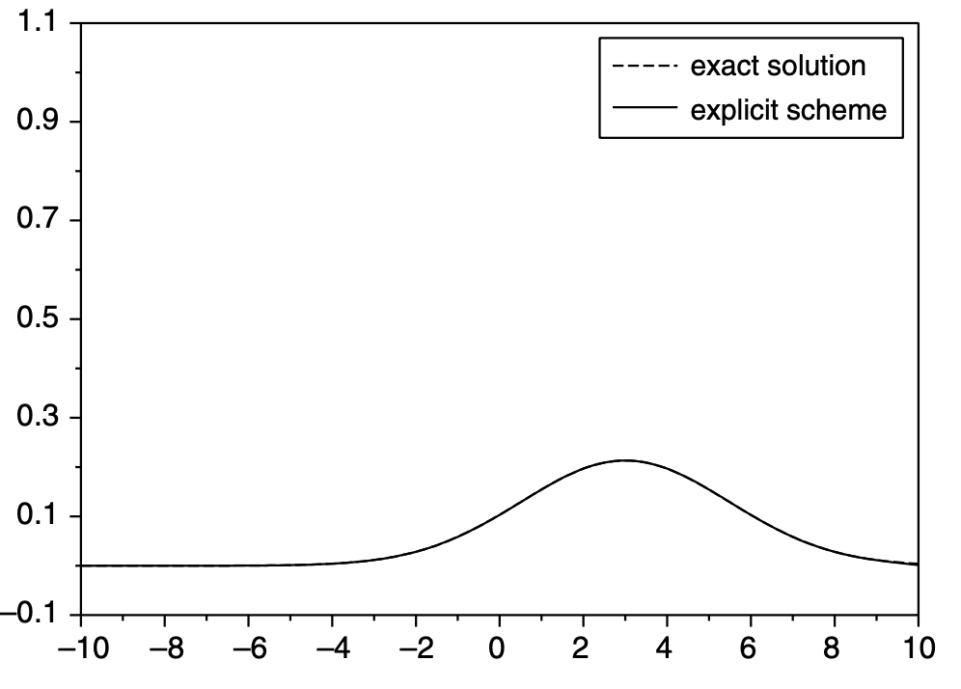
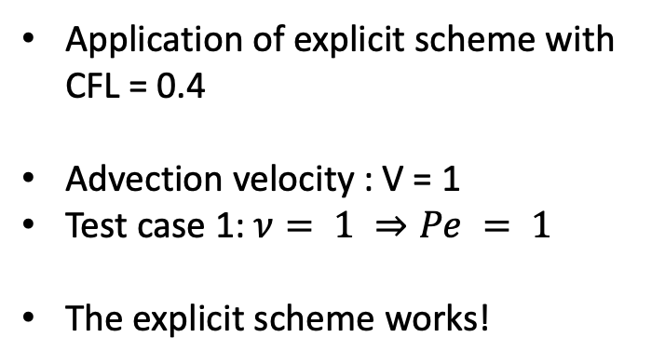
Advection-diffusion equation – test case 1
Application of explicit scheme with CFL = 0.4
Advection velocity : V = 1
Test case 1: $ν= 1 ⇒Pe = 1$
The explicit scheme works!

Slide 13
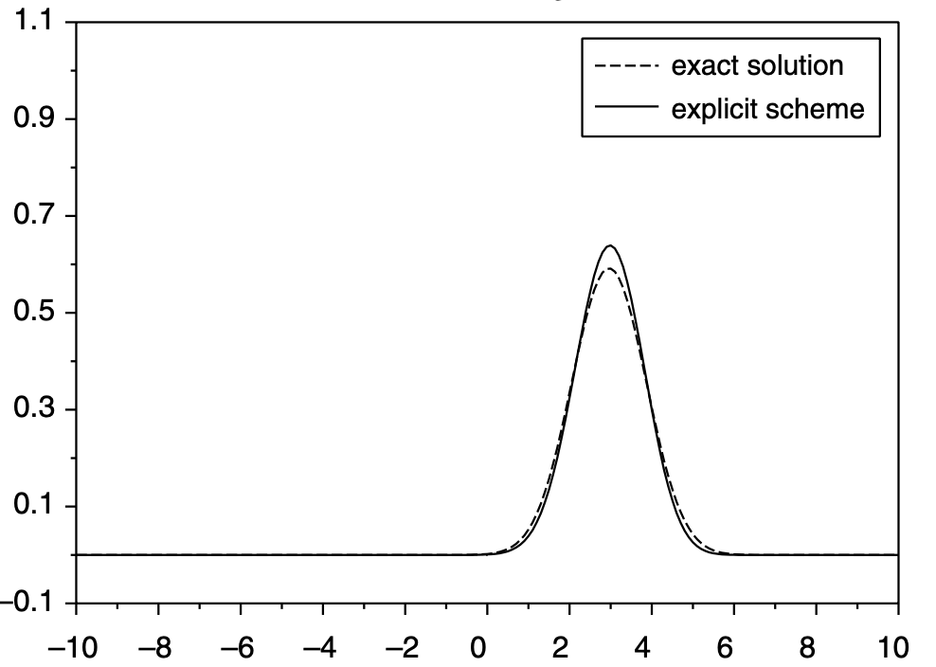
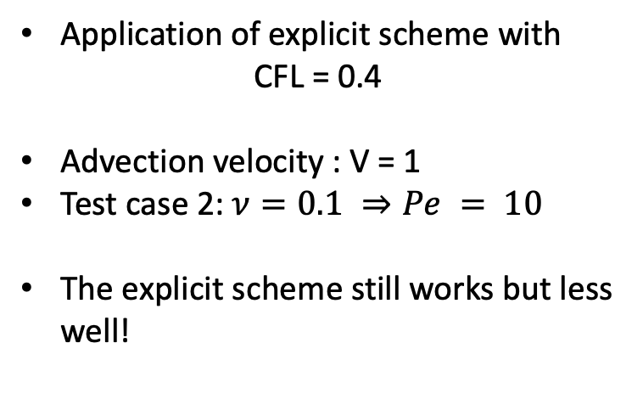
Advection-diffusion equation – test case 2
Application of explicit scheme with
CFL = 0.4
Advection velocity : V = 1
Test case 2: $ν=0.1 ⇒Pe = 10$
The explicit scheme still works but less well!

Slide 14
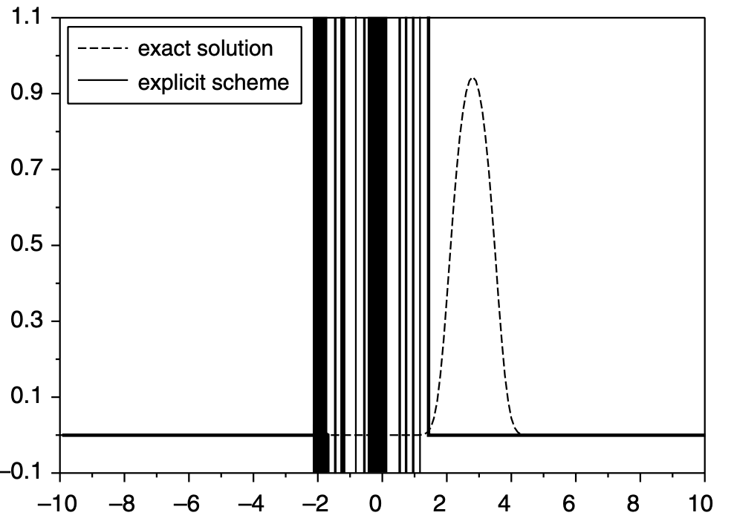
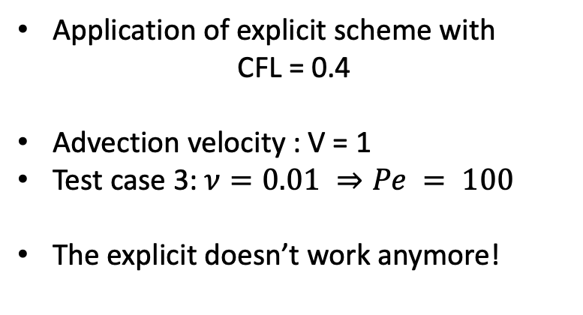
Advection-diffusion equation – test case 3
Application of explicit scheme with
CFL = 0.4
Advection velocity : V = 1
Test case 3: $ν=0.01 ⇒Pe = 100$
The explicit doesn’t work anymore!

Slide 15
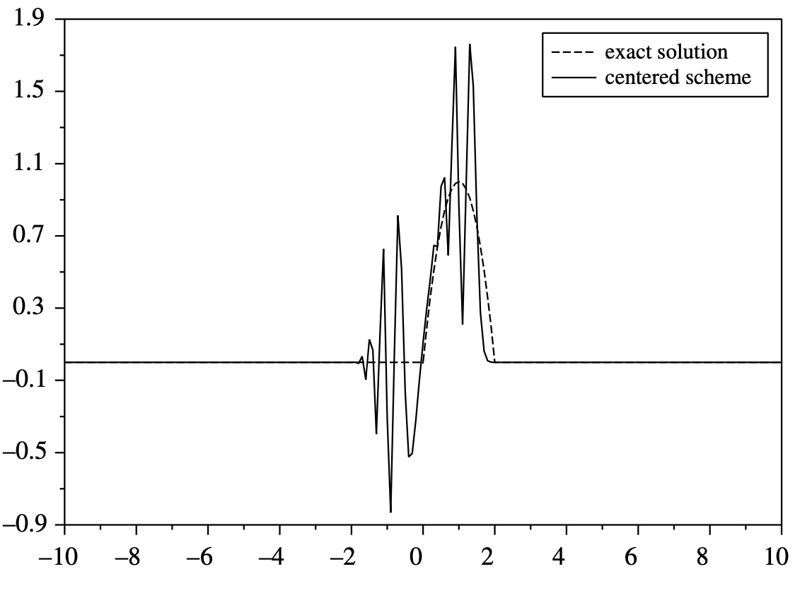
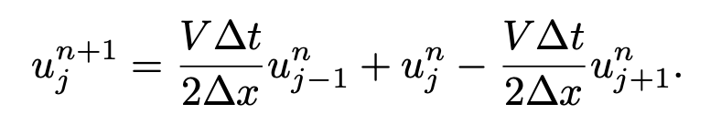

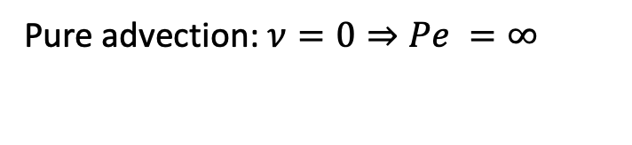
Explicit centred scheme – advection case
Pure advection: $ν=0⇒Pe =∞$
We see that $u_{j}^{n+1}$ cannot be a convex combination of $u_{j}^{n},u_{j−1}^{n}$, $u_{j+1}^{n}$ !

Slide 16
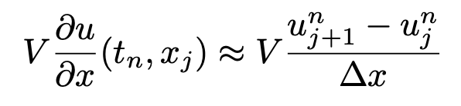
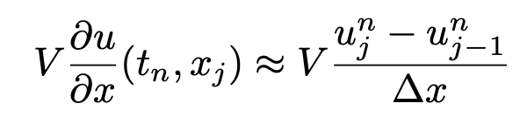
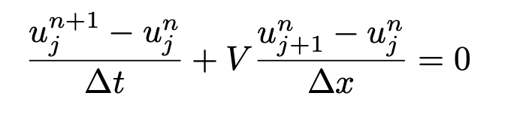
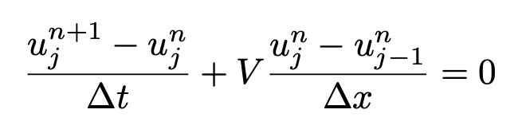
Downwiding vs. upwinding (V>0)
Centered schemes don’t work for pure advection problems!
Downwinding: find the information (to the right) following the current!
Upwinding: find the information (to the left) against the current!
BAD!
GOOD!

Slide 17
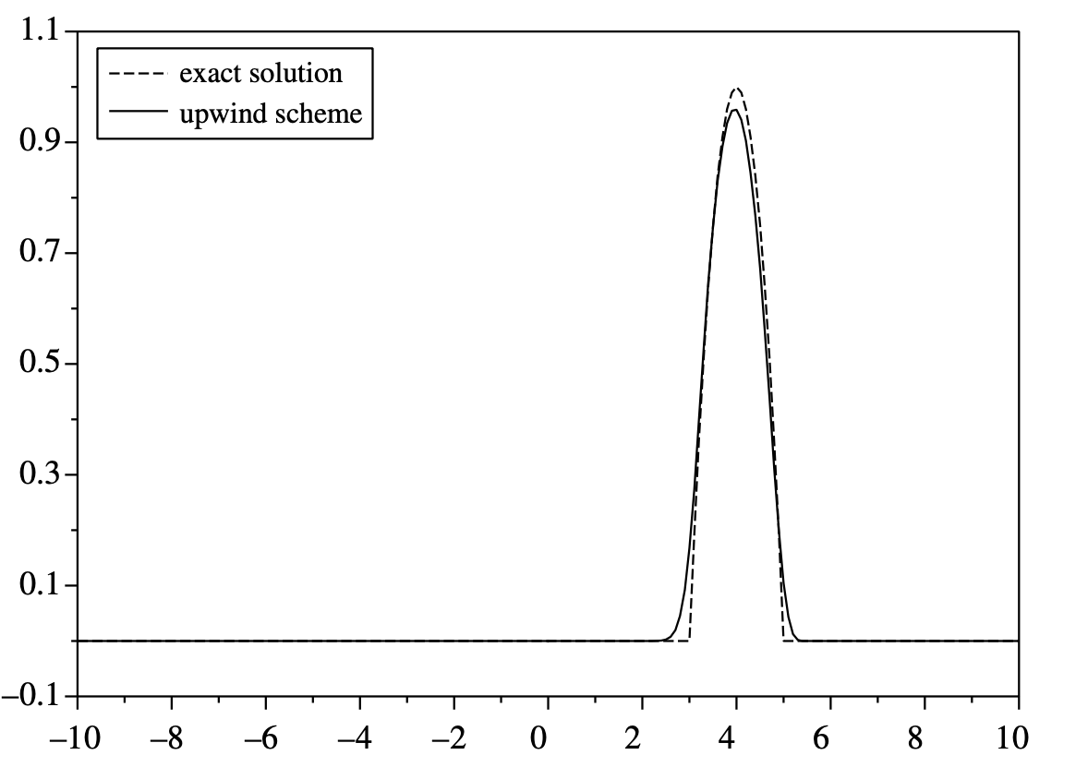
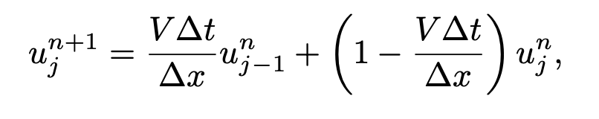

Upwind scheme - stability
The upwind scheme
Is a convex combination if
CFL = $\frac{VΔt}{Δx }≤1$
Test case with CFL = 0.9

Slide 18
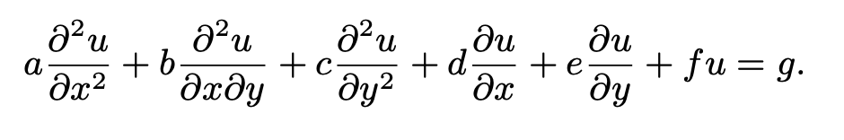

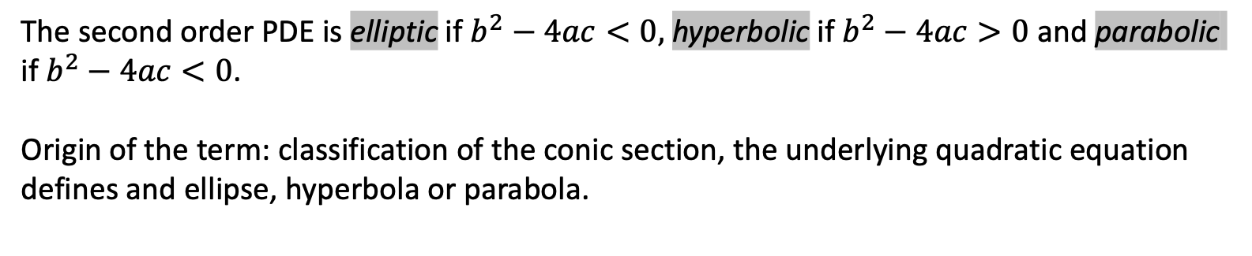
Classification of second order PDEs
General form of a second order partial differential equation (PDE)
The second order PDE is elliptic if $b^{2}−4ac<0,$ hyperbolic if $b^{2}−4ac>0$ and parabolic if $b^{2}−4ac<0$.
Origin of the term: classification of the conic section, the underlying quadratic equation defines and ellipse, hyperbola or parabola.

Slide 19
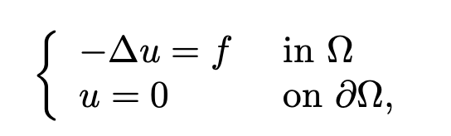
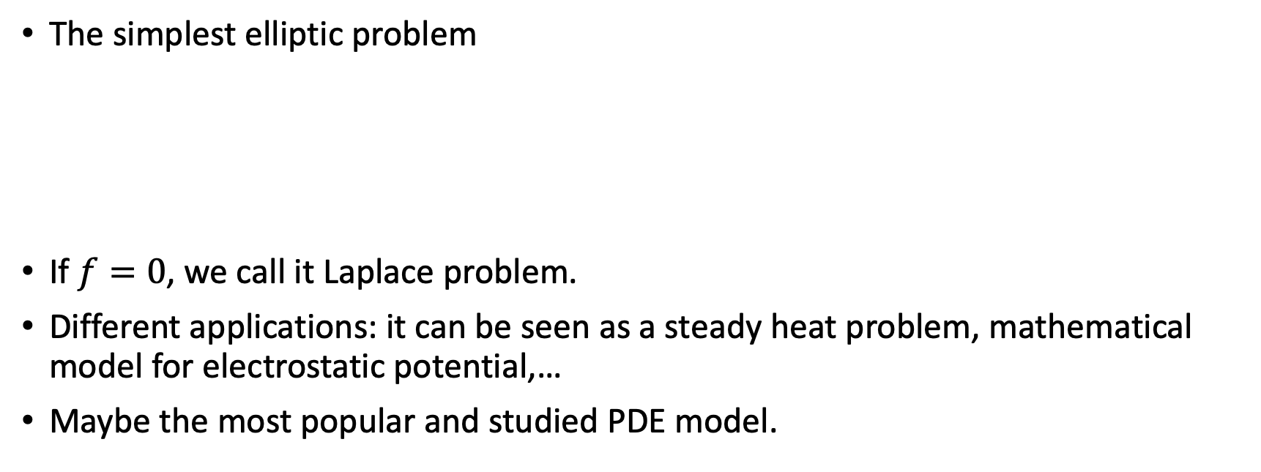
Elliptic problem – Poisson equation
The simplest elliptic problem
If $f=0$, we call it Laplace problem.
Different applications: it can be seen as a steady heat problem, mathematical model for electrostatic potential,…
Maybe the most popular and studied PDE model.

Slide 20
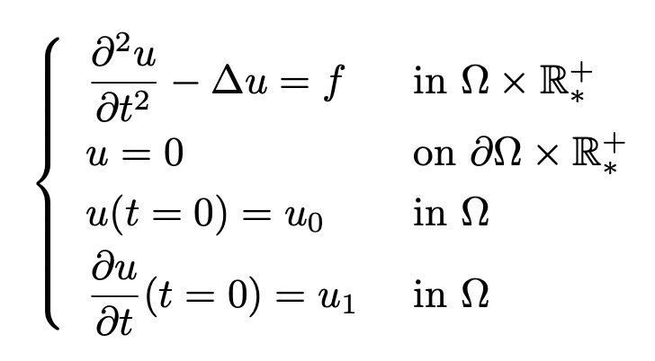
Hyperbolic problem – wave equation
Second order equation: we need 2 initial conditions!

Slide 21
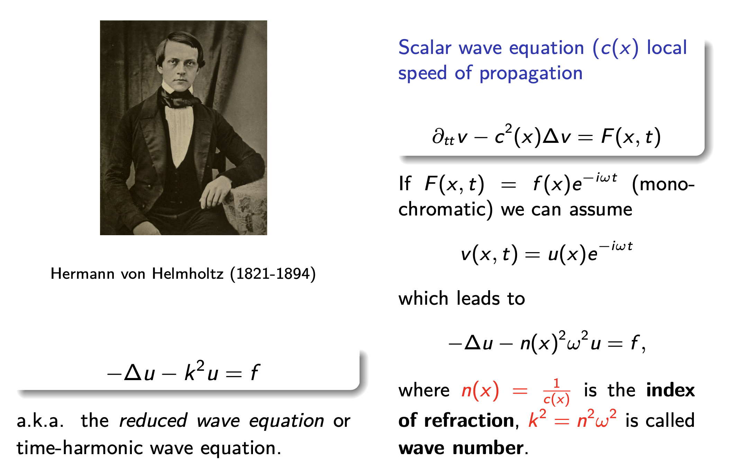
An elliptic indefinite problem: Helmholtz equation

Slide 22
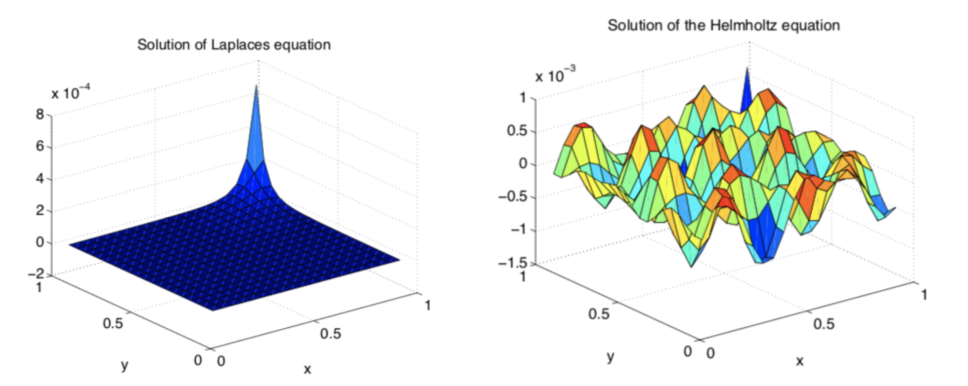
Laplace vs. Helmholtz equation
Elliptic problems can be very different in nature (positive definite or indefinite)

Slide 23
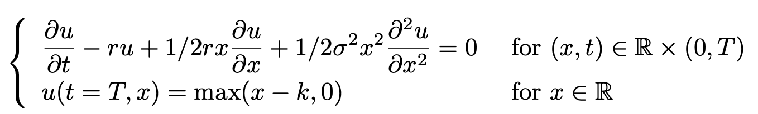
Parabolic problem – Black-Scholes equation
Very similar to the heat equation: Black-Scholes models the option pricing in finance
Parabolic equation with a final condition (instead of initial condition)

Slide 24
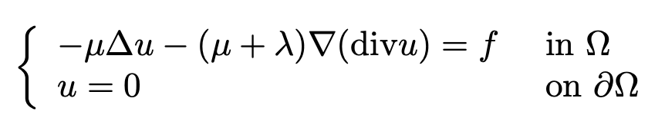
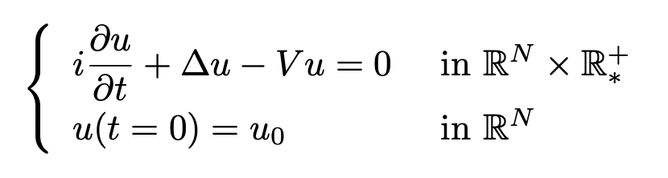
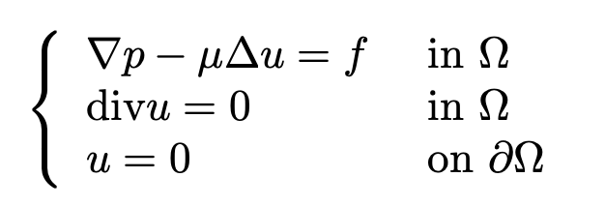
Other examples: advection, Euler, Navier-Stokes
Linear elasticity (Lamé system)
Schrodinger equation
(incompressible) Stokes equations

