Slide 1

REAL-TIME FACE ATTENDANCE SYSTEM
Group B4
Presented by Under the supervision of
G. Nikhil 245321748109 Mr. M. Manohar Rao
D. Vinay Kumar 245321748125
P. Adithya 245321748111

Slide 2
Introduction
Introducing the Real Time Face Attendance System, harnessing the remarkable one-shot learning capabilities of FaceNet. With unparalleled efficiency, our system streamlines attendance tracking for institutions by requiring just a single passport-sized photo per person for model training. This innovative approach not only ensures accuracy in face recognition but also offers a time-saving and convenient solution for educational and organizational settings.

Slide 3
Technology Stack
Open CV
Tkinter
Pillow
FaceNet
Haar Cascade Classifier
Keras
Tensorflow
Pandas
Numpy
Matplotlib

Slide 4
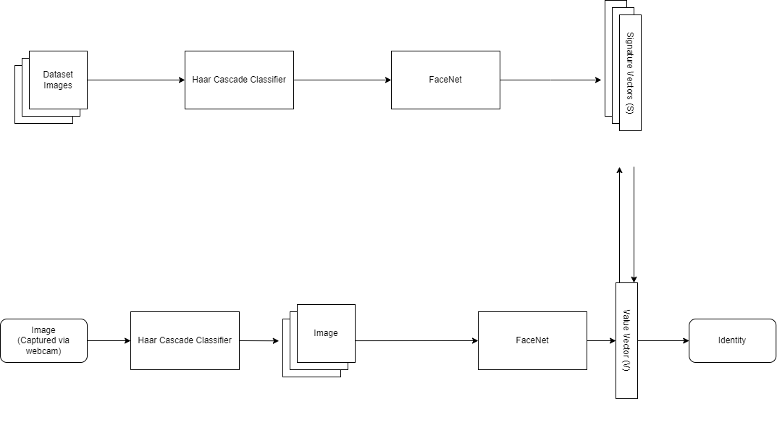
Project Workflow

Slide 5
FaceNet
One-Shot Learning: FaceNet excels in one-shot learning, allowing your system to effectively recognize faces with just a single example per person. This reduces the need for extensive training data and simplifies the onboarding process.
Embedding Generation: FaceNet generates high-dimensional face embeddings, representing unique features of each face in a compact vector space. These embeddings serve as effective descriptors for accurate face recognition.
Robust to Varied Conditions: FaceNet is robust to variations in lighting, pose, and facial expressions. This robustness ensures reliable performance in diverse environmental conditions, making it suitable for real-world applications.
Triplet Loss Function: The model employs a triplet loss function during training, which optimally positions face embeddings in a way that minimizes the intra-class distance and maximizes the inter-class distance, contributing to improved recognition accuracy.
Pre-Trained Models: Availability of pre-trained FaceNet models facilitates rapid implementation, enabling your project to leverage the benefits of state-of-the-art facial recognition without the need for extensive training infrastructure.

Slide 6
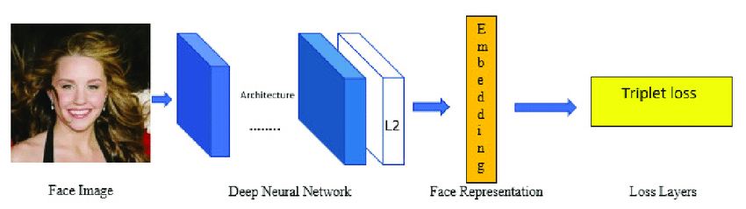

Slide 7
THANK YOU!

