Slide 1

31st Annual Student Research Conference (2023)
Analytical Predictive Modeling: Impact of Financial & Economic Indicators on JPMorgan Chase Stock
Presenter: Thao Pham | Faculty Sponsor: Dr. Emmanuel Thompson

Slide 2

TABLE OF CONTENTS
01
02
INTRODUCTION
METHODOLOGY
Research Context
Research Goal
Data Indicators and Description
Statistical Model Development
Model Evaluation
CONCLUSION
MODEL USEFULNESS
03
04
Research Conclusion
Future Work
Model Usefulness

Slide 3

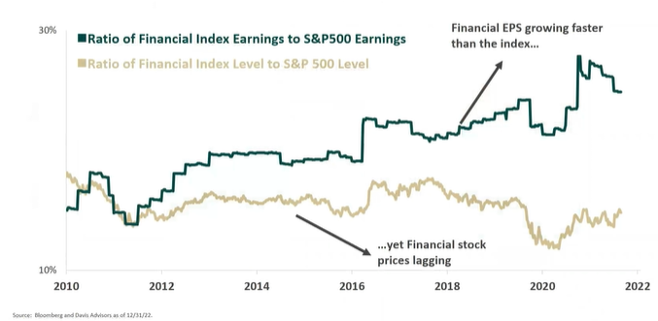

01. INTRODUCTION > Research Context > Research Goals
Keen on investing
in Financial Sectors?
No, thanksss
Source: Bloomberg and Davis Advisors as of 12/31/22
Okee, let’s seee

Slide 4
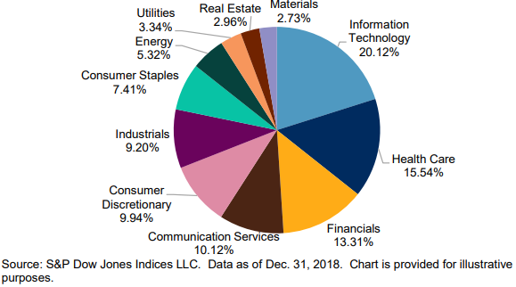
01. INTRODUCTION > Context > Research Goals
S&P 500 is a stock market index that is a widely recognized gauge for US equity markets
Financials Sector is the 3rd largest sector of S&P 500,
with four big players: JPMorgan Chase, Bank of America, Citigroup, and Wells Fargo
Goal: develop a predictive model for JPMorgan Chase's stock price &
identify critical investment indicators for potential investors in financial sector

Slide 5




02. METHODOLOGY > Data Description > Model Development > Model Evaluation
Quarterly data collection from Jan 1st, 2010 to Dec 31st, 2022 of:
S&P500 index (SP500)
JPMorgan Chase’s stock price (JPM)
US 3-month treasury bills (US3M)
6 financial & 4 economic indicators
Data sources:
 | Indicators | Description
Financial | Beta | Measure the volatility of a stock compared to the market (S&P500)
 | Free Cashflow/Share (FCF/Share) | Measure a company's financial flexibility
 | Price-to-Book Ratio (PB) | Evaluate the market's valuation of a company relative to its actual worth
 | Price-Earning Ratio (PE) | Measure the current price per share of a stock in relation to its earnings per share
 | Price-Earning-Growth Ratio (PEG) | Measure the stock's P/E ratio divided by the growth rate of its earnings
 | Dividend Yield | Measures % of a company's share price paid out in dividends per year
Economic | Interest Rate | The US Federal Fund Rate
 | US Consumer Price Index (CPI) | Measure inflation
 | US Personal Saving Rate (PSR) | Measure how much of income people are saving
 | US Gross Domestic Product (GDP) | Measure monetary value of all finished goods and services made in a country during specific period
Source: (Interest rate statistics 2022),
(Pokharel et al., 2022)

Slide 6

02. METHODOLOGY > Data Description > Model Development > Model Evaluation
Step 1: Define the model
The statistical model that predicts a Quarterly Closing Price (QCP) based on
all significant indicators & their interactions:
Source: (Pokharel et al., 2022)
intercept
indicator
Interaction term
residual error
Coefficient: shows strength of relationship
between QCP and predictor variables

Slide 7
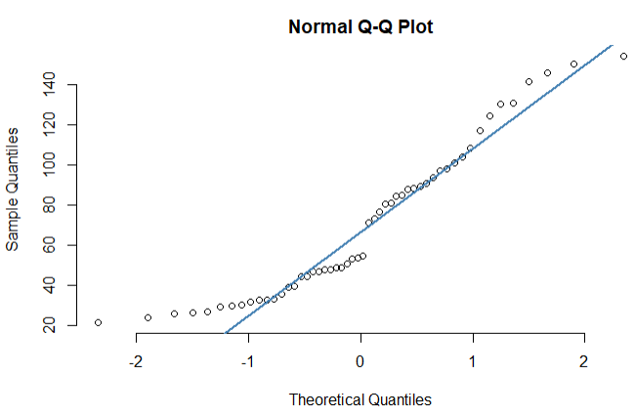
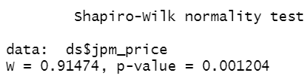
02. METHODOLOGY > Data Description > Model Development > Model Evaluation
Step 2: Check model assumption - Normal Distribution
The deviation from normality in Q-Q plot &
p-value < 0.05 at a 5% level of significance
indicates that QCP does not follow a Normal Distribution

Slide 8

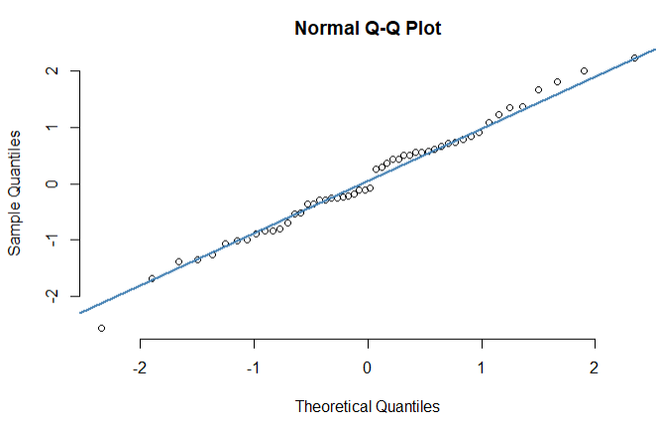
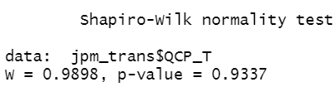
02. METHODOLOGY > Data Description > Model Development > Model Evaluation
Step 3: Apply Johnson Transformation to make data normal distributed
(Source: Pannell, 2023)
Original Data of JPM Stock Price
Transformed Data of JPM Stock Price
Johnson
Transformation
Mini Tab Software
DATA NOW IS NORMALLY DISTRIBUTED!!!

Slide 9
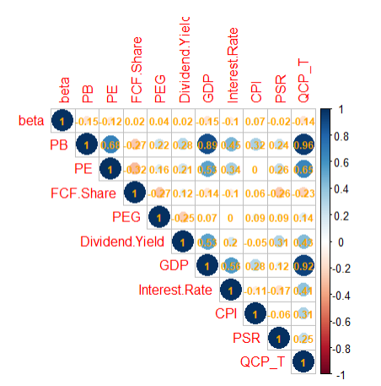
02. METHODOLOGY > Data Description > Model Development > Model Evaluation
Step 4: Check data multicollinearity
Variance Inflation Factor (VIF)
VIF > 10 indicates that the dataset has multicollinearity effect among
the attributable indicators.
Correlation matrix

Slide 10
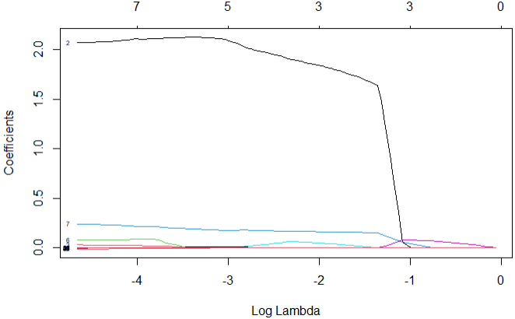
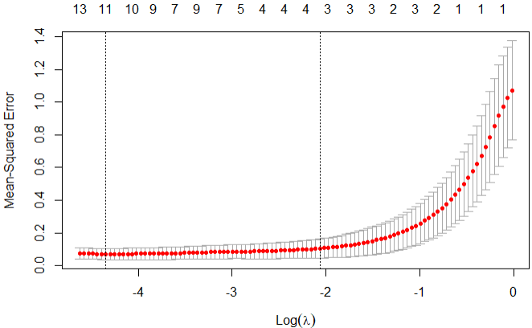
02. METHODOLOGY > Data Description > Model Development > Model Evaluation
Step 5: Splitting 80% training & 20% testing dataset for LASSO regression model
Source: (5.4 - the lasso: Stat 508)
LASSO (Least Absolute Shrinkage and Selection Operator) regression or L1 regularization technique shrinks the coefficients of the less important features towards zero to effectively remove irrelevant features
-> a simple and more interpretable model.
Graph of optimized λ value using cross-validation
“Coefficient shrinkage” via L1 Regularization

Slide 11
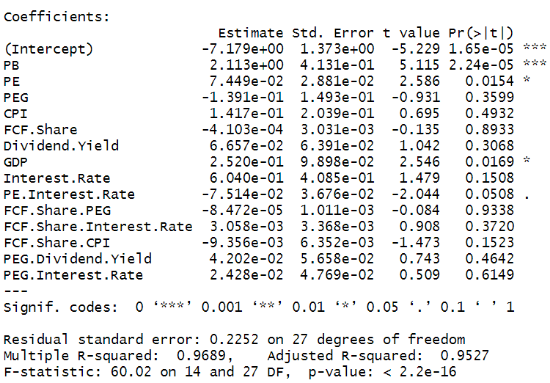
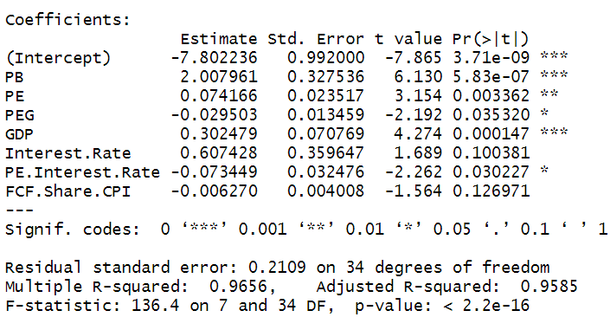
02. METHODOLOGY > Data Description > Model Development > Model Evaluation
Step 6: Backward Elimination
Backward Elimination refines feature selection to improve model interpretability.
This technique iteratively removes the least significant feature until reaching a stopping criterition. After it, 7 most important variables are picked out:
Among total 56 indicators and their two-way interactions, LASSO model keeps 14 important left:
Source: Padhma, M. (2022

Slide 12


02. METHODOLOGY > Data Description > Model Development > Model Evaluation
Step 7: Fit the model
Apply anti Johnson Transformation to estimate the desired prediction of Quarterly Closing Price of JPM stock:

Slide 13
02. METHODOLOGY > Data Description > Model Development > Model Evaluation
Evaluate the quality of the proposed model based on model performance and assumptions.
Performance Metrics | Score (Training Dataset) | Score (Testing Dataset)
R² | 96.56% | ------
R²_{adj} | 95.85% | ------
Root Mean Square Error | 0.1956403 | 0.1583031
Relative Root Mean Square Error | 4.284729 | 5.137496
Mean Absolute Percentage Error | 22.59932 | 32.46499
Mean of Residuals | -7.106606e-18 | ------
Sum of Residuals | -2.983724e-16 | ------

Slide 14
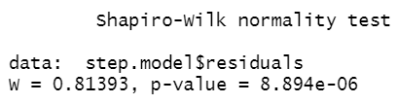

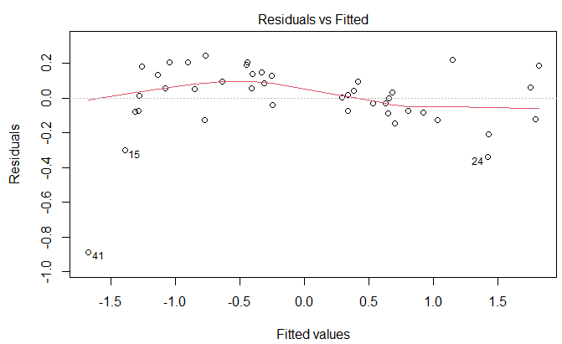
02. METHODOLOGY > Data Description > Model Development > Model Evaluation
Evaluate the quality of the proposed model based on model performance and assumptions.
Assumptions | Checking | Satisfy or not?
Normality of Residuals |  | No
Autocorrelation |  | Yes
Homoscedasticity |  | Yes

Slide 15



03. CONCLUSION > Research Conclusion > Future Work
Proposed model is significant for finance and economics
Price-to-Book ratio, Price-Earning, Price-Earning-Growth, GDP, Interest Rate, PE: Interest Rate, Free Cash Flow/Share: CPI are the most significant indicators for Quarterly Closing Price
95.85% of the variation in QCP can be explained by the 7 most significant indicators from the final model

Slide 16

03. CONCLUSION > Research Conclusion > Future Work
Try another regression (such as L2 or Elastic Net Regularization) for important feature selections
Try larger amount of dataset such as weekly or monthly data frequency
Research more indicators that may affect the stock price

Slide 17

04. MODEL USEFULNESS
Observe the change in key economic and financial indicators on QCP to estimate the change in stock price to determine optimal buying/selling time.

Slide 18
Reference
1.Funds, D. (n.d.). Selected funds. Why Select Banks are Undervalued Today - Selected Funds. Retrieved March 31, 2023, from https://selectedfunds.com/document/video/select-banks-today/
2. McCain, A. (2023, March 14). 25+ trending financial services industry statistics [2023]: How many jobs are available in finance. Zippia 25+ Trending Financial Services Industry Statistics 2023 How Many Jobs Are Available In Finance Comments. Retrieved March 31, 2023, from https://www.zippia.com/advice/financial-services-industry-statistics/
3. Pokharel, J. K., Tetteh-Bator, E., & Tsokos, C. P. (2022). Analytical predictive modeling: Impact of financial and economic indicators on stock. Journal of Mathematical Finance, 12(04), 661–682. https://doi.org/10.4236/jmf.2022.124035
4. 5.4 - the lasso: Stat 508. PennState: Statistics Online Courses. (n.d.). Retrieved April 19, 2023, from https://online.stat.psu.edu/stat508/lesson/5/5.4
5. Pannell, R. (2023, February 10). What is the johnson transformation? LeanScape. Retrieved April 19, 2023, from https://leanscape.io/what-is-the-johnson-transformation/
6. Padhma, M. (2022, September 22) End-to-End Introduction to Evaluating Regression Models. https://www.analyticsvidhya.com/blog/2021/10/evaluation-metric-for-regression-models
7. CFI Team (2022, May 6) Autocorrelation. https://corporatefinanceinstitute.com/resources/knowledge/other/autocorrelation
8. Interest rate statistics. U.S. Department of the Treasury. (2022, October 11). Retrieved April 19, 2023, from https://home.treasury.gov/policy-issues/financing-the-government/interest-rate-statistics

Slide 19

THANK YOU FOR
YOUR ATTENTION

