Slide 1
Point Groups
Patrick, Alex, Katherine

Slide 2
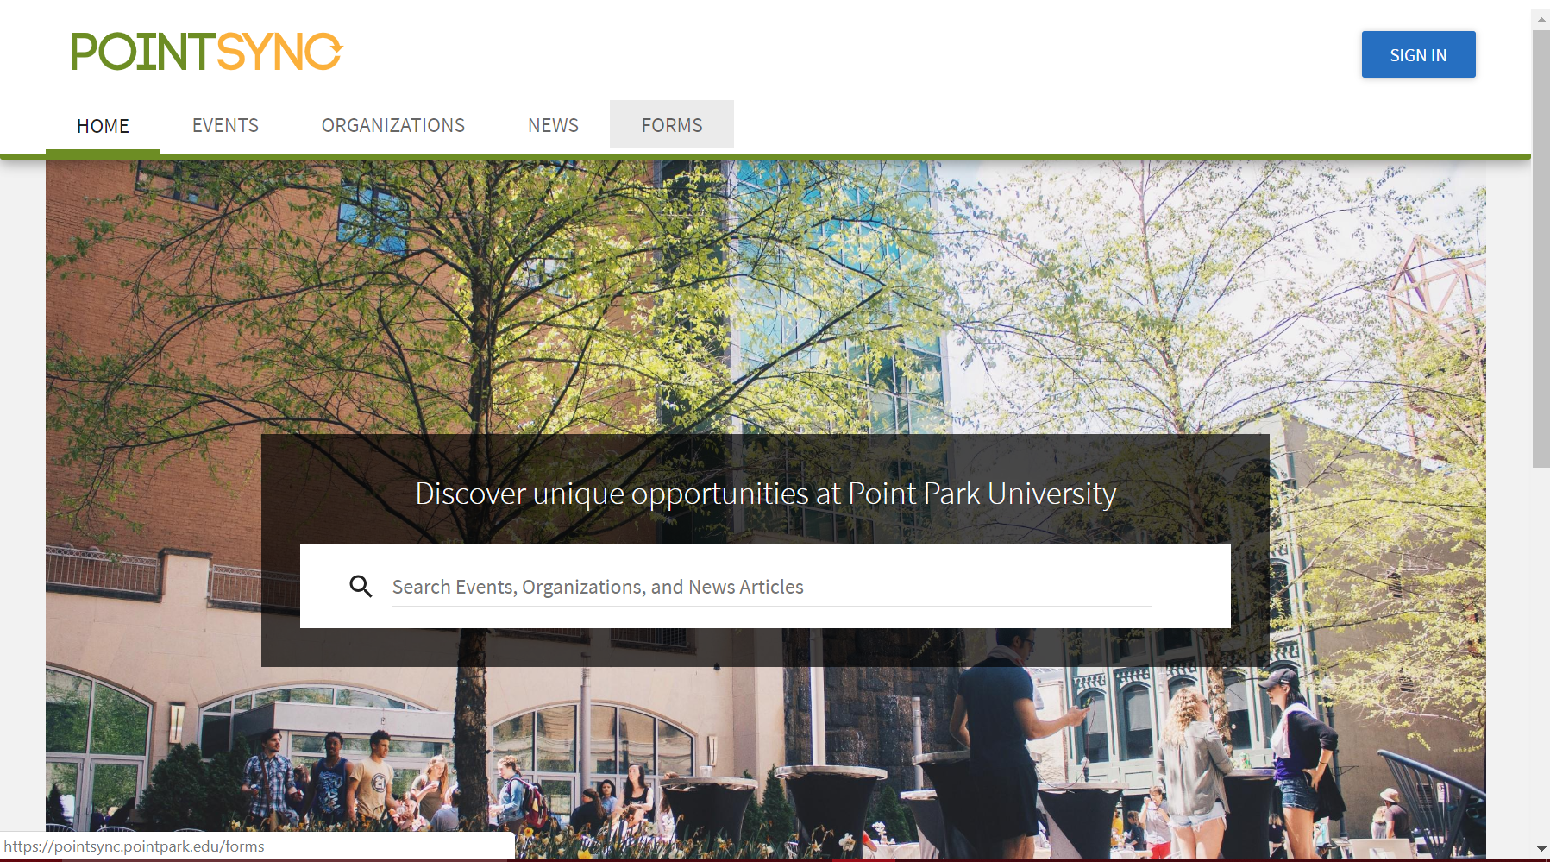
What’s the purpose
Replace the application that Point Park is already using called PointSync

Slide 3
Why do you need this
In source
User friendly
Students won’t always complain about it
Can always be updated.

Slide 4
How does this work
Login with point park credentials
Or create an account
Create groups to easily manage
Create events

Slide 5
Upcoming features
Messaging with Twillio
Interacting with group members
Interacting with google calendar
Expanding to more universities
Hopefully one day into the business world
Reddit type forum for each club

