Slide 1
Point Groups
Patrick Nucci, Alex McMahon, Kat Sullivan

Slide 2
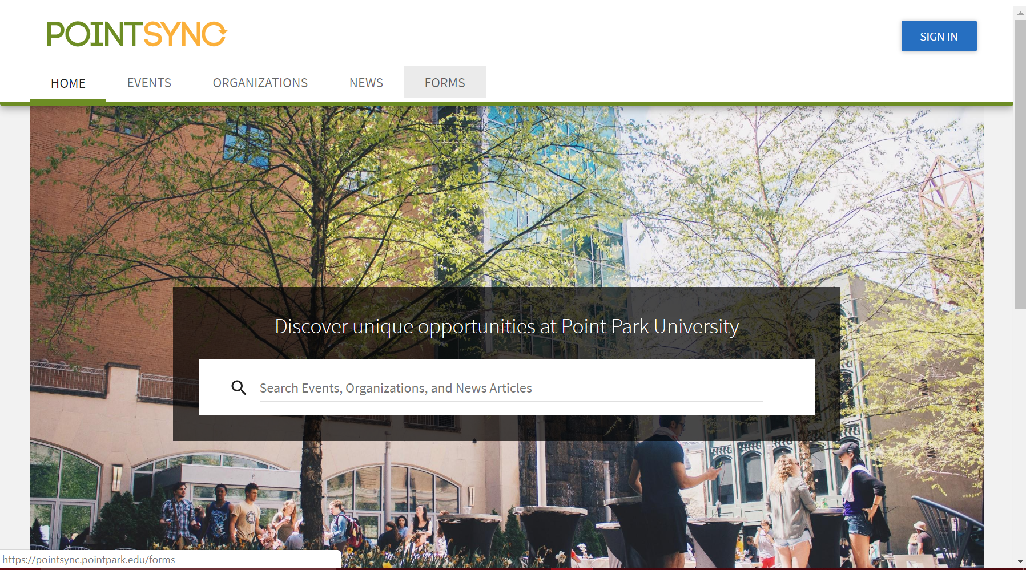
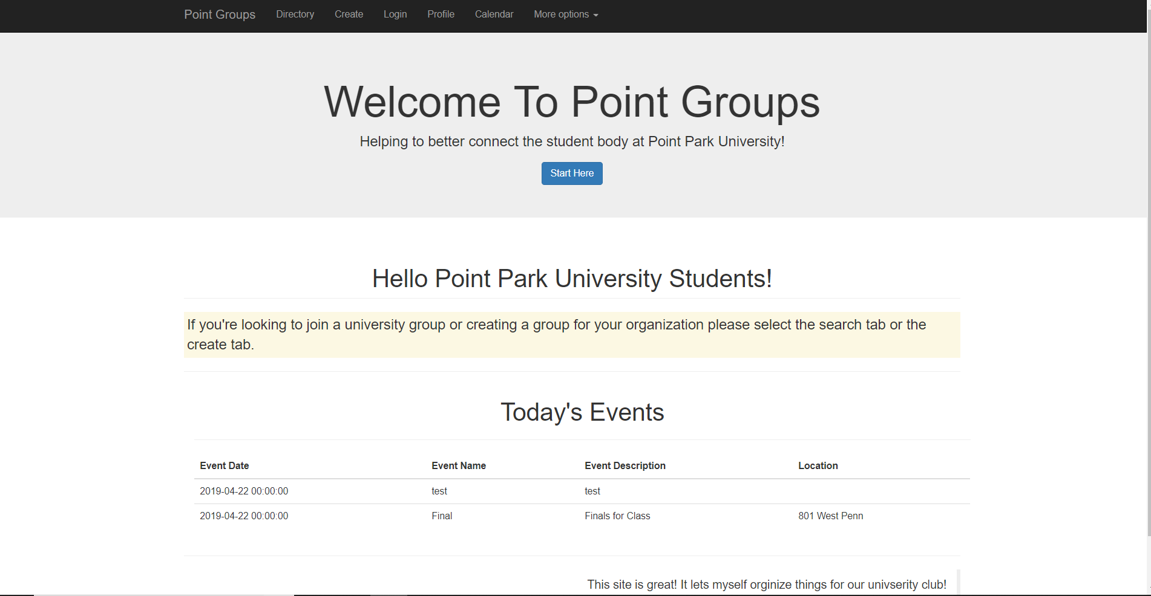
What’s the purpose
Replace the application that Point Park is already using called PointSync

Slide 3
Why do you need this
User friendly
Student complaints can be handled easier and faster
Can always be updated more often and more quickly add features
Open Source

Slide 4
How does this work
Login with point park credentials or create an account*
Create groups to easily manage
Create events
*future feature

Slide 5
Upcoming features
Messaging with Twillio
Interacting with group members
Interacting with google calendar
Expanding to more universities
Hopefully one day into the business world
Reddit type forum for each club

