Slide 1
Development of an AI Model for Glaucoma Detection through Segmentation
Team EPA (No. 40):
배민준 - 201924487
Bagheri Mahboubeh - 202155549
Calderoni Echeverri Aldo Sigfrido - 202155546
Professor: 황원주

Slide 2
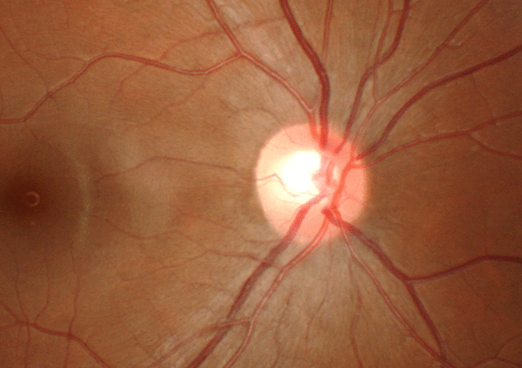
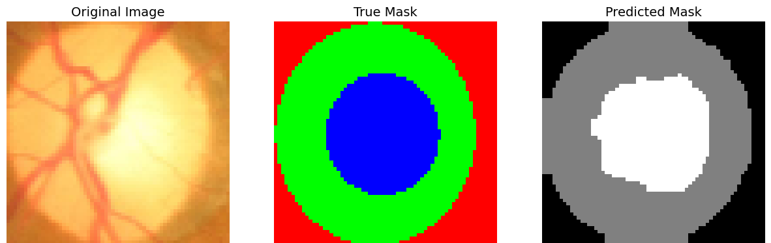
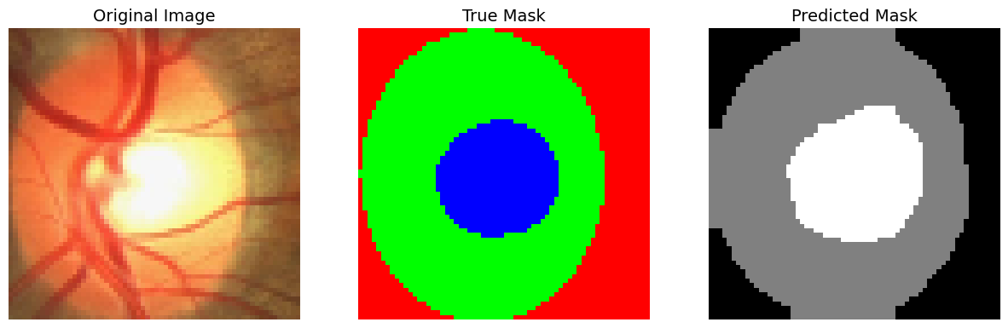
Background and Objective
Glaucoma is a chronic ophthalmology disease caused by damage to the optic nerve, which can lead to permanent blindness. As one of the primary causes of blindness in developed countries, it can result in irreversible vision impairment if not diagnosed and treated early.
Automated segmentation of the optic disc and cup enables rapid and accurate assessment of CDR (Cup to Disc Ratio), which is a critical parameter in glaucoma diagnosis.
The primary objective of this research was to develop an effective and reliable system for detecting glaucoma through image segmentation techniques. The model’s performance was assessed using standard evaluation metrics such as Dice Coefficient, Intersection over Union (IoU), and Accuracy.

Slide 3
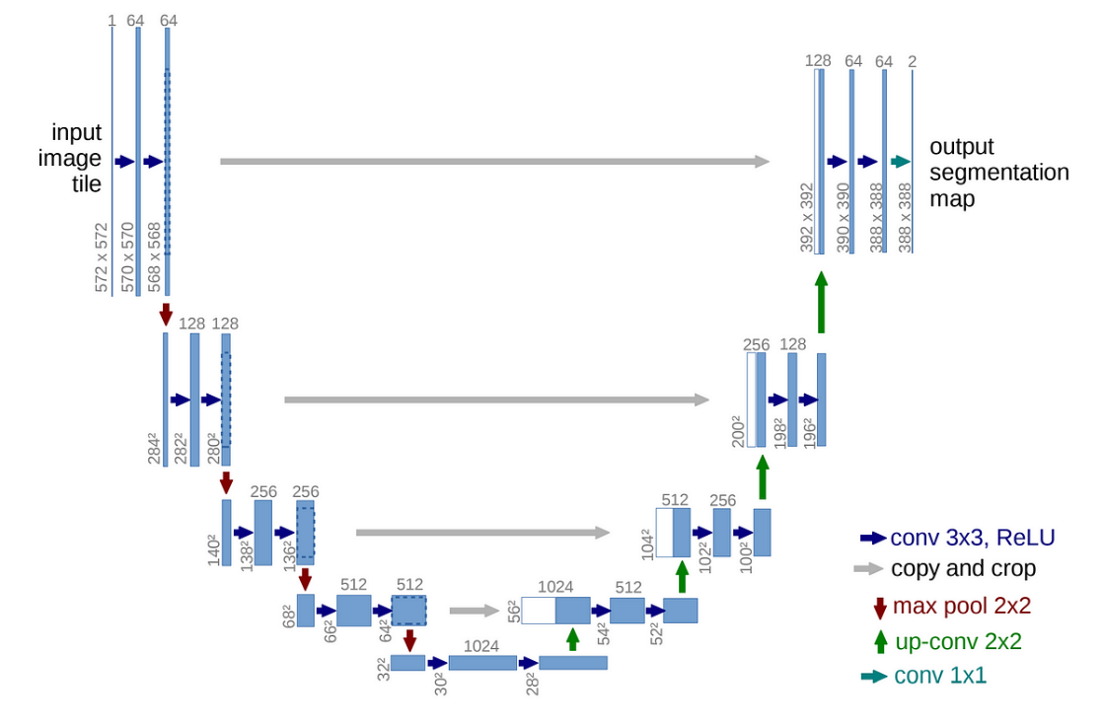
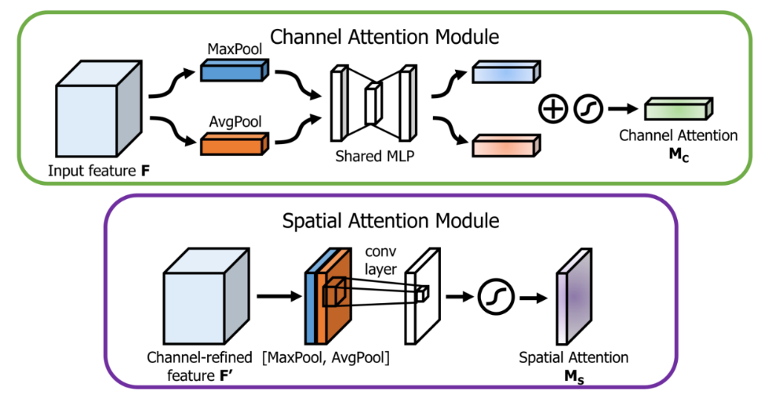
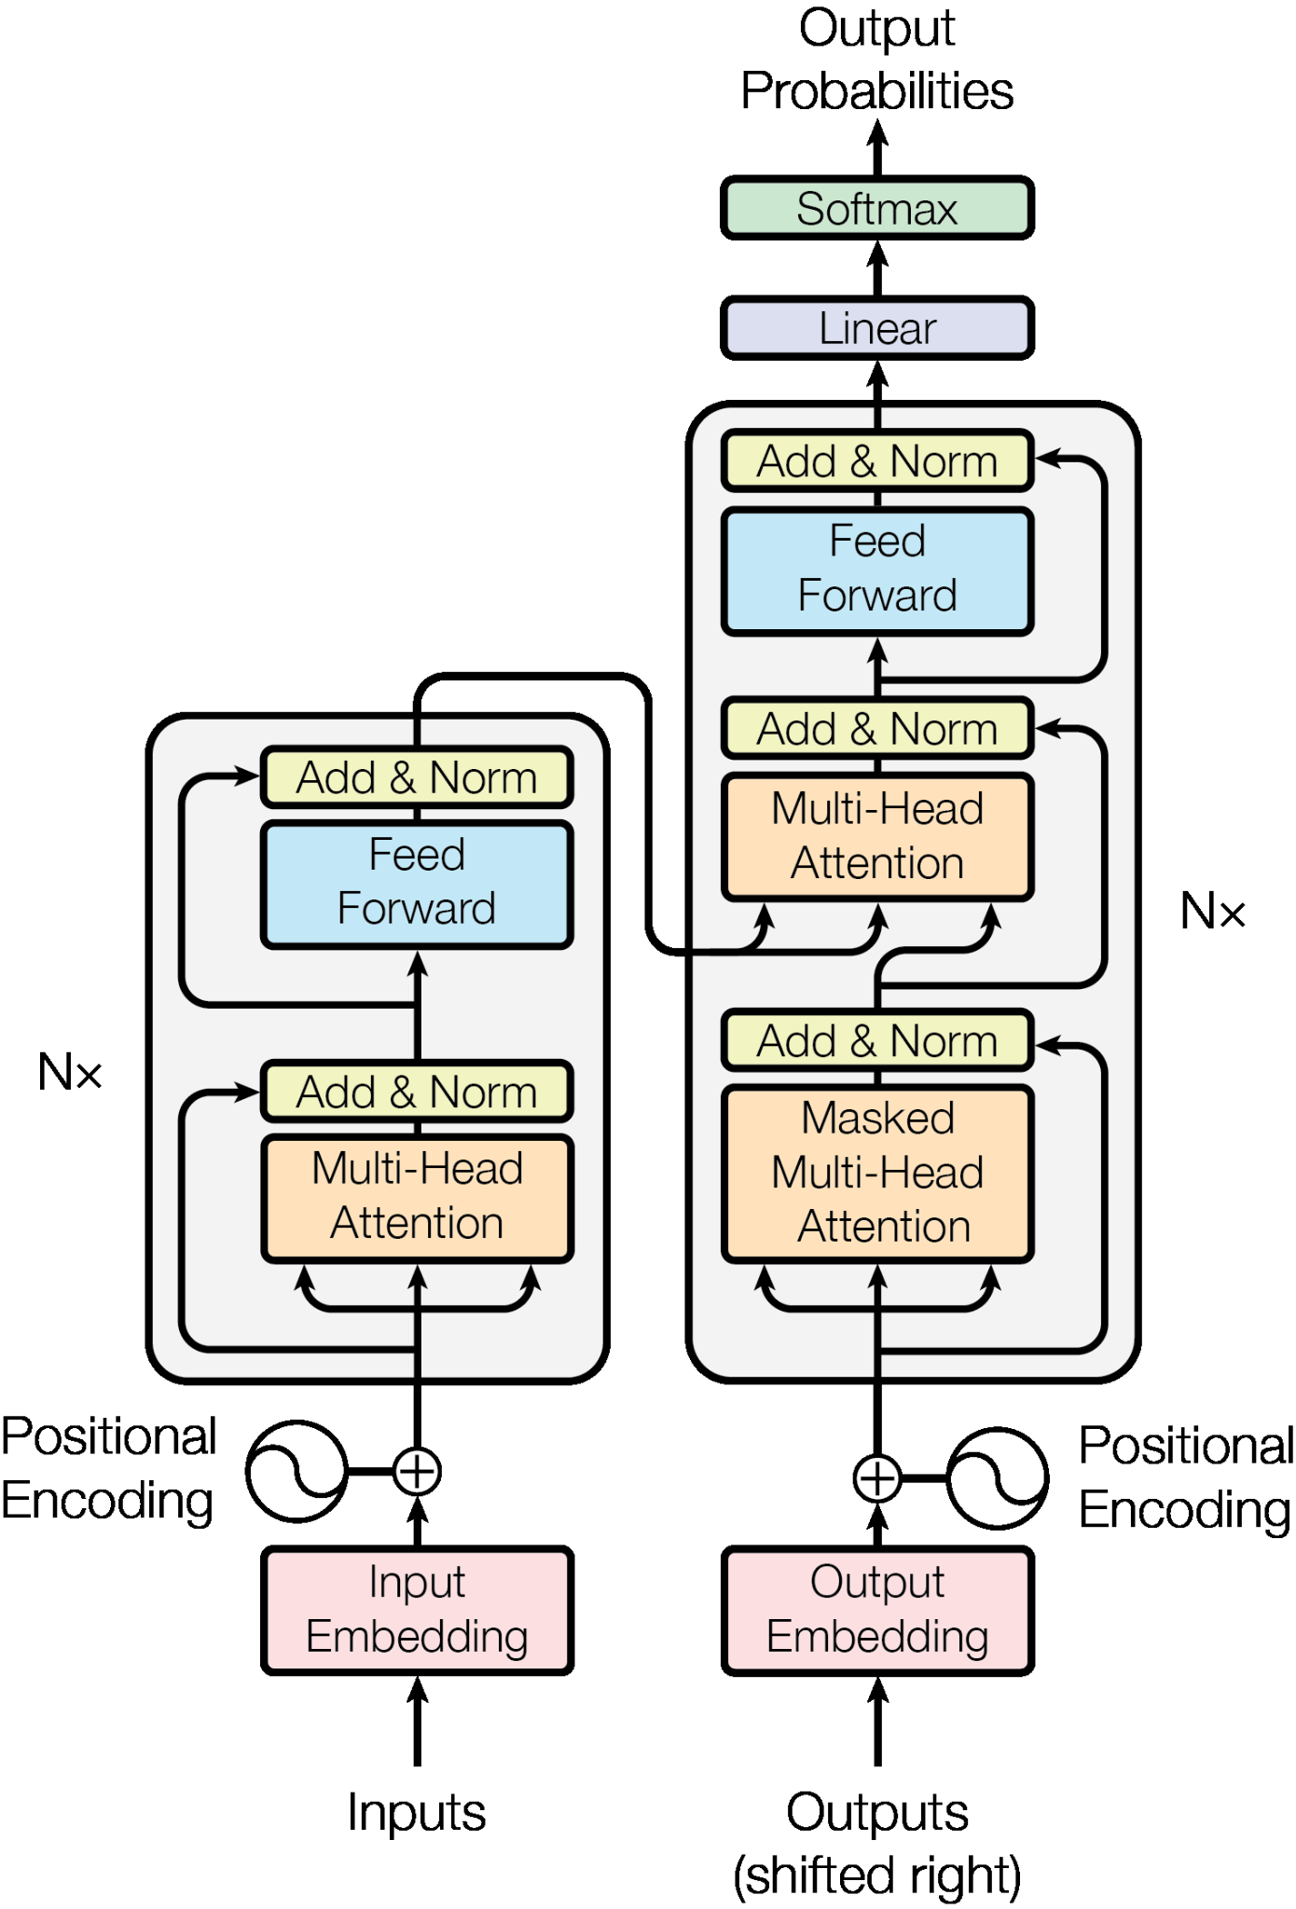
EPA’s Segmentation Model Architecture
It combines several advanced techniques:
U-Net (base model)
CBAM (Convolutional Block Attention Module)
DC Block (Dual Channel Blocks)
Transformer Block

Slide 4
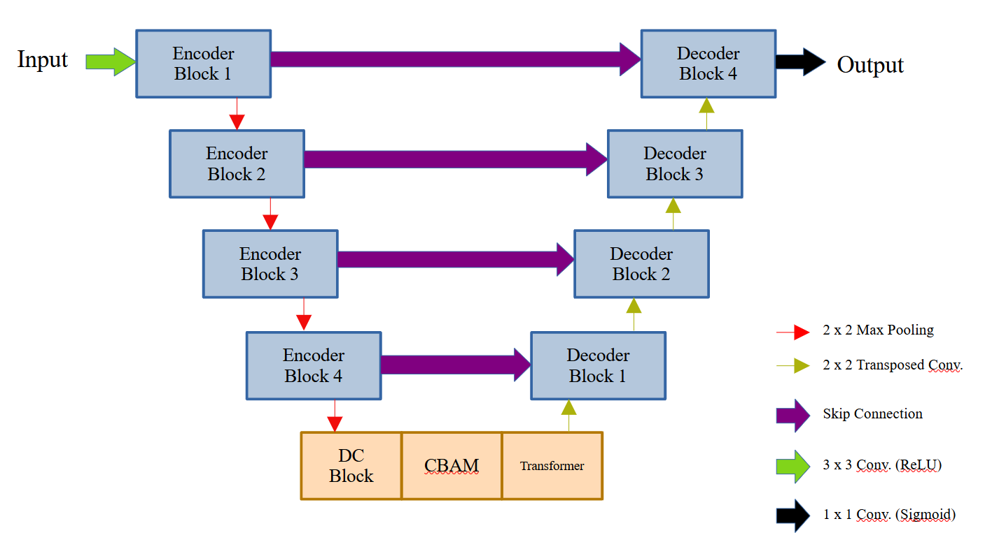
EPA’s Segmentation Model Architecture
The decision of selecting this methods was made after consulting in several papers what the best tools for medical segmentation were, a research that led us to the new hypothesis that their combination could bring a better solution for this task. Here we attach an image that displays a basic architecture of our model:

Slide 5
Function of Each Tool
U-Net: Convolutional neural network architecture designed specifically for medical image segmentation tasks. The U-Net architecture follows a symmetric encoder-decoder structure; its encoder uses successive layers of convolution, max pooling, and non-linear activation functions, whereas its decoder reconstructs the segmentation map by up-sampling the feature maps and combining them with high-resolution features from the encoder through skip connections.
DC-Block: Combines dense connectivity with the U-Net encoder-decoder design, allowing for efficient feature reuse and precise region identification, particularly beneficial for limited datasets.
CBAM: Convolutional Block Attention Module is an efficient attention mechanism used in convolutional neural networks (CNNs) to enhance model performance by focusing on the most important features within the data. CBAM applies attention to both the channel and spatial dimensions of feature maps.
Transformer: Transformers use a self-attention mechanism that processes all input tokens simultaneously, enabling greater parallelization.

Slide 6
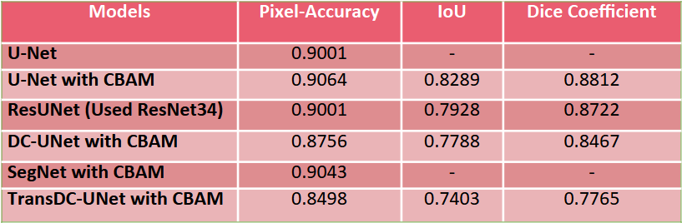
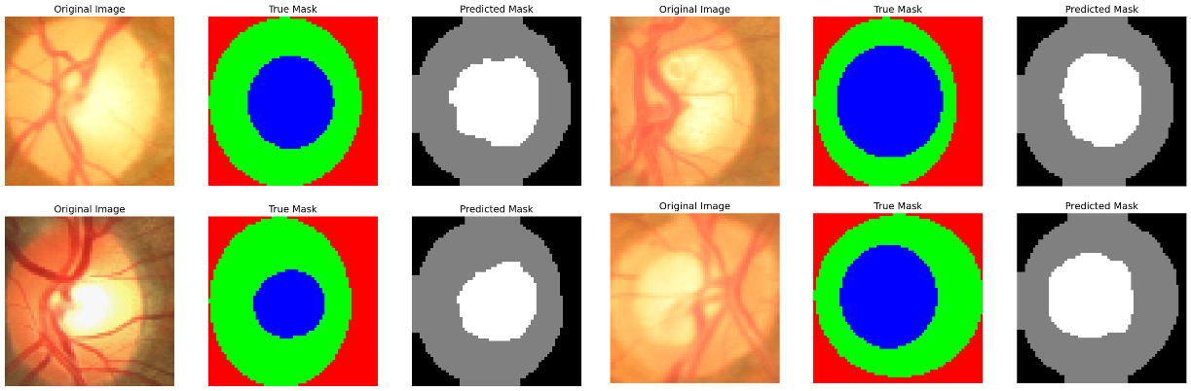
Comparison and Results
Although the performance of our model was lower than expected in terms of accuracy, we emphasize that the goal of this project was not merely to surpass U-Net in accuracy but to introduce ingenuity through the integration of state-of-the-art techniques such as CBAM, transformer blocks, and DC-UNet. The novelty of our approach lies in combining these elements, which, despite not yielding higher accuracy in this iteration, opens up new avenues for future refinement and optimization.

Slide 7
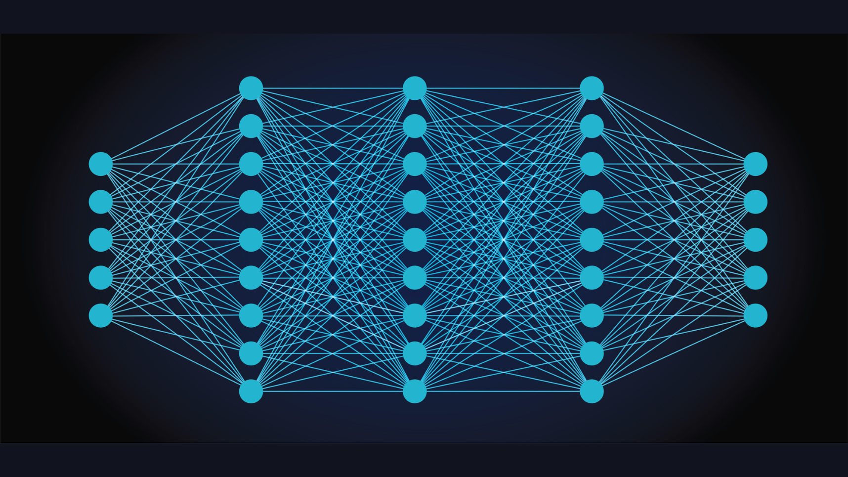
Conclusion
As a summary of our model, the integration of CBAM allowed the model to focus on the most informative regions of the image by enhancing the attention mechanism both spatially and channel-wise. Similarly, the inclusion of transformer blocks facilitated the capture of long-range dependencies within the data, which is crucial in medical image analysis. Additionally, the DC-UNet structure provided the benefits of dense connections, and this enabled feature reuse and more effective learning, especially with limited datasets.
Future work can build on this foundation to optimize the model further and explore its applications in different medical domains.

Slide 8


