Slide 1
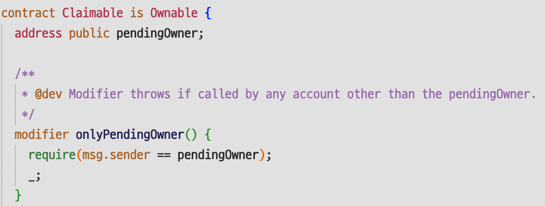
Solidity Code
Compile
Binary Code
Convert
Image

