Slide 1
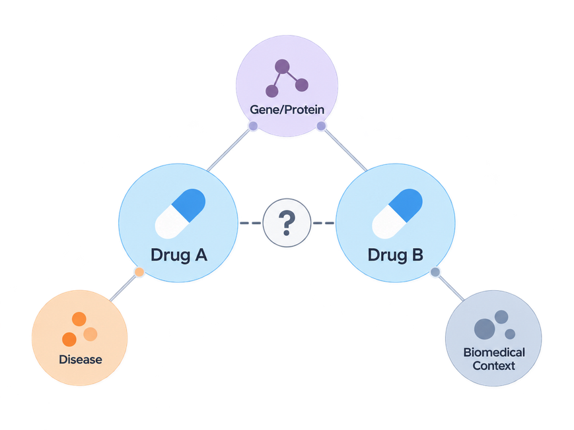
What Biomedical Information Helps Predict Drug Interactions?
Effect of Biomedical Knowledge Graph Composition on
R-GCN-Based Drug–Drug Interaction Prediction
Team CHEERS
Pusan National University
BYAMBASUREN TUVSHINJARGAL
GALBADRAKH BUYANDELGER
BAVUUJAV DELGERBAYAR

Slide 2
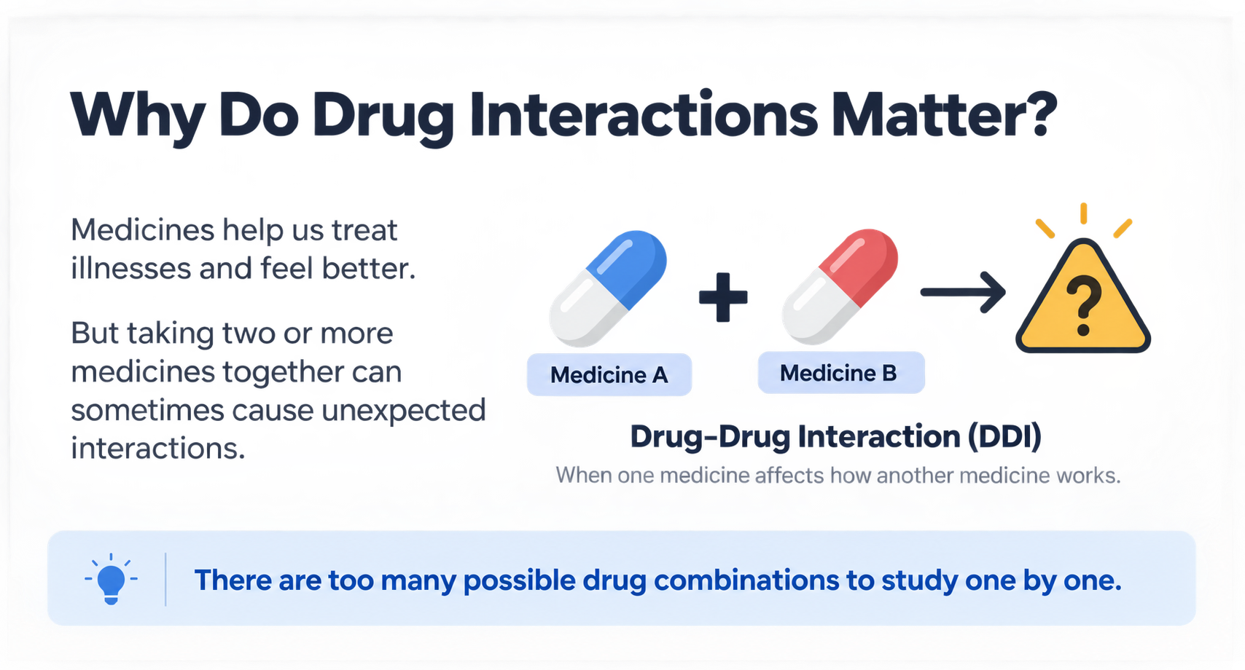

Slide 3




Our Research Question
Our Approach
The Problem
Compare four knowledge graphs while keeping the same model and evaluation setup.
Drug interactions are difficult to study because biomedical knowledge is large and incomplete.
Our Question
Our Goal
What kind of biomedical information helps improve drug–drug interaction prediction?
Measure whether gene/protein and disease context help the AI rank possible DDI links.

Slide 4
Study Setup
1.34M
4,278
4
5
  DDI Pairs
  Candidate Drugs
  Graph Variants
  Training Seeds
1,336,314 unique undirected drug–drug interaction pairs from PrimeKG.
The same candidate-drug population is used for ranking in every graph.
G0, G1, G2 and G3 differ only in the biomedical context supplied to the model.
Each graph is trained with seeds 42–46 to measure training variability.

Slide 5



Four Graph Variants
  G0 — DDI Only
  G1 — Gene / Protein
Only drug–drug interaction edges.
Adds Target, Enzyme, Transporter and Carrier relations.
  G2 — Disease
  G3 — Combined
Adds Indication, Contraindication and Off-label Use.
Combines both gene/protein and disease context.

Slide 6




How Does the Model Learn?
  Ranking
The model ranks candidate drugs; higher-ranked true links are better.
  DDI Scoring
A symmetric decoder gives each possible drug pair a ranking score.
  R-GCN
The R-GCN learns from different kinds of neighboring relationships.
  Node Embeddings
Each node starts with a learned numerical representation.
  Knowledge Graph
Drugs and biomedical entities are connected by typed relationships.

Slide 7





How We Evaluate
  Hits@5
How often the correct drug appears in the top 5.
  Hits@10
  Hits@1
How often the correct drug appears in the top 10.
How often the correct drug is ranked first.
  Paired Analysis
  MRR
We compare matched training seeds instead of relying on one run.
How high the correct drug appears on average.

Slide 8




Main Results
  G0 — DDI Only
  G1 — + Gene / Protein
  G2 — + Disease
  G3 — Combined
Mean MRR: 0.531 — a small descriptive improvement.
Mean MRR: 0.527 — disease context alone did not improve the baseline.
Mean MRR: 0.534 — the highest average result.
Mean MRR: 0.527

Slide 9
From Data to Demo
Evaluation
CHEERS Web App
Compare ranking metrics and uncertainty across seeds.
Export the verified model into an interactive research application.
  Step 1
  Step 2
  Step 3
  Step 4
  Step 5
PrimeKG
Graph Variants
R-GCN Training
Build a clean DDI split and biomedical support relations.
Create G0–G3 while keeping the experiment controlled.
Train the same R-GCN architecture across all graph variants.

Slide 10


Which Information Helped Most?
Transporter
Target
Also showed a small positive average effect.
Largest average individual improvement in the five-seed ablation.
Carrier
Uncertainty
Small relation, but a positive average effect.
No single relation was statistically established as better than G0.

Slide 11

CHEERS Web Application
Subgraph Explorer
DDI Predictor
Explores one drug's neighborhood with relation and entity filters.
Ranks possible unobserved drug–drug links for a selected drug.
Pair Graph Explorer
Evidence View
Shows shared gene/protein, disease and DDI graph context for a pair.
Retrieves FDA label information and PubMed literature separately from the model.

Slide 12





More System Features
Medicine Search
Entity Details
Search supported medicines and open research tools.
Inspect grounded drug, gene/protein and disease metadata.
PubMed
Medicine Label OCR
Retrieve related scientific literature for a selected drug pair.
Read label text in the browser to help select a supported drug.
FDA Labels
View relevant official label sections as independent evidence.

Slide 13

Key Takeaways
Combined Context
G3 produced the highest average internal ranking performance.
More ≠ Better
Adding more biomedical information does not automatically improve prediction.
Interactive System
CHEERS makes predictions, graph context and research results easier to explore.
No Single Winner
Research Prototype
No individual relation was statistically established as the source of improvement.
Model scores are ranking scores, not medical probabilities or treatment advice.

Slide 14
Thank You
Team CHEERS
Pusan National University Department of Computer Science and Engineering

