Slide 1


Slide 2


Slide 3
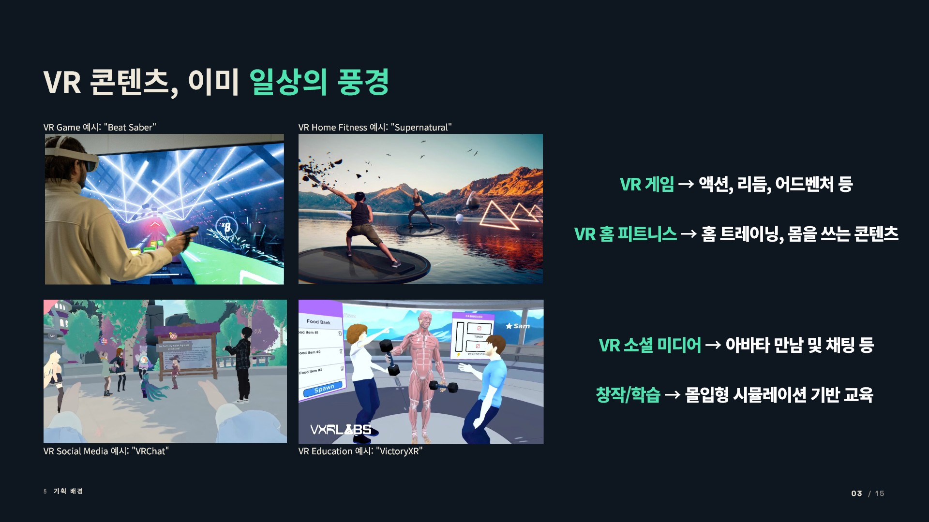

Slide 4

Virtual reality consumer product injuries: An analysis of national emergency department data
Daniel J Cucher ¹ , Melissa S Kovacs ², Clarence E Clark ³, Charles K P Hu ²
Affiliations + expand
PMID: 36803922 DOI: 10.1016/j.inJury.2023.01.0300
The characteristics ofVR injuries vary across age groups and reflect specific vulnerabilities in patient populations. Two published case reports describe cervical spine injuries featuring patients in the SS+ age group, which is consistent with injury patterns associated with age-related degenerative spine disease ⁵•⁶. Ourstudy found a disproportionate incidence of rib injuries in patients over SS, although older adults only represent 8.9% of the patient sample. This highlights the increased risk for skeletal injuries with advanced age, although fractures are commonly experienced among all age categories. On the other end of the age spectrum, the youngest patients (0-S} experienced facial injuries and were more likely to be bystanders of family members using VR devices.These second-hand VR injuries include patients being hit with VR hand controllers and the like.The possibility for bystander injuries demonstrates an underlying problem that is likely to lead to injury: VR device operation involves the entire body, and they are most oflen used in enclosed spaces, such as bedrooms and living rooms.The two most common diagnoses in the NEISS data associated with VR devices are fractures and lacerations. Injury narratives describe the mechanisms of injury as a result of collisions with walls, windows, tables, beds, fans, and similar objects.
Introduction: The growing popularity of virtual reality devices and increasingly widespread distribution of VR products into the home exposes users to risk of bodily harm. Safety features are integrated into the devices themselves, but the burden of cautious use rests upon the end user. The purpose of this study is to quantify and describe the array of injuries and demographics effected by the burgeoning VR industry to inform and encourage mitigation strategies.
Materials and methods: The National Electronic Injury Surveillance System (NEISS) data was used to examine a nationwide sample of emergency department records from 2013 - 2021. Inverse probability sample weights for cases were applied to arrive at national estimates. NEISS data included consumer product injuries, patient age, sex. race and ethnicity, drug and alcohol involvement, diagnoses, injury descriptions, and emergency department disposition.
Results: The first VR-related injury was reported in the NEISS data in 2017, and injuries were estimated to number 125. Incidents of VR-related injuries amplified as increased VR units sold, and by 2021, there wasa 352% increase in VR injuries totaling a weighted estimate of 1,336 ED visits. The most common VR-related injury diagnosis is fracture (30.3%), followed by laceration (18.6%), contusion (13.9%), other (118%), and strain I sprain (10.0%). VR-related injuries involve the hand (12.1%), face (11.5%), finger (10.6%), and knee (9.0%), head (7.0%) and upper trunk (7.0%). Patients

Slide 5
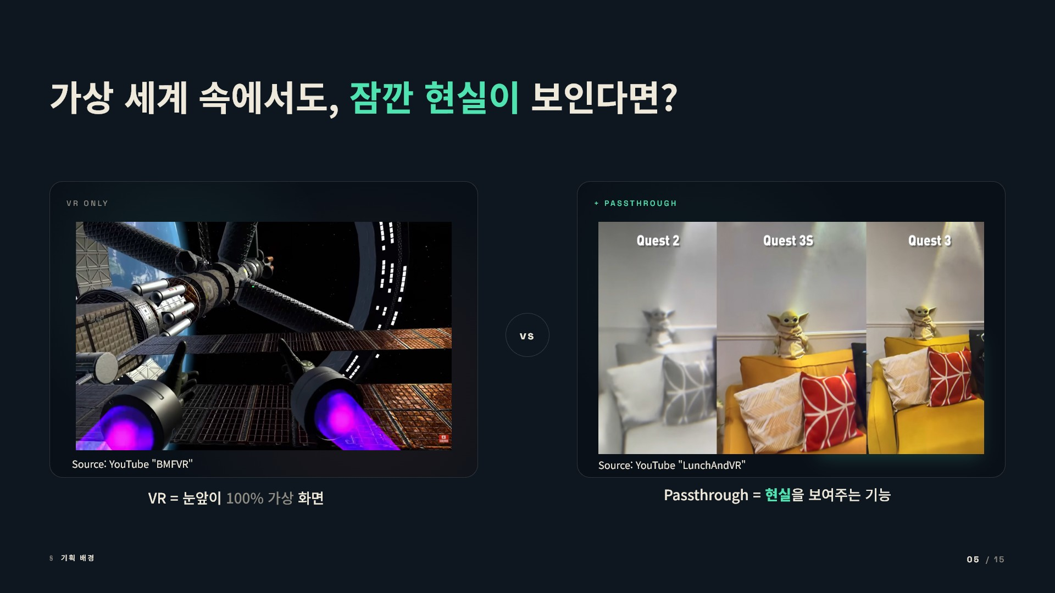

Slide 6
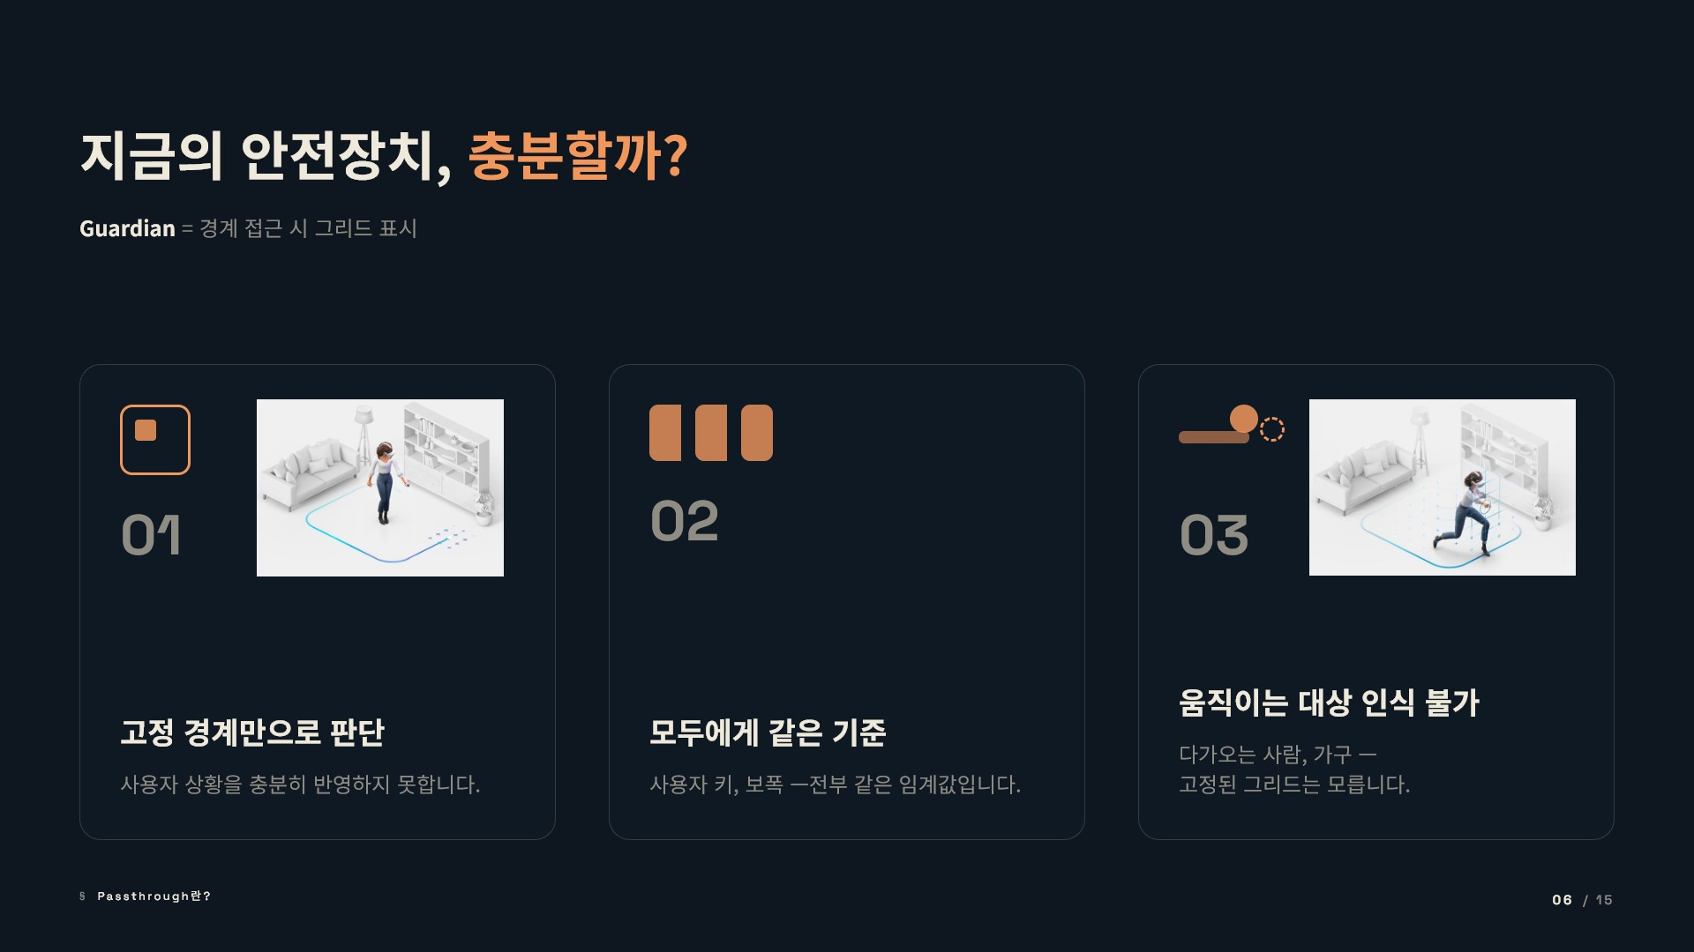

Slide 7
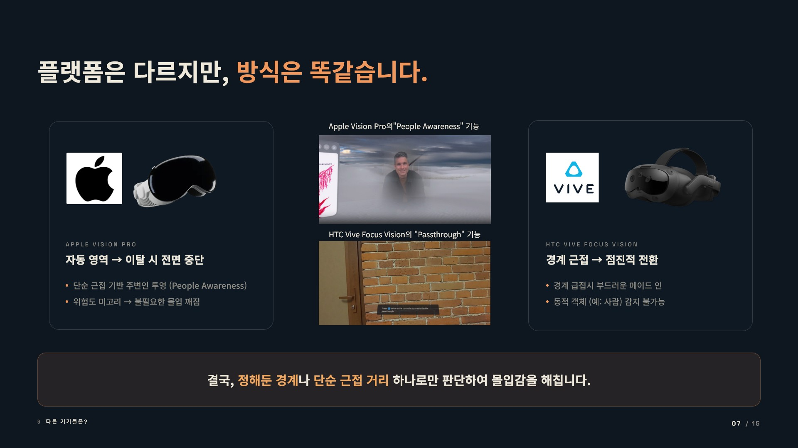

Slide 8


Slide 9


Slide 10


Slide 11
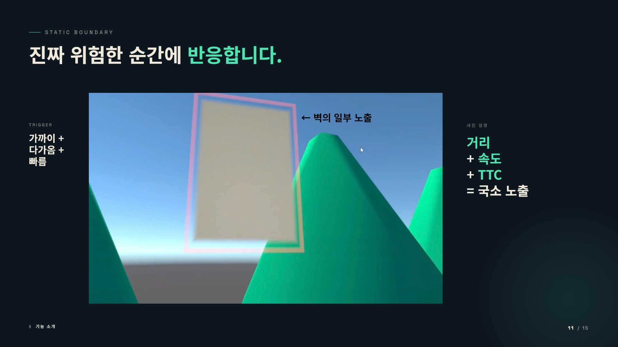

Slide 12
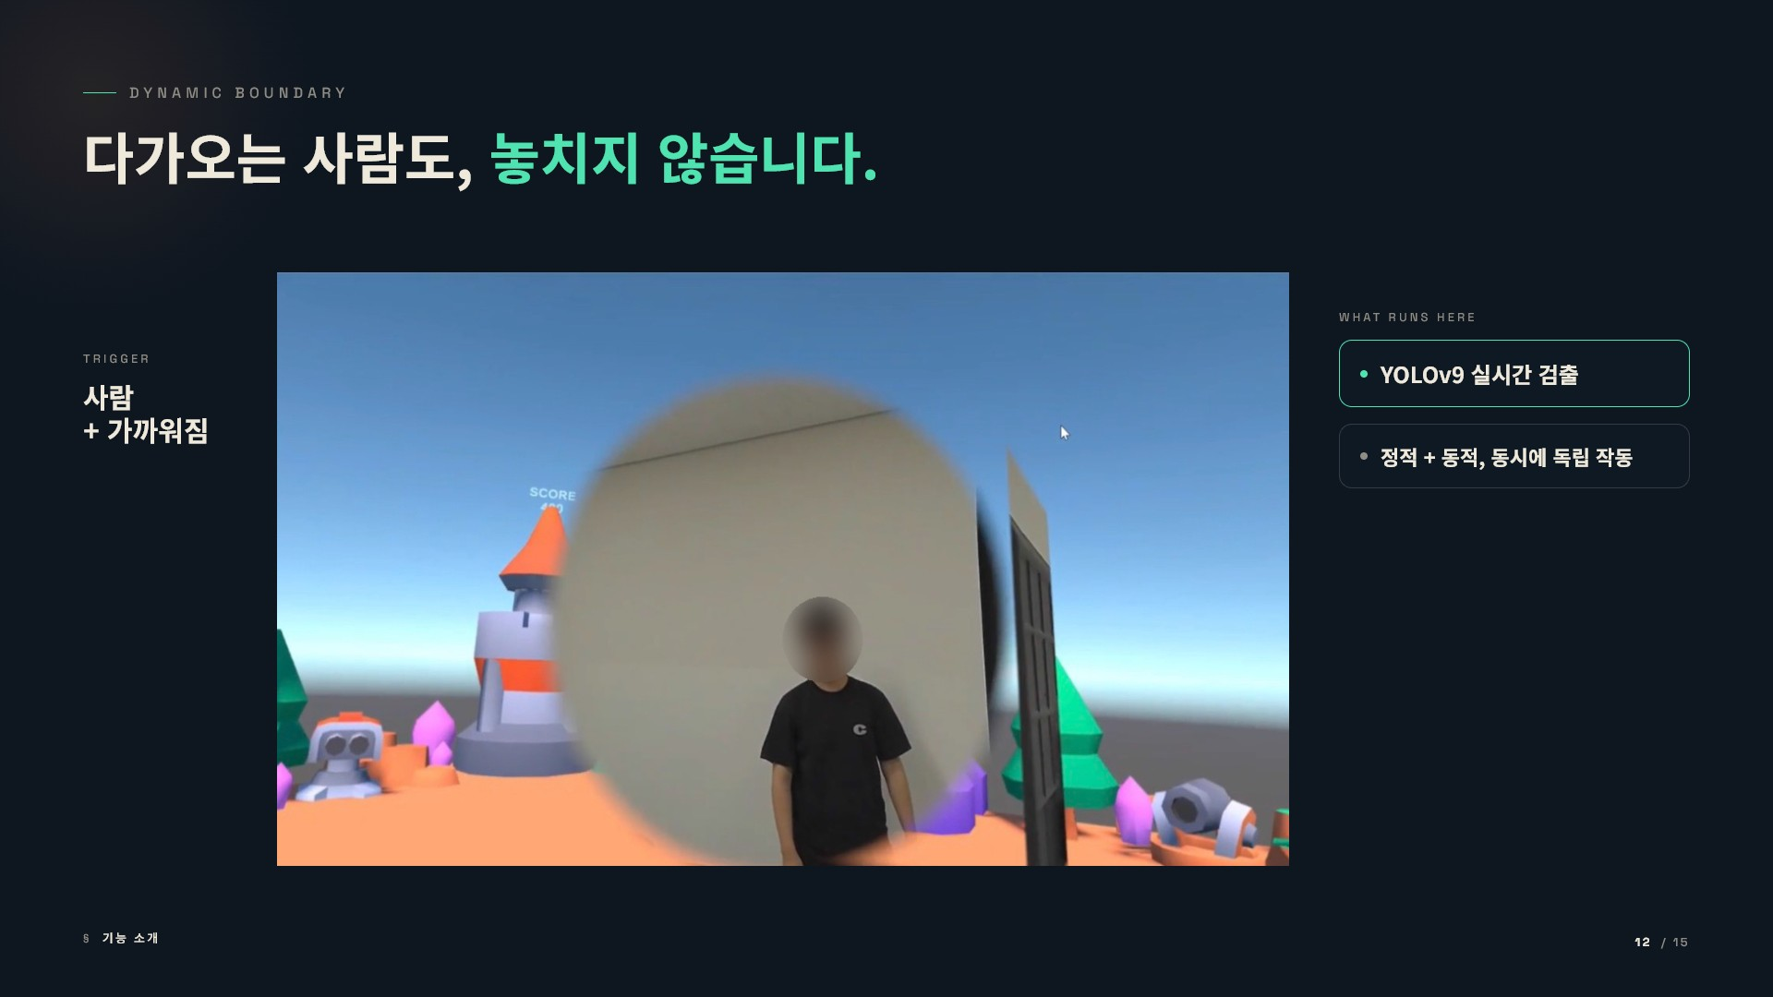

Slide 13


Slide 14
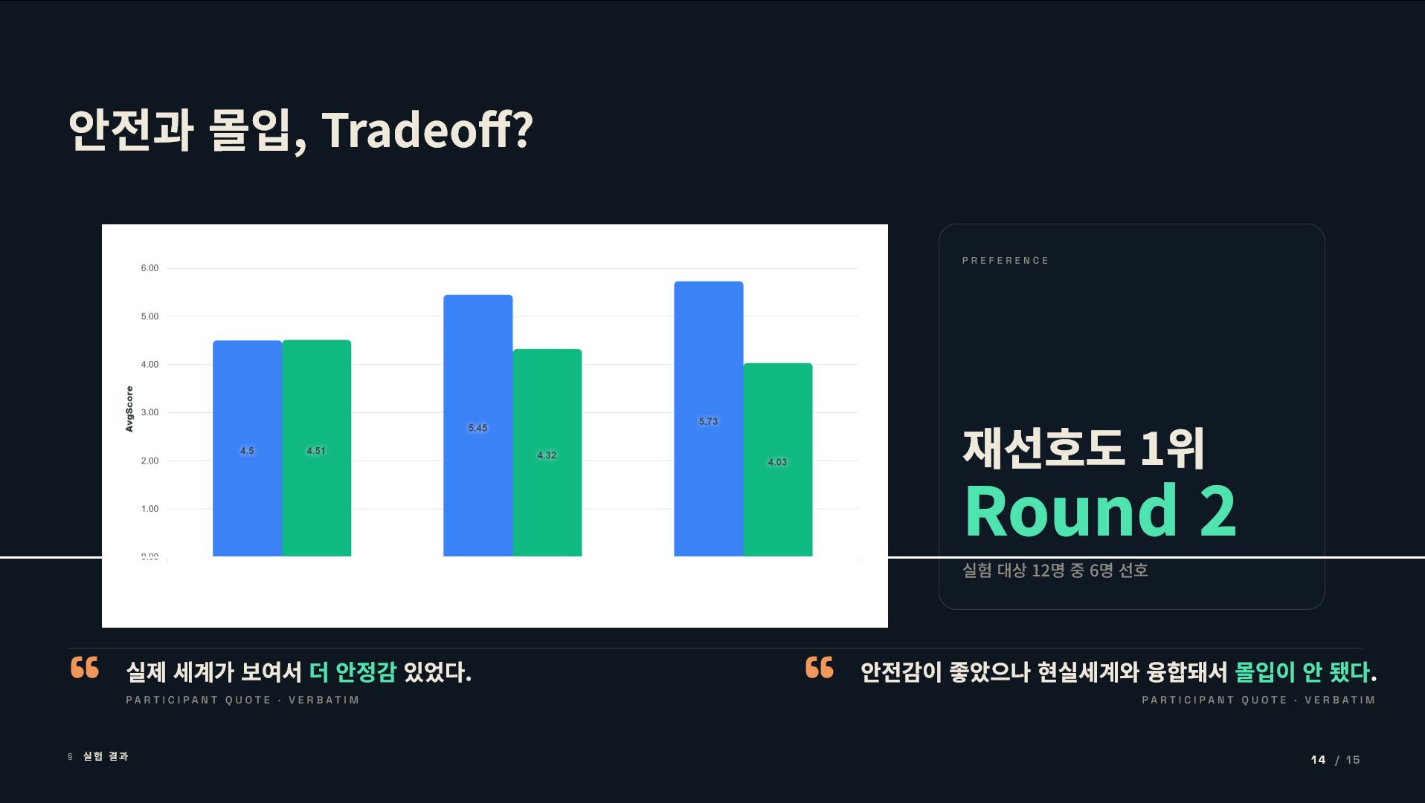
600
5.00
4.00
.
!
0
.x 3.00
_{c}"'
2.00
, 00
000
ff I(Perceived Safety) • It (lmmen;ion)

Slide 15


