Slide 1
JAVA SCRIPT Yearly Edition Version: 2024

Slide 2
JAVA SCRIPT FUNCTIONS
A JavaScript function is a block of code designed to perform a particular task.
A JavaScript function is executed when "something" invokes it (calls it).
JavaScript Function Syntax
function name(parameter1, parameter2, parameter3…) {
// code to be executed
}
JavaScript Function Arguments
// function with a parameter called 'name'
function greet(name) {
console.log(`Hello ${name});
}
// pass argument to the function
greet("John");

Slide 3
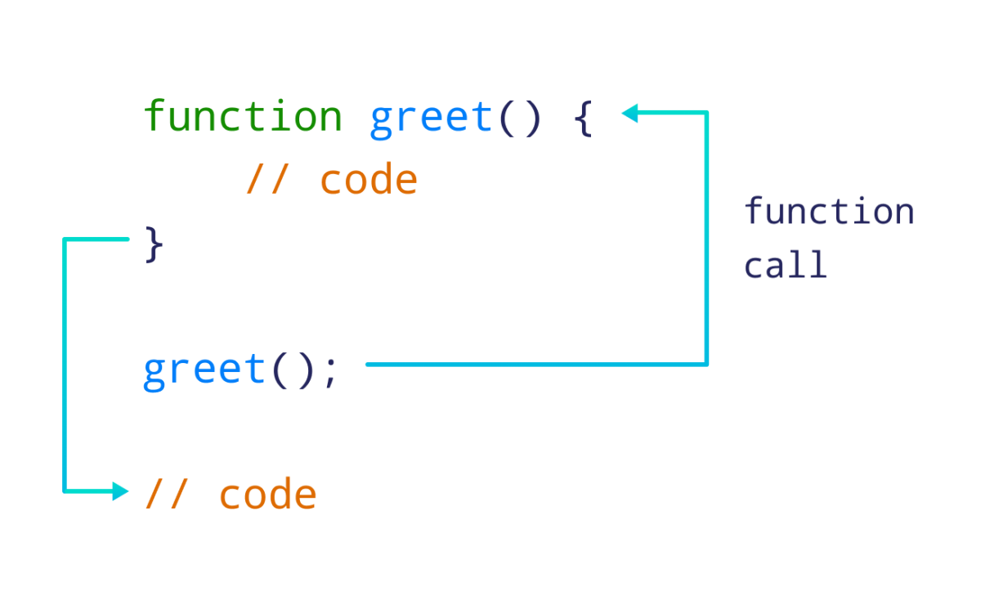
JAVA SCRIPT FUNCTIONS
// create a function named greet()
function greet() {
console.log("Hello World!");
}
// call the greet() function
greet();

Slide 4
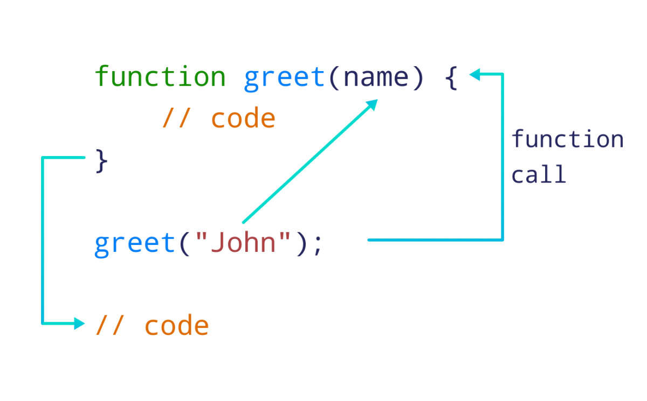
JAVA SCRIPT FUNCTIONS
JavaScript Function Arguments
// function with a parameter called 'name'
function greet(name) {
console.log(`Hello ${name}`);
}
// pass argument to the function
greet("John");
// Output: Hello John

Slide 5
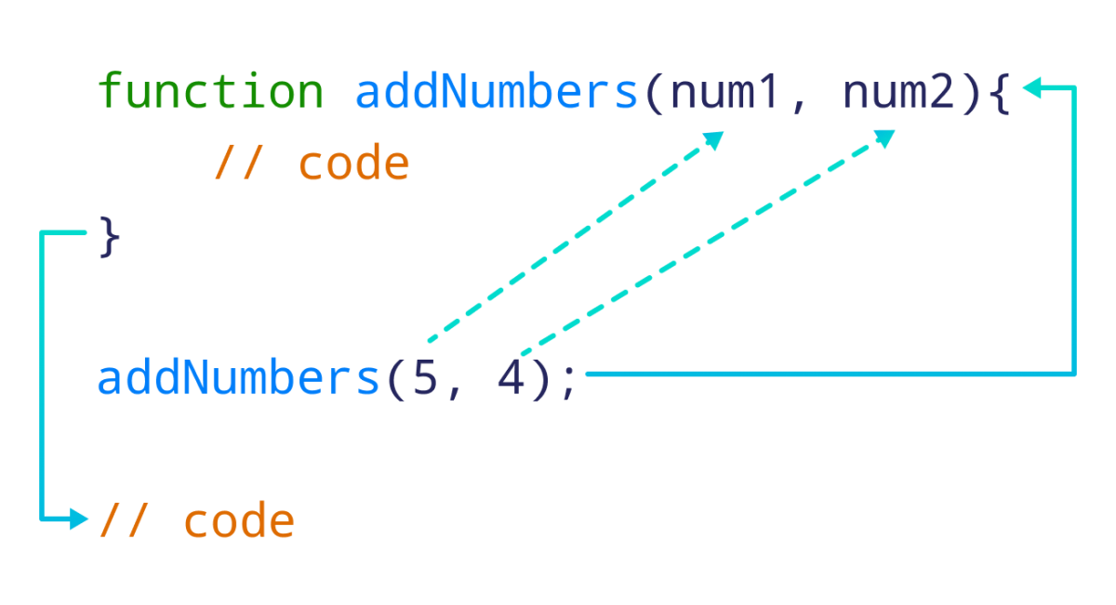
JAVA SCRIPT FUNCTIONS
JavaScript Function Two Arguments
function addNumbers(num1, num2) {
let sum = num1 + num2;
console.log(`Sum: ${sum}`);
}
// call function by passing two arguments
addNumbers(5, 4);
// Output:
// Sum: 9

Slide 6
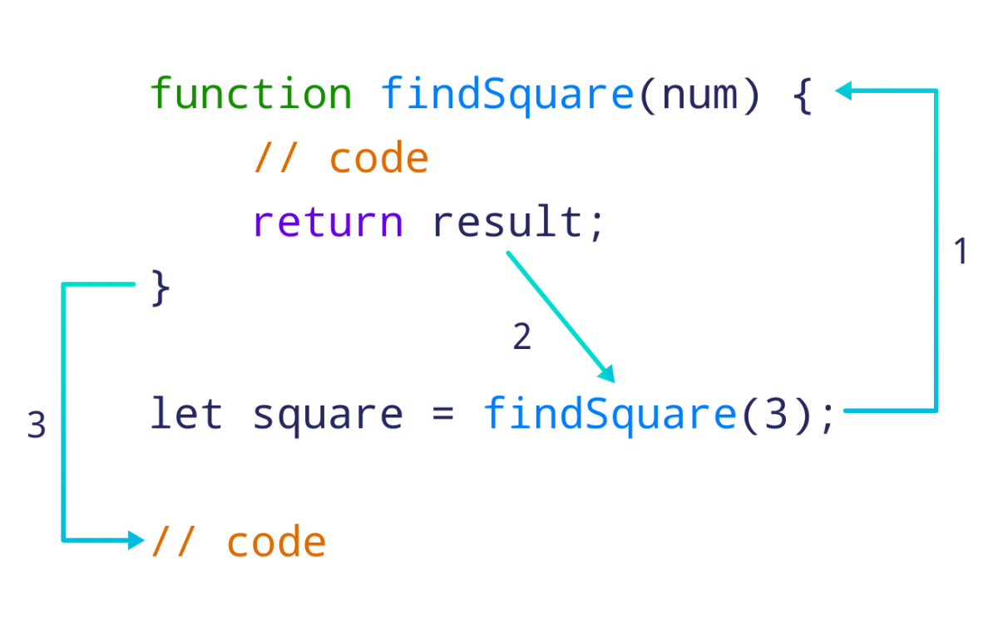
JAVA SCRIPT FUNCTIONS
JavaScript Function With Argument & Return
// function to find square of a number
function findSquare(num) {
// return square
return num * num;
}
// call the function and store the result
let square = findSquare(3);
console.log(`Square: ${square}`);

Slide 7
JAVA SCRIPT FUNCTIONS
Function Return
When JavaScript reaches a return statement, the function will stop executing
// Function is called, the return value will end up in x
let x = myFunction(4, 3);
function myFunction(a, b) {
// Function returns the product of a and b
return a * b;
}

Slide 8
JAVA SCRIPT ARROW FUNCTIONS
JavaScript Arrow Function
Syntax
The syntax of the arrow function is:
let myFunction = (arg1, arg2, ...argN) => {
statement(s)
}
Arrow Function With No Argument
const sayHello = () => "Hello, World!";
// call the arrow function and print its return value
console.log(sayHello());
Arrow Function With One Argument
const square = x => x * x;
// use the arrow function to square a number
console.log(square(5));
// Output: 25

Slide 9
JAVA SCRIPT ARROW FUNCTIONS
AVOID ARROW FUNCTION
You should not use arrow functions to create methods inside objects.
let person = {
name: "Jack",
age: 25,
sayName: () => {
console.log(this.age);
}
}
person.sayName(); // undefined
You cannot use an arrow function as a constructor.
let Foo = () => {};
let foo = new Foo();
// Output: TypeError: Foo is not a constructor

Slide 10
JAVA SCRIPT ASYNC /AWAIT
Asynchronous JavaScript
Functions running in parallel with other functions are called asynchronous
A good example is JavaScript setTimeout()
setTimeout(function() { myFunction(“PNY Training is leading IT Training Platform"); }, 3000);
function myFunction(value) {
document.getElementById("demo").innerHTML = value;
}
Waiting for Intervals:
When using the JavaScript function setInterval(), you can specify a callback function to be executed for each interval:
setInterval(myFunction,1000); function myFunction() { let d = new Date(); document.getElementById("demo").innerHTML= d.getHours() + ":" + d.getMinutes() + ":" + d.getSeconds(); }

Slide 11
JAVA SCRIPT ASYNC /AWAIT
JavaScript Promises
"Producing code" is code that can take some time
"Consuming code" is code that must wait for the result
A Promise is an Object that links Producing code and Consuming code
JavaScript Promise Object
A Promise contains both the producing code and calls to the consuming code:
Promise Syntax
let myPromise = new Promise(function(myResolve, myReject) { // "Producing Code" (May take some time) myResolve(); // when successful myReject(); // when error }); // "Consuming Code" (Must wait for a fulfilled Promise) myPromise.then( function(value) { /* code if successful */ }, function(error) { /* code if some error */ } );

Slide 12
JAVA SCRIPT ASYNC /AWAIT
When the producing code obtains the result, it should call one of the two callbacks:
When Promise | Call Promise
Success | myResolve(result value)
Error | myReject(error object)
Promise Object Properties
A JavaScript Promise object can be:
Pending
Fulfilled
Rejected
The Promise object supports two properties: state and result.
While a Promise object is "pending" (working), the result is undefined.
When a Promise object is "fulfilled", the result is a value.
When a Promise object is "rejected", the result is an error object.
myPromise.state | myPromise.result
"pending" | undefined
"fulfilled" | a result value
"rejected" | an error object

Slide 13
JAVA SCRIPT ASYNC /AWAIT
Promise How To Used
myPromise.then( function(value) { /* code if successful */ }, function(error) { /* code if some error */ } );
Note: Promise.then() takes two arguments, a callback for success and another for failure.

Slide 14
JAVA SCRIPT ASYNC /AWAIT
JavaScript Async
"async and await make promises easier to write"
async makes a function return a Promise
await makes a function wait for a Promise
Async Syntax
The keyword async before a function makes the function return a promise:
async function myFunction() { return "Hello"; }
OR
function myFunction() { return Promise.resolve("Hello"); }
Await Syntax
The await keyword can only be used inside an async function.
The await keyword makes the function pause the execution and wait for a resolved promise before it continues:
let value = await promise;

Slide 15
JAVA SCRIPT FORM VALIDATION
JavaScript Form Validation
HTML form validation can be done by JavaScript.
If a form field (fname) is empty, this function alerts a message, and returns false, to prevent the form from being submitted:
function validateForm() { let x = document.forms["myForm"]["fname"].value; if (x == "") { alert("Name must be filled out"); return false; } }
The function can be called when the form is submitted:
<form name="myForm" action="/action_page.php" onsubmit="return validateForm()" method="post"> Name: <input type="text" name="fname"> <input type="submit" value="Submit"> </form>

