Slide 1
JAVA SCRIPT Yearly Edition Version: 2024

Slide 2
JAVA SCRIPT FUNCTIONS
A JavaScript function is a block of code designed to perform a particular task.
A JavaScript function is executed when "something" invokes it (calls it).
JavaScript Function Syntax
function name(parameter1, parameter2, parameter3) {
// code to be executed
}
JavaScript Function Arguments
// function with a parameter called 'name'
function greet(name) {
console.log(`Hello ${name});
}
// pass argument to the function
greet("John");

Slide 3
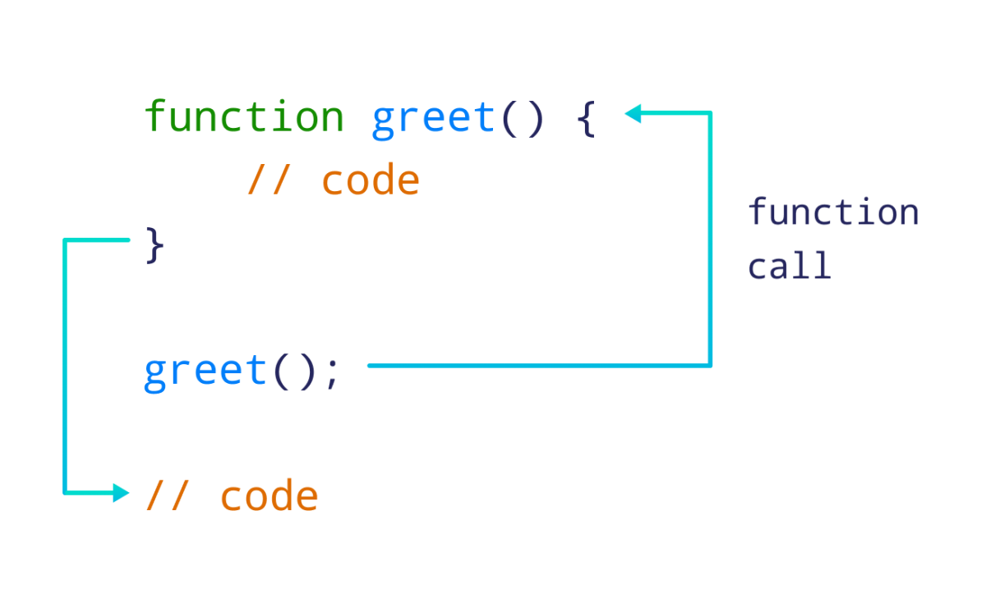
JAVA SCRIPT FUNCTIONS
// create a function named greet()
function greet() {
console.log("Hello World!");
}
// call the greet() function
greet();

Slide 4
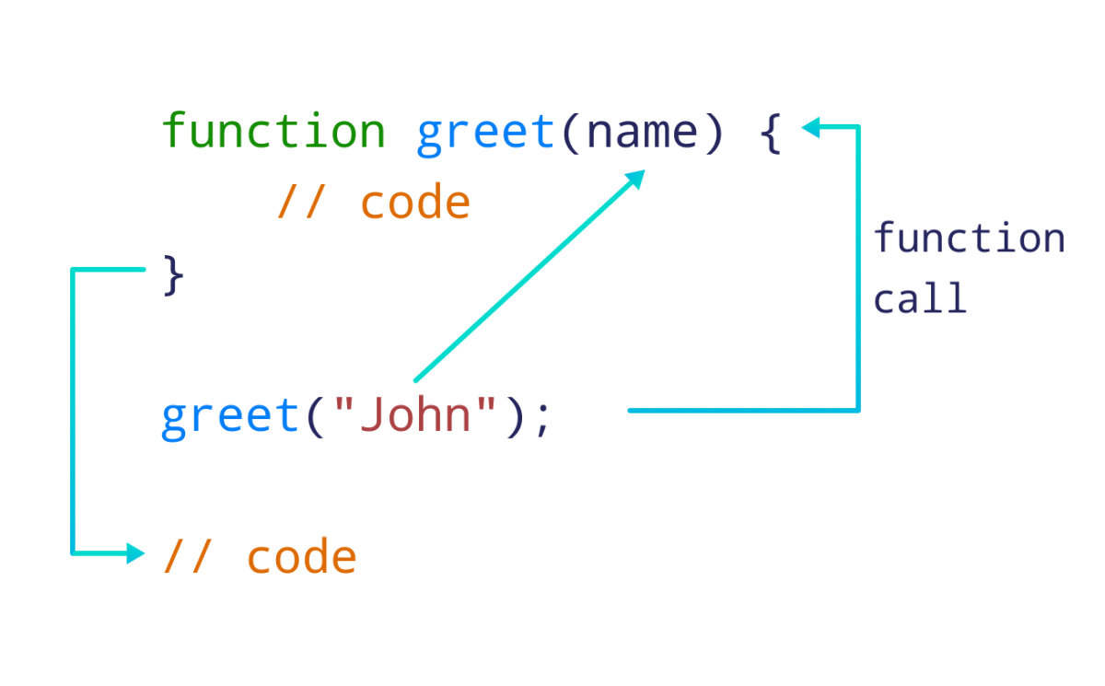
JAVA SCRIPT FUNCTIONS
JavaScript Function Arguments
// function with a parameter called 'name'
function greet(name) {
console.log(`Hello ${name}`);
}
// pass argument to the function
greet("John");
// Output: Hello John

Slide 5
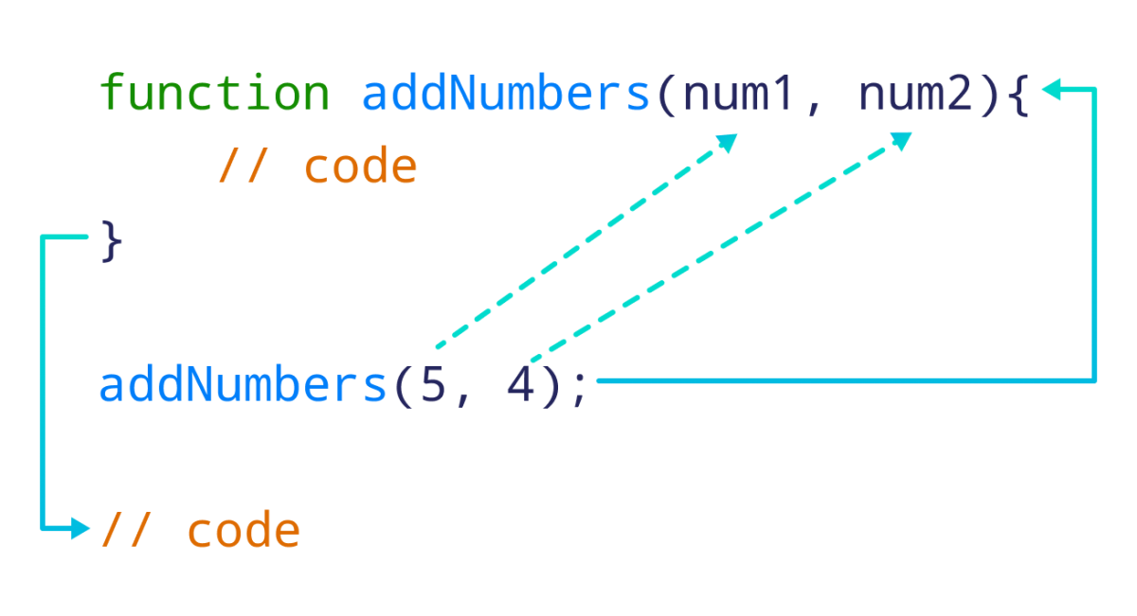
JAVA SCRIPT FUNCTIONS
JavaScript Function Two Arguments
function addNumbers(num1, num2) {
let sum = num1 + num2;
console.log(`Sum: ${sum}`);
}
// call function by passing two arguments
addNumbers(5, 4);
// Output:
// Sum: 9

Slide 6
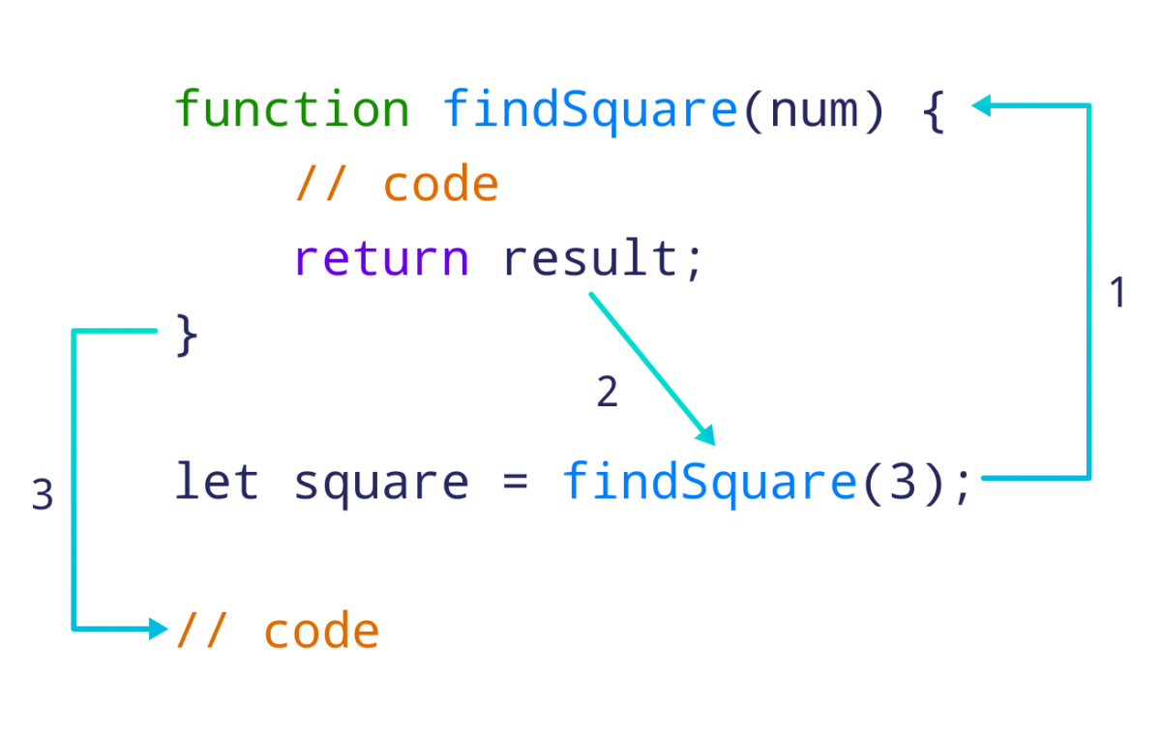
JAVA SCRIPT FUNCTIONS
JavaScript Function With Argument & Return
// function to find square of a number
function findSquare(num) {
// return square
return num * num;
}
// call the function and store the result
let square = findSquare(3);
console.log(`Square: ${square}`);

Slide 7
JAVA SCRIPT FUNCTIONS
Function Return
When JavaScript reaches a return statement, the function will stop executing
// Function is called, the return value will end up in x
let x = myFunction(4, 3);
function myFunction(a, b) {
// Function returns the product of a and b
return a * b;
}

Slide 8
JAVA SCRIPT ARROW FUNCTIONS
JavaScript Arrow Function
Syntax
The syntax of the arrow function is:
let myFunction = (arg1, arg2, ...argN) => {
statement(s)
}
Arrow Function With No Argument
const sayHello = () => "Hello, World!";
// call the arrow function and print its return value
console.log(sayHello());
Arrow Function With One Argument
const square = x => x * x;
// use the arrow function to square a number
console.log(square(5));
// Output: 25

Slide 9
JAVA SCRIPT ARROW FUNCTIONS
AVOID ARROW FUNCTION
You should not use arrow functions to create methods inside objects.
let person = {
name: "Jack",
age: 25,
sayName: () => {
console.log(this.age);
}
}
person.sayName(); // undefined
You cannot use an arrow function as a constructor.
let Foo = () => {};
let foo = new Foo();
// Output: TypeError: Foo is not a constructor

