Slide 1
NEURAL NETWORKS

Slide 2
Neural Networks: The Building Blocks of AI
Neural networks are a type of machine learning model inspired by the structure and function of the human brain. They are composed of interconnected nodes, called neurons, that work together to process and learn from data.
How Neural Networks Work
Input Layer: This is where the data is introduced to the network. Each neuron in the input layer represents a feature of the data.
Hidden Layers: These layers process the input data and extract relevant features. They can have multiple layers, each learning different patterns and relationships.
Output Layer: This layer produces the final output of the network, which can be a classification, prediction, or generation.

Slide 3
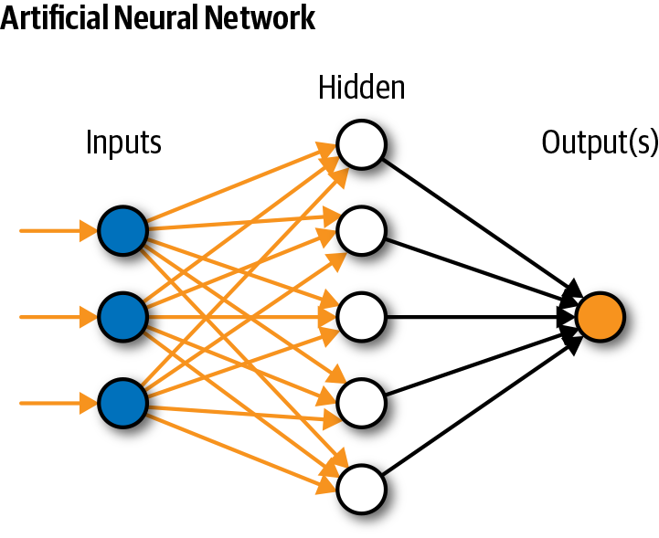
Neural Networks: The Building Blocks of AI

Slide 4
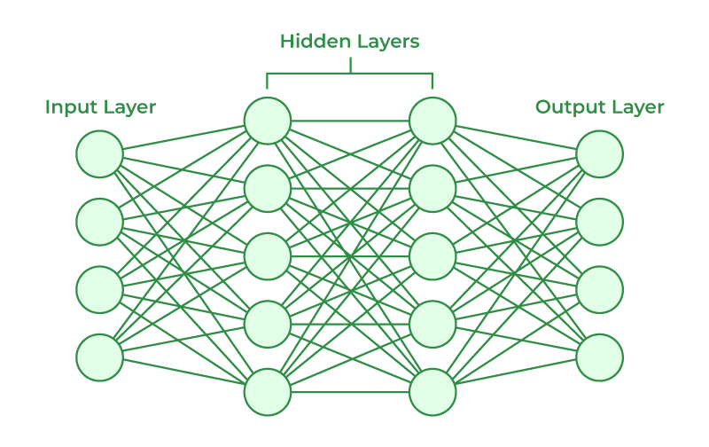
Neural Networks: The Building Blocks of AI

Slide 5
Types Of Neural Networks
Feedforward Neural Networks: The simplest type, where information flows in one direction from the input to the output layer.
Recurrent Neural Networks (RNNs): Designed to process sequential data, like text or time series. They have feedback connections that allow them to remember past information.
Convolutional Neural Networks (CNNs): Specialized for processing grid-like data, such as images. They use filters to extract features from the data.
Generative Adversarial Networks (GANs): Consists of two neural networks: a generator and a discriminator. They are used to generate new data, such as images or text.

Slide 6
Neural Networks - Example
Image Classification:
Imagine training a neural network to classify images as cats or dogs.
Input Layer: The input layer would have a large number of neurons, each representing a pixel in the image.
Hidden Layers: The hidden layers would extract features from the image, such as edges, corners, and textures.
Output Layer: The output layer would have two neurons, one for "cat" and one for "dog." The neuron with the highest activation would indicate the predicted class.
Activation Functions
Activation functions introduce non-linearity into the network, allowing it to learn complex patterns. Common activation functions include:
Sigmoid: Maps values between 0 and 1
ReLU: Returns the maximum of 0 and the input
Tanh: Maps values between -1 and 1

Slide 7
Weights in Neural Networks
Weights in neural networks are numerical values that determine the strength of the connections between neurons. They are essentially parameters that the network learns during the training process.
Think of weights as the "volume" of a connection. A higher weight means a stronger connection, while a lower weight means a weaker connection. When a neuron receives input from other neurons, the weighted sum of these inputs is calculated to determine the neuron's activation.
Here's a simplified example:
Imagine a simple neural network with two input neurons (A and B) and one output neuron (C). The connections between these neurons have weights:
Weight of A to C: W_AC
Weight of B to C: W_BC
If the inputs to A and B are X_A and X_B, respectively, then the activation of neuron C is calculated as:
Activation_C = W_AC * X_A + W_BC * X_B
During training, the neural network adjusts these weights to minimize the error between its predicted output and the correct output. This is achieved using algorithms like backpropagation.

Slide 8
Forward and Backward Propagation in Neural Networks
Neural networks learn by adjusting their weights to minimize the difference between their predicted outputs and the actual outputs. This process involves two main steps: forward propagation and backward propagation.
Forward Propagation
Input: The input data is presented to the network.
Calculation: The input data is passed through the network layer by layer. At each layer, the weighted sum of the inputs is calculated, and an activation function is applied to determine the output.
Output: The final output of the network is produced.
Backward Propagation
Error Calculation: The difference between the predicted output and the actual output (error) is calculated.
Gradient Calculation: The gradients of the error with respect to the weights are calculated. This tells us how much each weight contributes to the error.
Weight Update: The weights are updated using an optimization algorithm, such as gradient descent, to minimize the error.

Slide 9
Forward and Backward Propagation in Neural Networks
Here's a simplified example:
Imagine a simple neural network with one input neuron, one hidden neuron, and one output neuron.
Forward propagation: The input is multiplied by the weight of the connection between the input and hidden neuron, and the result is passed through an activation function. The output of the hidden neuron is then multiplied by the weight of the connection between the hidden and output neuron, and the result is passed through another activation function to produce the final output.
Backward propagation: The error between the predicted output and the actual output is calculated. The gradients of the error with respect to the weights are calculated. The weights are updated using an optimization algorithm to minimize the error.
This process is repeated many times with different training examples until the network learns to make accurate predictions.

Slide 10
How Neural Networks Embody Intelligence: A Breakdown
Neural networks are a type of machine learning model inspired by the human brain. While they don't possess consciousness or sentience in the same way humans do, they can exhibit intelligent behavior by learning from data and making complex decisions.
Key Factors Contributing to Neural Network Intelligence:
Learning from Data: Neural networks learn from large datasets. They identify patterns, relationships, and correlations within the data that humans might not be able to discern.
Weight Adjustment: The weights in a neural network determine the strength of connections between neurons. Through a process called backpropagation, the network adjusts these weights to minimize errors and improve its performance. This allows the network to learn and adapt over time.
Activation Functions: These functions introduce non-linearity into the network, enabling it to learn complex patterns that linear models cannot.
Architecture and Layers: The architecture of a neural network, including the number of layers and neurons, determines its capacity to learn and represent complex functions. Deeper networks can often learn more complex patterns.

Slide 11
How Neural Networks Embody Intelligence: A Breakdown
Large Datasets: Neural networks require large amounts of data to learn effectively. The more data they are trained on, the better they can generalize to new, unseen data.
Computational Power: The ability to train large neural networks with millions or billions of parameters requires significant computational resources. Advances in hardware and software have made this possible.
Examples of Neural Network Intelligence:
Image Recognition: Neural networks can accurately identify objects, people, and scenes in images.
Natural Language Processing: They can understand and generate human language, enabling tasks like machine translation and text summarization.
Game Playing: Neural networks have achieved superhuman performance in games like Go and chess.
Recommendation Systems: They can suggest products or content based on user preferences and behavior.
While neural networks don't possess consciousness or subjective experiences, their ability to learn from data, adjust their behavior, and perform complex tasks makes them a powerful tool for artificial intelligence. It's important to note that the intelligence exhibited by neural networks is a form of computational intelligence, which is distinct from human intelligence.

Slide 12
ADVANCE AI MODELS - GANs, Diffusers, and Transformer Models
GANs, Diffusers, and Transformer models are indeed some of the most important and influential architectures in AI right now, and they will continue to play a significant role in the future. Here's a brief explanation of each and why they're important:
1: GANs (Generative Adversarial Networks)
What They Do: GANs are great at generating realistic data, such as images, videos, or even music, from scratch. They are particularly famous for creating realistic images that look like photographs, even though they are entirely synthetic.
Why They're Important: GANs have opened up new possibilities in creative AI applications, from art generation to deepfake technology, and even in fields like medical imaging, where they can generate realistic but synthetic data for training models without needing large amounts of real data.
How they work: GANs consist of two neural networks: a generator and a discriminator. The generator creates new data samples, while the discriminator tries to distinguish between real and generated samples. Through a competitive process, the generator learns to produce increasingly realistic data.
Applications: GANs have been used for tasks such as image generation, style transfer, and data augmentation. They can create highly realistic images, videos, and audio, making them valuable for creative industries like art, design, and entertainment.

Slide 13
ADVANCE AI MODELS - GANs, Diffusers, and Transformer Models
2: Diffuser Models
What They Do: Diffusion models (or Diffusers) are a type of generative model that create data by gradually refining noise into a clear image or other data format. These models have been particularly successful in image synthesis tasks, such as generating high-quality, high-resolution images.
Why They're Important: Diffusion models have recently gained popularity due to their ability to generate extremely high-quality images. They are seen as a promising alternative to GANs, especially in applications where the generation of highly detailed images is crucial, like in design, fashion, and entertainment.
How they work: Diffusion models are a relatively new class of generative models that work by gradually adding noise to data and then learning to reverse this process. This approach allows them to generate high-quality samples while maintaining control over the generative process.
Applications: Diffusion models have shown great promise in tasks like image generation, audio synthesis, and text generation. They can produce highly detailed and diverse samples, making them a powerful tool for creative applications.

Slide 14
ADVANCE AI MODELS - GANs, Diffusers, and Transformer Models
3: Transformer Models
What They Do: Transformers are a type of neural network architecture that excels at processing sequences of data, such as text, speech, or even video frames. They are the backbone of many state-of-the-art models in natural language processing (NLP), such as GPT (like me!), BERT, and others.
Why They're Important: Transformers have revolutionized the field of AI, especially in language processing. They power most of the advanced AI models today, enabling machines to understand and generate human-like text, translate languages, summarize documents, and even interact conversationally. Beyond NLP, transformers are also being used in image processing, audio synthesis, and other areas.
How they work: Transformer models are neural network architectures that have revolutionized natural language processing (NLP). They use a mechanism called self-attention to capture the relationships between different parts of a sequence. This allows them to handle long-range dependencies and understand the context of language.
Applications: Transformer models have been used for tasks such as machine translation, text summarization, question answering, and text generation. Their ability to understand and generate human-like text makes them invaluable for applications like chatbots, virtual assistants, and content creation.

Slide 15
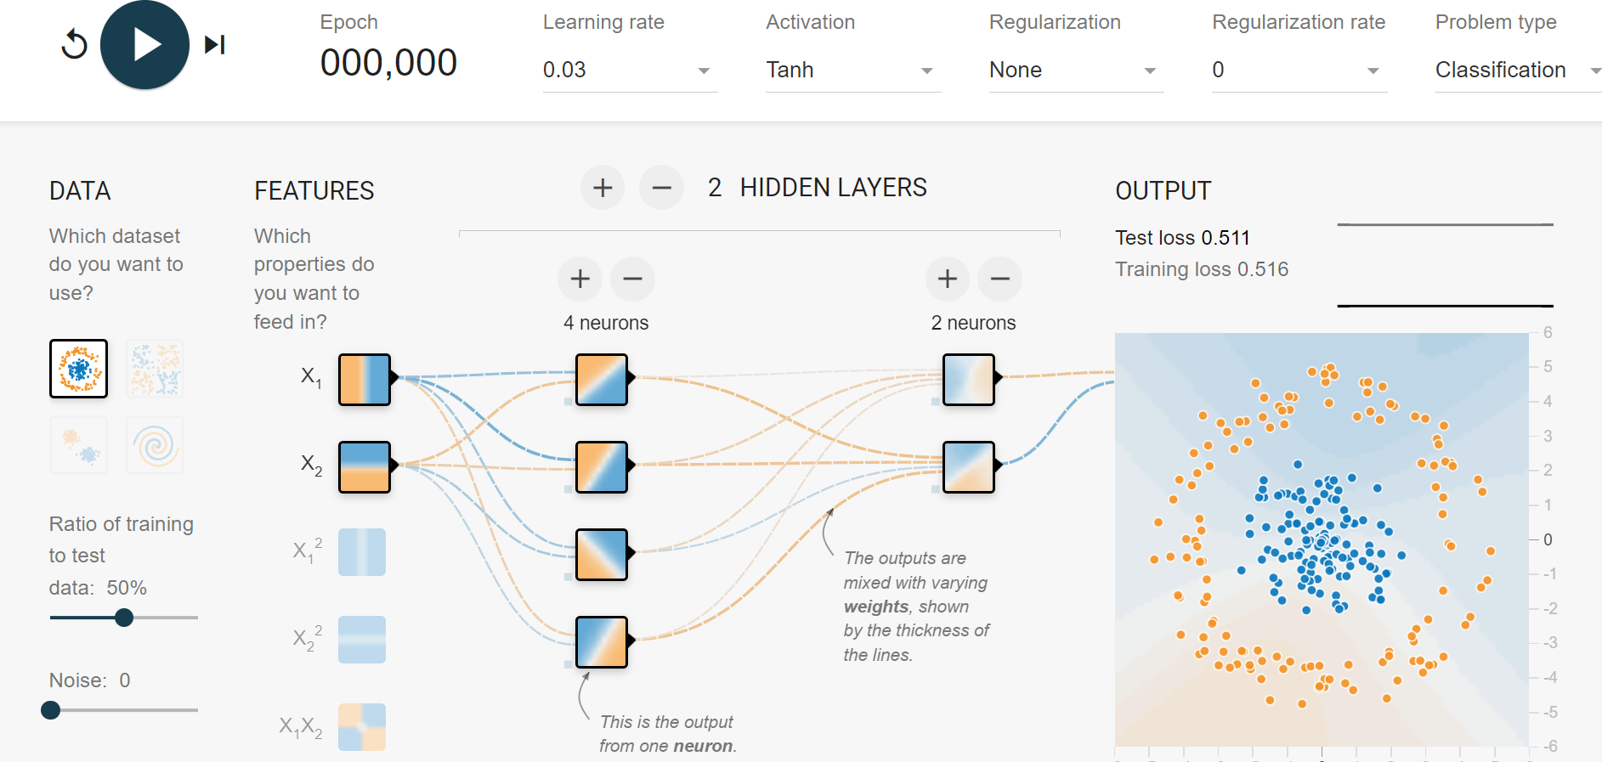
Neural Networks: Hyper-Parameters

Slide 16
Gradient Descent
A hyperparameter that controls the step size during gradient descent optimization. It determines how quickly the model adjusts its parameters in the direction that reduces the loss.
A higher learning rate might lead to faster convergence but risks overshooting, while a lower rate might slow down convergence.

Slide 17
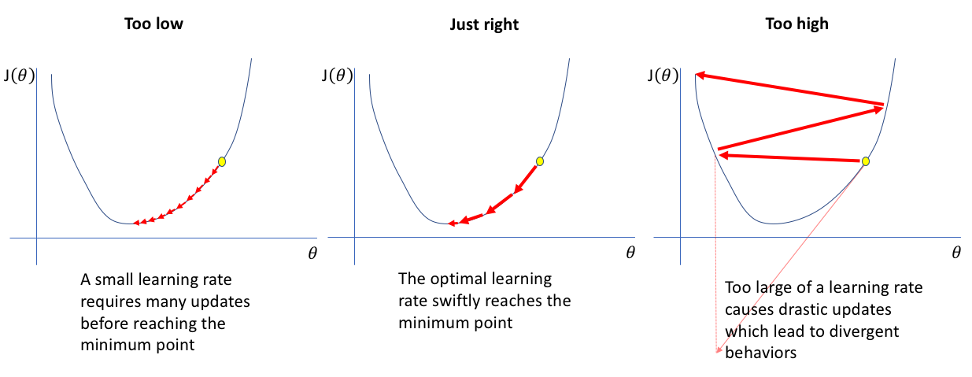
Learning Rate
A higher learning rate might lead to faster convergence but risks overshooting, while a lower rate might slow down convergence.

Slide 18
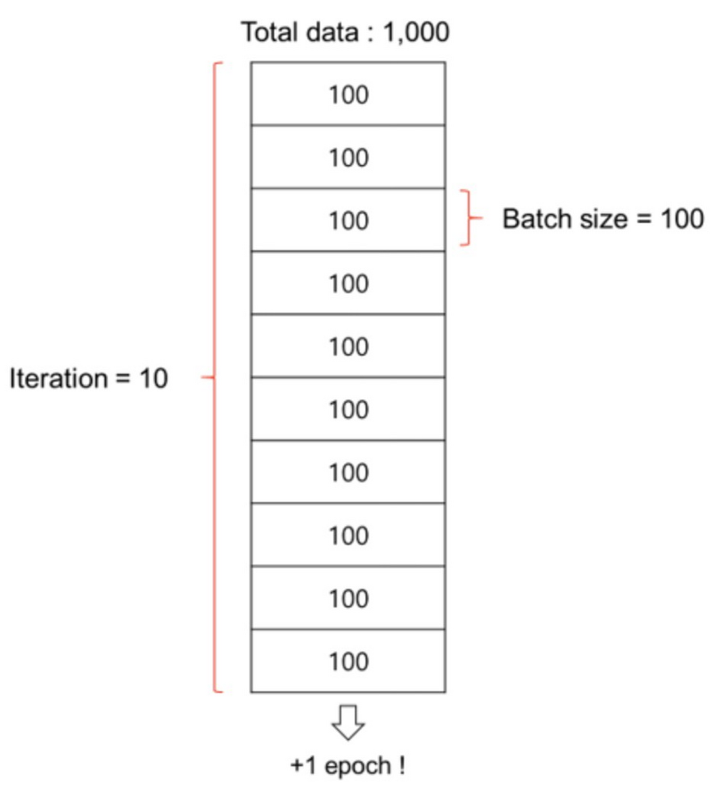
Batch Size
Batch is a subset of the training dataset used in each iteration of the training process.
Instead of processing the entire dataset at once, we divide it into smaller batches.
Batch size is the number of training examples in each batch.
It's a hyperparameter that can be adjusted based on hardware limitations and dataset characteristics.
Larger batch sizes may speed up training but require more memory.

Slide 19
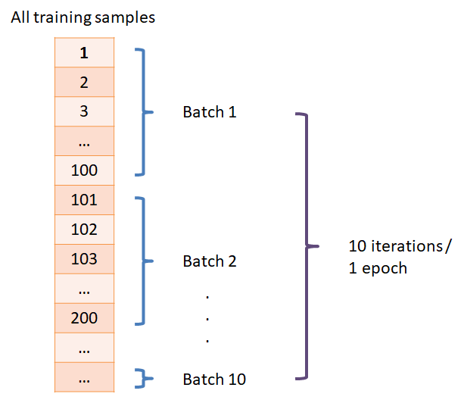
Number of Epochs
The number of times the entire training dataset is seen by the model during training.
Too few epochs might result in underfitting, while too many epochs can lead to overfitting.

Slide 20
Activation Functions (Neuron)
It determine the functions applied to the outputs of each neuron to introduce non-linearity.
Common activation functions include
ReLU (Rectified Linear Unit),
Softmax

