Slide 1
DESCRIPTIVE STATISTICS AND PROBABILTY

Slide 2
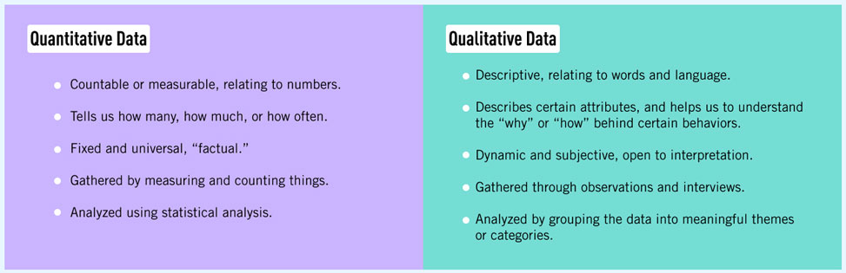
DATA & DATA TYPES
Data refers to facts, figures, and other relevant information that are collected through various means such as surveys, experiments, and observations. In the field of statistics, data is the fundamental basis for analysis, enabling statisticians to make inferences, predictions, and decisions.
Types of Data in Statistics
Quantitative Data and Qualitative Data.
1. Quantitative Data
Discrete Data
Continuous Data
2. Qualitative Data
Nominal Data
Ordinal Data

Slide 3
STRUCTURED / UNSTRUCTURED DATA
Structured data refers to data that is organized in a predefined format, often within relational databases. This type of data is highly organized, making it easily searchable and analyzable. Structured data typically resides in tables with rows and columns, where each column represents a specific attribute, and each row represents a record.
Characteristics of Structured Data:
Predefined Schema: Structured data follows a predefined data model or schema that dictates how data is stored and accessed.
Relational Databases: It is commonly stored in relational databases such as MySQL, PostgreSQL, and Oracle.
Ease of Search and Analysis: Due to its organized nature, structured data is easily searchable using SQL queries and can be analyzed using various statistical and analytical tools.
Examples: Examples of structured data include financial records, customer information, transaction logs, and inventory data.

Slide 4
STRUCTURED / UNSTRUCTURED DATA
Unstructured data refers to data that does not have a predefined format or structure. This type of data is often text-heavy and may include various types of multimedia content such as images, videos, and audio files. Unstructured data is typically more complex and difficult to analyze compared to structured data.
Characteristics of Unstructured Data:
No Predefined Schema: Unstructured data does not follow a specific format or schema, making it more flexible but harder to manage.
Storage in NoSQL Databases and Data Lakes: It is commonly stored in NoSQL databases like MongoDB or data lakes which can handle large volumes of diverse data types.
Complexity in Search and Analysis: Searching and analyzing unstructured data require specialized tools and techniques, such as natural language processing (NLP) and machine learning algorithms.
Examples: Examples of unstructured data include emails, social media posts, sensor data, documents, images, videos, and audio recordings.

Slide 5
QUANTATIVE & QUALITATIVE DATA
Quantitative Data
Quantitative data represents numerical values and is used to quantify the variables. It can be further divided into two subtypes:
Discrete Data: This type of data can take on only specific values, often integers, and is countable. Examples include the number of students in a class, the number of cars in a parking lot, or the number of books on a shelf.
Continuous Data: This type of data can take on any value within a given range and is measurable. Examples include height, weight, temperature, and time.

Slide 6
QUANTATIVE & QUALITATIVE DATA
Qualitative Data
Qualitative data, also known as categorical data, represents characteristics and attributes that cannot be measured but can be categorized. It can be divided into two subtypes:
Nominal Data: This type of data represents categories that do not have a natural order or ranking. Examples include gender (male/female), blood type (A, B, AB, O), and nationality.
Ordinal Data: This type of data represents categories that have a natural order or ranking, but the intervals between the categories are not necessarily equal. Examples include educational level (high school, bachelor's, master's, PhD), and satisfaction rating (satisfied, neutral, dissatisfied).

Slide 7
QUANTATIVE & QUALITATIVE DATA
Levels of Measurement
Data in statistics can also be classified based on levels of measurement, which indicate the nature of the data and the mathematical operations that can be performed on them. The four levels of measurement are:
Nominal Level: This is the simplest level of measurement, where data are categorized based on names, labels, or qualities. There is no order or ranking among the categories. Examples include eye color, type of car, and brand names.
Ordinal Level: This level involves data that can be ordered or ranked, but the intervals between the ranks are not equal. Examples include rankings in a competition (1st, 2nd, 3rd), levels of satisfaction, and socioeconomic status.
Interval Level: This level of measurement includes ordered data with equal intervals between values, but there is no true zero point. Examples include temperature in Celsius or Fahrenheit and IQ scores.
Ratio Level: This is the highest level of measurement, which includes ordered data with equal intervals and a true zero point. Examples include height, weight, age, and income.

Slide 8
MEASURES OF CENTRAL TENDENCY
Measures of central tendency are statistical metrics that describe the center or typical value of a dataset. They provide a summary of the dataset and help to understand the distribution of the data. The three main measures of central tendency are mean, median, and mode.
Mean, also known as the average, is the sum of all the values in a dataset divided by the number of values.
Formula:
Mean = Sum of All Number / Total Numbers
Example:
For the dataset: 5,10,15,20,25
Mean=5+10+15+20+25 = 75 / 5 = 15

Slide 9
MEASURES OF CENTRAL TENDENCY
Median is the middle value in a dataset when the values are arranged in ascending or descending order. If the number of values is even, the median is the average of the two middle values.
Steps to Find the Median:
Arrange the data in ascending order.
If the number of observations (n) is odd, the median is the middle value.
If n is even, the median is the average of the two middle values.
Example:
For the dataset: 5,10,20,15,25
Ordered dataset: 5,10,15,20,25
Median: 15 (middle value)
For the dataset: 5,10,20,15, 25
Ordered dataset: 5,10,15,20,25
Median: 15

Slide 10
MEASURES OF CENTRAL TENDENCY
Mode is the value that appears most frequently in a dataset. A dataset can have one mode (unimodal), more than one mode (bimodal or multimodal), or no mode if all values are unique.
Example:
For the dataset: 5,10,15,15,20,25
Mode: 15 (appears twice)

Slide 11
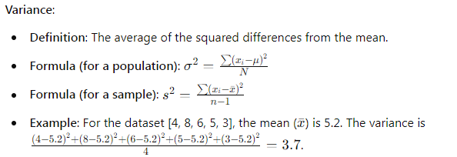
MEASURES OF DISPERSION
Measures of dispersion are statistical tools used to describe the spread or variability of a set of data. They provide insights into the degree to which data points in a dataset differ from the mean or median. The most commonly used measures of dispersion include:
Variance
Standard Deviation
Coefficient of Variation (CV)
VARIANCE:

Slide 12
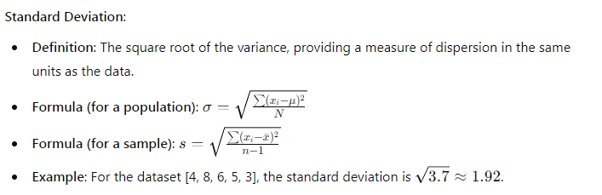
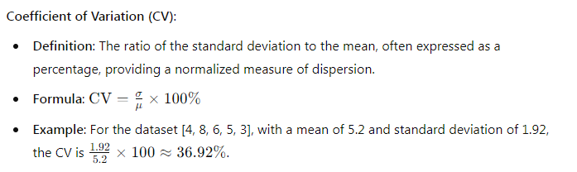
MEASURES OF DISPERSION
STANDARD DEVIATION
COEFFICIENT OF VARIATION

Slide 13
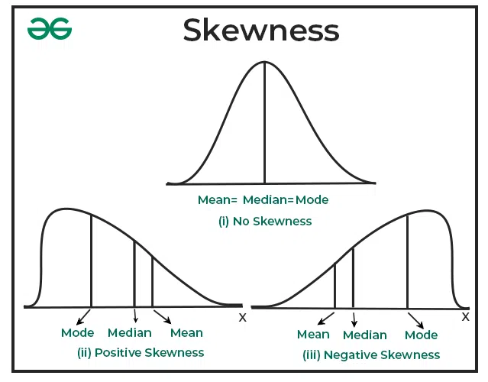
MEASURES OF DISPERSION
SKEWNESS AND KURTOSIS
Skewness is a measure of how skewed a distribution of data is, and can indicate where outliers are located. The value of skewness can be interpreted as follows:
Less than -0.5: Negatively skewed, or left-skewed, with data points on the right side and longer tails on the left. This indicates more larger values.
Greater than 0.5: Positively skewed, or right-skewed, with data points on the left side and longer tails on the right. This indicates more smaller values.
Between -0.5 and 0.5: Approximately symmetric.
Between -1 and -0.5 or 0.5 and 1: Slightly skewed.
Less than -1 or greater than 1: Highly skewed.

Slide 14
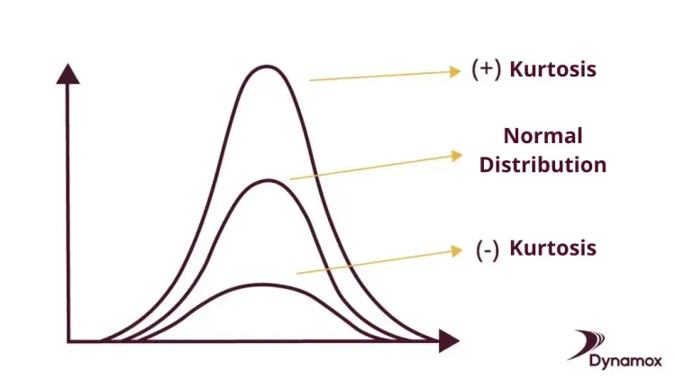
MEASURES OF DISPERSION
SKEWNESS AND KURTOSIS
Kurtosis is a measure of whether the data are heavy-tailed or light-tailed relative to a normal distribution. That is, data sets with high kurtosis tend to have heavy tails, or outliers. Data sets with low kurtosis tend to have light tails, or lack of outliers. A uniform distribution would be the extreme case.

Slide 15
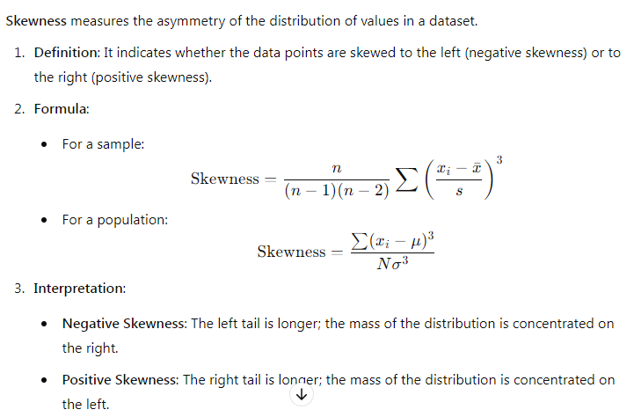
MEASURES OF DISPERSION
SKEWNESS AND KURTOSIS

Slide 16
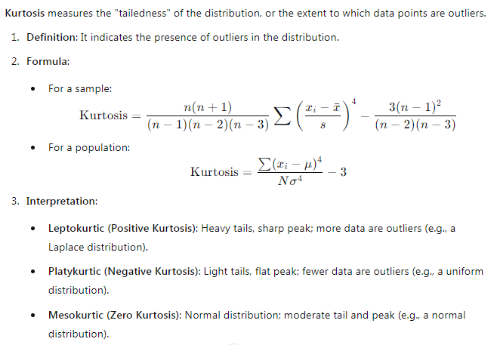
MEASURES OF DISPERSION
SKEWNESS AND KURTOSIS

Slide 17
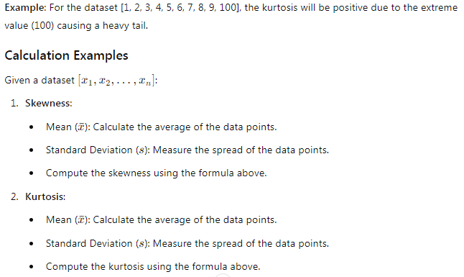
MEASURES OF DISPERSION
SKEWNESS AND KURTOSIS

Slide 18
MEASURES OF DISPERSION
SKEWNESS AND KURTOSIS

Slide 19
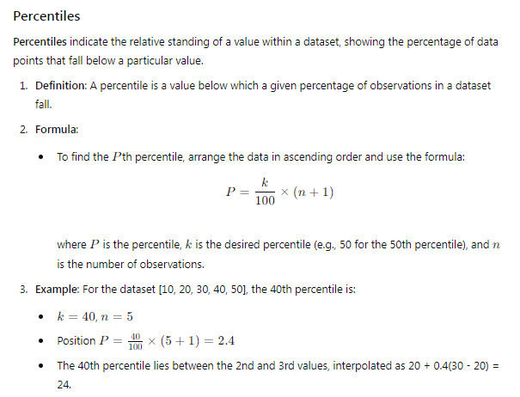
MEASURES OF POSITION
Measures of position are statistical tools that describe the location of specific values within a dataset. They help to understand how individual data points or subsets of data compare to the entire distribution. Common measures of position include percentiles, quartiles, deciles, and z-scores.

Slide 20
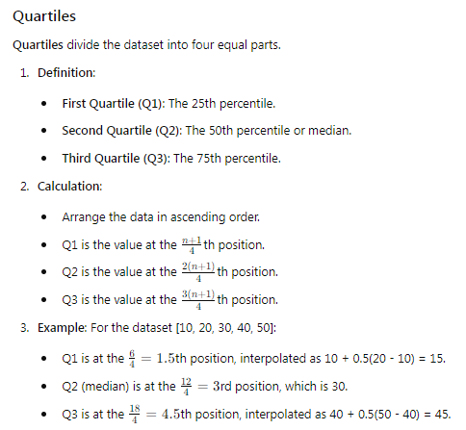
MEASURES OF POSITION

Slide 21
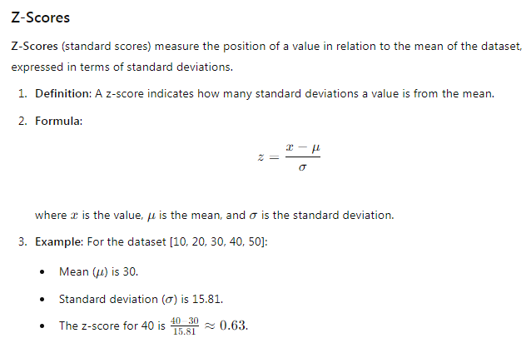
MEASURES OF POSITION

Slide 22
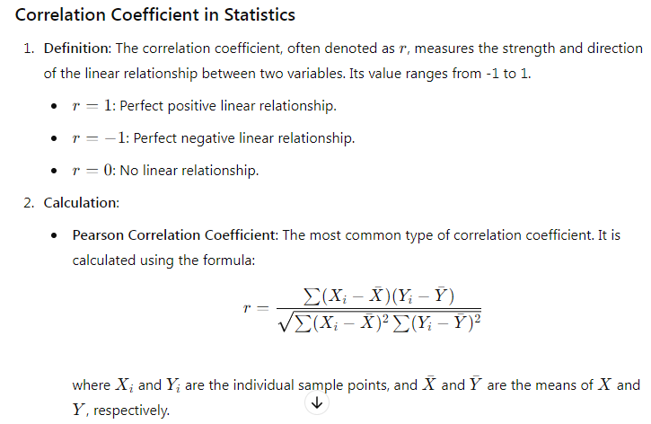
CORRELATION COEFFICIENT

Slide 23
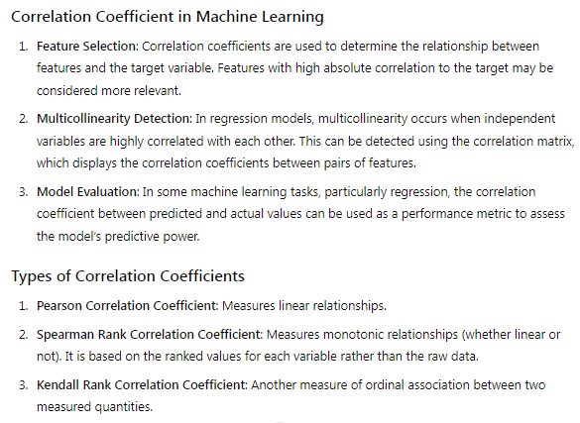
CORRELATION COEFFICIENT

Slide 24
UNIVARIATE, BIVARIATE AND MULTIVARIATE PLOTS
Univariate, bivariate, and multivariate plots are graphical methods used to visualize and understand data. They are essential tools in exploratory data analysis (EDA) for identifying patterns, trends, and relationships within the data.
Univariate Plots
Univariate plots are used to visualize the distribution of a single variable.
Histogram: Displays the frequency distribution of a continuous variable. It helps in understanding the central tendency, spread, and shape of the data distribution.
Box Plot: Shows the distribution of a continuous variable through its quartiles, highlighting the median, upper and lower quartiles, and potential outliers.
Density Plot: A smoothed version of the histogram, providing a continuous estimate of the probability density function of the variable.
Bar Plot: Used for categorical data to show the count or frequency of each category.

Slide 25
UNIVARIATE, BIVARIATE AND MULTIVARIATE PLOTS
Bivariate Plots
Bivariate plots are used to visualize the relationship between two variables.
Scatter Plot: Displays the relationship between two continuous variables. It helps in identifying correlations, trends, and outliers.
Line Plot: Useful for time series data to show the trend of a variable over time.
Box Plot: Can also be used to compare the distribution of a continuous variable across different categories of a categorical variable.
Heatmap: Shows the correlation between two variables using color intensity. Commonly used for correlation matrices.
Joint Plot: Combines scatter plots and histograms to show the distribution of two variables and their correlation.

Slide 26
UNIVARIATE, BIVARIATE AND MULTIVARIATE PLOTS
Multivariate Plots
Multivariate plots are used to visualize the relationships among three or more variables.
Pair Plot: Displays scatter plots for all pairs of variables along with histograms or density plots for the individual variables. Useful for examining pairwise relationships in the data.
Facet Grid: Allows plotting multiple plots for different subsets of the data, based on the values of categorical variables.
3D Scatter Plot: Visualizes the relationship among three continuous variables in a three-dimensional space.
Heatmap: Can also be used for higher-dimensional data where a matrix representation is feasible, such as correlation matrices for multiple variables.
Parallel Coordinates Plot: Used to visualize multi-dimensional categorical data by plotting each feature on a separate parallel axis and connecting points belonging to the same data instance.

Slide 27
PROBABILTY & USE IN MACHINE LEARNING
Probability is a fundamental concept in machine learning, providing a mathematical framework for modeling uncertainty and making predictions. Here’s a detailed look at how probability is used in machine learning:
Probability Basics
Definition: Probability quantifies the likelihood of an event occurring, ranging from 0 (impossible) to 1 (certain).
Probability Distribution: Describes how probabilities are distributed over different outcomes. Common distributions include:
Discrete Distributions: e.g., Binomial, Poisson.
Continuous Distributions: e.g., Normal (Gaussian), Exponential.

Slide 28
PROBABILTY & USE IN MACHINE LEARNING
Key Concepts in Probability:
Random Variables: Variables whose possible values are numerical outcomes of a random phenomenon.
Probability Density Function (PDF): For continuous variables, describes the likelihood of a random variable to take on a given value.
Cumulative Distribution Function (CDF): The probability that a random variable takes on a value less than or equal to a given point.
Joint Probability: The probability of two events occurring together.
Conditional Probability: The probability of an event occurring given that another event has occurred.
Role of Probability in Machine Learning:
Modeling Uncertainty: Machine learning often deals with uncertain data and outcomes. Probability provides a framework to model and manage this uncertainty.
Algorithm Design: Many machine learning algorithms are based on probabilistic principles, such as Bayesian inference and Hidden Markov Models.
Evaluation Metrics: Probabilistic metrics like log-likelihood are used to evaluate model performance.

Slide 29
PROBABILTY & USE IN MACHINE LEARNING
Examples of Probability in Machine Learning Algorithms:
Naive Bayes Classifier:
Assumes independence between features and uses Bayes' theorem for classification
Gaussian Mixture Models (GMM):
Models the data as a mixture of multiple Gaussian distributions
Hidden Markov Models (HMM):
Models sequential data with states that are not directly observable.

Slide 30
PROBABILTY – JOINT, MARGINAL & CONDITIONAL
Joint Probability:
Joint probability refers to the probability of two (or more) events happening at the same time. If we have two events, AAA and BBB, the joint probability is denoted as P(A∩B)P(AUB)or P(A,B)P(A, B)P(A,B). It represents the likelihood of both events occurring simultaneously.
For example, if AAA is the event that a person is male, and BBB is the event that a person is over 30 years old, P(A∩B)P(A \cap B)P(A∩B) is the probability that a person is both male and over 30 years old.
Marginal Probability:
Marginal probability refers to the probability of a single event occurring without consideration of any other events. It is obtained by summing or integrating the joint probabilities over all possible values of the other event(s).
For example, if we have the joint probability distribution of two events, AAA and BBB, the marginal probability of AAA, denoted as P(A)P(A)P(A), is calculated as: P(A)=∑BP(A∩B)P(A) = \sum_{B} P(A \cap B)P(A)=∑B​P(A∩B) or, in the case of a continuous distribution: P(A)=∫P(A,B) dBP(A) = \int P(A, B) \, dBP(A)=∫P(A,B)dB
Conditional Probability:
Conditional probability refers to the probability of one event occurring given that another event has already occurred. If we want to know the probability of event AAA occurring given that event BBB has occurred, we denote it as P(A∣B)P(A|B)P(A∣B).

Slide 31
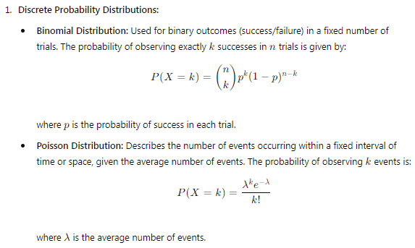
PROBABILTY DISTRIBUTION
A probability distribution describes how the values of a random variable are distributed. It provides a function that maps each possible outcome of the random variable to its probability of occurrence. Understanding probability distributions is crucial in both statistics and machine learning as they form the basis for statistical inference, model building, and prediction.
Types of Probability Distributions

Slide 32
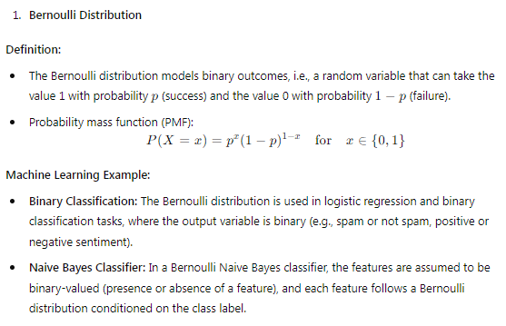
PROBABILTY DISTRIBUTION
Discrete Probability Distributions And Their Machine Learning Applications

Slide 33
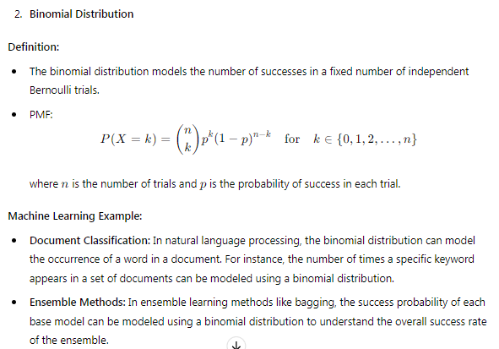
PROBABILTY DISTRIBUTION
Discrete Probability Distributions And Their Machine Learning Applications

Slide 34
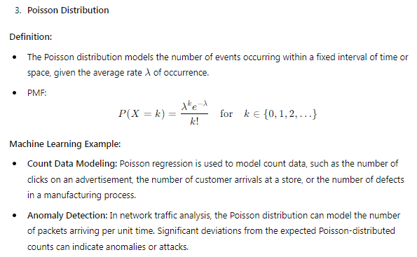
PROBABILTY DISTRIBUTION
Discrete Probability Distributions And Their Machine Learning Applications

Slide 35
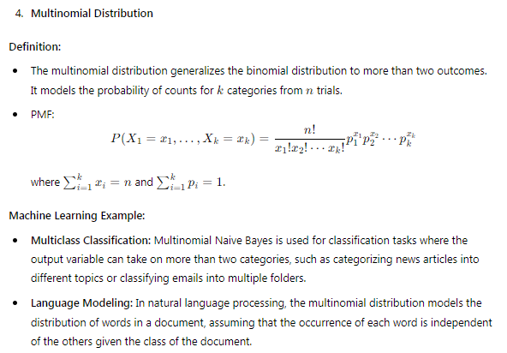
PROBABILTY DISTRIBUTION
Discrete Probability Distributions And Their Machine Learning Applications

Slide 36
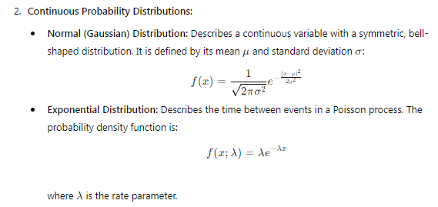
PROBABILTY DISTRIBUTION

Slide 37
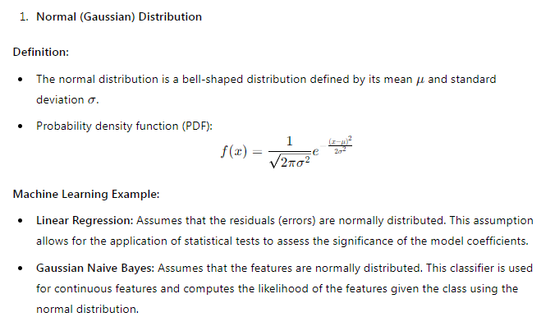
PROBABILTY DISTRIBUTION
Continuous Probability Distributions And Their Machine Learning Applications

Slide 38
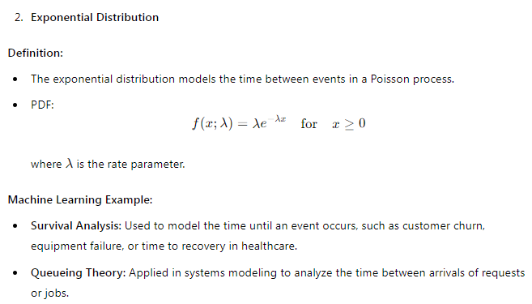
PROBABILTY DISTRIBUTION
Continuous Probability Distributions And Their Machine Learning Applications

Slide 39
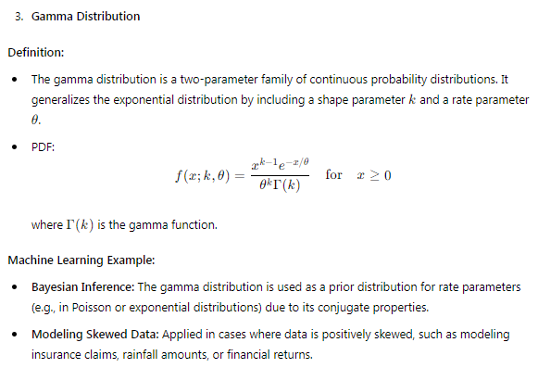
PROBABILTY DISTRIBUTION
Continuous Probability Distributions And Their Machine Learning Applications

Slide 40
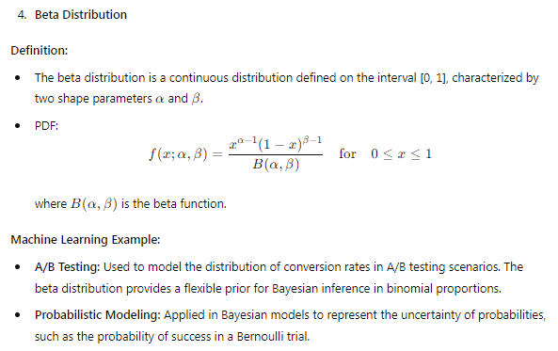
PROBABILTY DISTRIBUTION
Continuous Probability Distributions And Their Machine Learning Applications

Slide 41
PROBABILTY DISTRIBUTION
Bayesian Probability:
Bayesian probability is a method of probability interpretation that provides a way to update the probability estimate for a hypothesis as more evidence or information becomes available. It is based on Bayes' Theorem, which relates the conditional and marginal probabilities of random events. Bayesian methods are widely used in machine learning for probabilistic modeling, inference, and decision-making.

