Slide 1
MACHINE LEARNING AND ITS TYPES

Slide 2
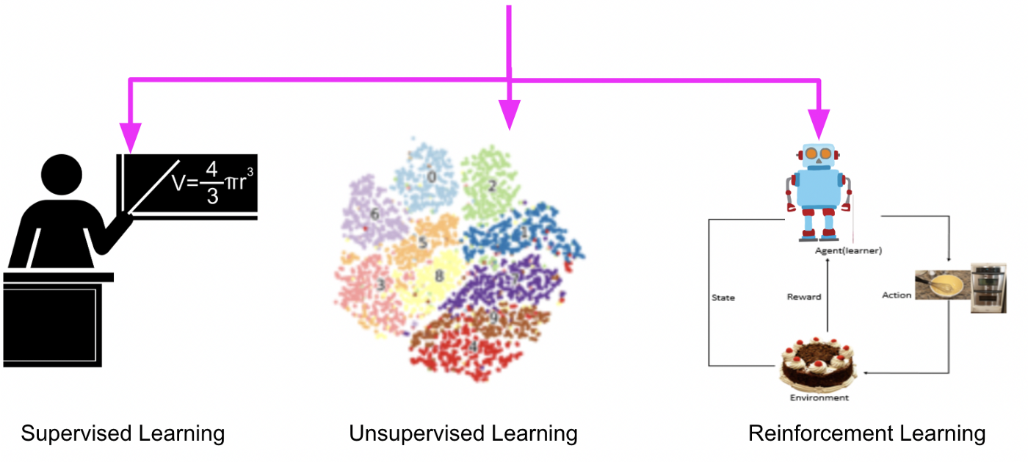
TYPES OF MACHINE LEARNING
Supervised Learning (learning with labeled data)
Unsupervised Learning (discover patterns in unlabeled data)
Reinforcement learning (learn to act based on feedback/rewards)

Slide 3
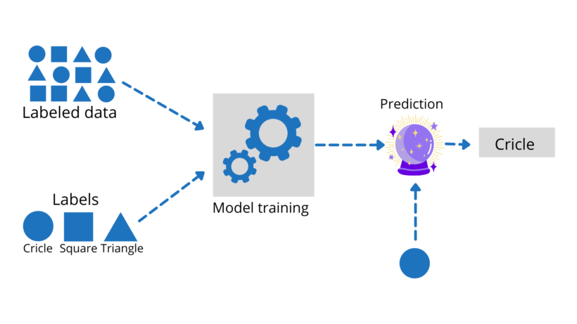
SUPERVISED LEARNING

Slide 4
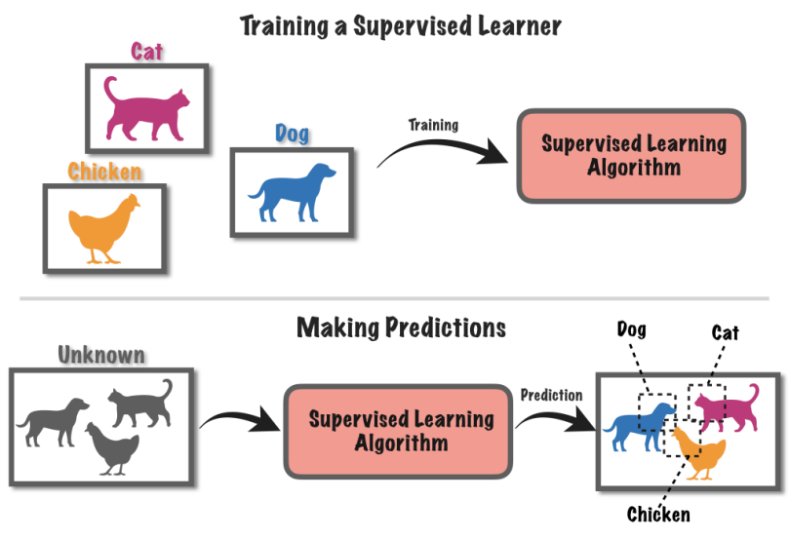
SUPERVISED LEARNING

Slide 5
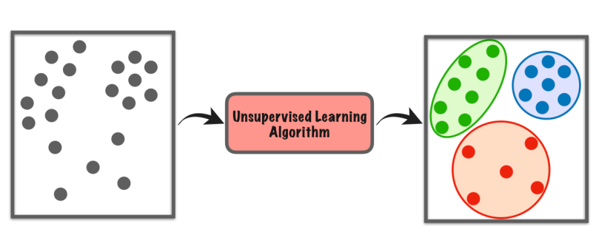
UNSUPERVISED LEARNING
Clustering
Dimensionality Reduction
Anomaly Detection

Slide 6
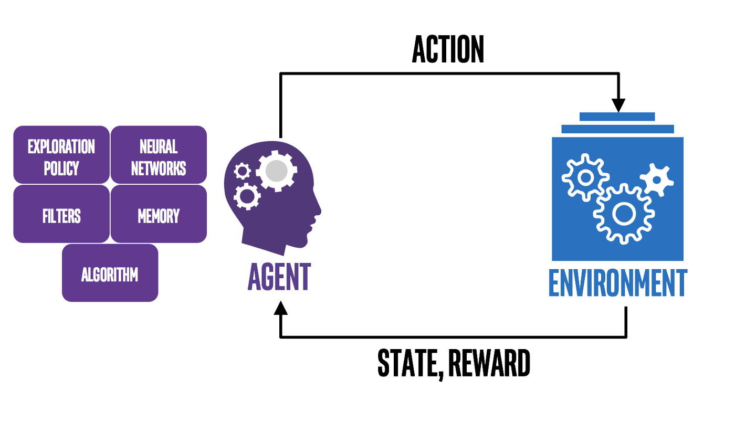
REINFORCEMENT LEARNING

Slide 7
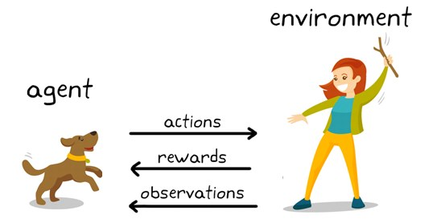
REINFORCEMENT LEARNING

Slide 8
STRUCTURED DATA
Structured data is organized and follows a predefined format, usually stored in databases or spreadsheets.
Example: A customer database with columns for name, age, email, and purchase history.
Ordinal data
Nominal data
Numerical data

Slide 9
UNSTRUCTURED DATA
Unstructured data refers to data that does not have a predefined format or structure. This type of data is often text-heavy and may include various types of multimedia content such as images, videos, and audio files. Unstructured data is typically more complex and difficult to analyze compared to structured data.
Characteristics of Unstructured Data:
No Predefined Schema: Unstructured data does not follow a specific format or schema, making it more flexible but harder to manage.
Storage in NoSQL Databases and Data Lakes: It is commonly stored in NoSQL databases like MongoDB or data lakes which can handle large volumes of diverse data types.
Complexity in Search and Analysis: Searching and analyzing unstructured data require specialized tools and techniques, such as natural language processing (NLP) and machine learning algorithms.
Examples: Examples of unstructured data include emails, social media posts, sensor data, documents, images, videos, and audio recordings.

Slide 10
SEMI-STRUCTURED DATA
Semi-structured data has some organization but does not adhere to a strict schema, often containing tags or labels.
Example: Emails, JSON files that contain data with tags or key-value pairs.

Slide 11
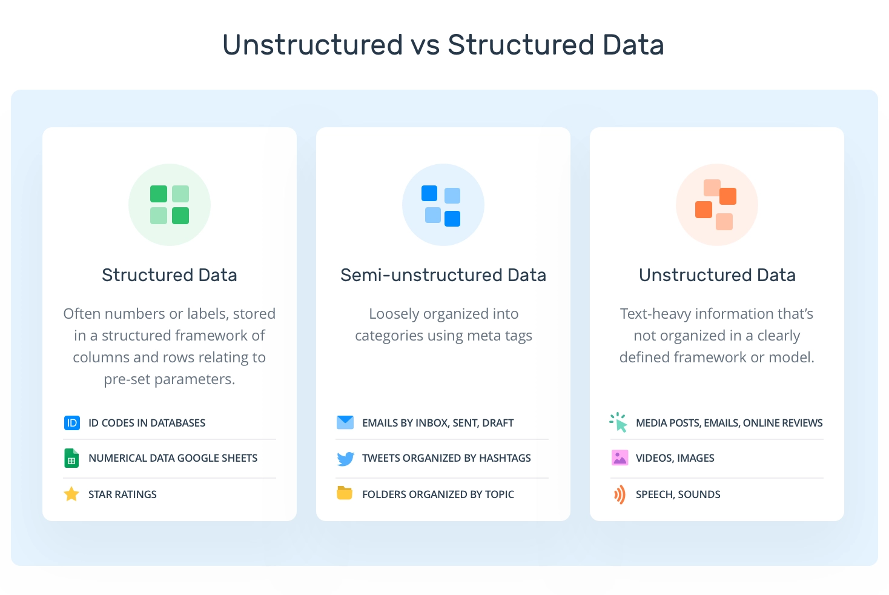
STRUCTURED / UNSTRUCTURED DATA

Slide 12
DATA PREPROCESSING
Data preprocessing is the process of cleaning, transforming, and organizing raw data to make it suitable for analysis and machine learning models.
Importance: High-quality data preprocessing is crucial for accurate and meaningful insights.

Slide 13
DATA PREPROCESSING
Common Steps in Data Preprocessing:
Importing the Data
Handling Missing Data
Handling Duplicate Data
Handling Outliers
Encoding Categorical Variables
Scaling and Normalization

Slide 14
DATA PREPROCESSING FOR CLASSIFICATION
Classification:
Classification is a machine learning technique used to predict categorical or discrete target variables.
Types of classification problems: binary (two classes) and multi-class (more than two classes).
Data preprocessing is essential to transform raw data into a suitable format for machine learning algorithms.
It involves cleaning, transforming, and encoding the data.
Preprocessing improves model accuracy, handles missing values, and deals with categorical variables.

Slide 15
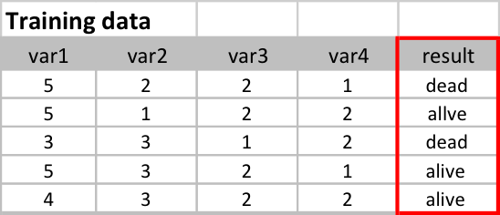
DATA PREPROCESSING FOR CLASSIFICATION
Selecting the Target Variable:
The target variable is the variable we want to predict/classify.
It represents the outcome or label we are interested in.
Choose a meaningful target variable based on the problem at hand.

Slide 16

What is Exploratory Data Analysis (EDA)?
The process of exploring and summarizing the main characteristics of the data to uncover patterns, relationships, and trends.
It helps in formulating questions and making data-driven decisions.

Slide 17
What is Exploratory Data Analysis (EDA)?
IMPORTANCE OF EDA:
Provides an initial understanding of the dataset.
Helps in identifying data quality issues, such as missing values, outliers, and inconsistencies.
Guides the selection of appropriate statistical techniques and models.
Helps in feature engineering and variable selection.
Enables the discovery of meaningful insights and actionable conclusions.

Slide 18
What is Exploratory Data Analysis (EDA)?
STEPS IN EDA:
Data Cleaning
Descriptive Statistics
Data Visualization
Data Distribution
Correlation Analysis
Outlier Detection
Data Transformation

Slide 19
DATA CLEANING TECHNIQUES
Handling Missing Data: We use methods like filling or removing to deal with missing values.
Outlier Detection: Find and address unusual data that can affect analysis or models.
Data Standardization: Make data consistent for easier analysis and comparison.
Data Validation: Check data against rules to ensure accuracy and reliability.

Slide 20
SCIKIT-LEARN
scikit-learn is a popular open-source machine learning library for Python.
It provides a wide range of tools and algorithms for classification, regression, clustering, and more.
Features include easy-to-use interfaces, extensive documentation, and integration with other scientific Python libraries.
https://scikit-learn.org/stable/

Slide 21
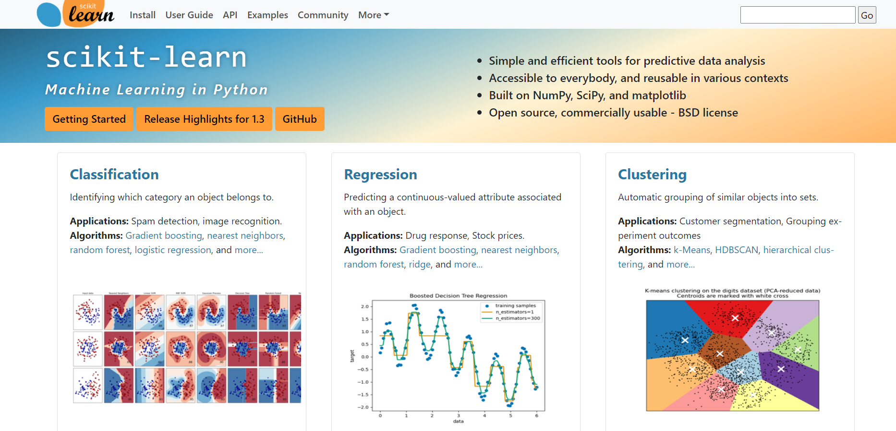
SCIKIT-LEARN

Slide 22
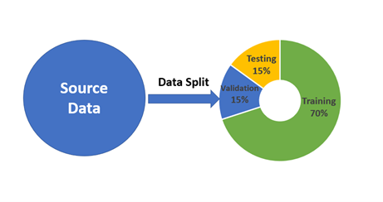
Data Splitting: Train and Test Sets
Splitting data into training and testing sets is crucial for evaluating model performance.
The training set is used to build and train the classification model.
The testing set is used to evaluate the model on unseen data.

Slide 23
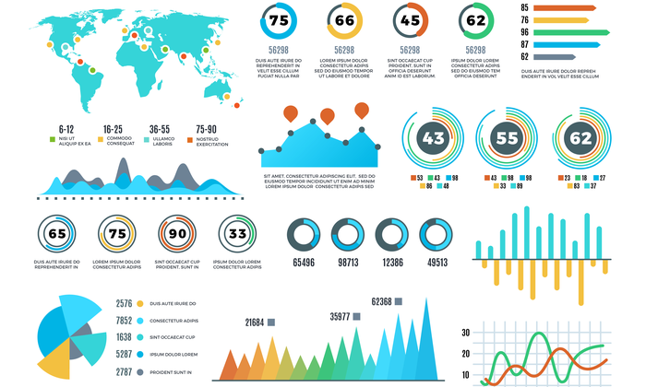
DATA VISUALIZATION
Data visualization is the graphical representation of data and information. It involves creating visual elements such as charts, graphs, and maps to help people understand complex data patterns.

Slide 24
DATA VISUALIZATION
Importance of data Visualization
Enhances Data Understanding
Identification of Patterns and Trends
Quick Problem Identification
Narrative Building

Slide 25
Interquartile Range (IQR)
The IQR represents the difference between the first and third quartiles(Q1 and Q3).
It indicates the spread of the middle 50% of the data.
Formula: IQR = Q3 - Q1
Interpretation of the IQR
The IQR provides information about the spread and variability of the data.
A larger IQR indicates a greater spread and more variability in the dataset.
Conversely, a smaller IQR suggests a less spread and less variability.

Slide 26
Correlation Analysis
Correlation analysis is used to determine the relationship between two or more variables in a dataset. It helps us understand how changes in one variable affect another variable.
Interpreting Correlation Values
Correlation values close to +1 or -1 indicate a strong relationship.
Correlation values close to 0 indicate a weak or no relationship.
The magnitude of the correlation value represents the strength of the relationship.

Slide 27
Correlation Analysis
Examples of Correlation Interpretation:
Correlation coefficient = +0.9:
There is a strong positive relationship between variables.
As one variable increases, the other variable tends to increase proportionally.
Correlation coefficient = -0.6:
There is a moderate negative relationship between variables.
As one variable increases, the other variable tends to decrease, but not as strongly as in a strong negative correlation.
Correlation coefficient = +0.2:
There is a weak positive relationship between variables.
The variables are positively related, but the relationship is not strong.

Slide 28
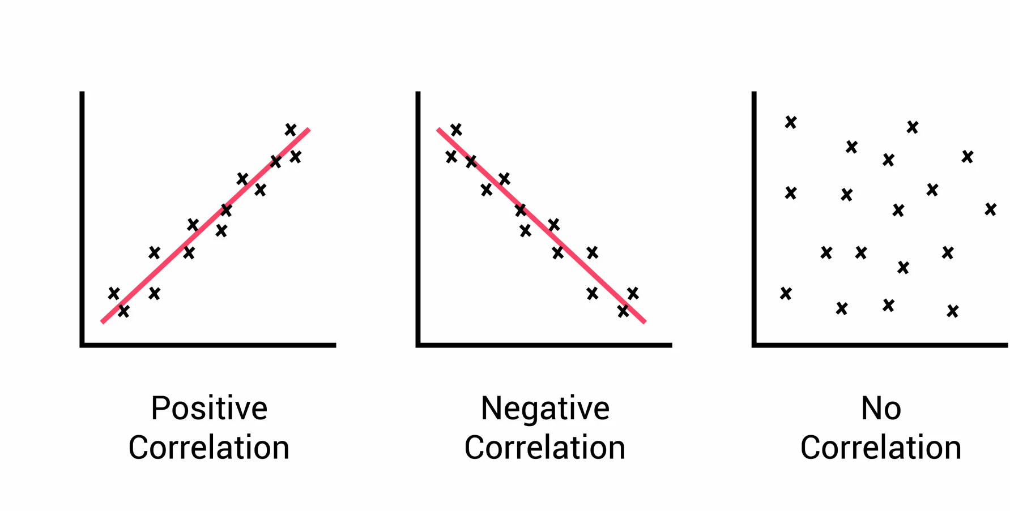
Correlation Analysis

Slide 29
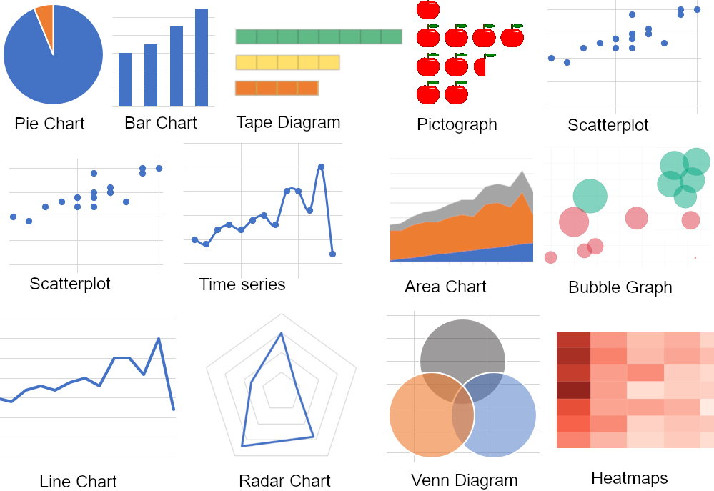
Types of Data and Visualization
Different data types require different visualization techniques to convey insights accurately.

Slide 30
REGRESSION AND CLASSIFICATION PROBLEMS
What is Regression
Regression is a fundamental technique in machine learning used to analyze relationships between variables and make predictions.
In Regression, we plot a graph between the variables which best fit the given data points. The machine learning model can deliver predictions regarding the data. In naïve words, “Regression shows a line or curve that passes through all the data points on a target-predictor graph in such a way that the vertical distance between the data points and the regression line is minimum.” It is used principally for prediction, forecasting, time series modeling, and determining the causal-effect relationship between variables.

Slide 31
TYPES OF REGRESSION MODELS
Linear Regression
Polynomial Regression
Logistics Regression
Linear Regression:
Linear regression is a simple and commonly used regression model. It assumes a linear relationship between a dependent variable (Y-axis) and one or more independent variables (X-axis). The relationship is represented by the equation: Y = a + bX
YYY is the dependent variable.
XXX is the independent variable.
aaa is the intercept (the value of YYY when X=0X = 0X=0).
bbb is the slope of the line (the rate of change in YYY with respect to XXX).
Simple Linear Regression: When there’s only one independent variable, it’s called simple linear regression. For example, predicting house prices based on their area.
Multiple Linear Regression:
When there are multiple independent variables, we call it multiple linear regression. For example, predicting a person’s salary based on years of experience, education level, and location.

Slide 32
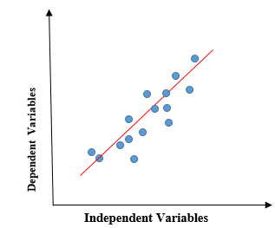
TYPES OF REGRESSION MODELS
What is Linear Regression?
Linear regression is a quiet and simple statistical regression method used for predictive analysis and shows the relationship between the continuous variables. Linear regression shows the linear relationship between the independent variable (X-axis) and the dependent variable (Y-axis), consequently called linear regression. If there is a single input variable (x), we call such linear regression simple linear regression. If there are more than one input variable, we call it multiple linear regression. The linear regression model gives a sloped straight line describing the relationship within the variables.

Slide 33
TYPES OF REGRESSION MODELS
Polynomial Regression
Polynomial regression is a form of linear regression in which the relationship between the independent variable XXX and the dependent variable YYY is modeled as an nnn-th degree polynomial. It’s useful when the relationship between variables isn’t linear.
Logistic Regression
Despite its name, logistic regression is a statistical method used for binary classification, not regression. It estimates the probability that an instance belongs to a particular class (e.g., yes/no, 1/0). The predicted values are mapped to [0, 1] through the logistic function (sigmoid function).

Slide 34
COMPONENTS OF SUPERVISED MACHINE LEARNING
Labeled Data:
Hypothesis (Model)
Cost Function (Loss Function):
Optimizer:

Slide 35
COMPONENTS OF SUPERVISED MACHINE LEARNING
Labeled Data:
Training Data: A dataset consisting of input-output pairs where each input is associated with a corresponding output label. This data is used to train the model.
Validation Data: A separate dataset used to tune the model's hyperparameters and assess its performance during training.
Test Data: A distinct dataset used to evaluate the final model's performance after training.
First, we need a dataset with labeled data. For example:
Size (sqft) | Bedrooms | Price ($)
1500 | 3 | 300000
1700 | 4 | 350000
1300 | 2 | 250000
2000 | 4 | 400000
1600 | 3 | 320000
This dataset will be split into training and test sets.

Slide 36
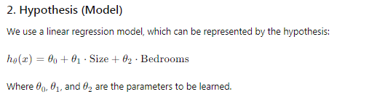
COMPONENTS OF SUPERVISED MACHINE LEARNING
Hypothesis (Model):
A hypothesis is a proposed model that represents the relationship between the input features and the output labels. It could be a linear regression model, decision tree, neural network, etc. The model parameters are adjusted during training to best fit the training data.

Slide 37
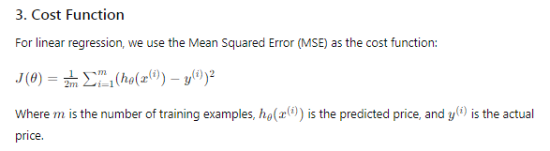
COMPONENTS OF SUPERVISED MACHINE LEARNING
Cost Function (Loss Function):
The cost function measures how well the model's predictions match the actual labels in the training data. It quantifies the error between the predicted and actual outputs. Common cost functions include Mean Squared Error (MSE) for regression tasks and Cross-Entropy Loss for classification tasks.

Slide 38
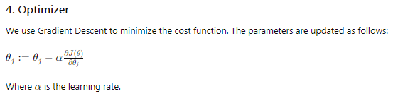
COMPONENTS OF SUPERVISED MACHINE LEARNING
Optimizer:
The optimizer is an algorithm used to minimize the cost function by adjusting the model's parameters iteratively. Common optimization algorithms include Gradient Descent, Stochastic Gradient Descent (SGD), Adam, and RMSprop. The optimizer updates the model parameters to reduce the error and improve the model's predictions.

Slide 39
COMPONENTS OF SUPERVISED MACHINE LEARNING
Explanation:
Labeled Data: The dataset X (features) and y (labels) is defined.
Hypothesis (Model): A linear regression model is created with parameters theta.
Cost Function: The compute_cost function calculates the MSE.
Optimizer: The gradient_descent function updates theta to minimize the cost function.

Slide 40
IMPLEMENTATION OF SUPERVISED MACHINE LEARNING
We'll use the Titanic dataset to demonstrate a supervised machine learning implementation. This dataset contains information about passengers on the Titanic, and we'll use it to predict whether a passenger survived or not based on features such as age, sex, and fare.
We'll use a logistic regression model for this binary classification problem.
Step-by-Step Implementation
Load the Dataset
Preprocess the Data
Define the Hypothesis (Model)
Define the Cost Function
Implement the Optimizer
Train the Model
Test the Model

Slide 41
IMPLEMENTATION OF SUPERVISED MACHINE LEARNING
Explanation:
Loading the Dataset: We load the Titanic dataset into a Pandas DataFrame.
Preprocessing the Data: We handle missing values, encode categorical variables using OneHotEncoder, and scale numerical features using StandardScaler. The data is split into training and test sets.
Defining the Hypothesis (Model): We initialize the parameters for a logistic regression model.
Defining the Cost Function: We define the logistic loss function.
Implementing the Optimizer: We implement gradient descent to minimize the cost function.
Training the Model: We train the model using gradient descent.
Evaluating the Model: We evaluate the model's performance on the test set using accuracy, confusion matrix, and classification report.

Slide 42
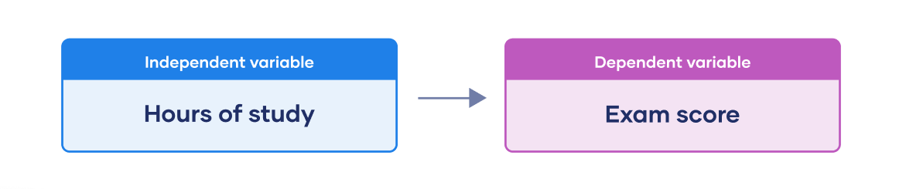
LINEAR REGRESSION
Linear regression is a supervised machine learning algorithm used for predicting a continuous output (dependent variable) based on one or more input features (independent variables).

Slide 43
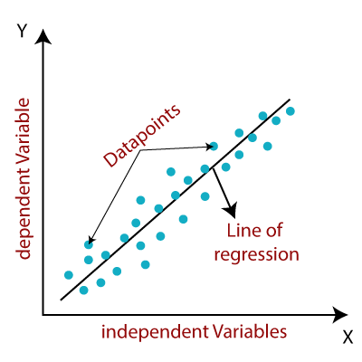
LINEAR REGRESSION
How does Linear Regression work?
It finds the best-fitting line that represents the relationship between X and Y.

Slide 44
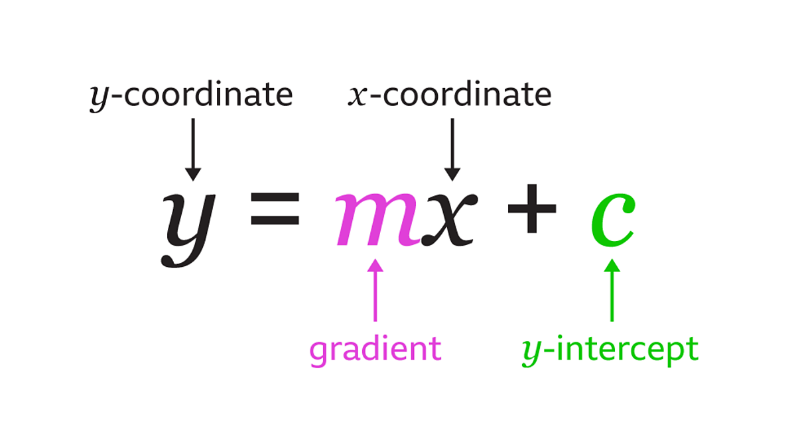
LINEAR REGRESSION
Understanding the Linear Equation
The linear equation: y = mx + c
y: The dependent variable (output/prediction we want to make)
x: The independent variable (input/feature)
m: The slope of the line (how much y changes when x changes)
c: The y-intercept (the value of y when x is 0)

Slide 45
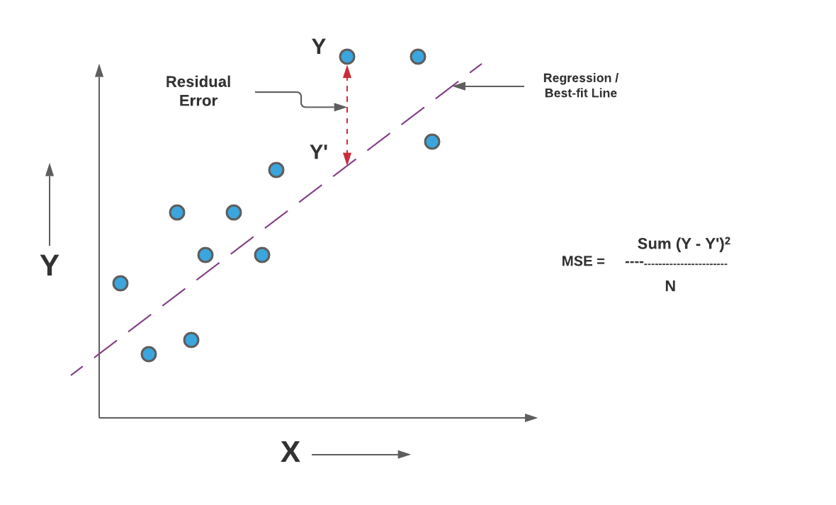
LINEAR REGRESSION
Mean Squared Error (MSE)
The Mean Squared Error (MSE) is a common evaluation metric used in regression tasks.
It measures the average squared difference between the actual and predicted values.

Slide 46
Feature Standardization and Transformation
Standardization
Standardization is a type of data preprocessing that makes different features have a similar scale.
Example
Suppose we have data on students' height in centimeters and weight in kilograms.
Heights might range from 150 cm to 180 cm, while weights might range from 40 kg to 80 kg.
Standardization scales both height and weight so they have similar ranges, like between 0 and 1.

Slide 47
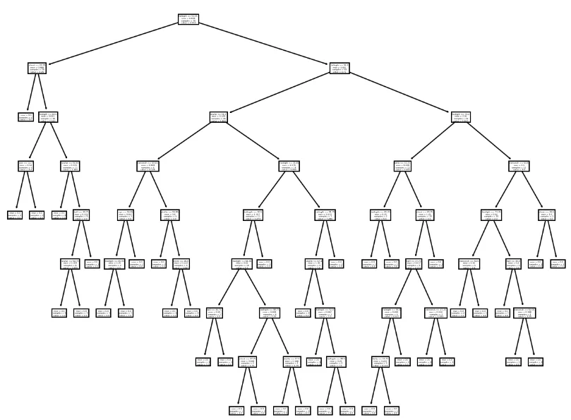
Different Regression Techniques
Decision Tree Regressor
Decision tree regression involves partitioning the data into subsets based on the values of independent variables and predicting the average of the target variable for each subset.

Slide 48
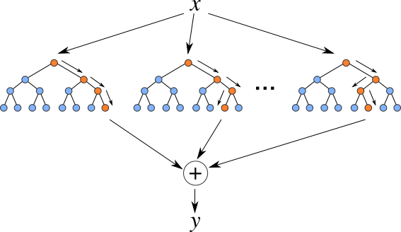
Different Regression Techniques
Random Forest Regressor:
Random Forest is learning method that creates multiple decision trees during training and outputs the average prediction (for regression) from all individual trees.

Slide 49
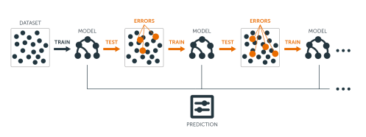
Different Regression Techniques
Gradient Boosting Regressor:
Gradient Boosting is learning technique that builds multiple decision trees sequentially, each one correcting the errors of its predecessor.

Slide 50
Comparison of Different regressors
Linear Regression: For simple and linear relationships.
Decision Tree: When dealing with non-linear patterns and interpretability is a priority.
Random Forest: For improved performance and robustness against outliers.
Gradient Boosting: When high accuracy is crucial, and longer training times are acceptable.

Slide 51
Comparison between Classification and Regression
Classification | Regression
In this problem statement, the target variables are discrete. | In this problem statement, the target variables are continuous.
Problems like Spam Email Classification, Disease prediction like problems are solved using Classification Algorithms. | Problems like House Price Prediction, Rainfall Prediction like problems are solved using regression Algorithms.
In this algorithm, we try to find the best possible decision boundary which can separate the two classes with the maximum possible separation. | In this algorithm, we try to find the best-fit line which can represent the overall trend in the data.
Evaluation metrics like Precision, Recall, and F1-Score are used here to evaluate the performance of the classification algorithms. | Evaluation metrics like Mean Squared Error, R2-Score, and MAPE are used here to evaluate the performance of the regression algorithms.
Here we face the problems like binary Classification or Multi-Class Classification problems. | Here we face the problems like Linear Regression models as well as non-linear models.
Input Data are Independent variables and categorical dependent variable. | Input Data are Independent variables and continuous dependent variable.
The classification algorithm’s task mapping the input value of x with the discrete output variable of y. | The regression algorithm’s task is mapping input value (x) with continuous output variable (y).
Output is Categorical labels. | Output is Continuous numerical values.
Objective is to Predict categorical/class labels. | Objective is to Predicting continuous numerical values.
Example use cases are Spam detection, image recognition, sentiment analysis | Example use cases are Stock price prediction, house price prediction, demand forecasting.
Examples of classification algorithms are: Logistic Regression, Decision Trees, Random Forest, Support Vector Machines (SVM), K-Nearest Neighbors (K-NN), Naive Bayes, Neural Networks, K-Means Clustering, Multi-layer Perceptron (MLP), etc. | Examples of regression algorithms are: Linear Regression, Polynomial Regression, Ridge Regression, Lasso Regression, Support Vector Regression (SVR), Decision Trees for Regression, Random Forest Regression, K-Nearest Neighbors (K-NN) Regression, Neural Networks for Regression, etc.

