Slide 1
PYTHON PROGRAMMING Version: 3.12.4
ARTIFICAL INTELLIGENCE MACHINE & DEEP LEARNING

Slide 2
PYTHON FUNCTION
PYTHON FUNCTIONS
A function is a block of code which only runs when it is called.
You can pass data, known as parameters, into a function.
A function can return data as a result.
Creating a Function
In Python a function is defined using the def keyword:
def my_function(): print("Hello from a function")
Calling a Function
To call a function, use the function name followed by parenthesis:
def my_function(): print("Hello from a function") my_function()

Slide 3
PYTHON FUNCTION
Function Arguments:
Information can be passed into functions as arguments.
Arguments are specified after the function name, inside the parentheses. You can add as many arguments as you want, just separate them with a comma.
def my_function(name): print(name + " Training") my_function(“PNY")
Number of Arguments
This function expects 2 arguments, and gets 2 arguments:
def my_function(name, lname): print(fname + " " + lname) my_function(“Azam", "Rashid")
Return Values
To let a function return a value, use the return statement:
def my_function(x): return 5 * x print(my_function(3))

Slide 4
PYTHON FUNCTION
Arbitrary Keyword Arguments, **kwargs
If you do not know how many keyword arguments that will be passed into your function, add two asterisk: ** before the parameter name in the function definition.
If the number of keyword arguments is unknown, add a double ** before the parameter name:
def my_function(**kid): print("His last name is " + kid[“name"]) my_function(fname = “Rashid", name = “Azam")
The pass Statement
function definitions cannot be empty, but if you for some reason have a function definition with no content, put in the pass statement to avoid getting an error.
def myfunction(): pass

Slide 5
PYTHON LAMBDA
A lambda function is a small anonymous function.
A lambda function can take any number of arguments, but can only have one expression.
Syntax
lambda arguments : expression
The expression is executed and the result is returned:
Add 10 to argument a, and return the result:
x = lambda a : a + 10 print(x(5))
Multiply argument a with argument b and return the result:
x = lambda a, b : a * b print(x(5, 6))
Summarize argument a, b, and c and return the result:
x = lambda a, b, c : a + b + c print(x(5, 6, 2))
lambda Return:
def myfunc(n): return lambda a : a * n

Slide 6
PYTHON map() Function
map() function returns a map object(which is an iterator) of the results after applying the given function to each item of a given iterable (list, tuple etc.)
Python map() Function Syntax
Syntax : map(fun, iter)
Parameters:
fun: It is a function to which map passes each element of given iterable.
iter: It is iterable which is to be mapped.
NOTE: You can pass one or more iterable to the map() function.
Returns: Returns a list of the results after applying the given function to each item of a given iterable (list, tuple etc.)
def addition(n):
return n + n
numbers = (1, 2, 3, 4)
result = map(addition, numbers)
print(list(result))
map() with Lambda Expressions
numbers = (1, 2, 3, 4)
result = map(lambda x: x + x, numbers)
print(list(result))

Slide 7
PYTHON map() / filter() Function
The filter() method filters the given sequence with the help of a function that tests each element in the sequence to be true or not.
Python filter() Syntax
Syntax: filter(function, sequence)
Parameters:
function: function that tests if each element of a sequence is true or not.
sequence: sequence which needs to be filtered, it can be sets, lists, tuples, or containers of any iterators.
Returns: an iterator that is already filtered.
# function that filters vowels
def fun(variable):
letters = ['a', 'e', 'i', 'o', 'u']
if (variable in letters):
return True
else:
return False
# sequence
sequence = ['g', 'e', 'e', 'j', 'k', 's', 'p', 'r']
# using filter function
filtered = filter(fun, sequence)
print('The filtered letters are:')
for s in filtered:
print(s)

Slide 8
PYTHON map() / filter() Function
Filter Function in Python with Lambda
Python filter() function is normally used with Lambda functions. In this example, we are using the lambda function to filter out the odd and even numbers from a list.
# a list contains both even and odd numbers.
seq = [0, 1, 2, 3, 5, 8, 13]
# result contains odd numbers of the list
result = filter(lambda x: x % 2 != 0, seq)
print(list(result))
# result contains even numbers of the list
result = filter(lambda x: x % 2 == 0, seq)
print(list(result))

Slide 9
PYTHON INNER FUNCTIONS
Inner functions
A function which is defined inside another function is known as:
inner function
or
nested function
EXAMPLE 1:
def outerFunction(text):
text = text
def innerFunction():
print(text)
innerFunction()
outerFunction('Hey !')
EXAMPLE 2:
def outer_function(x): def inner_function(y): return x + y return inner_function add_five = outer_function(5) result = add_five(10) # result is 15

Slide 10
PYTHON FILE HANDLING
Python supports file handling and allows users to handle files i.e., to read and write files, along with many other file handling options, to operate on files.
Python File Open
f = open(filename, mode)
Where the following mode is supported:
r: open an existing file for a read operation.
w: open an existing file for a write operation. If the file already contains some data, then it will be overridden but if the file is not present then it creates the file as well.
a: open an existing file for append operation. It won’t override existing data.
r+: To read and write data into the file. This mode does not override the existing data, but you can modify the data starting from the beginning of the file.
w+: To write and read data. It overwrites the previous file if one exists, it will truncate the file to zero length or create a file if it does not exist.
a+: To append and read data from the file. It won’t override existing data.
Working in Read mode
file = open('geek.txt', 'r')
print (file.read())
OR
for each in file:
print (each)

Slide 11
PYTHON FILE HANDLING
We can also split lines while reading files in Python. The split() function splits the variable when space is encountered.
with open("geeks.txt", "r") as file:
data = file.readlines()
for line in data:
word = line.split()
print (word)
Creating a File using the write() Function
file = open('geek.txt','w')
file.write("This is the write command")
file.write("It allows us to write in a particular file")
file.close()
Working of Append Mode
file = open('geek.txt', 'a')
file.write("This will add this line")
file.close()

Slide 12
PYTHON EXCEPTION HANDLING
In Python, there are several built-in Python exceptions that can be raised when an error occurs during the execution of a program. Here are some of the most common types of exceptions in Python:
SyntaxError: This exception is raised when the interpreter encounters a syntax error in the code, such as a misspelled keyword, a missing colon, or an unbalanced parenthesis.
TypeError: This exception is raised when an operation or function is applied to an object of the wrong type, such as adding a string to an integer.
NameError: This exception is raised when a variable or function name is not found in the current scope.
IndexError: This exception is raised when an index is out of range for a list, tuple, or other sequence types.
KeyError: This exception is raised when a key is not found in a dictionary.
ValueError: This exception is raised when a function or method is called with an invalid argument or input, such as trying to convert a string to an integer when the string does not represent a valid integer.
AttributeError: This exception is raised when an attribute or method is not found on an object, such as trying to access a non-existent attribute of a class instance.
IOError: This exception is raised when an I/O operation, such as reading or writing a file, fails due to an input/output error.
ZeroDivisionError: This exception is raised when an attempt is made to divide a number by zero.
ImportError: This exception is raised when an import statement fails to find or load a module.

Slide 13
PYTHON EXCEPTION HANDLING
Try and Except Statement – Catching Exceptions
Try and except statements are used to catch and handle exceptions in Python. Statements that can raise exceptions are kept inside the try clause and the statements that handle the exception are written inside except clause.
a = [1, 2, 3]
try:
print ("Second element = %d" %(a[1]))
print ("Fourth element = %d" %(a[3]))
except:
print ("An error occurred")
Catching Specific Exception
try: # statement(s) except IndexError: # statement(s) except ValueError: # statement(s)

Slide 14
PYTHON EXCEPTION HANDLING
Finally Keyword in Python
Python provides a keyword finally, which is always executed after the try and except blocks. The final block always executes after the normal termination of the try block or after the try block terminates due to some exception.
Syntax:
try: # Some Code.... except: # optional block # Handling of exception (if required) else: # execute if no exception finally: # Some code .....(always executed)
try:
k = 5//0
print(k)
except ZeroDivisionError:
print("Can't divide by zero")
finally:
print('This is always executed')

Slide 15
PYTHON EXCEPTION HANDLING
Raising Exception
The raise statement allows the programmer to force a specific exception to occur. The sole argument in raise indicates the exception to be raised.
try:
raise NameError("Hi there")
except NameError:
print ("An exception")
raise

Slide 16
Python Classes and Objects
Python is an object oriented programming language.
Almost everything in Python is an object, with its properties and methods.
A Class is like an object constructor, or a "blueprint" for creating objects.
Create a Class
To create a class, use the keyword class:
class MyClass: x = 5
Create Object
Now we can use the class named MyClass to create objects:
p1 = MyClass() print(p1.x)

Slide 17
Python Classes and Objects
Object Methods
Objects can also contain methods. Methods in objects are functions that belong to the object.
class Person: def __init__(self, name, age): self.name = name self.age = age def myfunc(self): print("Hello my name is " + self.name) p1 = Person("John", 36) p1.myfunc()
Modify Object Properties
p1.age = 40
Delete Object Properties
Delete the age property from the p1 object:
del p1.age
Note: The self parameter is a reference to the current instance of the class, and is used to access variables that belong to the class.

Slide 18
Python Classes and Objects
The __init__() Function
__init__ Function in Python is used to initialize objects of a class. It is also called a constructor.
__init__ Function is like default constructor in C++ and Java. Constructors are used to initialize the object’s state.
All classes have a function called __init__(), which is always executed when the class is being initiated.
Example 1:
# A Sample class with init method
class Person:
# init method or constructor
def __init__(self, name):
self.name = name
# Sample Method
def say_hi(self):
print('Hello, my name is', self.name)
p = Person('Nikhil')
p.say_hi()
Note: In Python, ‘self’ is a reference to the current instance of the class. It is used to access variables and methods that belong to the instance

Slide 19
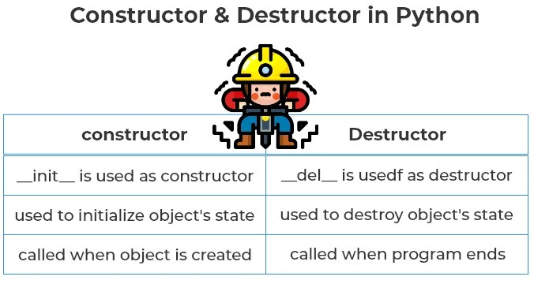
PYTHON CONSTRUTOR & DESTRUCTOR
Constructor: A constructor in Python is a special type of method which is used to initialize the instance members of the class. The task of constructors is to initialize and assign values to the data members of the class when an object of the class is created.
Destructor: Destructor in Python is called when an object gets destroyed. In Python, destructors are not needed, because Python has a garbage collector that handles memory management automatically.

Slide 20
PYTHON CONSTRUTOR & DESTRUCTOR
Constructor:
The __init__ method is similar to constructors in c++ and Java.
Constructors are used to initialize the object’s state.
The task of constructors is to initialize(assign values) to the data members of the class when an object of class is created.
Syntax:
class ClassName: def __init__( self , variables...): ##body
class A(object):
def __init__(self):
self.str1 = “PrepInsta”
print( self.str1)
print(‘In constructor’)
ob = A()

Slide 21
PYTHON CONSTRUTOR & DESTRUCTOR
Destructor:
The __del__ method is similar to destructor in c++ and Java.
Destructors are used to destroying the object’s state.
Syntax:
class ClassName: def __del__( self ,): ##body
class A(object):
def __init__(self):
self.str1 = ‘PrepInsta’
print(‘Object Created’ , self.str1)
def __del__(self):
print(‘Destructor is called Manually’)
ob = A()
del ob
#ob1=A()

Slide 22
Python Inheritance
Inheritance allows us to define a class that inherits all the methods and properties from another class.
Parent class is the class being inherited from, also called base class.
Child class is the class that inherits from another class, also called derived class.
Create a Parent Class
Create a class named Person, with firstname and lastname properties, and a printname method:
class Person: def __init__(self, fname, lname): self.firstname = fname self.lastname = lname def printname(self): print(self.firstname, self.lastname) #Use the Person class to create an object, and then execute the printname method: x = Person("John", "Doe") x.printname()

Slide 23
Python Inheritance
Create a Child Class
To create a class that inherits the functionality from another class, send the parent class as a parameter when creating the child class:
Create a class named Student, which will inherit the properties and methods from the Person class:
class Student(Person): pass
OR
class Student(Person): def __init__(self, fname, lname): Person.__init__(self, fname, lname)
x = Student("Mike", "Olsen") x.printname()
Use the super() Function
Python also has a super() function that will make the child class inherit all the methods and properties from its parent:
class Student(Person): def __init__(self, fname, lname): super().__init__(fname, lname)

Slide 24
Python Inheritance
Use the super() Function
Python also has a super() function that will make the child class inherit all the methods and properties from its parent:
class Student(Person): def __init__(self, fname, lname): super().__init__(fname, lname)
Add Properties
Add a property called graduationyear to the Student class:
class Student(Person): def __init__(self, fname, lname): super().__init__(fname, lname) self.graduationyear = 2019
Add Methods
Add a method called welcome to the Student class:
class Student(Person): def __init__(self, fname, lname, year): super().__init__(fname, lname) self.graduationyear = year def welcome(self): print("Welcome", self.firstname, self.lastname, "to the class of", self.graduationyear)

Slide 25
Access Modifiers in Python : Public, Private and Protected
A Class in Python has three types of access modifiers:
Public Access Modifier
Protected Access Modifier
Private Access Modifier
Public Access Modifier:
The members of a class that are declared public are easily accessible from any part of the program. All data members and member functions of a class are public by default.
# program to illustrate public access modifier in a class
class Geek:
# constructor
def __init__(self, name, age):
# public data members
self.geekName = name
self.geekAge = age
# public member function
def displayAge(self):
# accessing public data member
print("Age: ", self.geekAge)
# creating object of the class
obj = Geek("R2J", 20)
# accessing public data member
print("Name: ", obj.geekName)
# calling public member function of the class
obj.displayAge()

Slide 26
Access Modifiers in Python : Public, Private and Protected
Protected Access Modifier:
The members of a class that are declared protected are only accessible to a class derived from it. Data members of a class are declared protected by adding a single underscore ‘_’ symbol before the data member of that class.
Private Access Modifier:
The members of a class that are declared private are accessible within the class only, private access modifier is the most secure access modifier. Data members of a class are declared private by adding a double underscore ‘__’ symbol before the data member of that class.

Slide 27
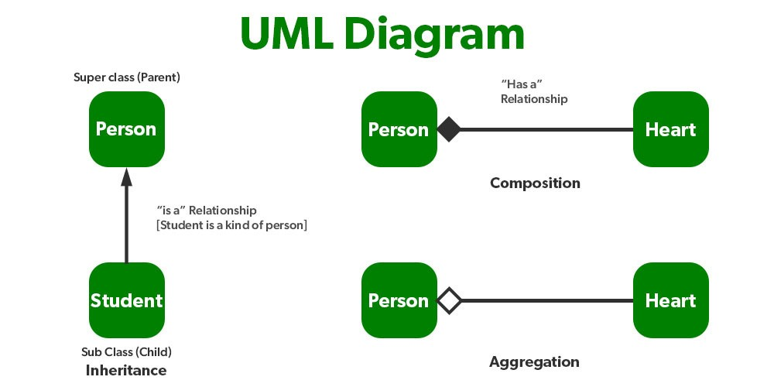
PYTHON- Association, Aggregation, Composition

Slide 28
PYTHON- Association, Aggregation, Composition
Composition
Composition is a type of Aggregation in which two entities are extremely reliant on one another.
It indicates a relationship component.
Both entities are dependent on each other in composition.
The composed object cannot exist without the other entity when there is a composition between two entities.
Aggregation
Aggregation is a concept in which an object of one class can own or access another independent object of another class.
It represents Has-A’s relationship.
It is a unidirectional association i.e. a one-way relationship. For example, a department can have students but vice versa is not possible and thus unidirectional in nature.
In Aggregation, both the entries can survive individually which means ending one entity will not affect the other entity.

Slide 29
PYTHON POLYMORPHISM
The word "polymorphism" means "many forms", and in programming it refers to methods/functions/operators with the same name that can be executed on many objects or classes.
The literal meaning of polymorphism is the condition of occurrence in different forms.
Polymorphism is a very important concept in programming. It refers to the use of a single type entity (method, operator or object) to represent different types in different scenarios.
Polymorphism in addition operator
We know that the + operator is used extensively in Python programs. But, it does not have a single usage.
For integer data types, + operator is used to perform arithmetic addition operation.
num1 = 1 num2 = 2 print(num1+num2)
Similarly, for string data types, + operator is used to perform concatenation.
str1 = "Python" str2 = "Programming" print(str1+" "+str2)

Slide 30
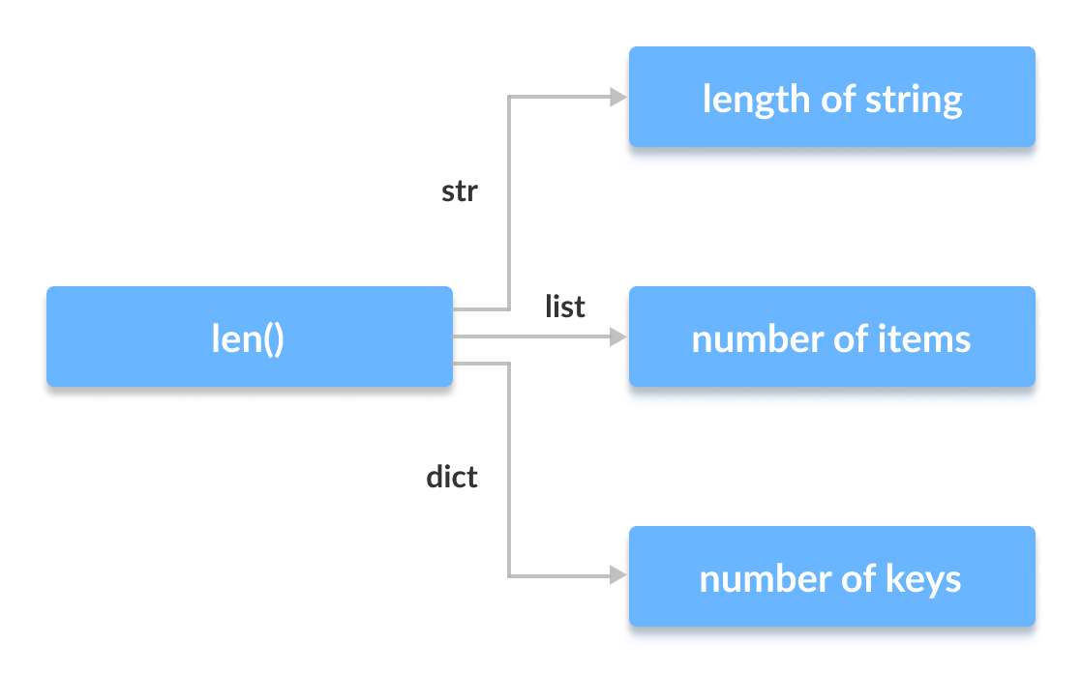
PYTHON POLYMORPHISM
Function Polymorphism in Python
There are some functions in Python which are compatible to run with multiple data types.
One such function is the len() function. It can run with many data types in Python.
print(len(["Python", "Java", "C"]))

Slide 31
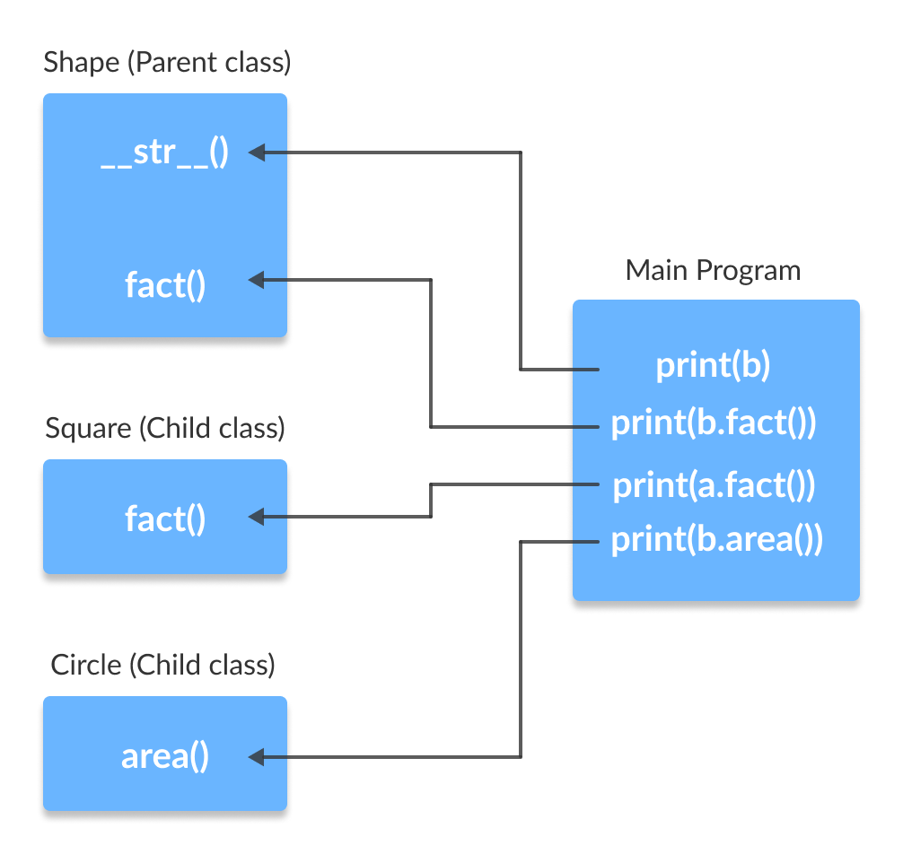
PYTHON POLYMORPHISM
Class Polymorphism in Python
We can use the concept of polymorphism while creating class methods as Python allows different classes to have methods with the same name.
Polymorphism and Inheritance
Polymorphism allows us to access these overridden methods and attributes that have the same name as the parent class.
Method Overriding

Slide 32
PYTHON OPERATOR OVERLOADING
In Python, we can change the way operators work for user-defined types.
For example, the + operator will perform arithmetic addition on two numbers, merge two lists, or concatenate two strings.
This feature in Python that allows the same operator to have different meaning according to the context is called operator overloading.
Python Special Functions
Class functions that begin with double underscore __ are called special functions in Python.
The special functions are defined by the Python interpreter and used to implement certain features or behaviors.
They are called "double underscore" functions because they have a double underscore prefix and suffix, such as __init__() or __add__().

Slide 33
PYTHON MAGIC / THUNDER FUNCTIONS
Classes using special methods, also known as magic methods or dunder methods. A special method is a method whose name starts and ends with a double underscore. These methods have special meanings for Python.
SYNTAX:
__method__()
num=10
res = num.__add__(5)
print(res)
num=12
val = int.__str__(num)
print(type(val))
Built-in classes in Python define many magic methods. Use the dir() function to see the number of magic methods inherited by a class. For example, the following lists all the attributes and methods defined in the int class.
print(dir(int))

Slide 34
PYTHON MAGIC / THUNDER FUNCTIONS
Dynamic polymorphism in Python, often referred to as runtime polymorphism, allows methods to be defined in a subclass that override methods defined in a base class. This enables different behaviors based on the subclass that is instantiated.
demonstrating dynamic polymorphism using inheritance and method overriding:
Explanation
Base Class (Animal): The Animal class defines an abstract method speak. This method is meant to be overridden in subclasses.
Subclasses (Dog, Cat, Bird): Each subclass of Animal overrides the speak method to provide its own implementation.
Polymorphism in Action: The animal_sound function takes an instance of Animal (or any subclass thereof) and calls the speak method. Depending on the actual subclass of the animal object, the appropriate overridden method is executed.
Benefits of Dynamic Polymorphism
Flexibility: You can write code that works with objects of different classes, allowing for more flexible and reusable code.
Maintainability: It is easier to maintain and extend. You can add new subclasses without changing the existing code that uses the base class.

Slide 35
PYTHON ABSTRACT CLASS & METHODS
An abstract class can be considered a prototype / sketch for other classes. It allows you to create a set of methods that must be created within any child classes built from the abstract class.
A class that contains one or more abstract methods is called an abstract class. An abstract method is a method that has a declaration but does not have an implementation
Working on Python Abstract classes
By default, Python does not provide abstract classes. Python comes with a module that provides the base for defining Abstract Base classes(ABC) and that module name is ABC.
A method becomes abstract when decorated with the keyword @abstractmethod.

Slide 36
PYTHON KEYWORD ARGUMENTS
Keyword Arguments
You can also send arguments with the key = value syntax.
This way the order of the arguments does not matter.
def my_function(child3, child2, child1): print("The youngest child is " + child3) my_function(child1 = "Emil", child2 = "Tobias", child3 = "Linus")

