Slide 1
PYTHON Version: 3.12.4

Slide 2
PYTHON POLYMORPHISM
The word "polymorphism" means "many forms", and in programming it refers to methods/functions/operators with the same name that can be executed on many objects or classes.
The literal meaning of polymorphism is the condition of occurrence in different forms.
Polymorphism is a very important concept in programming. It refers to the use of a single type entity (method, operator or object) to represent different types in different scenarios.
Polymorphism in addition operator
We know that the + operator is used extensively in Python programs. But, it does not have a single usage.
For integer data types, + operator is used to perform arithmetic addition operation.
num1 = 1 num2 = 2 print(num1+num2)
Similarly, for string data types, + operator is used to perform concatenation.
str1 = "Python" str2 = "Programming" print(str1+" "+str2)

Slide 3
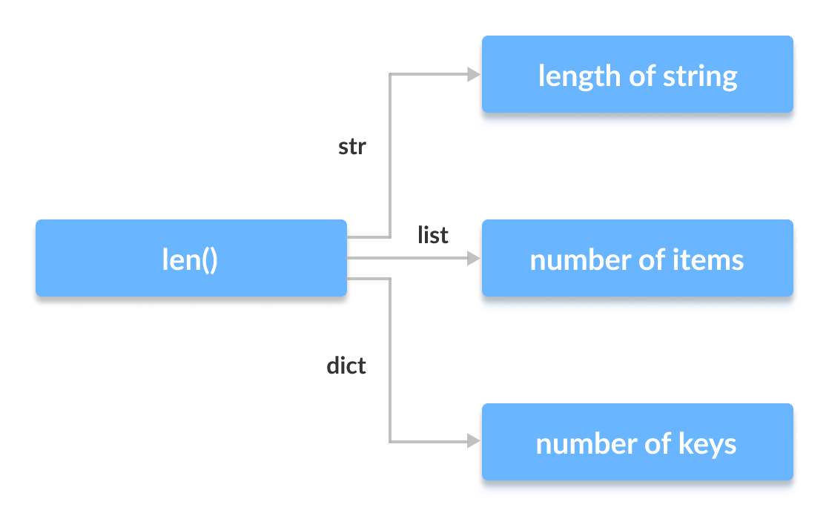
PYTHON POLYMORPHISM
Function Polymorphism in Python
There are some functions in Python which are compatible to run with multiple data types.
One such function is the len() function. It can run with many data types in Python.
print(len(["Python", "Java", "C"]))

Slide 4
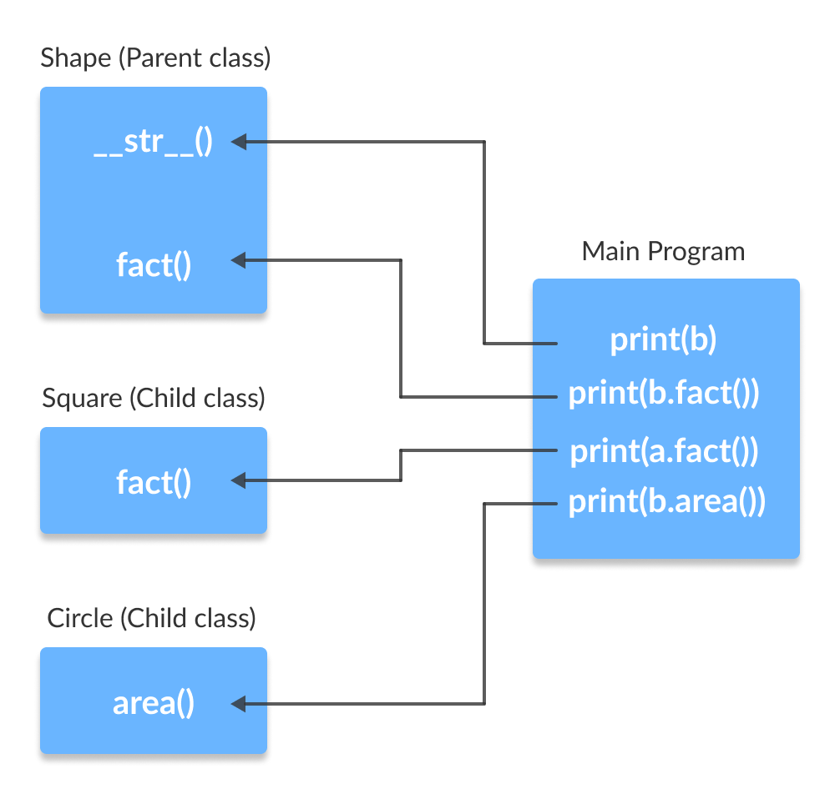
PYTHON POLYMORPHISM
Class Polymorphism in Python
We can use the concept of polymorphism while creating class methods as Python allows different classes to have methods with the same name.
Polymorphism and Inheritance
Polymorphism allows us to access these overridden methods and attributes that have the same name as the parent class.
Method Overriding

Slide 5
PYTHON OPERATOR OVERLOADING
In Python, we can change the way operators work for user-defined types.
For example, the + operator will perform arithmetic addition on two numbers, merge two lists, or concatenate two strings.
This feature in Python that allows the same operator to have different meaning according to the context is called operator overloading.
Python Special Functions
Class functions that begin with double underscore __ are called special functions in Python.
The special functions are defined by the Python interpreter and used to implement certain features or behaviors.
They are called "double underscore" functions because they have a double underscore prefix and suffix, such as __init__() or __add__().

Slide 6
PYTHON MAGIC / THUNDER FUNCTIONS
Classes using special methods, also known as magic methods or dunder methods. A special method is a method whose name starts and ends with a double underscore. These methods have special meanings for Python.
SYNTAX:
__method__()
num=10
res = num.__add__(5)
print(res)
num=12
val = int.__str__(num)
print(type(val))
Built-in classes in Python define many magic methods. Use the dir() function to see the number of magic methods inherited by a class. For example, the following lists all the attributes and methods defined in the int class.
print(dir(int))

Slide 7
PYTHON MAGIC / THUNDER FUNCTIONS
Dynamic polymorphism in Python, often referred to as runtime polymorphism, allows methods to be defined in a subclass that override methods defined in a base class. This enables different behaviors based on the subclass that is instantiated.
demonstrating dynamic polymorphism using inheritance and method overriding:
Explanation
Base Class (Animal): The Animal class defines an abstract method speak. This method is meant to be overridden in subclasses.
Subclasses (Dog, Cat, Bird): Each subclass of Animal overrides the speak method to provide its own implementation.
Polymorphism in Action: The animal_sound function takes an instance of Animal (or any subclass thereof) and calls the speak method. Depending on the actual subclass of the animal object, the appropriate overridden method is executed.
Benefits of Dynamic Polymorphism
Flexibility: You can write code that works with objects of different classes, allowing for more flexible and reusable code.
Maintainability: It is easier to maintain and extend. You can add new subclasses without changing the existing code that uses the base class.

Slide 8
PYTHON ABSTRACT CLASS & METHODS
An abstract class can be considered a prototype / sketch for other classes. It allows you to create a set of methods that must be created within any child classes built from the abstract class.
A class that contains one or more abstract methods is called an abstract class. An abstract method is a method that has a declaration but does not have an implementation
Working on Python Abstract classes
By default, Python does not provide abstract classes. Python comes with a module that provides the base for defining Abstract Base classes(ABC) and that module name is ABC.
A method becomes abstract when decorated with the keyword @abstractmethod.

Slide 9
PYTHON KEYWORD ARGUMENTS
Keyword Arguments
You can also send arguments with the key = value syntax.
This way the order of the arguments does not matter.
def my_function(child3, child2, child1): print("The youngest child is " + child3) my_function(child1 = "Emil", child2 = "Tobias", child3 = "Linus")

