Slide 1
MACHINE LEARNING MODELS EVALUATION METRICS / FUNCTIONS

Slide 2
Evaluation Metrics for Classification Models
Accuracy
Accuracy is the ratio of correctly predicted instances to the total instances. It is a simple metric but can be misleading in imbalanced datasets.
Confusion Matrix
The confusion matrix shows the counts of true positives (TP), false positives (FP), true negatives (TN), and false negatives (FN). It helps in understanding the types of errors the model is making.

Slide 3
Evaluation Metrics for Classification Models
Precision, Recall, and F1 Score
Precision: The ratio of true positives to the sum of true positives and false positives. It answers how many selected items are relevant.
Recall: The ratio of true positives to the sum of true positives and false negatives. It answers how many relevant items are selected.
F1 Score: The harmonic mean of precision and recall. It balances precision and recall.
ROC Curve and AUC
The ROC curve plots the true positive rate against the false positive rate at various threshold settings. AUC (Area Under the Curve) represents the model’s ability to distinguish between classes.

Slide 4
Evaluation Metrics for Regression Models
Mean Absolute Error (MAE)
MAE measures the average magnitude of errors in a set of predictions, without considering their direction.
Mean Squared Error (MSE)
MSE measures the average of the squares of the errors. It penalizes larger errors more heavily.
Root Mean Squared Error (RMSE)
RMSE is the square root of MSE and provides a measure of the standard deviation of residuals.
R-squared (Coefficient of Determination)
R-squared measures the proportion of the variance in the dependent variable that is predictable from the independent variables.

Slide 5
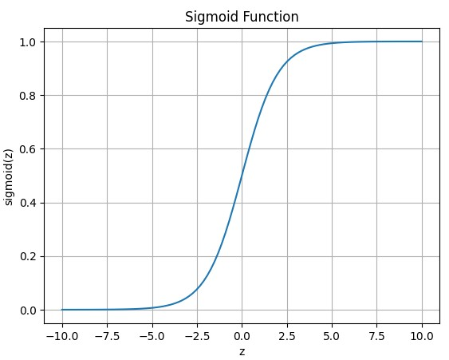
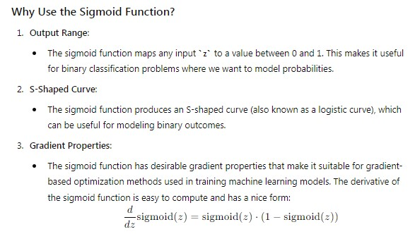
SIGMOID FUNCTION
The sigmoid function is often used in binary classification models to map predicted values (logits) to probabilities. It squashes the output to a range between 0 and 1, making it interpretable as a probability.

Slide 6
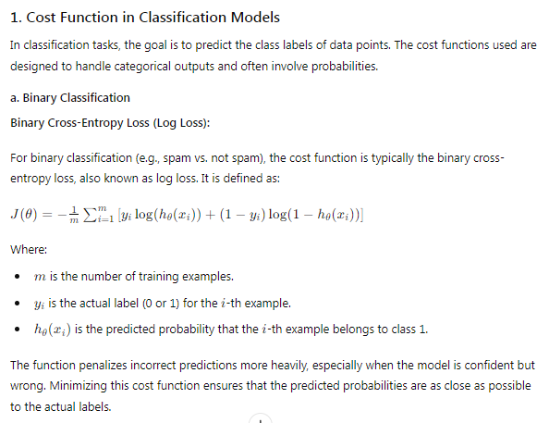
COST / LOSS FUNCTION
The cost function, or loss function, measures how well the model’s predictions match the actual values. For logistic regression, the cost function is the Binary Cross-Entropy Loss.

Slide 7
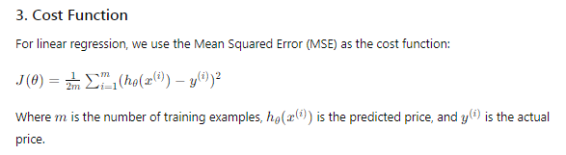
COMPONENTS OF SUPERVISED MACHINE LEARNING
Cost Function (Loss Function):
The cost function measures how well the model's predictions match the actual labels in the training data. It quantifies the error between the predicted and actual outputs. Common cost functions include Mean Squared Error (MSE) for regression tasks and Cross-Entropy Loss for classification tasks.

Slide 8
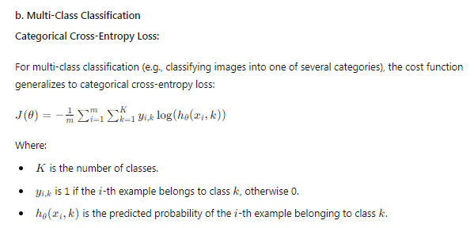
COST / LOSS FUNCTION

Slide 9
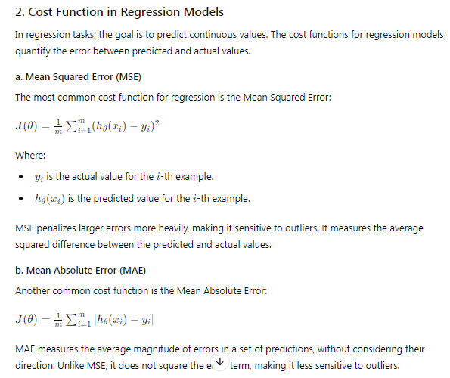
COST / LOSS FUNCTION

Slide 10
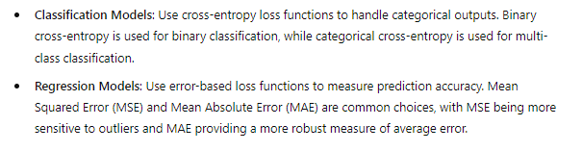
COST / LOSS FUNCTION

Slide 11
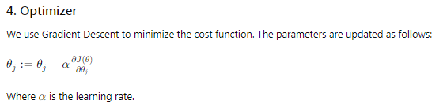
EVALUATION FUNCTIONS
Optimizer:
Optimizers are algorithms used to minimize the cost function by updating the model parameters. In logistic regression, Gradient Descent is commonly used. There are various types of gradient descent optimizers, including:
Batch Gradient Descent
Stochastic Gradient Descent (SGD)
Mini-Batch Gradient Descent

Slide 12
EVALUATION FUNCTIONS
Sigmoid Function: Maps logits to probabilities, essential for binary classification.
Cost Function: Measures the error between predicted probabilities and actual labels; binary cross-entropy is used for logistic regression.
Optimizer: Updates model parameters to minimize the cost function. Gradient Descent and its variants are commonly used optimizers.

