Slide 1
Machine / Deep Learning IN PyTorch

Slide 2
Our Course Roadmap
Stage 0: Orientation
Stage 1: Introduction with AI Tools
Stage 2: Python Programming
Stage 3: Concept of APIs and Hands-on
Stage 4: Machine Learning Concepts
Stage 6: Data Visualizations

Slide 3
Our Course RoadMap
Stage 6: Machine Learning Models
Stage 7: API Development (FastAPI)
Stage 8: GUI Designing Streamlit
Stage 9: Tensorflow
Stage 10: Deep Learning Models
Stage 11: PyTorch

Slide 4
Our Course RoadMap
Stage 12: Chatbots (LangChain, Langgraph, LlamaIndex)
Stage 13: Hugging Faces ML / DL Models OR API’s
Stage 14: Cloud Development / Deployment
Stage 15: Docker Cloud / Microsoft Azure [Cloud Native]
Stage 16: ML / DL Project Deployment on Cloud

Slide 5

Introduction to PyTorch
PyTorch is a powerful open-source machine learning library.
Developed by Facebook's AI Research lab (FAIR).
Widely used in the deep learning community for research and production.

Slide 6
Why PyTorch?
Building and Training: PyTorch is used for creating and training deep learning models.
Flexibility: It offers flexibility for research and production applications.
Versatile: Provides tools and libraries for computer vision, NLP, and more.

Slide 7
Capabilities of PyTorch
GPU Acceleration: Strong support for GPU acceleration for high-performance computing.
Rich Ecosystem: Offers libraries like torchvision, torchaudio, and transformers.
Active Community: A vibrant community and abundant learning resources.

Slide 8
PyTorch
You can learn more at
https://pytorch.org/tutorials/
https://github.com/pytorch/pytorch

Slide 9
Regression Model using PyTorch
Regression is a statistical technique used to model the relationship between a dependent variable and one or more independent variables
The dependent variable is often referred to as the "outcome" or "target", while the independent variables are called "variables" or "features".

Slide 10
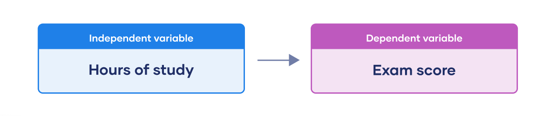
Dependent vs independent Variable

Slide 11
Why use Linear Regression?
Widely used in various fields, including finance, economics, and data science.
Great for making predictions and understanding relationships between variables.

Slide 12
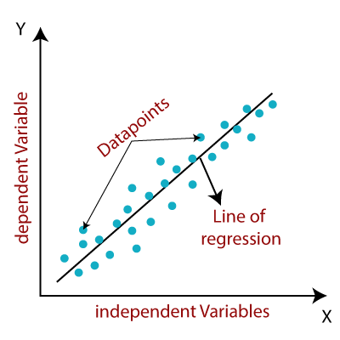
How does Regression work?
It finds the best-fitting line that represents the relationship between X and Y.

Slide 13
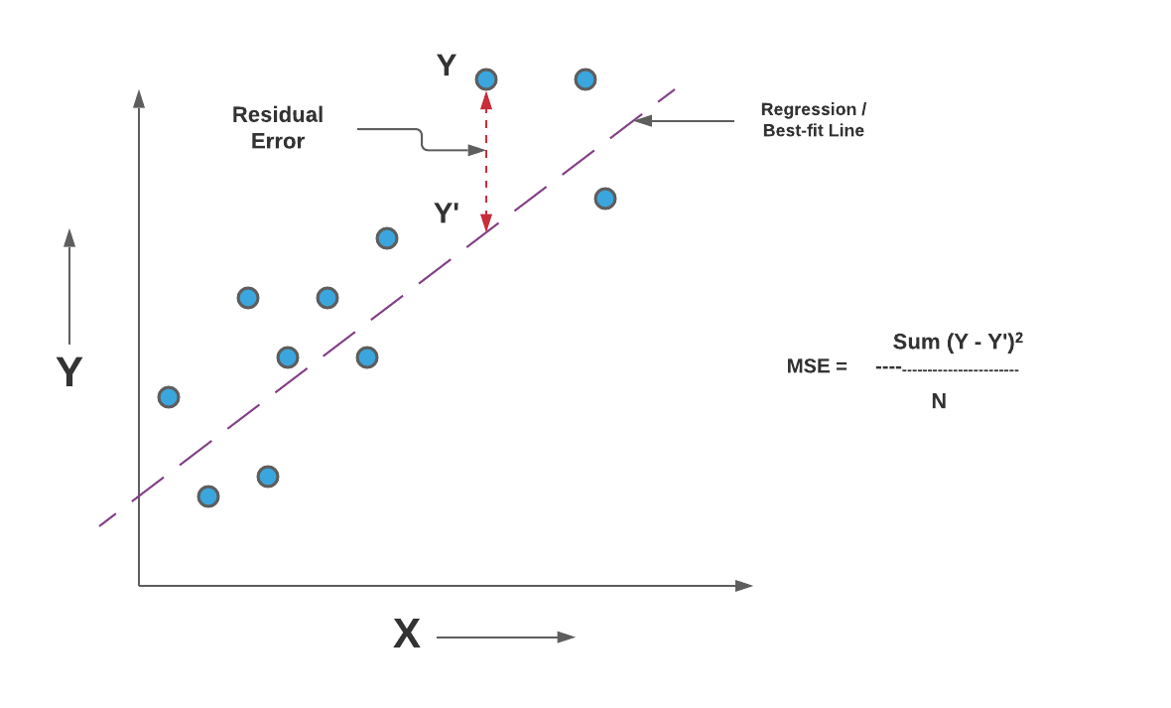
Mean Squared Error (MSE)
The Mean Squared Error (MSE) is a common evaluation metric used in regression tasks.
It measures the average squared difference between the actual and predicted values.

Slide 14
Mean Squared Error (MSE)

