Slide 1
Chess Tutorial
Jack Pemberton

Slide 2
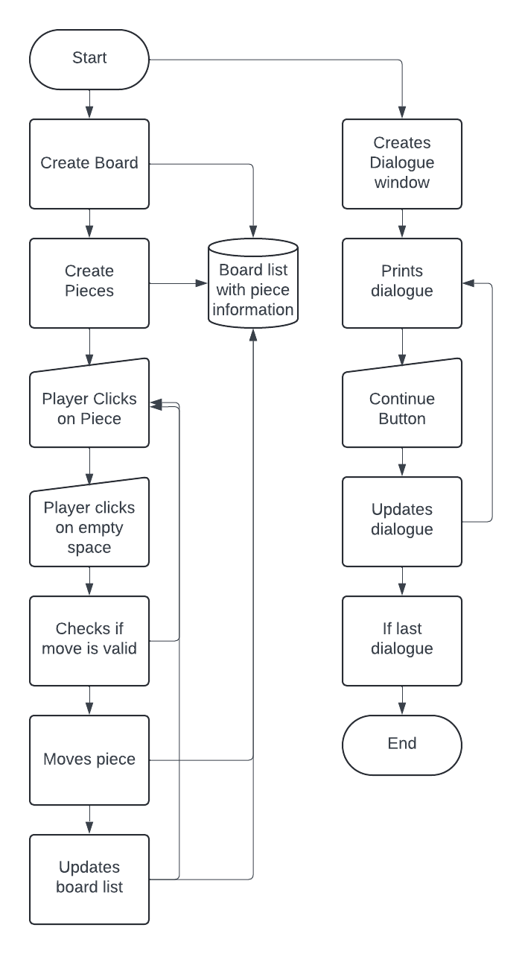
Planning
During the first stages of development, I created a list of things I wanted to include in my Chess Tutorial and ticked them off as I completed them. After most of the programming was done, I created a flow chart to make it easier to understand what might have gone wrong when a bug occurs.
Create board
Create pieces
Create piece movement and rules
Create tutorial dialogue box below board
Create tutorial steps
Create logic for castling and pawn promotion
Create thanks for playing screen

Slide 3
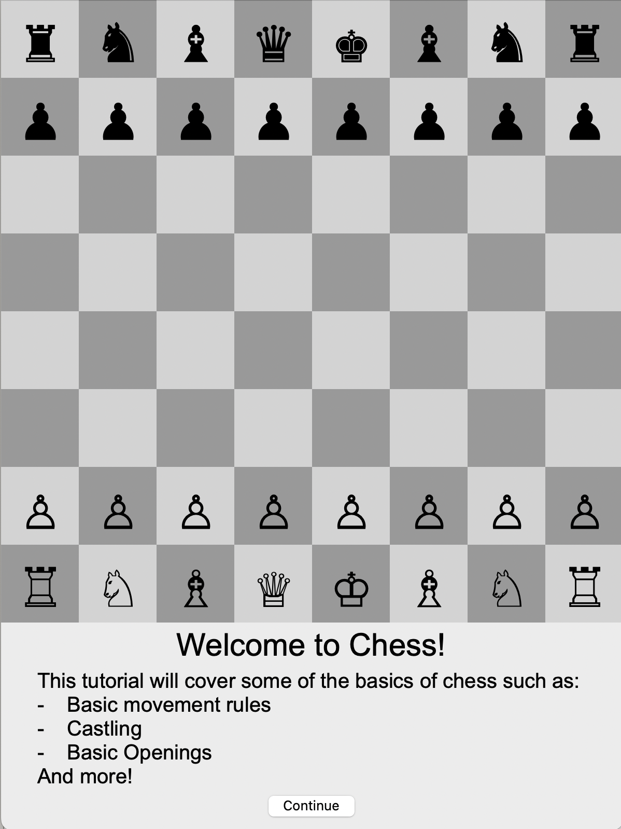
Design
The layout of this chess tutorial has the board above the dialogue box and a continue button included within the dialogue box.
This layout is used as it is simple and minimalistic making it easy for beginners to use.

Slide 4
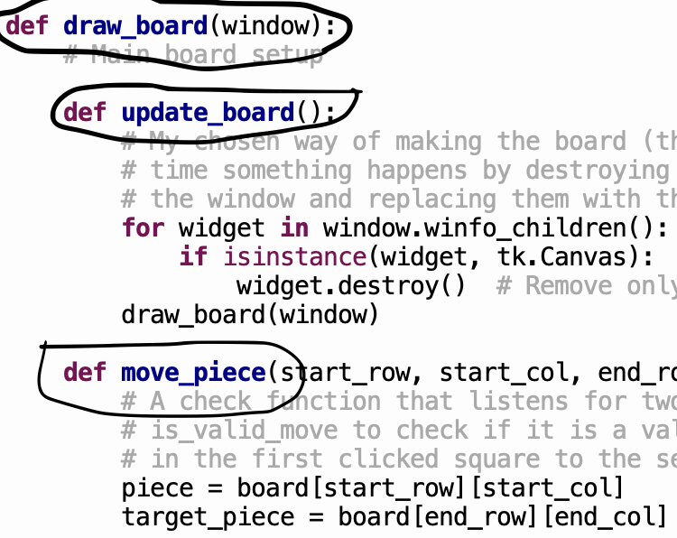
Implementation
This chess tutorial program was created keeping object orientated programing in mind. For example, I have created it using various definition functions and call and return functions. I have also included many comments in my programing to make it easy to read and understand.

Slide 5
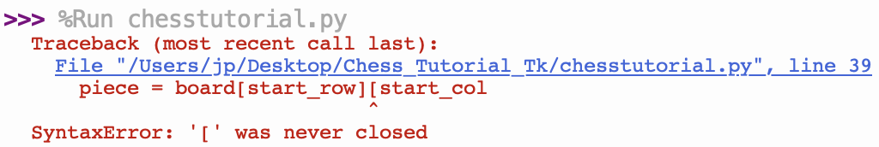
Testing
During the development of this chess tutorial, I put it through rigorous testing with me and other play testers trying to find and glitches to the chess board platform and dialogue box. Because of how I wrote the program any errors that popped up were easy to locate and fix.

Slide 6
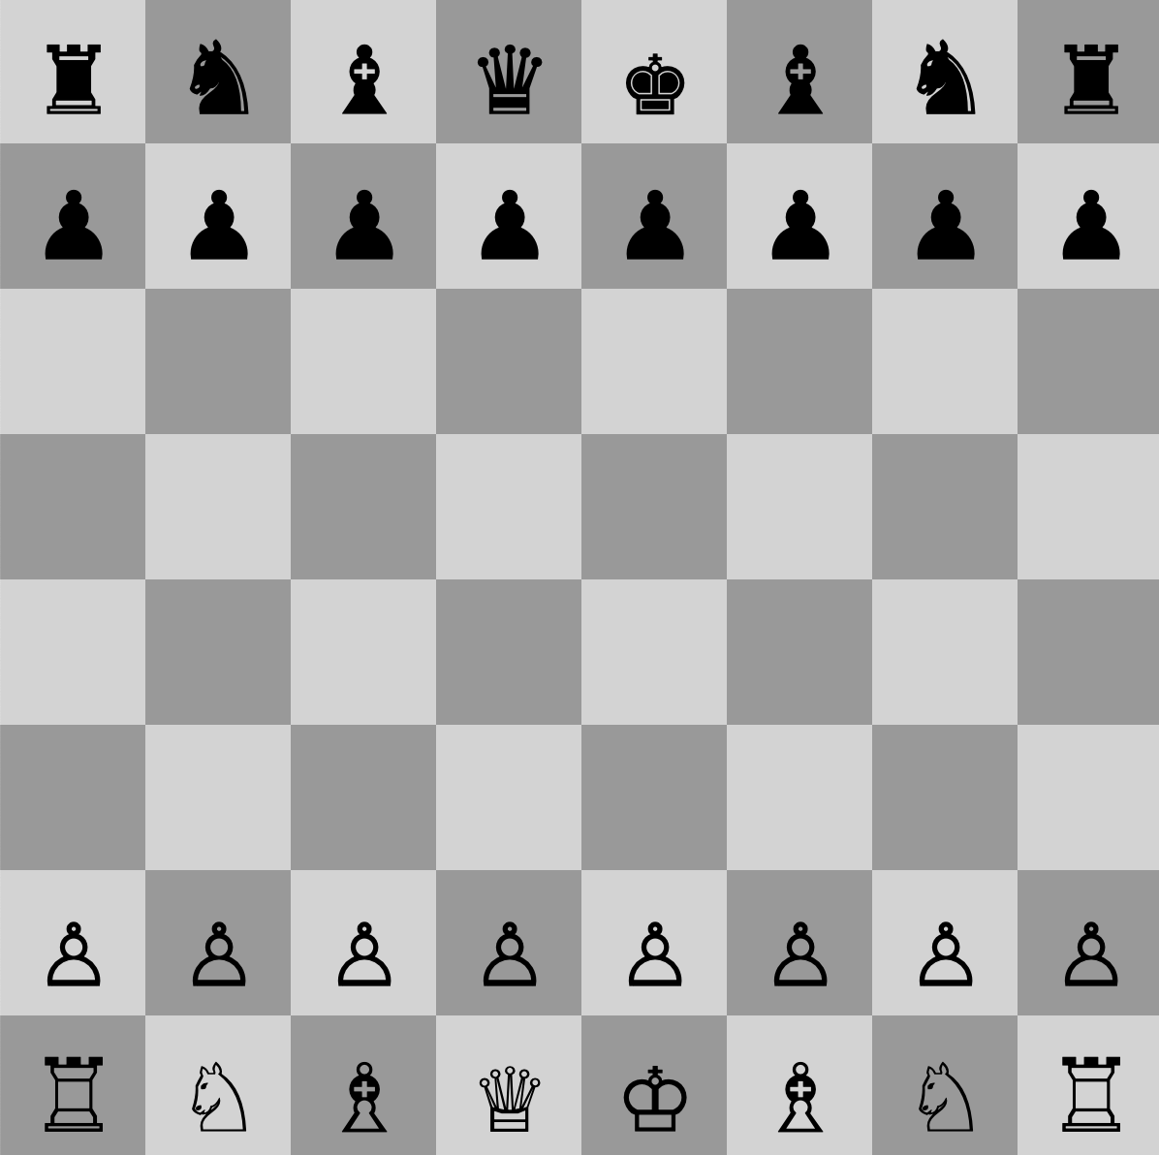
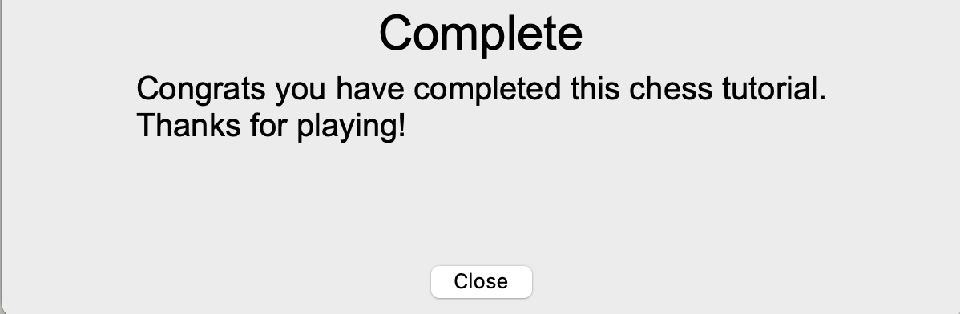
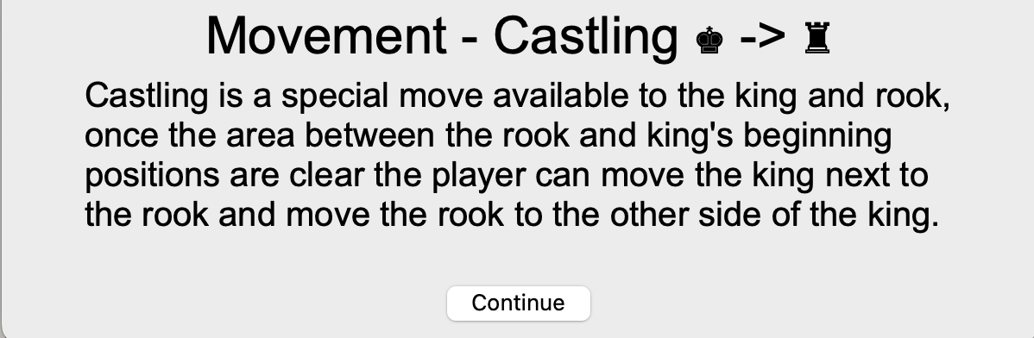
Final program
With the Chess tutorial complete there is 285 lines of code, a complete chess engine with castling and pawn promotion and 9 detailed explanations of the mechanics of chess.

Slide 7
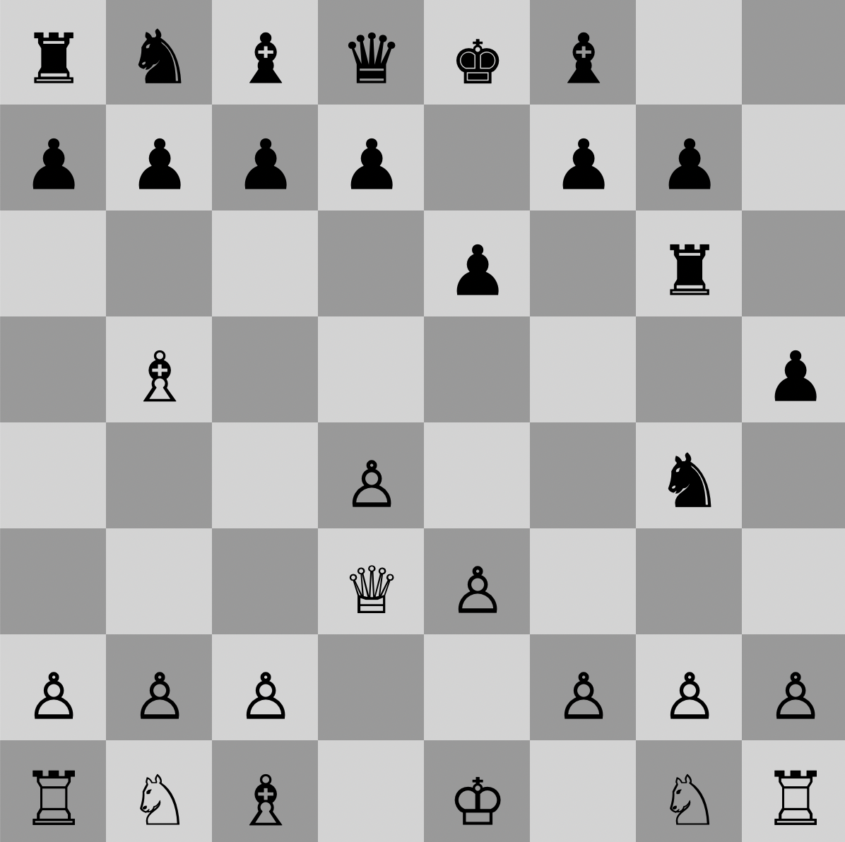
Evaluation
Overall, this chess tutorial is a simple and easy to use program that successfully teaches new players the basics of playing chess.
This has been proven through playtesting as in the final stages of development I gave this program to people who didn’t know how to play chess and they said they enjoyed it and can now play.

