Slide 1
Chess Tutorial
Jack Pemberton

Slide 2
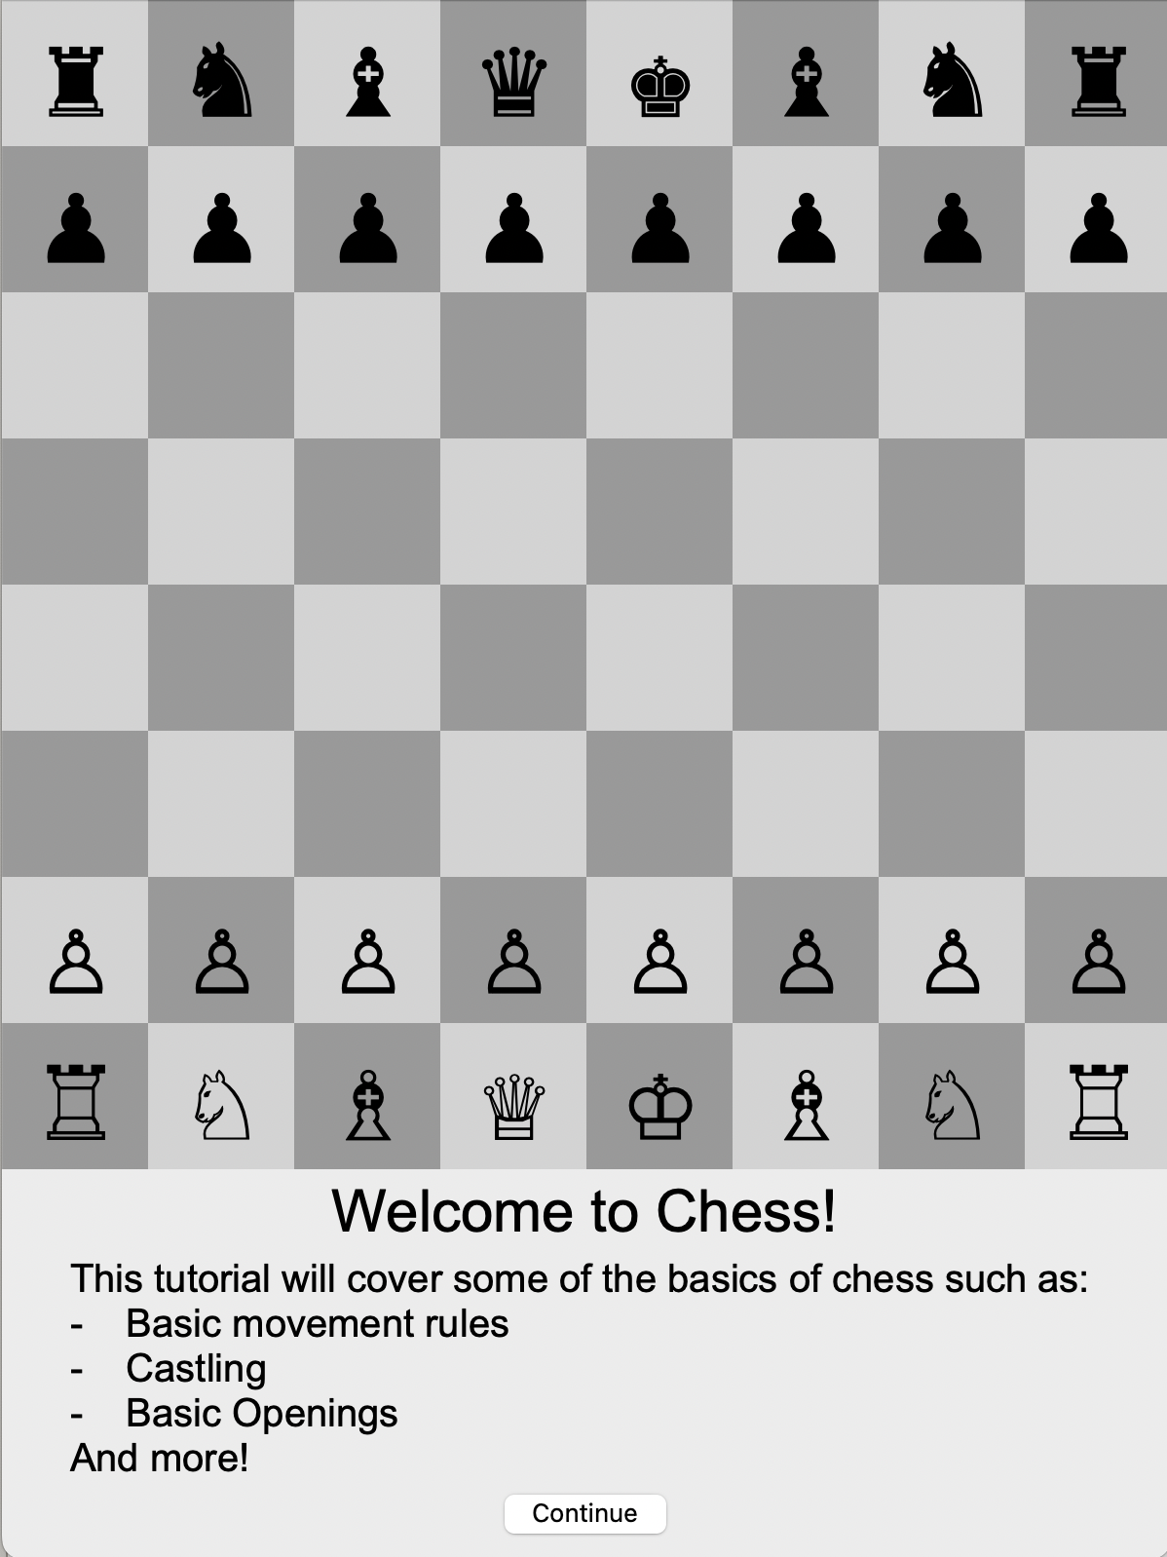
Design
The layout of this chess tutorial has the board above the dialogue box and a continue button included within the dialogue box.
This layout is used as it is simple and minimalistic making it easy for beginners to use.

Slide 3
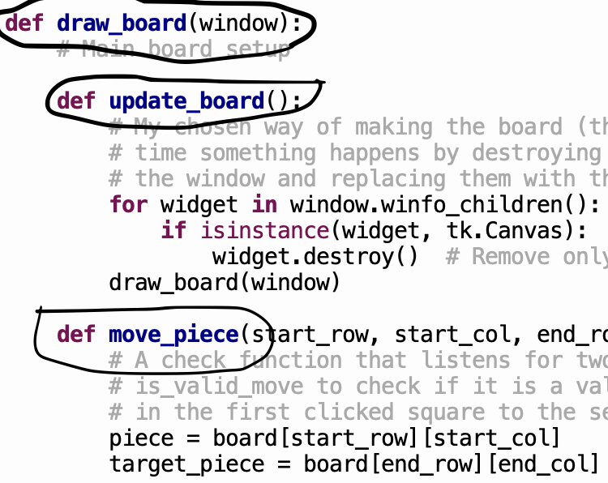
Implementation
This chess tutorial program was created keeping object orientated programing in mind. For example, I have created it using various definition functions and call and return functions. I have also included many comments in my programing to make it easy to read and understand.

Slide 4
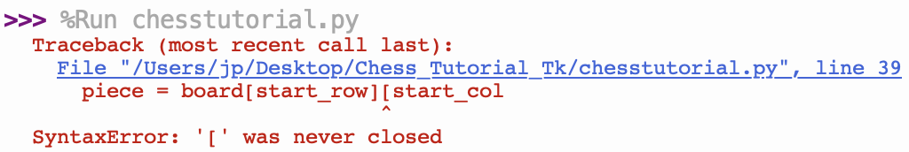
Testing
During the development of this chess tutorial, I put it through rigorous testing with me and other play testers trying to find and glitches to the chess board platform and dialogue box. Because of how I wrote the program any errors that popped up were easy to locate and fix.

Slide 5
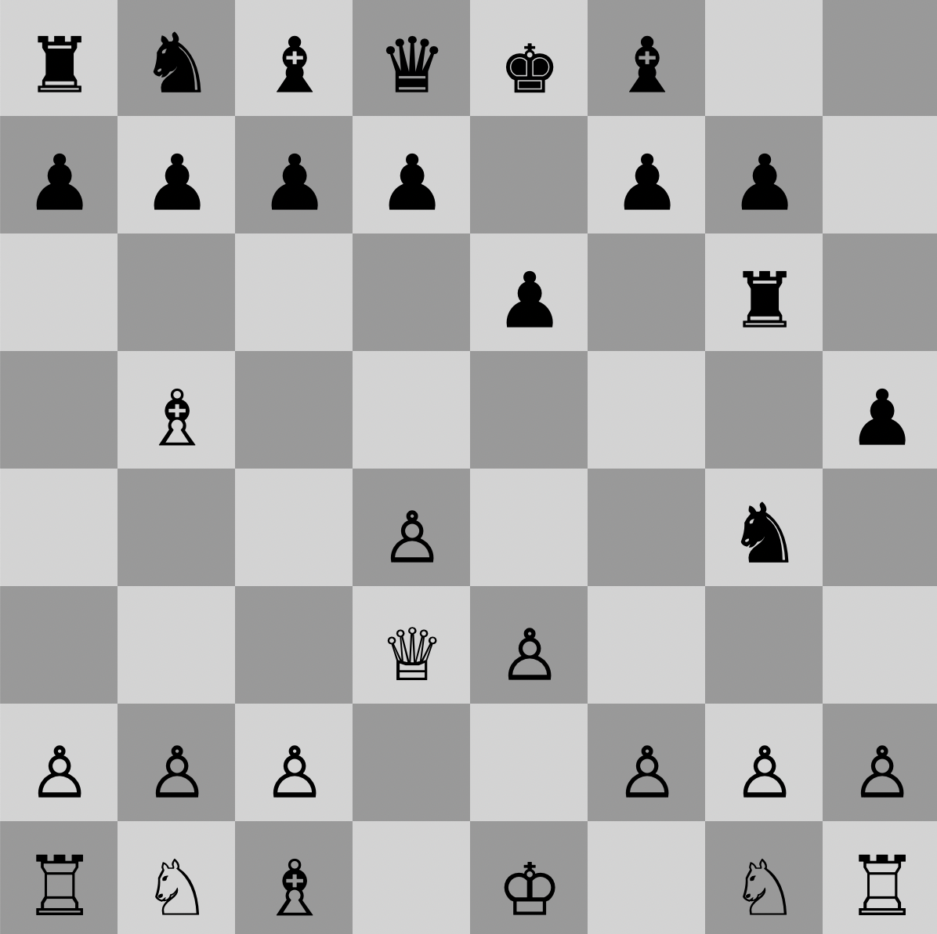
Evaluation
Overall, this chess tutorial is a simple and easy to use program that successfully teaches new players the basics of playing chess.
This has been proven through playtesting as in the final stages of development I gave this program to people who didn’t know how to play chess and they said they enjoyed it and can now play.

