Slide 1
CMP MANAGEMENT ASIA
Test Annual Report
Smoke Test
2026

Slide 2
SUMMARY STATISTICS
PROJECTS COMPLETED
TEAM MEMBERS
PERIOD COVERED
1
1
2023
total selected
active professionals
date range
Projects by Category
Construction (1)
Construction (1)

Slide 3
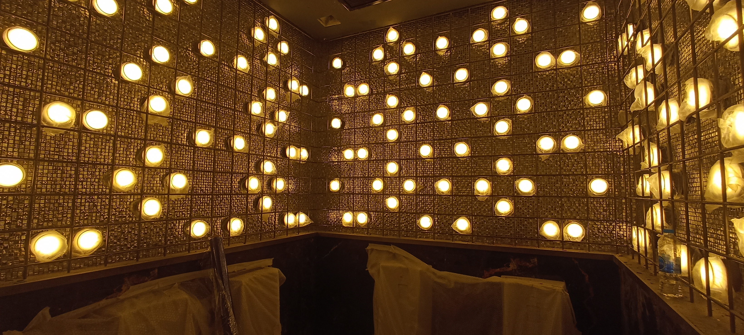
TIMELINE — 2023
2023
Atlas Super Club Ratchada Soi 4
Super Night Club / Entertainment Venue | Design, Project Management, Construction Management & QS
Client: HW Group Indonesia

Slide 4
TEAM SNAPSHOT
Johnny Beh
Founder / CEO
30+ years construction & project management expertise. Led major developments across Asia and Middle East. PAM School of Architecture graduate. Fluent: Engli...

Slide 5
CMP MANAGEMENT ASIA
From Vision to Guaranteed Reality. 30+ years of construction expertise across Asia.
Next Steps
• Schedule strategy review with stakeholders
• Finalise project pipeline for next period
• Distribute report to partners & clients
www.cmpmanagementasia.com

