Slide 1
CMP MANAGEMENT ASIA
Annual Report 2025
CMP Management Asia
2026

Slide 2
SUMMARY STATISTICS
PROJECTS COMPLETED
TEAM MEMBERS
PERIOD COVERED
12
4
2019 – 2025
total selected
active professionals
date range
Projects by Category
Commercial (3)
Construction (4)
Residential (5)

Slide 3
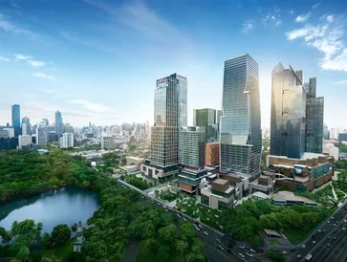
TIMELINE — 2019
2019
The One Bangkok
Substructure and Architectural Work | Contract & Commercial Management
Client: Italian Thai Development Public Company Limited

Slide 4
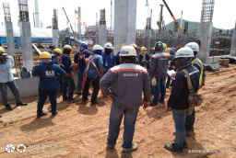
TIMELINE — 2020
2020
Thai Oil Clean Oil Project Leam Chabang
OC1 & OC2 Work Packages - Civil & Structure Works | Contract & Commercial Management
Client: Italian Thai Development Public Company Limited

Slide 5
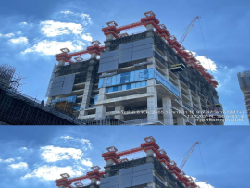
TIMELINE — 2021
2021
One Bangkok Forum
Art & Cultural Multi-Purpose Hall | Contract & Commercial Management
Client: TTS Engineering 2004 Co., Ltd.

Slide 6
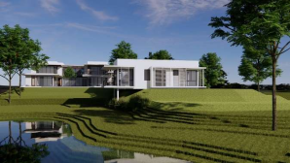
TIMELINE — 2022
2022
Residence at Kaoyai
6 Buildings Complex | 1500m2 | Structure Design & Building Construction
Client: Confidential

Slide 7
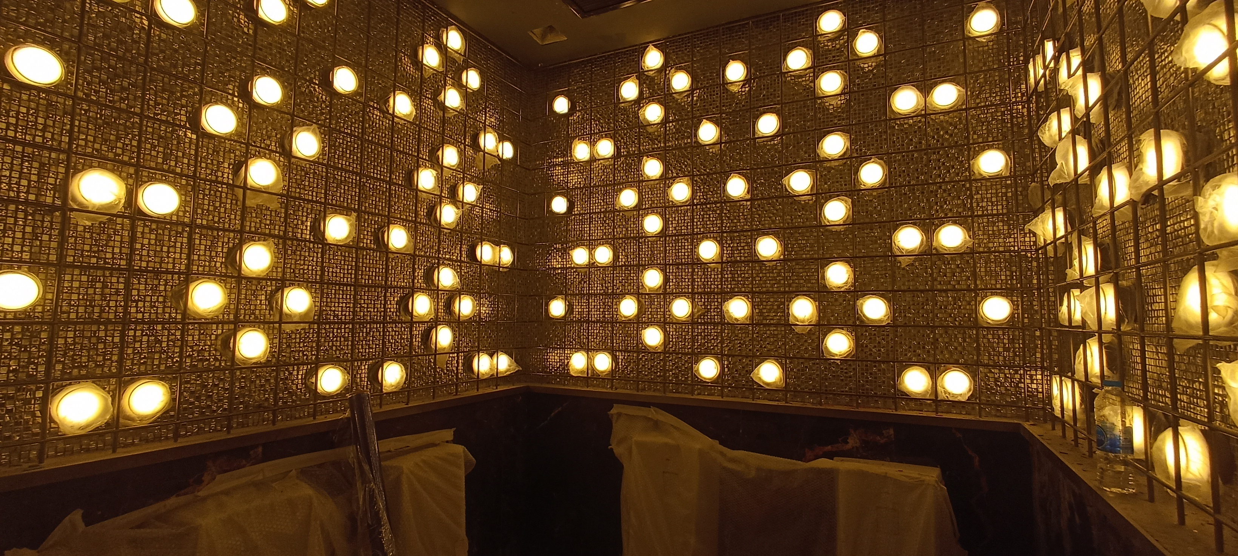
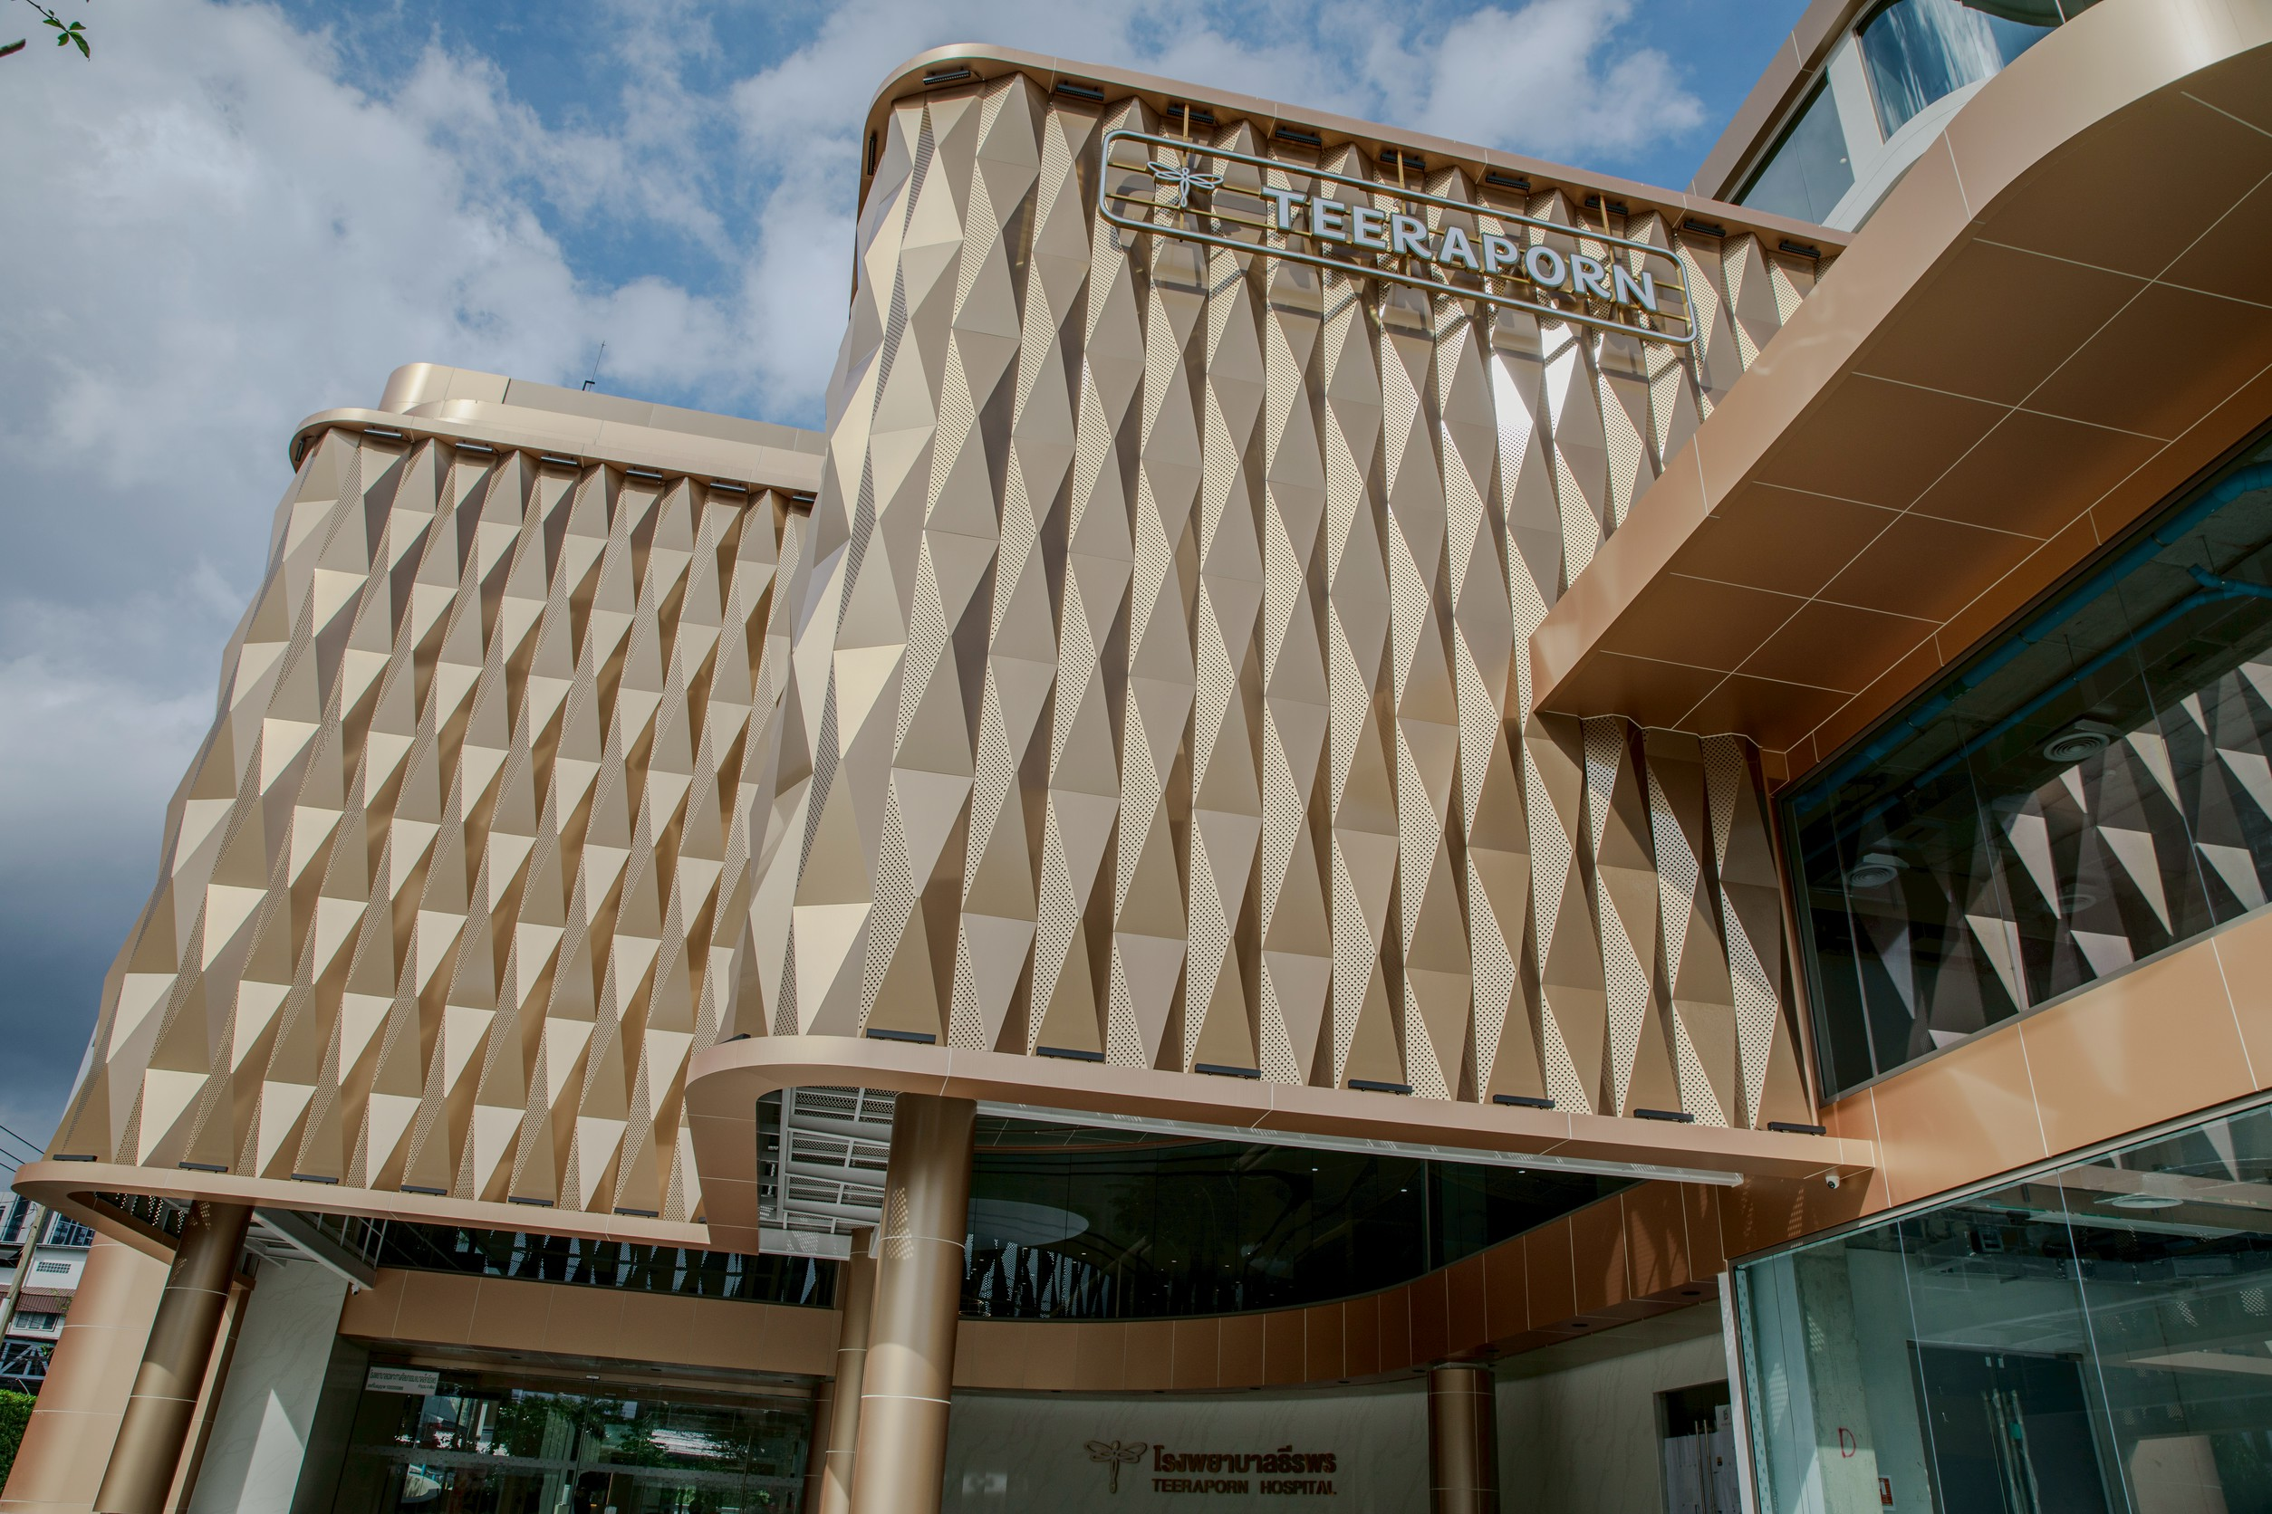
TIMELINE — 2023
2023
Atlas Super Club Ratchada Soi 4
Teeraporn Clinic Bangkok
Super Night Club / Entertainment Venue | Design, Project Management, Construction Management & QS
6-Storey Medical Building | Internal Construction Management
Client: HW Group Indonesia
Client: Italian Thai Development Public Company Limited

Slide 8
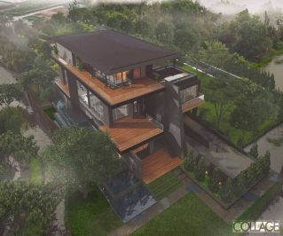
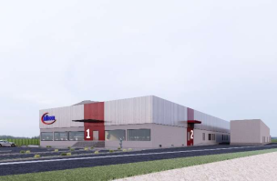
TIMELINE — 2023
2023
KB Private Residence
Frasers Temporary Factory
Structural Design & Building Construction | Structural Design & Building Construction
7000m2 Clean Room Manufacturing Facility | Structure, Architectural & MEP Design
Client: Dear Child Co., Ltd.
Client: Frasers Industry / Italian Thai Development Public Company Limited

Slide 9
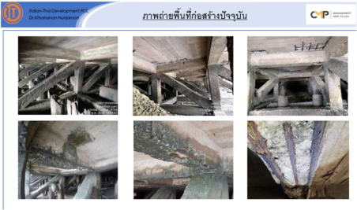
TIMELINE — 2023
2023
Custom Department Building Rehabilitation
Pier Repair & Structural Rehabilitation | Design of Rehabilitation of Structure
Client: Customs Department Thailand

Slide 10
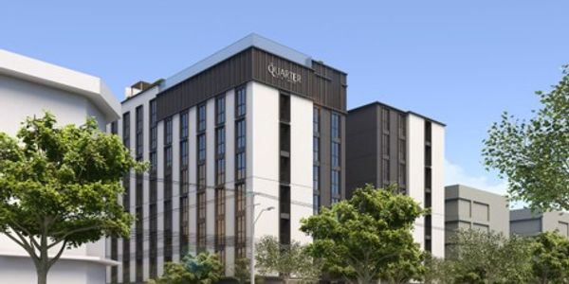
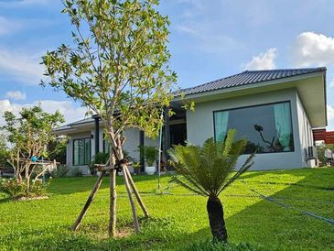
TIMELINE — 2024
2024
The Quarter Hotel Ekkamai
Boon Nak Residence Ubon
8-Storey Building + 1 Basement (Hotel) | Construction Management & Quantity Surveying
Design & Building Construction | Contractor
Client: Urban 63 Company Limited
Client: Boonnak Kanharin

Slide 11
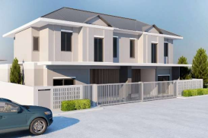
TIMELINE — 2025
2025
Baan Parinyada Renovation Work
Residential Renovation & Construction | Renovation Works Construction
Client: K. Kwang

Slide 12
TEAM SNAPSHOT
Johnny Beh
Philaiwan Thathisa
Worapot Kitcharenchai
Clarence Sim B.H
Founder / CEO
Finance Director
Chief Operating Officer
Operations Director
30+ years construction & project management expertise. Led major developments across Asia and Middle East. PAM School of Architecture graduate. Fluent: Engli...
Strategic financial leadership since 2019. Ramkhamhaeng University graduate. Expertise in financial strategy, fiscal discipline, and sustainable growth. Flue...
12 years specialized marketing & operations expertise. Drives innovation through data-driven strategies and streamlined project execution. Committed to scala...
15+ years construction & property development. Selkirk College graduate. Expert in cost control & quality assurance. Fluent: English, Mandarin, Thai.

Slide 13
CMP MANAGEMENT ASIA
From Vision to Guaranteed Reality. 30+ years of construction expertise across Asia.
Next Steps
• Schedule strategy review with stakeholders
• Finalise project pipeline for next period
• Distribute report to partners & clients
www.cmpmanagementasia.com

