Slide 1
CMP MANAGEMENT ASIA
Test Portfolio
Smoke Test

Slide 2
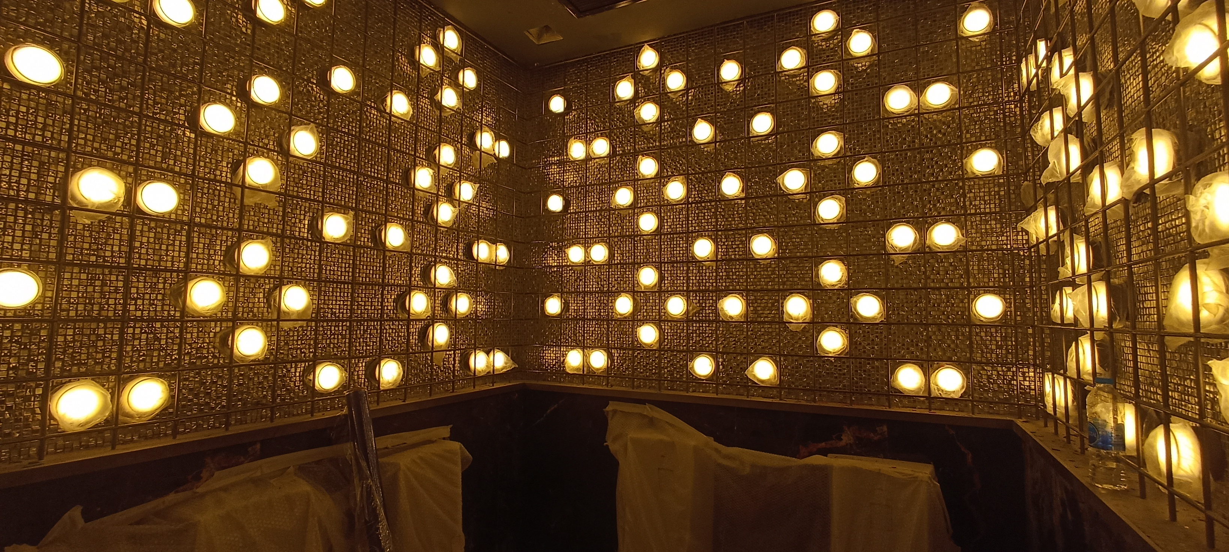
01 / 01
CONSTRUCTION
Atlas Super Club Ratchada Soi 4
Super Night Club / Entertainment Venue
Client: HW Group Indonesia
Role: Design, Project Management, Construction Management & QS
2023

Slide 3
THANK YOU
From Vision to Guaranteed Reality. 30+ years of construction expertise across Asia.
CMP Management Asia www.cmpmanagementasia.com contact@cmpmanagementasia.com

