Slide 1
CMP Management Asia
Our Team
CMP Management Asia
From Vision to Guaranteed Reality. 30+ years of construction expertise across Asia.

Slide 2
Company Overview
CMP Management Asia
From Vision to Guaranteed Reality. 30+ years of construction expertise across Asia.
30+
4
3
Years of Experience
Expert Team Members
Service Disciplines
Serving clients across Asia with integrated construction and project management solutions.

Slide 3
TEAM MEMBER
Johnny Beh
Founder / CEO
JB
30+ years construction & project management expertise. Led major developments across Asia and Middle East. PAM School of Architecture graduate. Fluent: English, Bahasa Malaysia, Mandarin.

Slide 4
TEAM MEMBER
Philaiwan Thathisa
Finance Director
PT
Strategic financial leadership since 2019. Ramkhamhaeng University graduate. Expertise in financial strategy, fiscal discipline, and sustainable growth. Fluent: Thai, English.

Slide 5
TEAM MEMBER
Worapot Kitcharenchai
Chief Operating Officer
WK
12 years specialized marketing & operations expertise. Drives innovation through data-driven strategies and streamlined project execution. Committed to scalable growth and industry leadership.

Slide 6
TEAM MEMBER
Clarence Sim B.H
Operations Director
CS
15+ years construction & property development. Selkirk College graduate. Expert in cost control & quality assurance. Fluent: English, Mandarin, Thai.

Slide 7
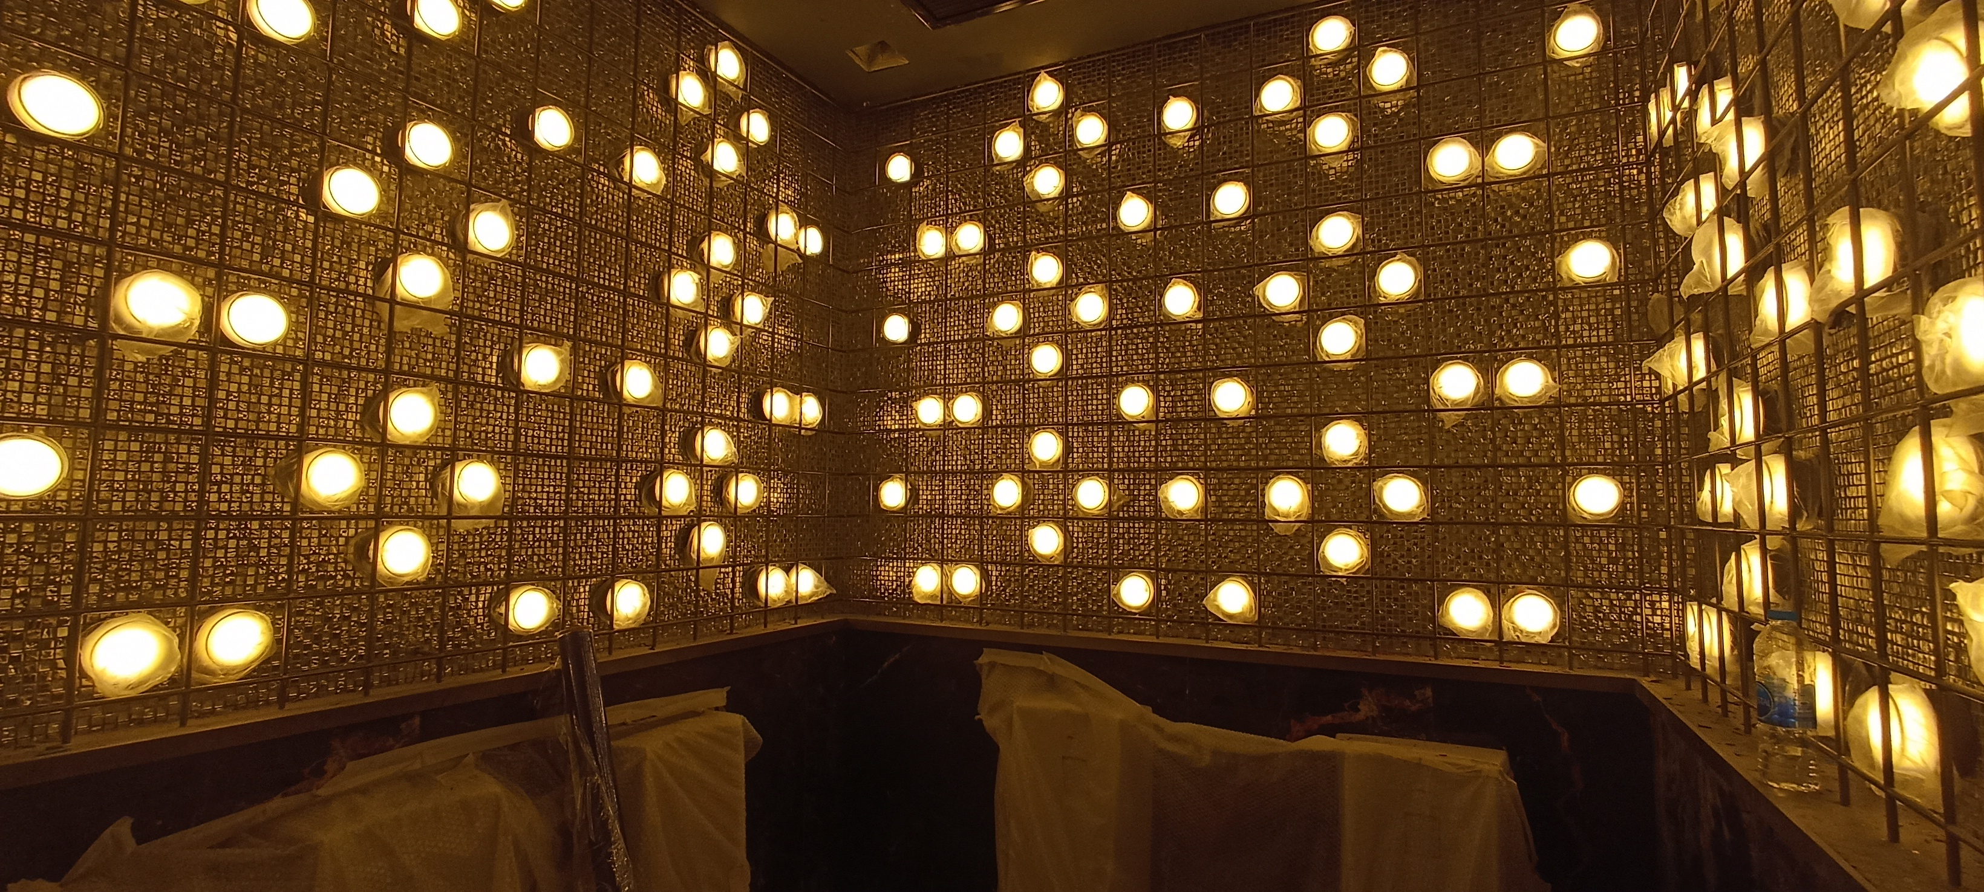
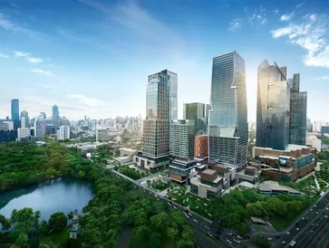
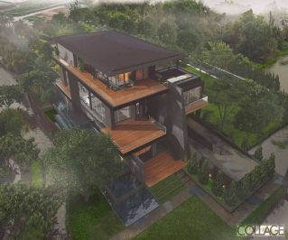
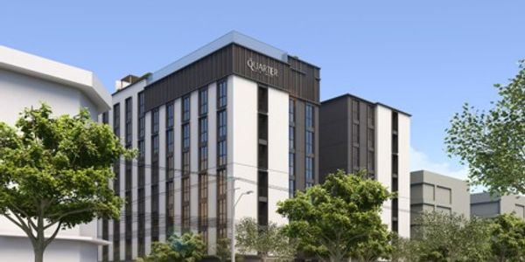
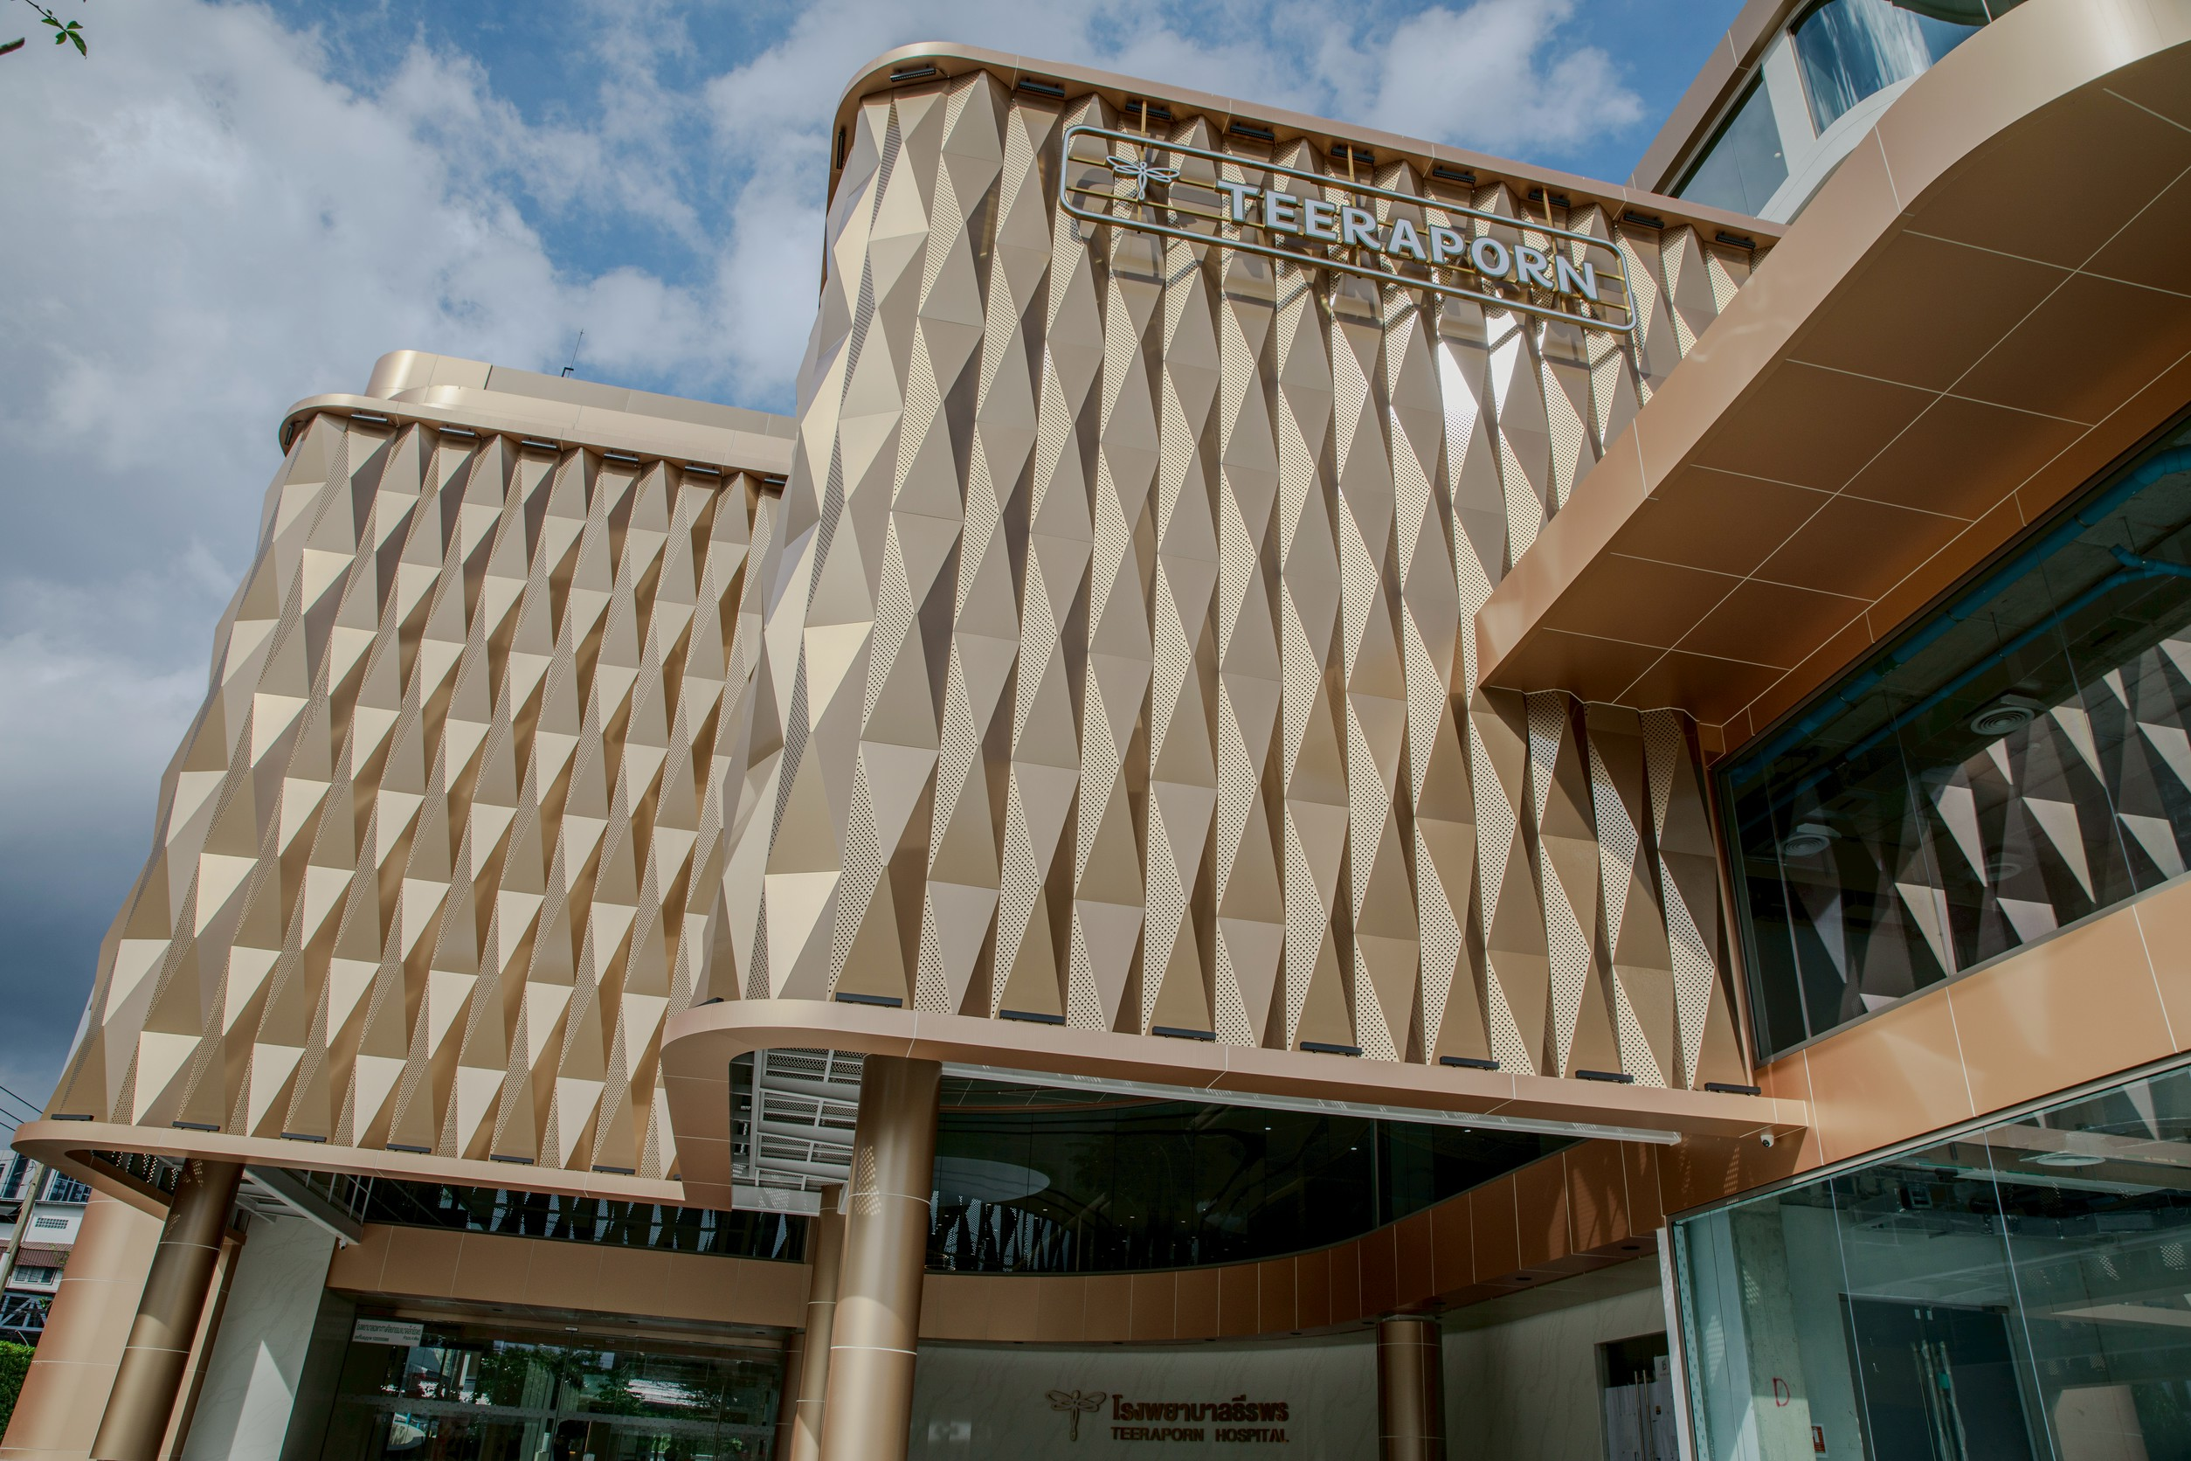
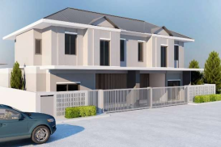
Featured Projects
Atlas Super Club Ratchada Soi 4
The One Bangkok
KB Private Residence
The Quarter Hotel Ekkamai
Teeraporn Clinic Bangkok
Baan Parinyada Renovation Work

Slide 8
CMP Management Asia
Thank You
From Vision to Guaranteed Reality. 30+ years of construction expertise across Asia.
www.cmpmanagementasia.com
info@cmpmanagementasia.com

