Slide 1
CMP MANAGEMENT ASIA
Test Annual
2026
2026

Slide 2
SUMMARY STATISTICS
PROJECTS COMPLETED
TEAM MEMBERS
PERIOD COVERED
2
4
2023 – 2024
total selected
active professionals
date range
Projects by Category
Construction (2)

Slide 3
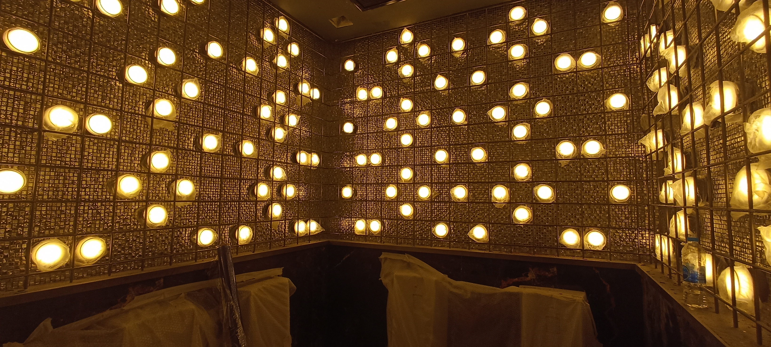
TIMELINE — 2023
2023
Atlas Super Club Ratchada Soi 4
Super Night Club / Entertainment Venue | Design, Project Management, Construction Management & QS
Client: HW Group Indonesia

Slide 4
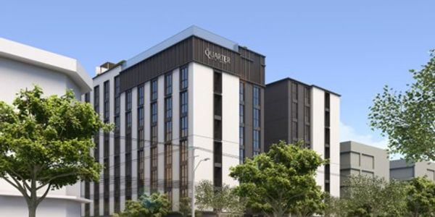
TIMELINE — 2024
2024
The Quarter Hotel Ekkamai
8-Storey Building + 1 Basement (Hotel) | Construction Management & Quantity Surveying
Client: Urban 63 Company Limited

Slide 5
TEAM SNAPSHOT
Johnny Beh
Philaiwan Thathisa
Worapot Kitcharenchai
Clarence Sim B.H
Founder / CEO
Finance Director
Chief Operating Officer
Operations Director
30+ years construction & project management expertise. Led major developments across Asia and Middle East. PAM School of Architecture graduate. Fluent: Engli...
Strategic financial leadership since 2019. Ramkhamhaeng University graduate. Expertise in financial strategy, fiscal discipline, and sustainable growth. Flue...
12 years specialized marketing & operations expertise. Drives innovation through data-driven strategies and streamlined project execution. Committed to scala...
15+ years construction & property development. Selkirk College graduate. Expert in cost control & quality assurance. Fluent: English, Mandarin, Thai.

Slide 6
CMP MANAGEMENT ASIA
From Vision to Guaranteed Reality. 30+ years of construction expertise across Asia.
Next Steps
• Schedule strategy review with stakeholders
• Finalise project pipeline for next period
• Distribute report to partners & clients
www.cmpmanagementasia.com

