Slide 1
CMP MANAGEMENT ASIA
Project Portfolio 2026
CMP Management Asia – Selected Works

Slide 2
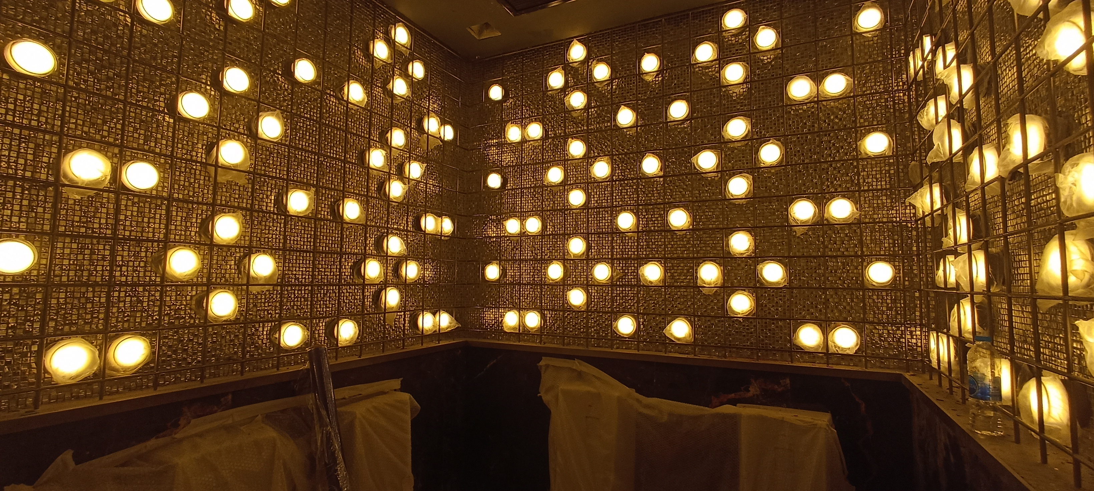
01 / 06
CONSTRUCTION
Atlas Super Club Ratchada Soi 4
Super Night Club / Entertainment Venue
Client: HW Group Indonesia
Role: Design, Project Management, Construction Management & QS
2023

Slide 3
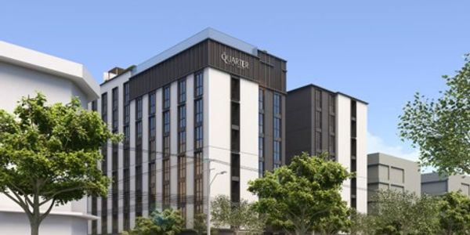
02 / 06
CONSTRUCTION
The Quarter Hotel Ekkamai
8-Storey Building + 1 Basement (Hotel)
Client: Urban 63 Company Limited
Role: Construction Management & Quantity Surveying
2024

Slide 4
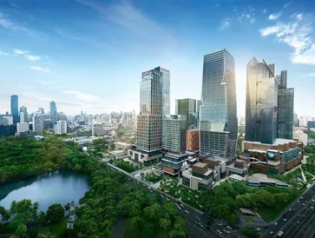
03 / 06
COMMERCIAL
The One Bangkok
Substructure and Architectural Work
Client: Italian Thai Development Public Company Limited
Role: Contract & Commercial Management
2019

Slide 5
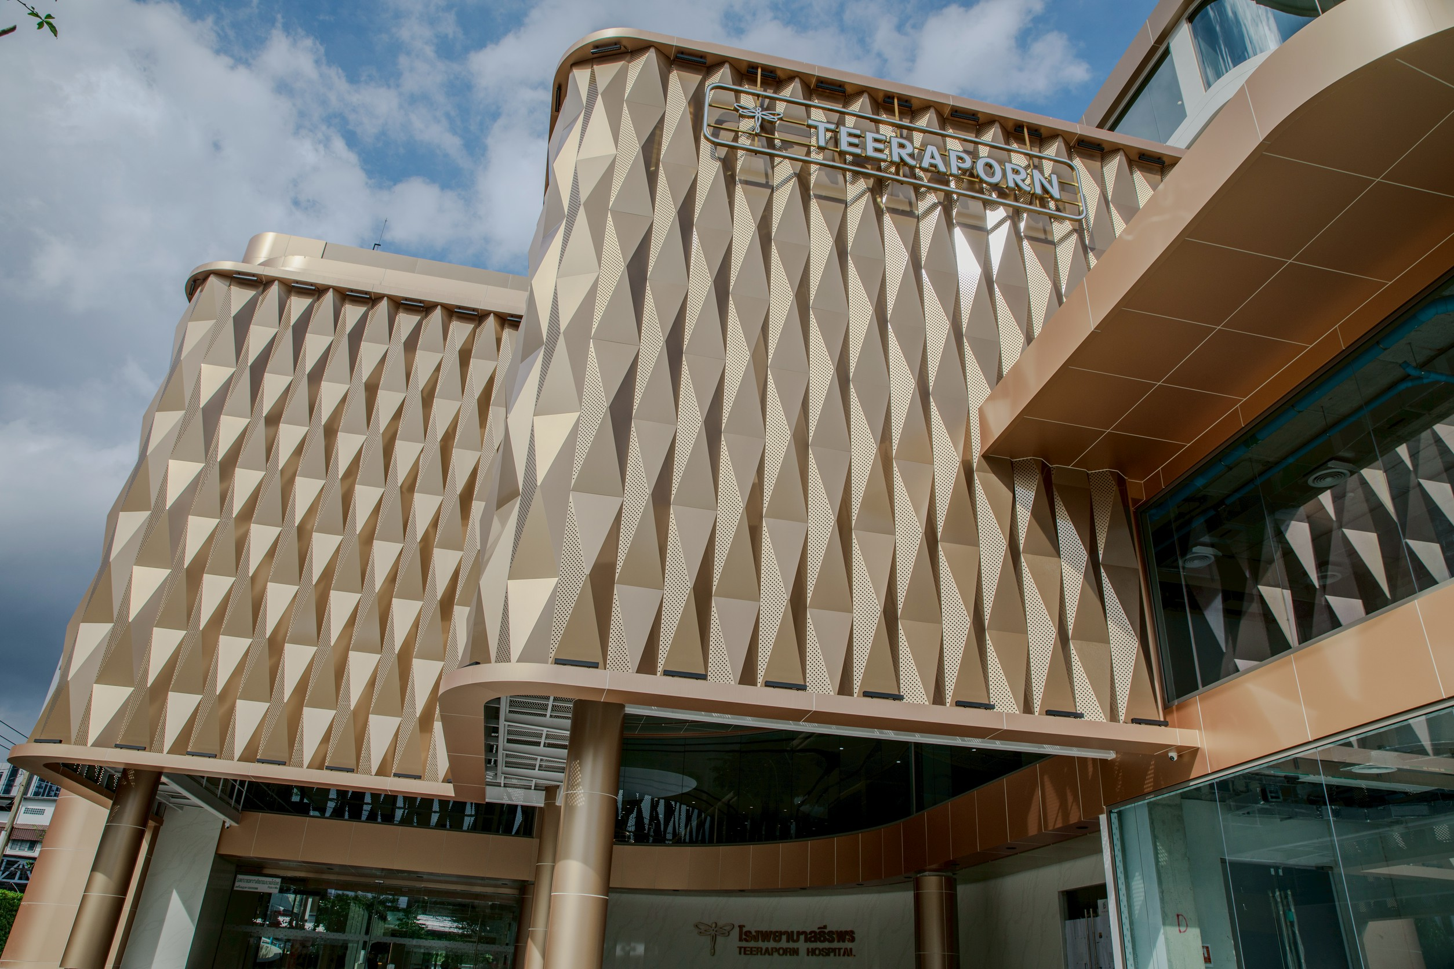
04 / 06
RESIDENTIAL
Teeraporn Clinic Bangkok
6-Storey Medical Building
Client: Italian Thai Development Public Company Limited
Role: Internal Construction Management
2023

Slide 6
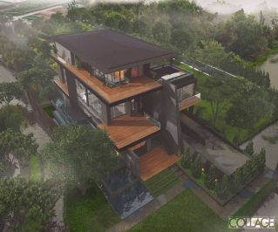
05 / 06
RESIDENTIAL
KB Private Residence
Structural Design & Building Construction
Client: Dear Child Co., Ltd.
Role: Structural Design & Building Construction
2023

Slide 7
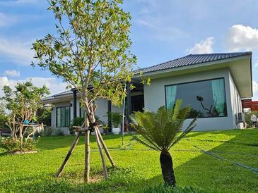
06 / 06
RESIDENTIAL
Boon Nak Residence Ubon
Design & Building Construction
Client: Boonnak Kanharin
Role: Contractor
2024

Slide 8
THANK YOU
From Vision to Guaranteed Reality. 30+ years of construction expertise across Asia.
CMP Management Asia www.cmpmanagementasia.com contact@cmpmanagementasia.com

