Slide 1
Spring

Slide 2
Agenda
What is Spring
Advantages/disadvantages
IOC, AOP
Spring projects
Beans
Hello World

Slide 3
What is Spring?
Popular application development framework
Open source
Supports all major application servers and JEE standards

Slide 4
Pros & cons
Pros
Cons
Simplicity with POJOs
Loose coupling
Testability
Modular
Complex
Longer configuration
XML

Slide 5
Main features
Dependency Injection
Also known as IoC (Inversion of Control)
Aspect Oriented Programming
Runtime injection-based

Slide 6
Aspect Oriented programming (AOP)
Attempts to separate concerns, increase modularity, and decrease redundancy
Separation of Concerns (SoC)
Break up features to minimize overlap
Don’t Repeat Yourself (DRY)
Minimize code duplication
Cross-Cutting Concerns
Program aspects that affect many others (e.g. logging)
In Spring: AspectJ or XML

Slide 7
Inversion of Control (IoC)
The ability to supply (inject) an external dependency into a software component.
Types of Dependency Injection:
Constructor
Setter
Primary goal is reduction of dependencies in code

Slide 8
Inversion of Control (IoC)
Constructor
public class CustomerService {
private ICustomerRepository repo;
public CustomerService(ICustomerRepository repo){
this.repo = repo;
}
}

Slide 9
Inversion of Control (IoC)
Setter
public class CustomerService {
private ICustomerRepository repo;
public void setCustomerService(ICustomerRepository repo) {
this.repo = repo;
}
public ICustomerRepository getCustomerService() {
returnthis.repo = repo;
}
}

Slide 10
Spring <project-name>
Framework
Boot
IO platform
Cloud data flow
Cloud
Data
Integration
Batch
Security
Flo
Kafka
HATEOAS
Social
AMQP
Mobile
for Android
Web flow
Web services
LDAP
Session
Shell

Slide 11
Spring Framework

Slide 12
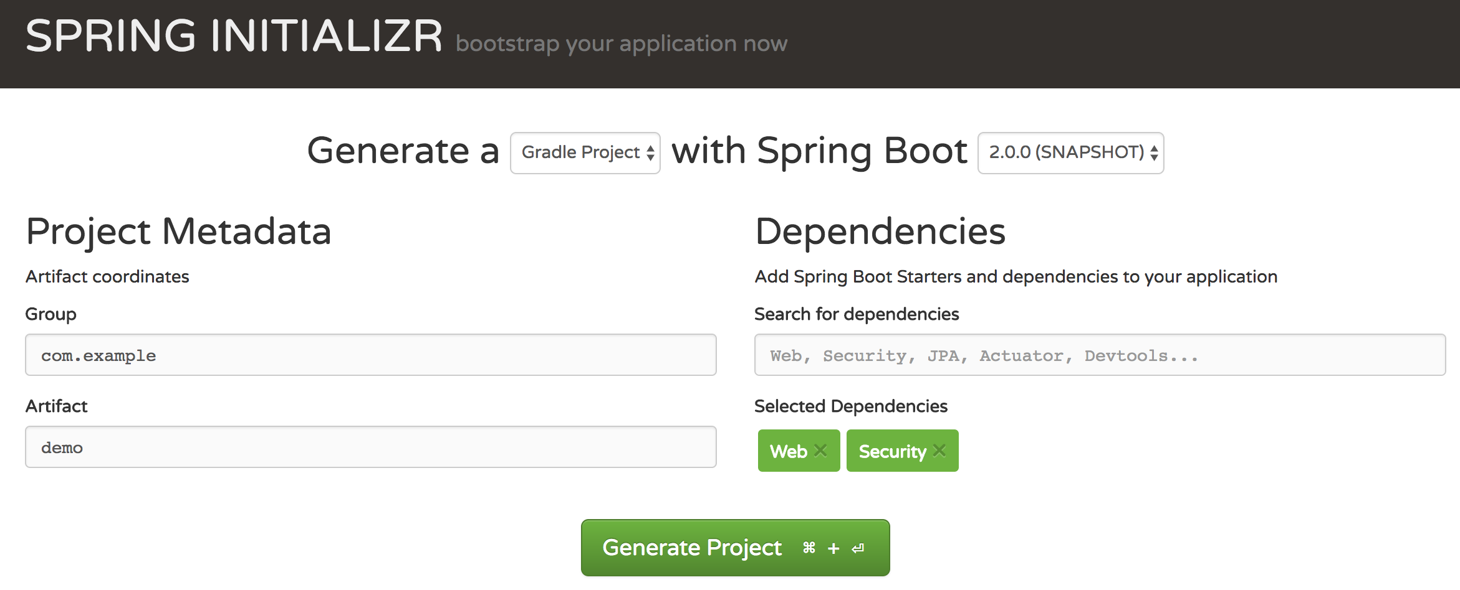
Spring Boot
https://start.spring.io/

Slide 13
Beans

Slide 14
Bean
Typical java bean with a unique id
In spring there are basically two types
Singleton
One instance of the bean created and referenced each time it is requested
Prototype (non-singleton)
New bean created each time
Same as new ClassName()
Beans are normally created by Spring as late as possible

Slide 15
Bean
Defines a bean for Spring to manage
Key attributes
class (required): fully qualified java class name
id: the unique identifier for this bean
configuration: (singleton, init-method, etc.)
constructor-arg: arguments to pass to the constructor at creation time
property: arguments to pass to the bean setters at creation time
Collaborators: other beans needed in this bean (a.k.a dependencies), specified in property or constructor-arg
Typically defined in an XML file

Slide 16
Bean: example
<?xml version = "1.0" encoding = "UTF-8"?>
<beans xmlns = "http://www.springframework.org/schema/beans" xmlns:xsi = "http://www.w3.org/2001/XMLSchema-instance" xsi:schemaLocation = "http://www.springframework.org/schema/beans http://www.springframework.org/schema/beans/spring-beans-3.0.xsd">
<bean id = "..." class = "..."> </bean>
<bean id = "..." class = "..." init-method = "..."> </bean>
<bean id = "..." class = "..." scope = "singleton"> </bean>
</beans>

Slide 17
Bean Factory
Often seen as an ApplicationContext
BeanFactory is not used directly often
ApplicationContext is a complete superset of bean factory methods
Same interface implemented
Offers a richer set of features
Spring uses a BeanFactory to create, manage and locate “beans” which are basically instances of a class
Typical usage is an XML bean factory which allows configuration via XML files

Slide 18
Bean creation
Beans are created in order based on the dependency graph
Often they are created when the factory loads the definitions
Can override this behavior in bean
<bean class=“className” lazy-init=“true” />
Spring will instantiate beans in the order required by their dependencies
If scope is singleton, then eagerly instantiated at container startup
created when dependent bean created
created when accessed in code

Slide 19
Bean injection
A dependency graph is constructed based on the various bean definitions
Beans are created using constructors (mostly no-arg) or factory methods
Dependencies that were not injected via constructor are then injected using setters
Any dependency that has not been created is created as needed

Slide 20
Bean properties
The primary method of dependency injection
Can be another bean, value, collection, etc.
<bean id="exampleBean" class="org.example.ExampleBean">
<property name="anotherBean">
<ref bean="someOtherBean" />
</property>
</bean>
This can be written in shorthand as follows
<bean id="exampleBean" class="org.example.ExampleBean">
<property name="anotherBean" ref="someOtherBean" />
</bean>

Slide 21
Bean properties
Beans that do not need to be referenced elsewhere can be defined anonymously
This bean is identified (has an id) and can be accessed to inject it into another bean
Inner beans:
<bean id="outer" class="org.example.SomeBean">
<property name="person">
<bean class="org.example.PersonImpl">
<property name="name"><value>Aaron</value></property>
<property name="age"><value>31</value></property>
</bean>
</property>
</bean>

Slide 22
Bean init-method
The init method runs AFTER all bean dependencies are loaded
Constructor loads when the bean is first instantiated
Allows the programmer to execute code once all dependencies are present
<bean id="exampleBean" class=”org.example.ExampleBean"
init-method=”init” />
public class ExampleBean {
public void init() {
// do something
}
}

Slide 23
Bean values
Spring can inject more than just other beans
Values on beans can be of a few types
Direct value (string, int, etc.)
Collection (list, set, map, props)
Bean
Compound property
<bean class="org.example.ExampleBean">
<property name="email">
<value>test@test.com</value>
</property>
</bean>
<property name=”anotherExample" value=”Example number #{5}"/>
<property name="song" value="#{songSelector.selectSong()?.toUpperCase()}"/>

Slide 24
Spring hello world
com.example.hello
public class HelloWorld {
private String greeting;
public void setGreeting(String greeting){
this.greeting = greeting;
}
public void getGreeting(){
System.out.println(greeting);
}
}
…
<bean id = ”helloWorld" class = "com.example.hello.HelloWorld">
<property name = ”greeting" value = "Hello World!"/>
</bean>
…

Slide 25
Spring hello world
package com.example;
import org.springframework.context.ApplicationContext;
import org.springframework.context.support.ClassPathXmlApplicationContext;
public class MainApp {
public static void main(String[] args) {
ApplicationContext context = new ClassPathXmlApplicationContext("Beans.xml");
HelloWorld helloWorld = (HelloWorld) context.getBean("helloWorld");
helloWorld.getGreeting();
}
}

Slide 26
Spring hello world via annotations
com.example.hello
import org.springframework.context.annotation.*;
@Configuration
public class HelloWorldConfig {
@Bean
public HelloWorld helloWorld(){
return new HelloWorld();
}
}
Same as:
…
<bean id = "helloWorld" class = "com.example.hello.HelloWorld”/>
…

Slide 27
Spring hello world via annotations
package com.example;
import org.springframework.context.ApplicationContext;
import org.springframework.context.support.ClassPathXmlApplicationContext;
public class MainApp {
public static void main(String[] args) {
ApplicationContext context = new AnnotationConfigApplicationContext(HelloWorldConfig.class);
HelloWorld helloWorld = ctx.getBean(HelloWorld.class);
helloWorld.setGreeting(“Hello World!”);
helloWorld.getGreeting();
}
}

