Slide 1
Concurrency
Threads and Multithreading

Slide 2
Concurrency
Do more than one thing at a time: concurrent software
A great way to increase the performance of some types of programs
Possible also in simple single processor systems
java.util.concurrent

Slide 3
Multithreading as a realisation of concurrency
Benefits:
Better resource utilization.
More responsive programs and GUI.
Modern GUI frameworks, such as the AWT and Swing toolkits, replace the main event loop with an event dispatch thread(EDT). When a user interface event such a button press occurs, application defined event handlers are called
Easier to model object behavior (real life object interactions)
When used properly: can reduce development and maintenance costs and improve the performance of complex applications (simpler program design in some situations).

Slide 4
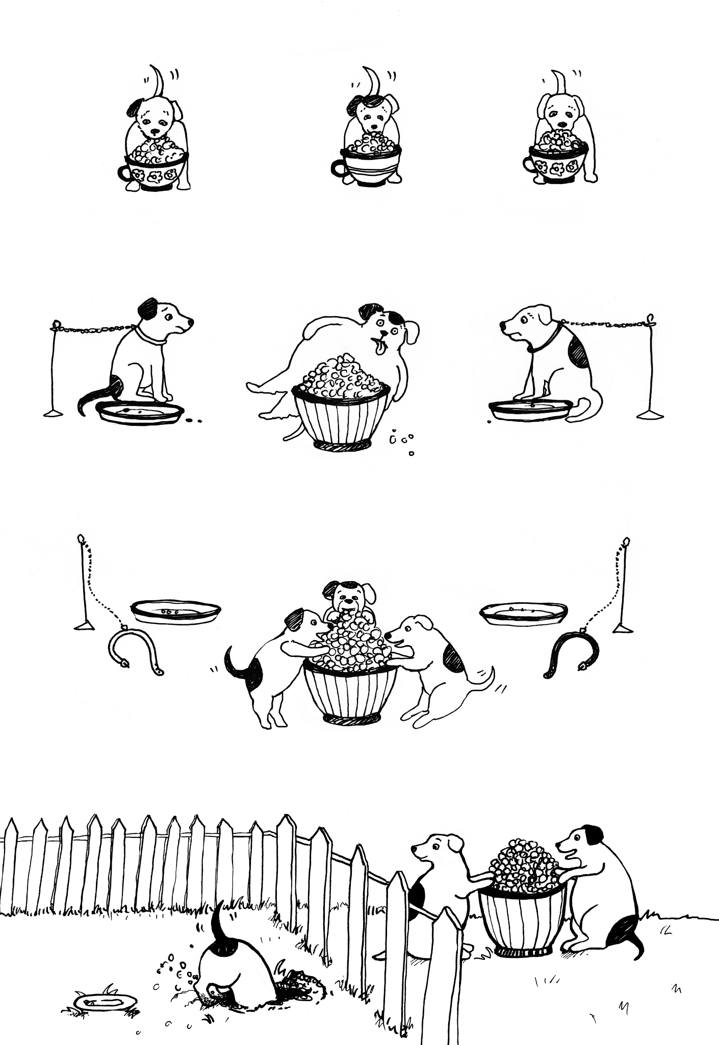

Multithreading as a realisation of concurrency
Challenges and Hazards:
Executing within the same program
Reading and writing the same memory simultaneously

Slide 5
Processes and Threads
Two basic units of execution: processes and threads
Java: mostly concerned with threads

Slide 6
Processes and Threads
Process
Self-contained execution environment.
Generally a complete, private set of basic run-time resources
Each process with it own memory space
Often seen as synonymous with programs or applications
For user a single application may be a set of cooperating processes.
Most OS support Inter Process Communication (IPC) resources, such as pipes and sockets.
Most implementations of the JVM run as a single process
A Java application can create additional processes using a ProcessBuilder object.

Slide 7
Processes and Threads
Threads
Sometimes called as lightweight processes
Share the process's resources, including memory and open files
Multithreaded execution is an essential feature of the Java platform
Threads exist within a process — every process has at least one (every application has at least one thread) - Main thread
Main thread:
ability to create additional threads

Slide 8
States of Java Threads
4 separate states
new: just created but not started
runnable: created, started, and able to run
blocked: created and started but unable to run because it is waiting for some event to occur
dead: thread has finished or been stopped
stop() end of run()
dead
runnable
new
start()
notify() I/O completion resume()
wait() I/O request suspend()
blocked

Slide 9
Implementation
For slides 10-13 refer to demo1 and demo2 in source code that comes along with the lecture

Slide 10
Implementation #1: Impelmenting Interface
The Runnable interface
Defines a single method, run, meant to contain the code executed in the thread
Runnable object is passed to the Thread constructor
public class ThreadingExample implements Runnable {
public static void main(String[] args) {
(new Thread(new ThreadingExample())).start();
}
@Override
public void run() {
for(int i = 0; i < 10; i++)
{
System.out.println("Executing Thread");
}
}
}

Slide 11
Implementation #2: Inheriting Thread Class
Subclass of Thread
The Thread class itself implements Runnable, though its run method does nothing
public class ThreadingExample extends Thread {
public static void main(String[] args) {
(new ThreadingExample()).start();
}
@Override
public void run()
{
for(int i = 0; i < 10; i++)
{
System.out.println("Executing Thread");
}
}
}

Slide 12
Implementation #3: Creating New Thread
Simple way for:
GUI applications and execute queries
private void jButtonActionPerformed(java.awt.event.ActionEvent evt) {
Thread testThread = new Thread("TestThread") {
public void run() {
for (int i = 0; i < 20; i++) {
System.out.println(i+" "+Thread.currentThread().getName());
}
}
};
testThread.start();
}

Slide 13
Implementation: Passing an argument
Passing an argument
public class ThreadingExample implements Runnable {
private int value;
public ThreadingExample(int val)
{
value = val;
}
public static void main(String[] args) {
(new Thread(new ThreadingExample(0))).start();
(new Thread(new ThreadingExample(1))).start();
}
@Override
public void run() {
for(int i = 0; i < 1000; i++)
{
System.out.println("Thread "+value);
}
}
}

Slide 14
Controlling Threads

Slide 15
Pausing Execution: #1
Thread.sleep causes the current thread to suspend execution for a specified period.
Making processor time available to the other threads of an application or other applications that might be running on a computer system
//Pause for 4 seconds Thread.sleep(4000);
sleep throws InterruptedException

Slide 16
Pausing Execution: #2
A wait() can be "woken up" by another thread calling notify() or notifyAll() on the monitor which is being waited on whereas a sleep cannot
Function notify()
Wakes up only one thread waiting on the object
Function notifyAll()
Wakes up all the threads waiting on the object

Slide 17
State and Priority of the Thread
start() begins a thread running
isAlive() Checks if a thread is active (true) or killed (false)
Managing Thread Priority:
setPriority(int val) 0 to 10 (MIN_PRIORITY to MAX_PRIORITY); 5 is default (NORM_PRIORITY)
yield() current thread gives up processor so another of equal priority can run

Slide 18
Interrupts
An interrupt:
Indication to a thread that it should stop what it is doing and do something else.
Very common for the thread to terminate.
A thread sends an interrupt by invoking interrupt on the Thread object for the thread to be interrupted
Interrupted thread must support its own interruption.
Support implement through InterruptedException
This allows interrupt handling code to be centralized in a catch clause.
if (Thread.interrupted()) {
throw new InterruptedException();
}

Slide 19
Interrupts
Let’s see an example: How to stop an infinite while loop in JAVA?
Will spin the CPU endlessly
while (true) { // Nothing }

Slide 20
Interrupts
Now when we put it on another thread:
Thread infLoop = new Thread(
new Runnable() {
@Override
public void run() {
while (true) {
}
}
}
);
infLoop.start();

Slide 21
Interrupts
Check if interrupted:
Thread infLoop = new Thread(
new Runnable() {
@Override
public void run() {
while (true) {
if (Thread.interrupted()) {
break;
}
// Continue to do nothing
}
}
}
);
infLoop.start();
infLoop.interrupt();

Slide 22
Interrupts
Thread.interrupted()
Returns the flag AND sets it to false.
Once InterruptedException is thrown, the flag is reset - the thread no longer knows anything about the interruption request sent by the owner.
try { Thread.sleep(100); } catch (InterruptedException ex) { Thread.currentThread().interrupt();
throw new RuntimeException(ex); }

Slide 23
Join
Allows one thread to wait for the completion of another
The join method allows one thread to wait for the completion of another. If thr is a Thread object whose thread is currently executing, thr.join() causes the current thread to pause execution until thr's thread terminates.
Overloads of join allows to specify a waiting period.
As with sleep(), join() is dependent on the OS for timing.
Do not assume that join will wait exactly as long as you specify.
Like sleep(), join() responds to an interrupt by exiting with an InterruptedException.

Slide 24
Join
Thread th1 = new Thread(new ThreadingExample(0));
Thread th2 = new Thread(new ThreadingExample(1));
th1.start();
try {
th1.join();
} catch (InterruptedException ex) {
Logger.getLogger(ThreadingExample.class.getName()).log(Level.SEVERE, null, ex);
}
th2.start();

Slide 25
Thread Safety

Slide 26
Thread Safety (#1): Synchronization
Interference happens when two operations, running in different threads, but acting on the same data, interleave
two operations consist of multiple steps, and the sequences of steps overlap.
Possible solutions:
Don't share the state variable across threads;
Make the state variable immutable;
Use synchronization whenever accessing the state variable.

Slide 27
Thread Safety (#1): Synchronization
Launch 2 threads th1 & th2 on Counter():
th1: Retrieve cnt.
th2: Retrieve cnt.
th1: Increment retrieved value; result is 1.
th2: Decrement retrieved value; result is -1.
th1: Store result in cnt; cnt is now 1.
th2: Store result in cnt; cnt is now -1.
class Counter {
private int cnt = 0;
public void increment(){
cnt++;
}
public void decrement(){
cnt--;
}
public int value() {
return cnt;
}
}

Slide 28
Thread Safety (#1): Synchronization
JAVA provides two basic synchronization idioms:
synchronized methods
Add the synchronized keyword to its declaration public synchronized void increment() { c++; }
Constructors cannot be synchronized
Enable a simple strategy for preventing thread interference and memory consistency errors
If an object is visible to more than one thread, all reads or writes to that object's variables are done through synchronized methods (final fields also through non-synchronized methods)

Slide 29
Thread Safety (#1): Synchronization
JAVA provides two basic synchronization idioms:
synchronized statements
Intrinsic Locks (monitors)
Enforce exclusive access to an object's state and
Establish happens-before relationships that are essential to visibility
Thread has to:
Acquire the object's intrinsic lock before accessing them
Release the intrinsic lock when it's done with them
Thread owns the intrinsic lock between acquiring the lock and releasing it
As long as a thread owns an intrinsic lock, no other thread can acquire the same lock
The other thread will block when it attempts to acquire the lock.

Slide 30
Thread Safety (#1): Synchronization
JAVA provides two basic synchronization idioms:
Synchronized statements
Useful for improving concurrency with fine-grained synchronization
public void addStudentName(String name) {
synchronized(this) {
lastName = name;
nameCount++;
}
//Do something else

Slide 31
Thread Safety (#2): Atomic Access
Effectively happens all at once
Cannot stop in the middle - happens completely, or it doesn't happen at all
No side effects of an atomic action are visible until the action is complete
Reads and writes are atomic for reference variables and for most primitive variables (all types except long and double).
Reads and writes are atomic for all variables declared volatile (including long and double variables).
volatile variable establishes a happens-before relationship with subsequent reads of that same variable
instruct JVM threads to read value of volatile variable from main memory and don't cache it locally
If a variable is not shared between multiple threads no need to use volatile keyword with that variable.
Using simple atomic variable access is more efficient than accessing these variables through synchronized cod

Slide 32
Thread Safety (#3): Liveness
Application's ability to execute in a timely manner
Most kind of problem: deadlock
A situation where two or more threads are blocked forever, waiting for each other
Starvation
A situation where a thread is unable to gain regular access to shared resources and is unable to make progress
Happens when shared resources are made unavailable for long periods by "greedy" threads
LiveLock
If the other thread's action is also a response to the action of another thread, then livelock may result
Are unable to make further progress
Are not blocked — they are simply too busy responding to each other to resume work
Comparable to two people attempting to pass each other in a corridor

Slide 33
Thread Safety (#4): Guarded Blocks
Common coordination idiom of thread actions
Begins by polling a condition that must be true before the block can proceed
Example: method that must not proceed until a shared variable has been set by another thread
Solution: could simply loop till the conditions are right. WASTEFUL!
Effective solution: invoke Object.wait
wait does not return until another thread has issued a notification that some special event may have occurred

Slide 34
Thread Safety (#4): Guarded Blocks
Object.wait to suspend the current thread
Invocation of wait does not return until another thread has issued a notification that some special event may have occurred
wait can throw InterruptedException
Example:
Loops once for each special event, which may not be the event we're waiting for
public synchronized void guardedBlockMethod() {
while (!var) {
try {
wait();
} catch (InterruptedException e) {}
}
System.out.println("Variable is received!" );
System.out.println("Efficiency have been achieved!");
}

Slide 35
Thread Safety (#4): Guarded Blocks
When wait is invoked, the thread releases the lock and suspends execution
At some future time, another thread will acquire the same lock and invoke Object.notifyAll, informing all threads waiting on that lock that something important has happened:
public synchronized notifyGuardedBlockMethod() {
var = true;
notifyAll();
}

Slide 36
Thread Safety (#5): Immutable Objects
Its state cannot change after it is constructed
Cannot be corrupted by thread interference or observed in an inconsistent state
Particularly useful in concurrent applications
If trying to read two states from class, after reading one, second could be changed and do not correspond to the necessary state
class Color {
String name;
int r;
int g;
int b;
...
}

Slide 37
Thread Safety (#5): Immutable Objects
Strategy:
All fields final and private & declare the class as final.
A more sophisticated approach: private constructor, construct instances in factory methods.
Do not allow subclasses to @Override methods.
If the instance fields include references to mutable objects, do not allow those objects to be changed:
Do not provide methods that modify the mutable objects (no "setter" methods)
Do not share references to the mutable objects.
Never store references to external, mutable objects passed to the constructor; if necessary, create copies, and store references to the copies. Similarly, create copies of your internal mutable objects when necessary to avoid returning the originals in your methods.

Slide 38
High Level Concurrency Objects

Slide 39
High Level Concurrency Objects
All previous - low-level APIs
Further - high-level APIs
Lock objects:
Support locking idioms that simplify many concurrent applications.
Executors:
Define a high-level API for launching and managing threads.
Implementations provided by java.util.concurrent provide thread pool management suitable for large-scale applications.

Slide 40
High Level Concurrency Objects
All previous - low-level APIs
Further - high-level APIs
Concurrent collections:
Make it easier to manage large collections of data.
Can greatly reduce the need for synchronization.
Atomic variables:
Have features that minimize synchronization and help avoid memory consistency errors.
ThreadLocalRandom (in JDK 7) provides efficient generation of pseudorandom numbers from multiple threads.

Slide 41
Executor demo
ExecutorService executorService = Executors.newSingleThreadExecutor();
executorService.execute(new Runnable() {
public void run() {
System.out.println(”Running");
}
});
executorService.shutdown();

Slide 42
Executor demo
ExecutorService executorService = Executors.newSingleThreadExecutor();
Future future = executorService.submit(new Runnable() {
public void run() {
System.out.println(”Running");
}
});
future.get();
executorService.shutdown();

Slide 43
Lock Objects
java.util.concurrent.locks, will focus on its most basic interface, Lock.
Lock objects used by synchronized code
Only one thread can own a Lock object at a time
Also support a wait/notify mechanism through their associated Condition objects
Advantage
Ability to back out of an attempt to acquire a lock
The tryLock method backs out if the lock is not available immediately or before a timeout expires (if specified)
lockInterruptibly method backs out if another thread sends an interrupt before the lock is acquired

Slide 44
Lock Objects
ReentrantLock - key class to focus on
Same as synchronized code block but attempt to acquire lock is explicit
lock() blocks until lock is available (until unlock() is executed)
Thread can reacquire a lock it already owns
public static void testRLoc() {
Lock myLock = new ReentrantLock();
myLock.lock();
try {
//Synchronized code comes here
} finally {
myLock.unlock();
}
}

Slide 45
CyclicBarrier
Runnable action = new Runnable() {
public void run() {
System.out.println(”Action");
}
};
CyclicBarrier barrier = new CyclicBarrier(2, action);

Slide 46
AtomicLong demo
ValueSetter valueSetter = new ValueSetter(new AtomicLong(100));
valueSetter.start();
for (int i = 0; i < 3; i++) { new ValueGetter(valueSetter).start(); }
Notes:
Refer to demo3 in source code that comes along with the lecture

Slide 47
Questions?

