Slide 1
Date Time API

Slide 2
Problem: Date
Date date = new Date(12,12,12);
System.out.println(date);
// Sun Jan 12 00:00:00 EET 1913
Notes:
Several problems here:
Which 12 is for which date field?
Month 12 is December, right? No. January.
Year 12 is 12 CE, right? Wrong. 1913.
Wait - there is a time in a date?
More than that, there is a time zone.
Conceptually an instant, not a date
Properties have random offsets
Some zero-based, like month and hours
Some one-based, like day of the month
Year has an offset of 1900
Mutable, not thread-safe
Not internationalizable
Millisecond granularity
Does not reflect UTC

Slide 3
Problem: Calendar
Calendar calendar =
new GregorianCalendar(12,12,12);
Date date = calendar.getTime();
String formattedDate = simpleDateFormat
.format(date);
System.out.println(formattedDate);
// Thu Jan 12 00:00:00 AM EET 0013
Notes:
Several problems here:
1. Which 12 is for which date field?
2. Month 12 is December, right? No. January.
3. They got the year right! Almost. 13 CE.
4. Wait - there is a time in a calendar?
5. More than that, there is a time zone.
Not much imporovement
Conceptually an instant, not a calendar
But, can’t create a Calendar from a Date
Can’t format a Calendar
Zero-based offsets
Stores internal state in two different ways
milliseconds from epoch
set of fields
Has bugs and performance issues
Mutable, not thread-safe

Slide 4
Date Time API: LocalDate
LocalDate date = LocalDate.of(12, 12, 12);
System.out.println(date);
// 0012-12-12
Notes:
No problems:
ISO 8601 order of fields - year, month, day.
Month 12 is December.
Year is 12 CE.
No time component.
No time zone.

Slide 5
Date Time API
Machine views vs human views
Epoch
Clear purpose
Immutable, thread-safe
Extensible
Standards
Notes:
Standard - ISO 8601

Slide 6
Date Time API: Packages
java.time
java.time.format
java.time.temporal
java.time.zone
java.time.chrono
Notes:
java.time - instants, durations, dates, times, time zones, periods
java.time.format - formatting and parsing
java.time.temporal - field, unit, or adjustment access to temporals
java.time.zone – support for time zones
java.time.chrono - calendar systems other than ISO-8601

Slide 7
Date Time API: Common Classes
LocalDate
LocalTime
LocalDateTime
Instant
Notes:
LocalDate:
Corresponds to SQL DATE type
LocalTime:
Corresponds to SQL TIME type
LocalDateTime (no timezone):
Corresponds to SQL TIMESTAMP type
ZoneId – id of timezone
ZoneOffset – time zone offset from Greenwich
ZonedDateTime = LocalDateTime + ZoneId
OffsetDateTime = LocalDateTime + ZoneOffset
OffsetTime = LocalTime + ZoneOffset
Instant – nanoseconds from EPOCH. Constants:
Instant.EPOCH
Instant.MIN
Instant.MAX

Slide 8
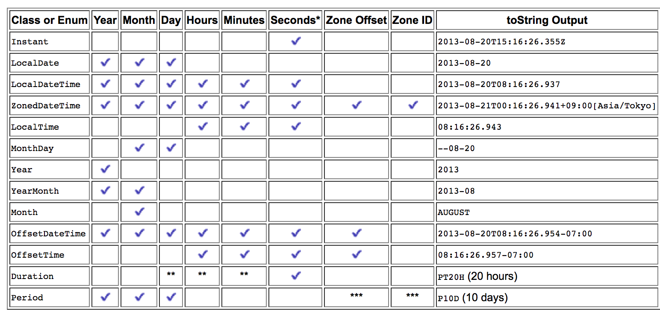
Date Time API: Common Classes
Notes:
The following table summarizes the temporal-based classes in the java.time package that store date and/or time information, or that can be used to measure an amount of time. A check mark in a column indicates that the class uses that particular type of data and the toString Output column shows an instance printed using the toString method.
Oracle tutorial
*Seconds are captured to nanosecond precision
.**This class does not store this information, but has methods to provide time in these units.
***When a Period is added to a ZonedDateTime, daylight saving time or other local time differences are observed.

Slide 9
Date Time API: Operations
of
from
get
is
with
to
plus/minus
Notes:
LocalTime.now();
LocalTime.of(6, 30);
LocalTime.parse("06:30").plus(1, ChronoUnit.HOURS);
LocalTime.parse("06:30").getHour();
LocalTime.parse("06:30").isBefore(LocalTime.parse("07:30"));
with - immutable copy with elements changed
to - converts to another object type
plus, minus - immutable copy after operation

Slide 10
Date Time API: Constants
DayOfWeek.FRIDAY
Month.MARCH
ChronoUnit.DAYS
LocalTime.MIDNIGHT // 00:00
LocalTime.NOON // 12:00
Notes:
System.out.printf("%d%n", Month.FEBRUARY.maxLength());

Slide 11
Date Time API: Formatting
Use DateTimeFormatter
LocalDate localDate = localDateTime
.format(DateTimeFormatter.ISO_DATE);
Notes:
ISO 8601
Thread-safe
Can throw DateTimeParseException, DateTimeException.

Slide 12
Date Time API: Formatting
DateTimeFormatter dateFormatter =
DateTimeFormatter
.ofLocalizedDateTime(FormatStyle.MEDIUM);
localDateTime
.format(dateFormatter)
.withLocale(Locale.TAIWAN));
// 2015/1/25 上午 06:30:00
Notes:
Internationalization is supported

Slide 13
Date Time API: Temporal
LocalTime time = LocalTime.of(12,0,0);
LocalTime newTime = time.with(temp ->
temp.plus(4, ChronoUnit.MINUTES));

Slide 14
Date Time API: Temporal Query
boolean isMyBirthday(TemporalAccessor date) { int month = date.get(ChronoField.MONTH_OF_YEAR); int day = date.get(ChronoField.DAY_OF_MONTH); return month == Month.APRIL.getValue() && day == 3; }
boolean isItMyBirthday = date
.query(BirthDay::isMyBirthday)
Notes:
Externalize the process of querying
Examples:
get the time zone in a temporal
check if date is February 29 in a leap year
calculate days until your next birthday

Slide 15
Date Time API: Time Period
LocalDate date1 = LocalDate.parse("2010-03-11"); LocalDate date2 = LocalDate.parse("2007-03-11"); int yearDiff = Period.between(date1, date2).getYears(); long yearDiff2 = ChronoUnit.YEARS.between(date1 , date2);
// -3
Notes:
Period class has getters:
getMonths
getDays
getYears
LocalDate initialDate = LocalDate.parse("2007-05-10");
LocalDate finalDate = initialDate.plus(Period.ofDays(5));
Similar to Period, the Duration class is use to deal with Time.

Slide 16
Home Reading
https://docs.oracle.com/javase/tutorial/datetime/iso/index.html

