Slide 1

SMART INDIA HACKATHON 2026
TITLE PAGE
Problem Statement ID – 26122
Problem Statement Title- Intelligent Data Capture & Schedule-Linking Layer for Infrastructure Project Management: Real-Time Actual Progress Tracking (Planning-to-Execution Bridge)
Theme- Smart Automation
PS Category- Software
Team ID-
Team Name- NamasteByte
Notes:
Problem statement metadata taken from the SIH portal listing for PS 26122, Oil India Limited.
Team ID intentionally left blank until the portal issues it.

Slide 2
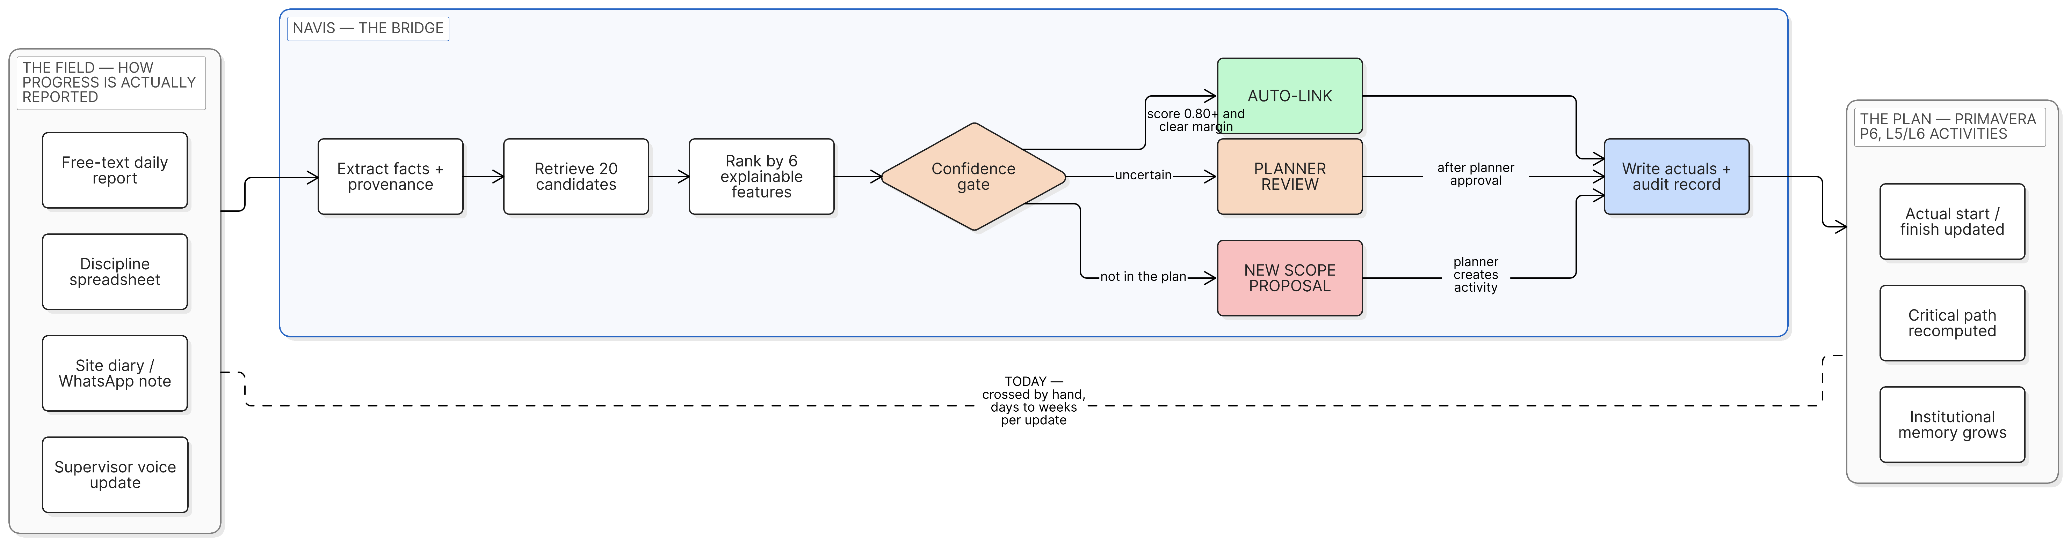
IDEA TITLE
NamasteByte
NAVIS - one evidence trail from a field sentence to a reviewed P6 actual.
PROPOSED SOLUTION
THE PROBLEM
HOW NAVIS SOLVES IT
WHAT IS NEW - REFUSAL IS THE FEATURE
Progress is reported as prose - daily reports, discipline sheets, voice notes. Primavera P6 needs an activity ID and a date. A planner bridges that gap by hand, every cycle, on a schedule of thousands of activities.
Extract the fact with the file and line it came from, retrieve 20 candidate activities, rank on 6 explainable features, then gate on confidence. Actuals are written with an append-only audit record.
100% auto-link precision, 67 of 67 on a held-out test. The rest is queued for a planner, never guessed. A wrong actual date triggers false billing or a premature hydrotest - so the system asks instead.
Notes:
Diagram: Eraser workspace 2qnRjujRIBvJMgxD2vov, diagram 9JyHxB0LPKk1vQ5E_QwS.
100 percent auto-link precision, 67 of 67, on the held-out test split - reproduce with python eval.py.
Coverage is 43.5 percent by design; the remaining mentions go to the planner review queue.

Slide 3
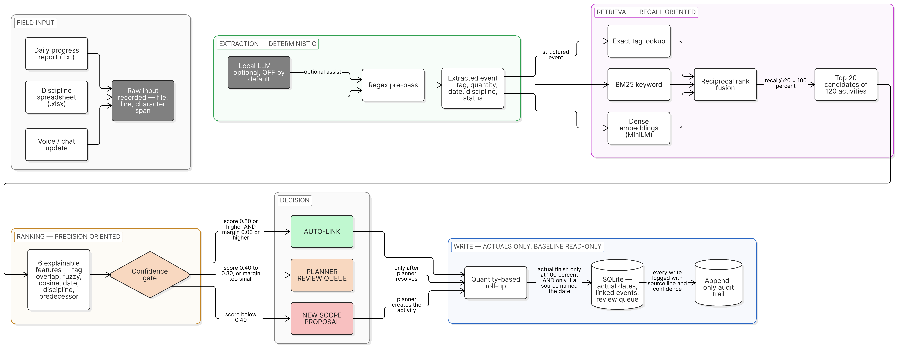
TECHNICAL APPROACH
NamasteByte
TECHNOLOGIES USED
FLOW CHART
React + TypeScript - Vite front end
FastAPI - 18 REST routes, live OpenAPI docs
Deterministic rules extraction - .txt, .xlsx, .pdf, .csv, image OCR
Hybrid retrieval - exact tag + BM25 + MiniLM embeddings, RRF fused
Ranking - 6 explainable features, no black box in the loop
SQLite - actuals, review queue, append-only audit
Primavera P6 PMXML and XER - pure Python, no MPXJ, no JVM
100%
43.5%
86.9%
GitHub
github.com/poa8534-crypto/SIH-2026
Local LLM via Ollama - optional, OFF by default
AUTO-LINK PRECISION
67 of 67 correct
COVERAGE
67 of 154 mentions
TOP-1 ACCURACY
126 of 145
Verify
python eval.py reproduces every figure above
Working prototype - 1,426 automated tests passing
Runs on one laptop CPU. No cloud service, no API key.
Notes:
Diagram: Eraser workspace 2qnRjujRIBvJMgxD2vov, diagram LxOWrZi9aG3a2C87B7_8.
Thresholds shown on the chart are the shipped configuration: high 0.80, low 0.40, margin 0.03 (matching/config.py).
Auto-link precision 100 percent (67/67), coverage 43.5 percent (67/154), top-1 86.9 percent (126/145) on the held-out test split.
1,426 automated tests = 1,202 pytest plus 224 vitest, all passing on 10 September 2026.
The optional local LLM may help read a messy report. It never chooses the activity and never writes a date.

Slide 4
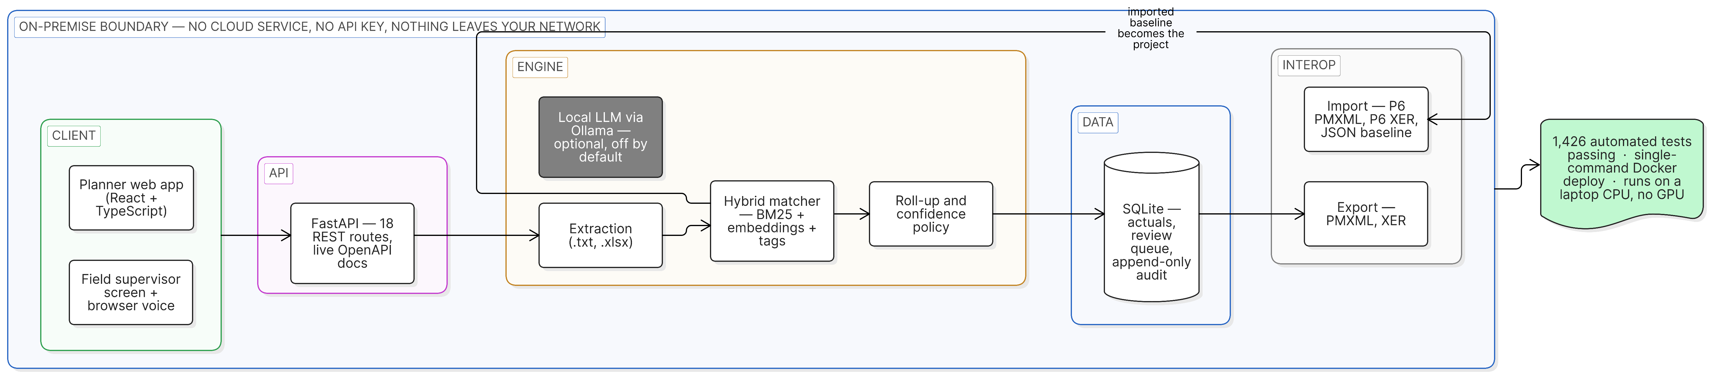
FEASIBILITY AND VIABILITY
NamasteByte
FEASIBILITY - IT RUNS ON ONE LAPTOP
No cloud service, no API key, nothing leaves your network.
CHALLENGES AND RISKS
MITIGATION - ALREADY BUILT
Field wording never matches the WBS text
Three retrieval channels fused - the correct activity is inside the top 20, recall@20 = 100%
A wrong actual date means false billing or a premature hydrotest
Nothing is auto-written unless score, margin and discipline all agree - 0 wrong auto-links
Work happens that nobody planned
Raised to the planner as a new-scope proposal, never dropped silently
No live Oil India schedule is available to us
Synthetic schedule structured on the public CFIHOS oil and gas taxonomy - and we say so
Site or venue has no internet
The whole stack runs on one laptop CPU - no cloud, no GPU, no API key
Known gaps, stated: no authentication (the login screen is a role picker), no offline queue, no .mpp import, synthetic labels.
Notes:
Diagram: Eraser workspace 2qnRjujRIBvJMgxD2vov, diagram Vwn78M3zjDixZbTZ4tdn.
recall@20 = 100 percent on the held-out test split; fusion places the correct activity inside the retrieved 20.
The XER writer emits a simplified shape and is not a P6-valid round trip (D-047).
OCR is on-premise only when local Tesseract is installed; an optional cloud vision provider would send that document out.

Slide 5
IMPACT AND BENEFITS
NamasteByte
Today this knowledge dies in a supervisor's notebook at project close.
THE LOOP THAT CLOSES
the loop closes - execution history becomes the next plan
PROJECT EXECUTES
NAVIS CAPTURES
STRUCTURED RECORD
QUERYABLE HISTORY
NEXT BASELINE
reports, diaries,
field updates
real start, real finish,
real quantity
durations, delay causes,
discipline productivity
how long does this
really take here
calibrated,
not guessed
WHO GAINS, AND WHAT THEY GAIN
SITE SUPERVISOR
PLANNING ENGINEER
Speaks one sentence instead of filling a form. Reporting stops being a second job.
Reviews ranked exceptions instead of matching thousands of rows by hand.
PROJECT MANAGER
PSU / OWNER
Sees a schedule that reflects this week, not last month - slippage while it can still be acted on.
Every actual date is defensible with a file, a line and a confidence.
SCALE OF THE EXPOSURE
Context only. NAVIS has run no field pilot, so no saving, ROI or productivity figure is claimed.
1,948 monitored central-sector projects, ₹41.99 lakh crore latest revised cost (MoSPI PAIMANA, February 2026).
Notes:
MoSPI PAIMANA portal, February 2026: 1,948 monitored central-sector projects, latest revised cost 41,98,684.28 crore rupees.
That figure sets the scale of the exposure. It is not a NAVIS savings claim and the slide says so.
No field pilot has run, so no ROI, monetary saving or productivity percentage is claimed anywhere in this deck.

Slide 6
RESEARCH AND REFERENCES
NamasteByte
REFERENCE AND RESEARCH WORK
OUR OWN EVIDENCE - WHY COVERAGE IS UNDER HALF
MoSPI PAIMANA
154 held-out test mentions
Central project monitoring scale
ipm.mospi.gov.in
six source files, no threshold tuned on them
▼
GAO Schedule Assessment Guide
67 auto-linked
What makes a schedule reliable
gao.gov/products/gao-16-89g
43.5% coverage at 100% precision
▼
NIST AI Risk Management Framework
39 schedule nodes touched
Traceability and human oversight
nist.gov/itl/ai-risk-management-framework
after quantity-based roll-up
Oracle Primavera P6 EPPM docs
32 had no measurable quantity
7 finish dates withheld
PMXML and XER interchange
docs.oracle.com - primavera-p6
no percentage, no date written
the only date came from a report header
CFIHOS oil and gas taxonomy
Every narrowing step is a deliberate refusal. Reproduce it live: python eval.py
Structure behind the synthetic schedule
public specification, datasets/real/
EVIDENCE BOUNDARY
Synthetic schedule and reports
No live Oil India data yet
In-distribution benchmark
1,426 tests - 1,202 pytest, 224 vitest
Notes:
MoSPI PAIMANA: https://ipm.mospi.gov.in/
GAO Schedule Assessment Guide GAO-16-89G: https://www.gao.gov/products/gao-16-89g
NIST AI Risk Management Framework: https://www.nist.gov/itl/ai-risk-management-framework
Oracle Primavera P6 EPPM documentation: https://docs.oracle.com/en/industries/construction-engineering/primavera-p6-enterprise-project-portfolio/
METRICS.md section 3.4a audits our own benchmark: 84 percent of test positives reuse an activity seen in training, so these are in-distribution numbers.

