Slide 1
Analysis and Recommendations for Starting a Movie Studio
Pierre-Olivier Ariston
February 2020
Notes:
Microsoft sees all the big companies creating original video content, and they want to get in on the fun. They have decided to create a new movie studio, but the problem is they don’t know anything about creating movies. They have hired you to help them better understand the movie industry. Your team is charged with doing data analysis and creating a presentation that explores what type of films are currently doing the best at the box office. You must then translate those findings into actionable insights that the CEO can use when deciding what type of films they should be creating.

Slide 2
Problem Statement and business value
How to increase the odds of making successful movies?
As we are starting a movie studio from scratch, it is vital to make profitable movies right away.
Notes:
Insist on profitability. Explain that it is not because a movie made a lot of money that it is profitable. Success is relative to the cost of the movie.

Slide 3
Methodology 1/3
Profit ratio = 1 - neither making nor losing money.
Profit ratio < 1 - losing money.
Profit ratio > 1 - making money.
Movies | $ Profits
Movie #1 | $ Profit #1
… | …
Movie #n | $ Profit #n
Average profits
Average profit #1
Average profit #2
…
Average profit #20000
random selections
Average profits
Repeat many times with different random selections of movies
Notes:
Data comes from websites:
Box Office Mojo
IMDB
Rotten Tomatoes
TheMovieDB.org
Feature Engineering: Explain that a profit ratio of 1 means neither make nor lose money. Smaller than 1 means lose money. Bigger than 1 means make money.
Can we expect to make a profit as a starting inexperienced movie studio?
To answer these questions, we randomly selected movies and calculated their average profit. We repeated this process 20000 times, each time choosing between 1 and 100 movies.
From tn.movie_budgets.csv, we analyzed the profitability of 4617 movies. For these movies, we used the budget and gross income data. We asked ourselves if the movie business is a good business to invest in. Considering all the available movies - good or bad -, how profitable are them on average? Can we expect to make a profit as a starting inexperienced movie studio?
To answer these questions, we randomly selected movies and calculated their average profit. We repeated this process 20000 times, each time choosing between 1 and 100 movies.

Slide 4
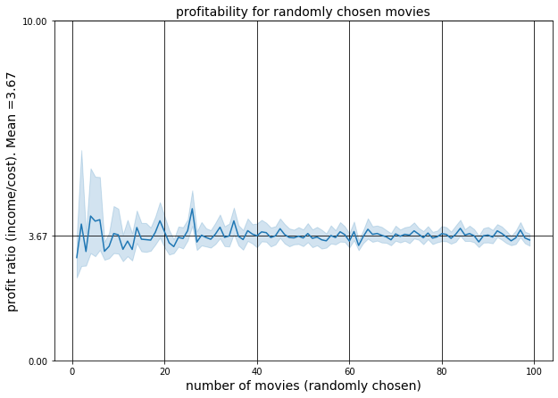
Findings 1/3
Notes:
Getting into the movie business is a good choice as the level of profits is generally high: With randomly chosen movies. After 20 movies, we are almost certain to reach a profit ratio higher than 3
Pretty good!

Slide 5
Findings 1/3
Getting into the movie business is a good choice as the level of profits is generally high.
With randomly chosen movies, after 20 movies, we are almost certain to reach a profit ratio higher than 3.
Pretty good!
Notes:
Explain that a profit ratio of 1 means neither make nor lose money. Smaller than 1 means lose money. Bigger than 1 means make money.
Getting into the movie business is a good choice as the level of profits is generally high: With randomly chosen movies. After 20 movies, we are almost certain to reach a profit ratio higher than 3
Pretty good!

Slide 6
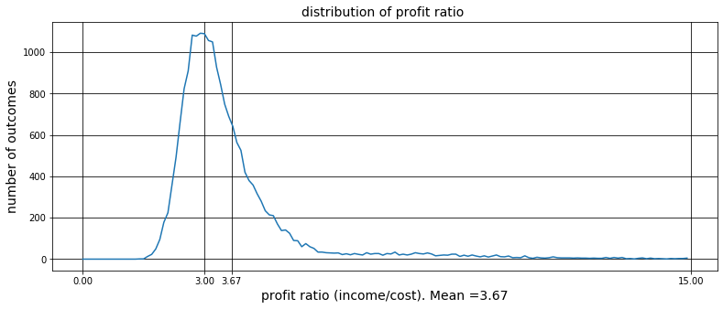
Findings 1/3
Notes:
Again we see that the movie business is quite lucrative.
when we take random selections of movies and their average profit, we get a normal distribution of the profit ratio. The central value reached the most often is about 3.

Slide 7
Findings 1/3
Again we see that the movie business is quite lucrative.
When we take random selections of movies and their average profit, we get a normal distribution of the profit ratio.
The central value reached the most often is about 3.
Notes:
Again we see that the movie business is quite lucrative.
when we take random selections of movies and their average profit, we get a normal distribution of the profit ratio. The central value reached the most often is about 3.
Note:
The Central Theorem predicts that this normal distribution should be centered around the population mean ~3.67. The discrepancy observed here should be the subject of further study.

Slide 8
Methodology 2/3
LOW profitability
HIGH profitability
Movie | genre | profitability
Movie #1 | comedy | low
… | … | …
Movie #n | war | low
… | … | …
Movie #p | action | high
… | … | …
Movie #q | comedy | high
genre | Number of movies
comedy | #
drama | #
… | …
genre | Number of movies
comedy | #
drama | #
… | …
Notes:
We classified movies into 3 groups low, medium and high profitability. We ranked the genres based on the proportion of high profit movies vs. movies loosing money.
From imdb.title.basics.csv and tn.movie_budgets.csv, we analyzed profitability of movies according to their genre. We classified movies into 3 groups low, medium and high profitability. We ranked the genres based on the proportion of high profit movies vs. movies loosing money.

Slide 9
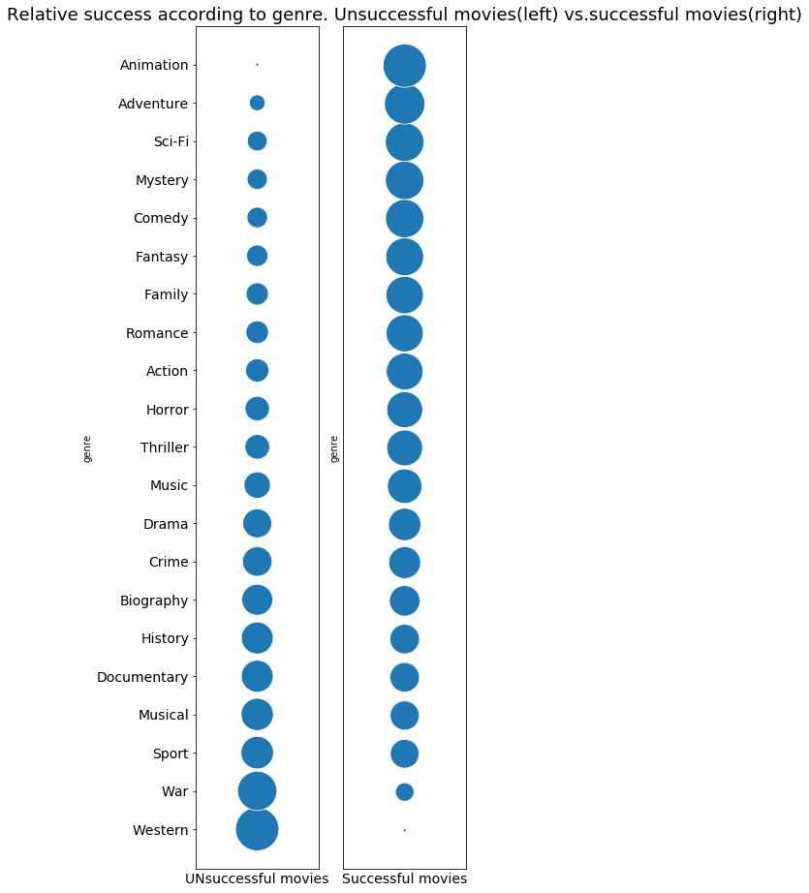
Findings 2/3
Notes:
Genres and movie success are corelated.
The five genres with highest rates of successful movies are : Animation, Adventure, Sci-Fi, Mystery and Comedy. As a starting movie studio, we should focus on those.
By contrast, the 5 genres with the worst rate of success are: Documentary, Musical, Sport, War and Western. As these genres are riskier, we should stay away from them until we are a stable business

Slide 10
Findings 2/3
Genres and movie success are corelated.
5 most successful genres: Animation, Adventure, Sci-Fi, Mystery and Comedy.
As a starting movie studio, we should focus on those.
5 least successful: Documentary, Musical, Sport, War and Western.
As these genres are riskier, we should stay away from them until we are a stable business.
Notes:
The five genres with highest rates of successful movies are : Animation, Adventure, Sci-Fi, Mystery and Comedy. As a starting movie studio, we should focus on those.

Slide 11
Methodology 3/3
Movie | Review | profitability
Movie #1 | “ blablabla “ | low
… | … | …
Movie #n | “ blablabla “ | low
… | … | …
Movie #p | “ blablabla “ | high
… | … | …
Movie #q | “ blablabla “ | high
LOW profitability
HIGH profitability
keyword | Number of occurences
character | #
funny | #
… | …
keyword | Number of occurences
performance | #
cast | #
… | …
Notes:
We looked for the most used keywords in the reviews and obtained key characteristics that make or break a movie.
From rt.reviews.tsv and rt.movie_info.tsv, we analyzed 16447 movie reviews: 8343 for movies with high incomes and 8104 for movies with low income. We looked for the most used keywords in the reviews and obtained key characteristics that make or break a movie.

Slide 12
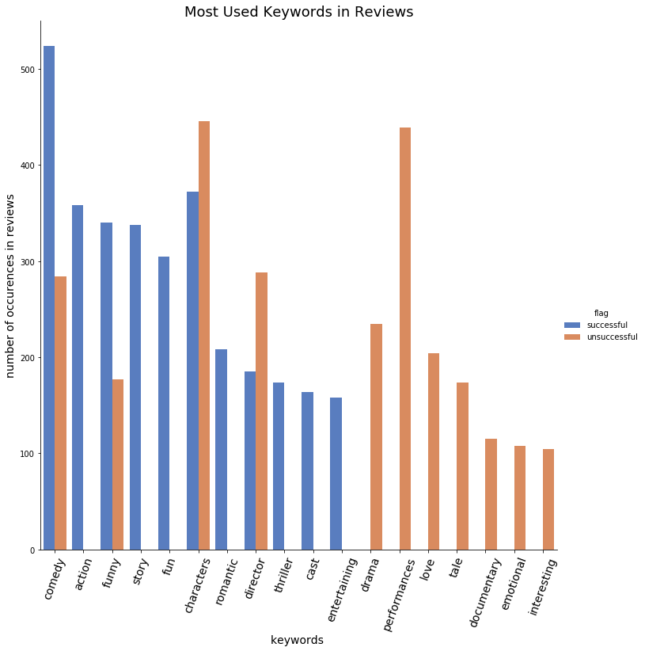
Findings 3/3
Notes:
The words "action", "story", "fun", "cast" and "entertaining" appear often in the reviews of profitable movies, but rarely in reviews of unsuccessful movies. They are likely to be characteristics contributing to success at the box office.
The words "comedy" and "funny" appear more in successful movies’ reviews. So, they are also likely to be contributors to success.
The words "characters" and "director" appear in both types of reviews but a bit more in unsuccessful movies. They must be key in making a movie successful or not. It seems they can almost equally "make or break" a movie.
The words "drama", "performances", "love", "tale", "documentary", "emotional" and "interesting" are more difficult to interpret as they are very frequent only in unsuccessful movies’ reviews, but they are not inherently negative.
Conclusion:
To make a successful movie, invest time and effort into the story and the cast. Make sure there is action and the movie is fun and entertaining. Include some romance and comedy bits. Make sure you have quality characters and choose the director wisely.

Slide 13
Findings 3/3
Ingredients for successful movies:
Action
Story
Fun
Romantic
Thriller
Cast
Entertaining
They can make or break a movie:
Comedy
Funny
Characters
Director
Notes:
The words "action", "story", "fun", "cast“, “romantic”, “thriller” and "entertaining" appear often in the reviews of profitable movies, but rarely in reviews of unsuccessful movies. They are likely to be characteristics contributing to success at the box office.
The words "comedy" and "funny" appear more in successful movies’ reviews. So, they are also likely to be contributors to success.
The words "characters" and "director" appear in both types of reviews but a bit more in unsuccessful movies. They must be key in making a movie successful or not. It seems they can almost equally "make or break" a movie.
The words "drama", "performances", "love", "tale", "documentary", "emotional" and "interesting" are more difficult to interpret as they are very frequent only in unsuccessful movies’ reviews, but they are not inherently negative.
Conclusion:
To make a successful movie, invest time and effort into the story and the cast. Make sure there is action and the movie is fun and entertaining. Include some funny comedy bits. Make sure you have quality characters and choose the director wisely.

Slide 14
Future Work
1.
Why the discrepancy?
2.
1 movie = multiple genres !! What is the main genre?
3.
Characters … Good or bad? Drama … Good or bad?
Realistic characters vs. simplistic characters
Notes:
There is future potential work for each of the 3 analysis.
For the first analysis (overall rentability of movie industry) , our random movie selections end up most often with a profit ratio of 3. The Central Theorem predicts that this normal distribution should be centered around the population mean ~3.67. The discrepancy observed here should be the subject of further study. The first thing to do would be to increase the number of movies in the database.
The second analysis about the genres as predictors of success seems the most robust. The main improvement could come from the fact that movies have multiple genres assigned to them. We could try to find what is the dominant genre and the secondary genres for each movie as the dominant genre should be weighted more heavily.
There is more room for interpretation in the third analysis (most used keywords in reviews). Potential further work could look in the review around the keywords we found and find the closest adverb or adjective. For example, in a good movie review we expect to find “realistic characters” and in a bad one, “simplistic characters”.

Slide 15
Thank you!
Questions?

