Slide 1
Teaching Scripting to Testers
Bret Pettichord
(bret@pettichord.com, www.pettichord.com)
Brian Marick
(marick@testing.com, www.testing.com)
Workshop on Teaching Software Testing, Melbourne, Florida, February 2004
Copyright © 2004 Bret Pettichord & Brian Marick.
Permission to reproduce granted under the TestingEducation.com license.

Slide 2
Agenda
Tutorial Structure
Creating an Ad Hoc Lab
Tutorial Materials
Tutorial Evolution
Who Benefits?
Changes Planned
Ruby and Our Toolkit

Slide 3
Agenda for One-Day Tutorial
A series of hands-on exercises:
Manual Testing
Using IRB and IE Controller
Writing Scripts
Web Services
For each exercise:
Show students how to do a task
  Often improvised
Provide reference material
Give students a specific goal and have them give it a go
Provide impromptu demos if they get stuck

Slide 4

Educational Objectives
Hands-on experience writing automated test scripts
Overcome fear of programming
Develop skill rather than just provide knowledge
Learn benefits of scripting languages
Understand value of different interfaces for testing
  GUI vs CLI vs API vs Web vs Web Service

Slide 5
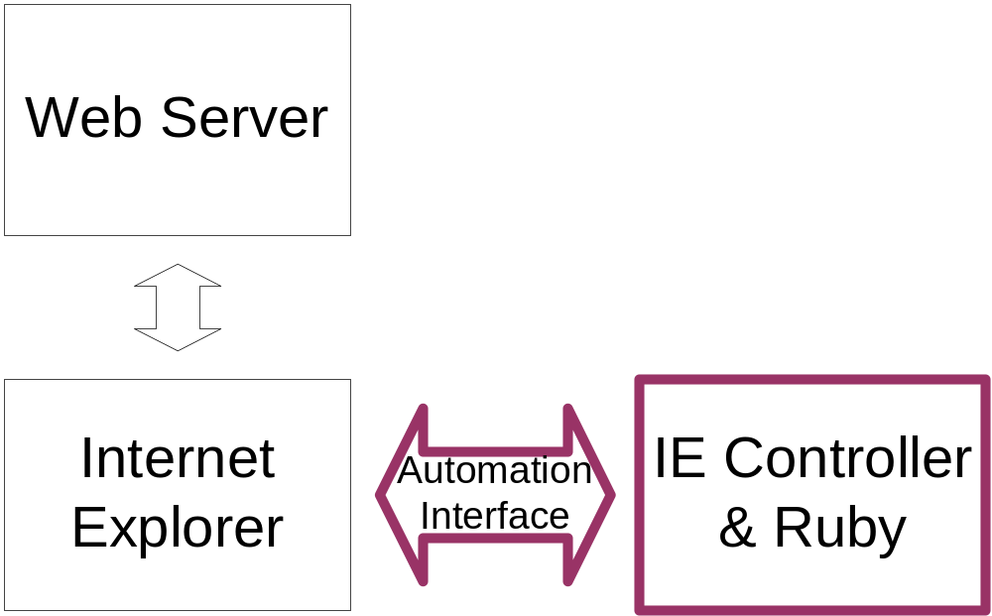
Browser Automation
Use the COM Automation interface to Internet Explorer
Tests drive the browser

Slide 6
A snippet
require 'iec'
start_ie("http://localhost:8080")
get_forms[0].name = "bret"
submit_form(get_forms[0])
Notes:
A longer example: start_stop.rb

Slide 7
Class History
STAR East Orlando | May 2003
PNSQC Portland, Oregon | October 2003
STAR West San Jose | October 2003

Slide 8
Building the Ad Hoc Lab
Students provide Windows laptops
Instructors provide:
  Wired/Wireless Network
    Router, Hubs, Cables
  Laptop (Mac) running web server
  Projector

Slide 9
Problems with Student Laptops
May: Old Creaky Laptops
  No CD drive
  No Network Card
  Flaky Behavior
Oct: Increased Network Security
  Firewalls
  Proxies
  Unusual Network Software Configurations
Also: Easier to distribute files from Mac than Windows!

Slide 10
What’s on the CD
Software
  Ruby 1.6.8 (Matz, Thomas, Hunt)
  Timeclock (Marick)
  Distributed Ruby (Seki)
  IE Controller (Morris)
  Tutorial Example Solutions (Pettichord, Marick)
Books and Articles
  Programming with Ruby (Thomas, Hunt)
  “Programming in Ruby” (Thomas, Hunt)
  “Bypassing the GUI” (Marick)
Tutorial Handouts
  Brief example-based documentation (“cheat sheets”)
  Lab exercises
We’ve also used a few slides

Slide 11
Ruby Cheat Sheet
Variables
Conditionals
Function calls
Function definitions
Very simply regular expressions
Truth and falsehood
Objects and methods and messages
Arrays
Dictionaries
Iteration

Slide 12
Spring
Tutorial
Agenda
Browser
Cocoa
GUI
Command
Line
Guts
Show Web browser interface and GUI (on Mac)
Teach how to test CLI
Teach Ruby and IRB
Teach xUnit test harness
Teach how to test Web service interface
Finish with testing Web browser interface

Slide 13
Changes from Spring to Fall
Start with Web Browser Testing
  Students really took to it
  Felt most like testing
  Direct feedback using IRB
Drop language theory
  What a class is
  Difference between a method and a message
  Students didn’t need it

Slide 14
Who Benefits?
Designed for testers scared of programming
Worked better for testers with some programming experience
Experienced programmers were able to run ahead and stay engaged
Requires two instructors for classes of 30 students

Slide 15
Pair Programming
We suggested that students pair program
They mostly resisted
Laptop requirement made students committed to using their laptops
Problem with “bad pair”

Slide 16
Changes Planned
Don’t require connection to network
Use USB drives to share code and encourage pairing
Teach pair programming as a technique
Add names to Timeclock controls
Drop web services material
Conclude with language comparison and technical overview of IE Controller
Organize and improve suggested solutions
  Also, put them all in a regression suite
Update to Ruby 1.8 and newest WTR
Improve installation docs & software
  Problems using DOS CLI
IE Controller (WTR) improvements
  Resolve interface disputes

Slide 17
New Homebrew Tutorial
Survey scripting languages and open source test tools
  http://www.io.com/~wazmo/papers/homebrew_test_automation_200311.pdf
Use Ruby WTR as basis for exemplar test suite
Create demo test suite with examples of different kinds of tests
  functional, concurrency, scenario
Use STAF for distributed testing
Plan to teach through local groups (e.g. SPINs)

Slide 18
Scripting Languages
 | Free | Free Doc | Mature | Line Interp | OO | Func | Dyn | COM | Templating
Ruby | ✓ | *** | * | ** | *** | *** | *** | ✓ | ✓
Python | ✓ | ** | ** | *** | ** | ** | ** | ✓
Perl | ✓ | * | *** | ? | * |  |  | ✓ | ✓
TCL | ✓ | ? | *** | *** | * | ** |  | ? | ✓
VBScript | ✓ | * | *** |  | *½ |  |  | ✓

Slide 19
Building Your Own
Any decent language can call Internet Explorer’s COM Automation interface.
Many applications built with Microsoft technology have COM Automation interfaces.
There are equivalent interface mechanisms for other technologies.
Perl example
  Samie (Wasserman)
  http://samie.sourceforge.net/

Slide 20
IE Controller / WTR
Wiki
  http://www.clabs.org/wtr/
Mailing List
  http://rubyforge.org/projects/wtr/
Overview
  http://www.rubygarden.org/ruby?IeController

Slide 21
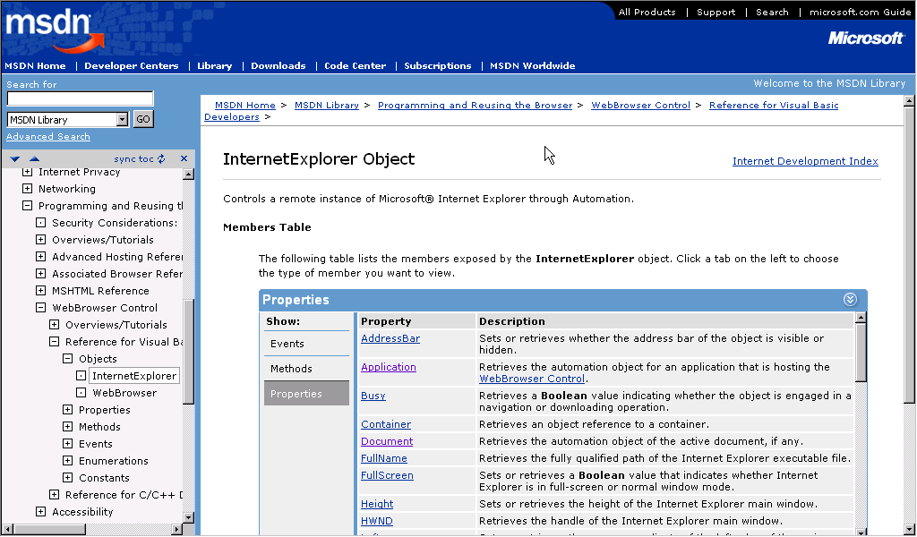
IE Automation Reference
http://msdn.microsoft.com/workshop/browser/webbrowser/reference/Objects/InternetExplorer.asp

