Slide 1
The Technology Value Stream
By: Tatiana Tan
DevOps CSD 380

Slide 2
What is Technology Value Stream?
In the DevOps Handbook 2nd Edition, the book explains TVS as the process required to convert a business hypothesis into a technology-enabled service or feature that delivers value to the customer.
On the website Gartner, a value stream is defined as the sequence of activities necessary to deliver a product, service, or experience to a customer, internal or external.
On the website VSM Consortium, the author describes it simply as anything that delivers a product or a service.

Slide 3
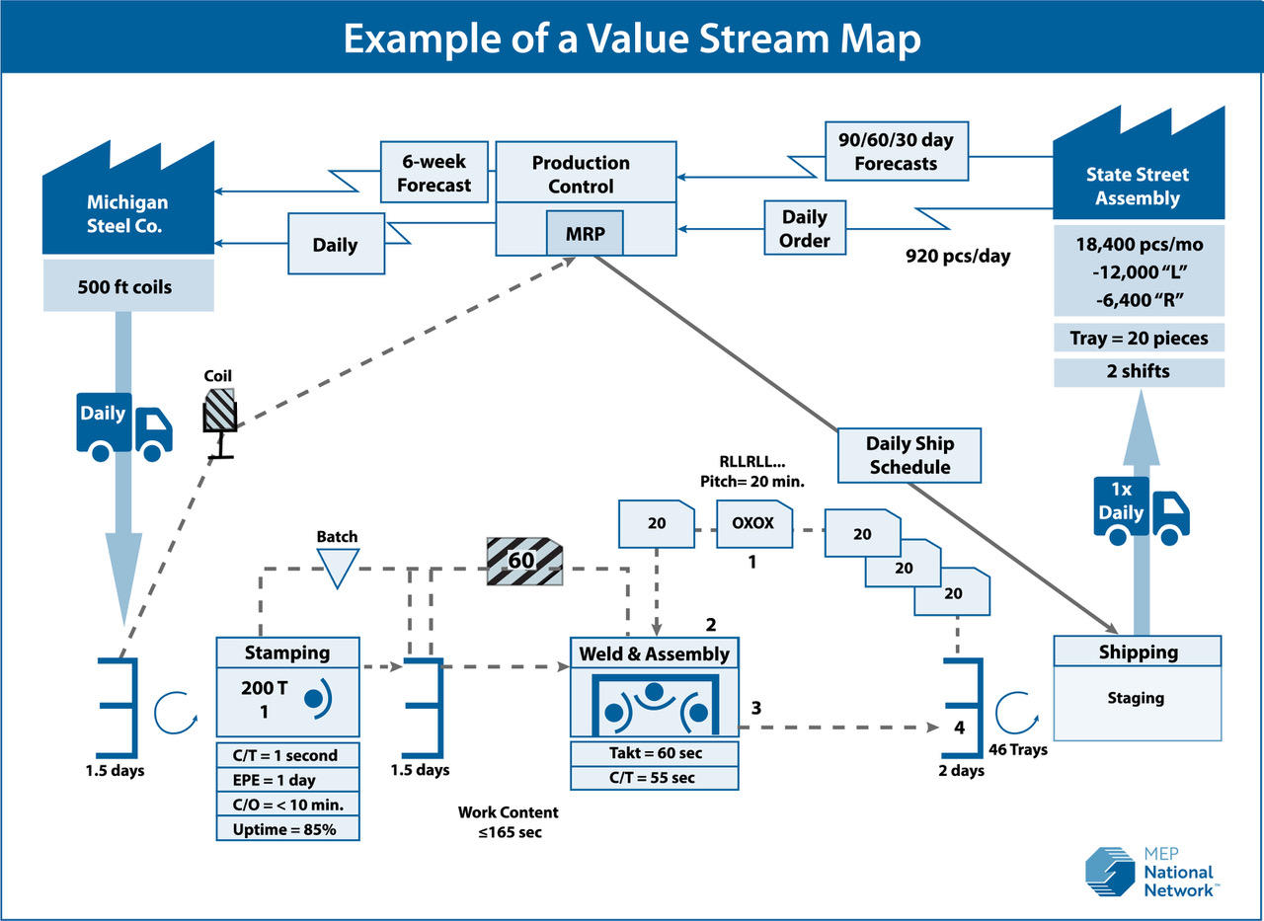
Example of a Value Stream from NIST
Here in this mapping example, you can see how the manufacturing process is visualized and how information flows.
Per the NIST website:
Value stream mapping generally involves four steps:
Identify the product value stream to map
Develop the current state map of materials, processes and flow of information
Diagnose problems, identify opportunities for improvement and define a future state
Implement improvements

Slide 4
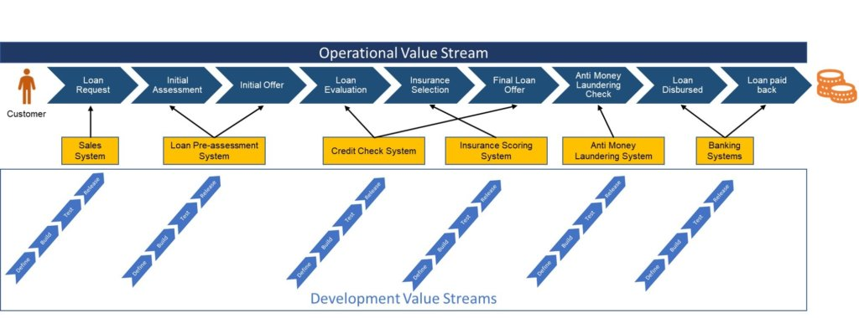
Example of Value Stream
Article Written by Satyan Prakash
Visual explains how Development Value Streams and Operational Value Streams correlate

Slide 5
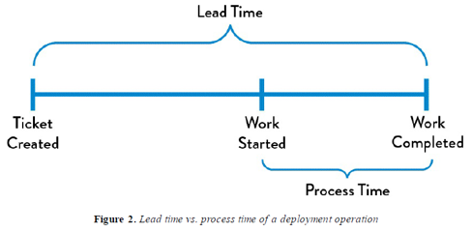
What is Lead Time versus Processing Time
Lead Time
Lead time is one of the times measuring performance in value streams
Starts when request is made and then ends when it is finished
The time the customer experiences
More of focus when looking at improvement
Processing Time
AKA touch time or task time
Clock begins when the task is actively being worked on
Part of Lead time
Work started to Work completed

Slide 6
Deployment Lead Times Requiring Months
Deployment lead times often requires several months in large organizations
This more likely to happen in big companies that have “monolithic systems” that have long test and production lead times as stated by the DevOps Handbook
The longer lead times may result in a variety of changes with different teams which then merge, and the final product or code not working or passes any tests
Fixing the codes then leads to several days or weeks of investigation which results in poor customer results

Slide 7
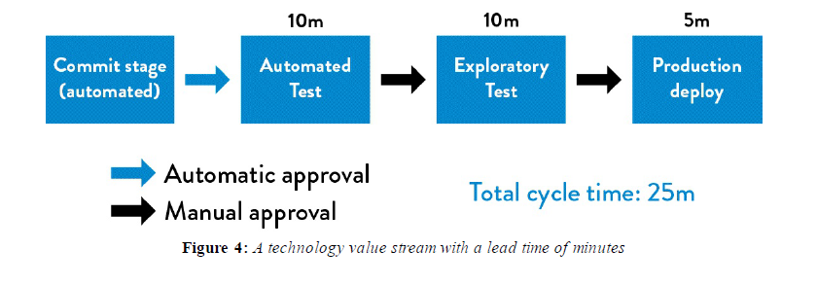
DevOps Ideal: Deployment Lead Times of Minutes How do you counteract long Lead Times according to the DevOps Handbook
According to the course text, developers will receive constant feedback while working on their code
The constant feedback will in turn encourage the developers to be more independent and implement and validate their codes to be deployed into the production environment
Small code changes are continuously checked and then tested either automated or exploratory
With constantly checking the small changes, the team is assured that the code will operate as intended during production

Slide 8

Conclusion
The concept of value streams is important especially in the world of DevOps
Technology Value Streams are crucial to understand on how a business hypothesis convers to a technology-enabled feature for the customer
Lead times can be short or long, but ideally shorter ones are preferred to keep everything on the same page
Processing times are important to understand that it begins when the task is being worked on
Deployment Lead times of Minutes guarantees the product will work as intended by the developer

Slide 9
Sources Used:
The DevOps Handbook 2nd Edition written by Gene Kim, Jez Humble, Patrick Debois and John Willis
https://www.devopsinstitute.com/value-stream-management-explained-in-plain-english/
https://www.nist.gov/mep/value-stream-mapping
https://red-green-refactor.com/2020/11/04/book-club-the-devops-handbook-chapter-1-agile-continuous-delivery-and-the-three-ways/
https://www.vsmconsortium.org/blog/what-is-a-value-stream
https://www.gartner.com/en/information-technology/glossary/value-stream#:~:text=A%20value%20stream%20is%20the,from%20customer%20request%20to%20delivery.

