Slide 1
Barriers to Implementing a Just Culture in DevOps and Software Development
Challenges and Strategies for Cultivating a Learning-Oriented Environment
By: Tatiana Tan

Slide 2
Intro to Just Culture
What is ”Just Culture”? : A just culture promotes accountability and learning from mistakes without assigning individual blame.
Why is it important in DevOps? : Encourages open communication, continuous improvement, and collaboration across teams.
What is the goal? : Identify barriers to creating a just culture and suggest solutions.

Slide 3
Barrier One – Siloed Organizational Structures
Problem: Development, operations, and QA teams often operate in isolation.
Effect : Limited communication leads to misunderstandings and a lack of shared responsibility.
Solution: Form cross-functional teams with shared goals to work together.

Slide 4
Barrier Two – Resistance to Change
Problem: Employees may fear that changes threaten their roles.
Effect: Hesitation or refusal to adopt new practices or lead to retaliation.
Solution: Leadership should communicate benefits and provide training.

Slide 5

Barrier Three – Blame-Oriented Culture
Problem: Mistakes are often met with punishment rather than analysis.
Effect: Employees may hide errors, reducing opportunities for learning.
Solution: Shift focus from individual blame to systemic analysis on what to do better.

Slide 6
Barrier Four – Lack of Trust Among Teams
Problem: Teams may be unwilling to admit mistakes.
Effect: Hinders open communication and collaboration with others.
Solution: Build trust through transparency and supportive leadership.

Slide 7
Barrier Five –Not Enough Leadership Support
Problem: Without leadership endorsement, cultural shifts are hard to sustain.
Effect: Initiatives may lack direction and momentum.
Solution: Engage leadership to model just culture values.

Slide 8
Barrier Six – Integration with Legacy Systems
Problem: Older systems may not support DevOps practices.
Effect: Limits automation and collaboration.
Solution: Invest in infrastructure and DevOps-enabling tools.

Slide 9
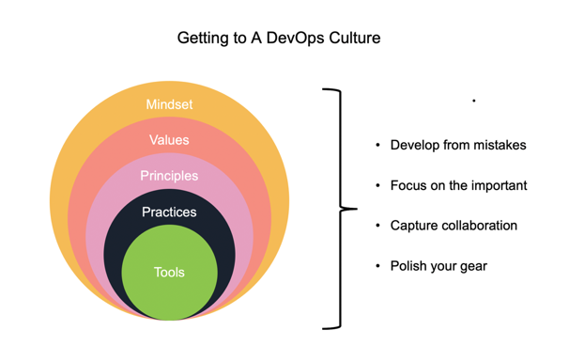
From DevOps.Com

Slide 10
Conclusion and References
We can address a just culture by addressing isolation , resistance with team, blame, trust, leadership gaps, and legacy systems.
We can promote transparency and continuous learning with team collaboration.
References: hackernoon.com, blog.yarsalabs.com, upguard.com, medium.com, noobtomaster.com, devops.com

