Slide 1
All you need is interaction (with IL-1β)
Departmental meeting, 2023-06-23 Tsunghan Hsieh (Musa’s group)

Slide 2
Inflammation

Slide 3
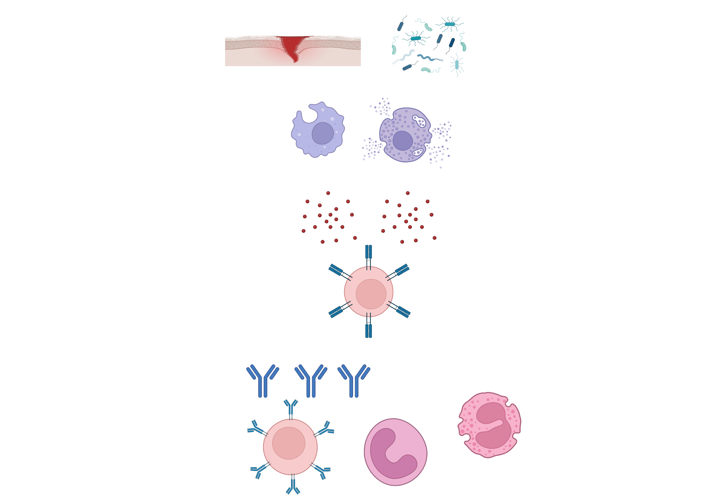
Inflammation
Tissue injury
Microbial infection
First-line Innate immune cells
Inflammatory cytokines

Slide 4
Inflammation
Inflammatory cytokines
T helper cells (CD4⁺ T cells)

Slide 5
Inflammation
Inflammatory cytokines
Wound healing
Neutralizing microbial toxins
Removing microbes
PMN
B cells

Slide 6
IL-1β

Slide 7


Cytokine | Woking range
IL-1β | 1-5 pg/ml
IL-6 | >20 pg/ml
IL-18 | 10000-20000 pg/ml
IFN-g | 100-1000 pg/ml
IL-1β is the apex cytokine

Slide 8
IL-1β / Th17: uncontrolled inflammation
IL-1β
Th17 -> pathogenic Th17 (with IL-23, via STAT3)
PMN
B cells

Slide 9
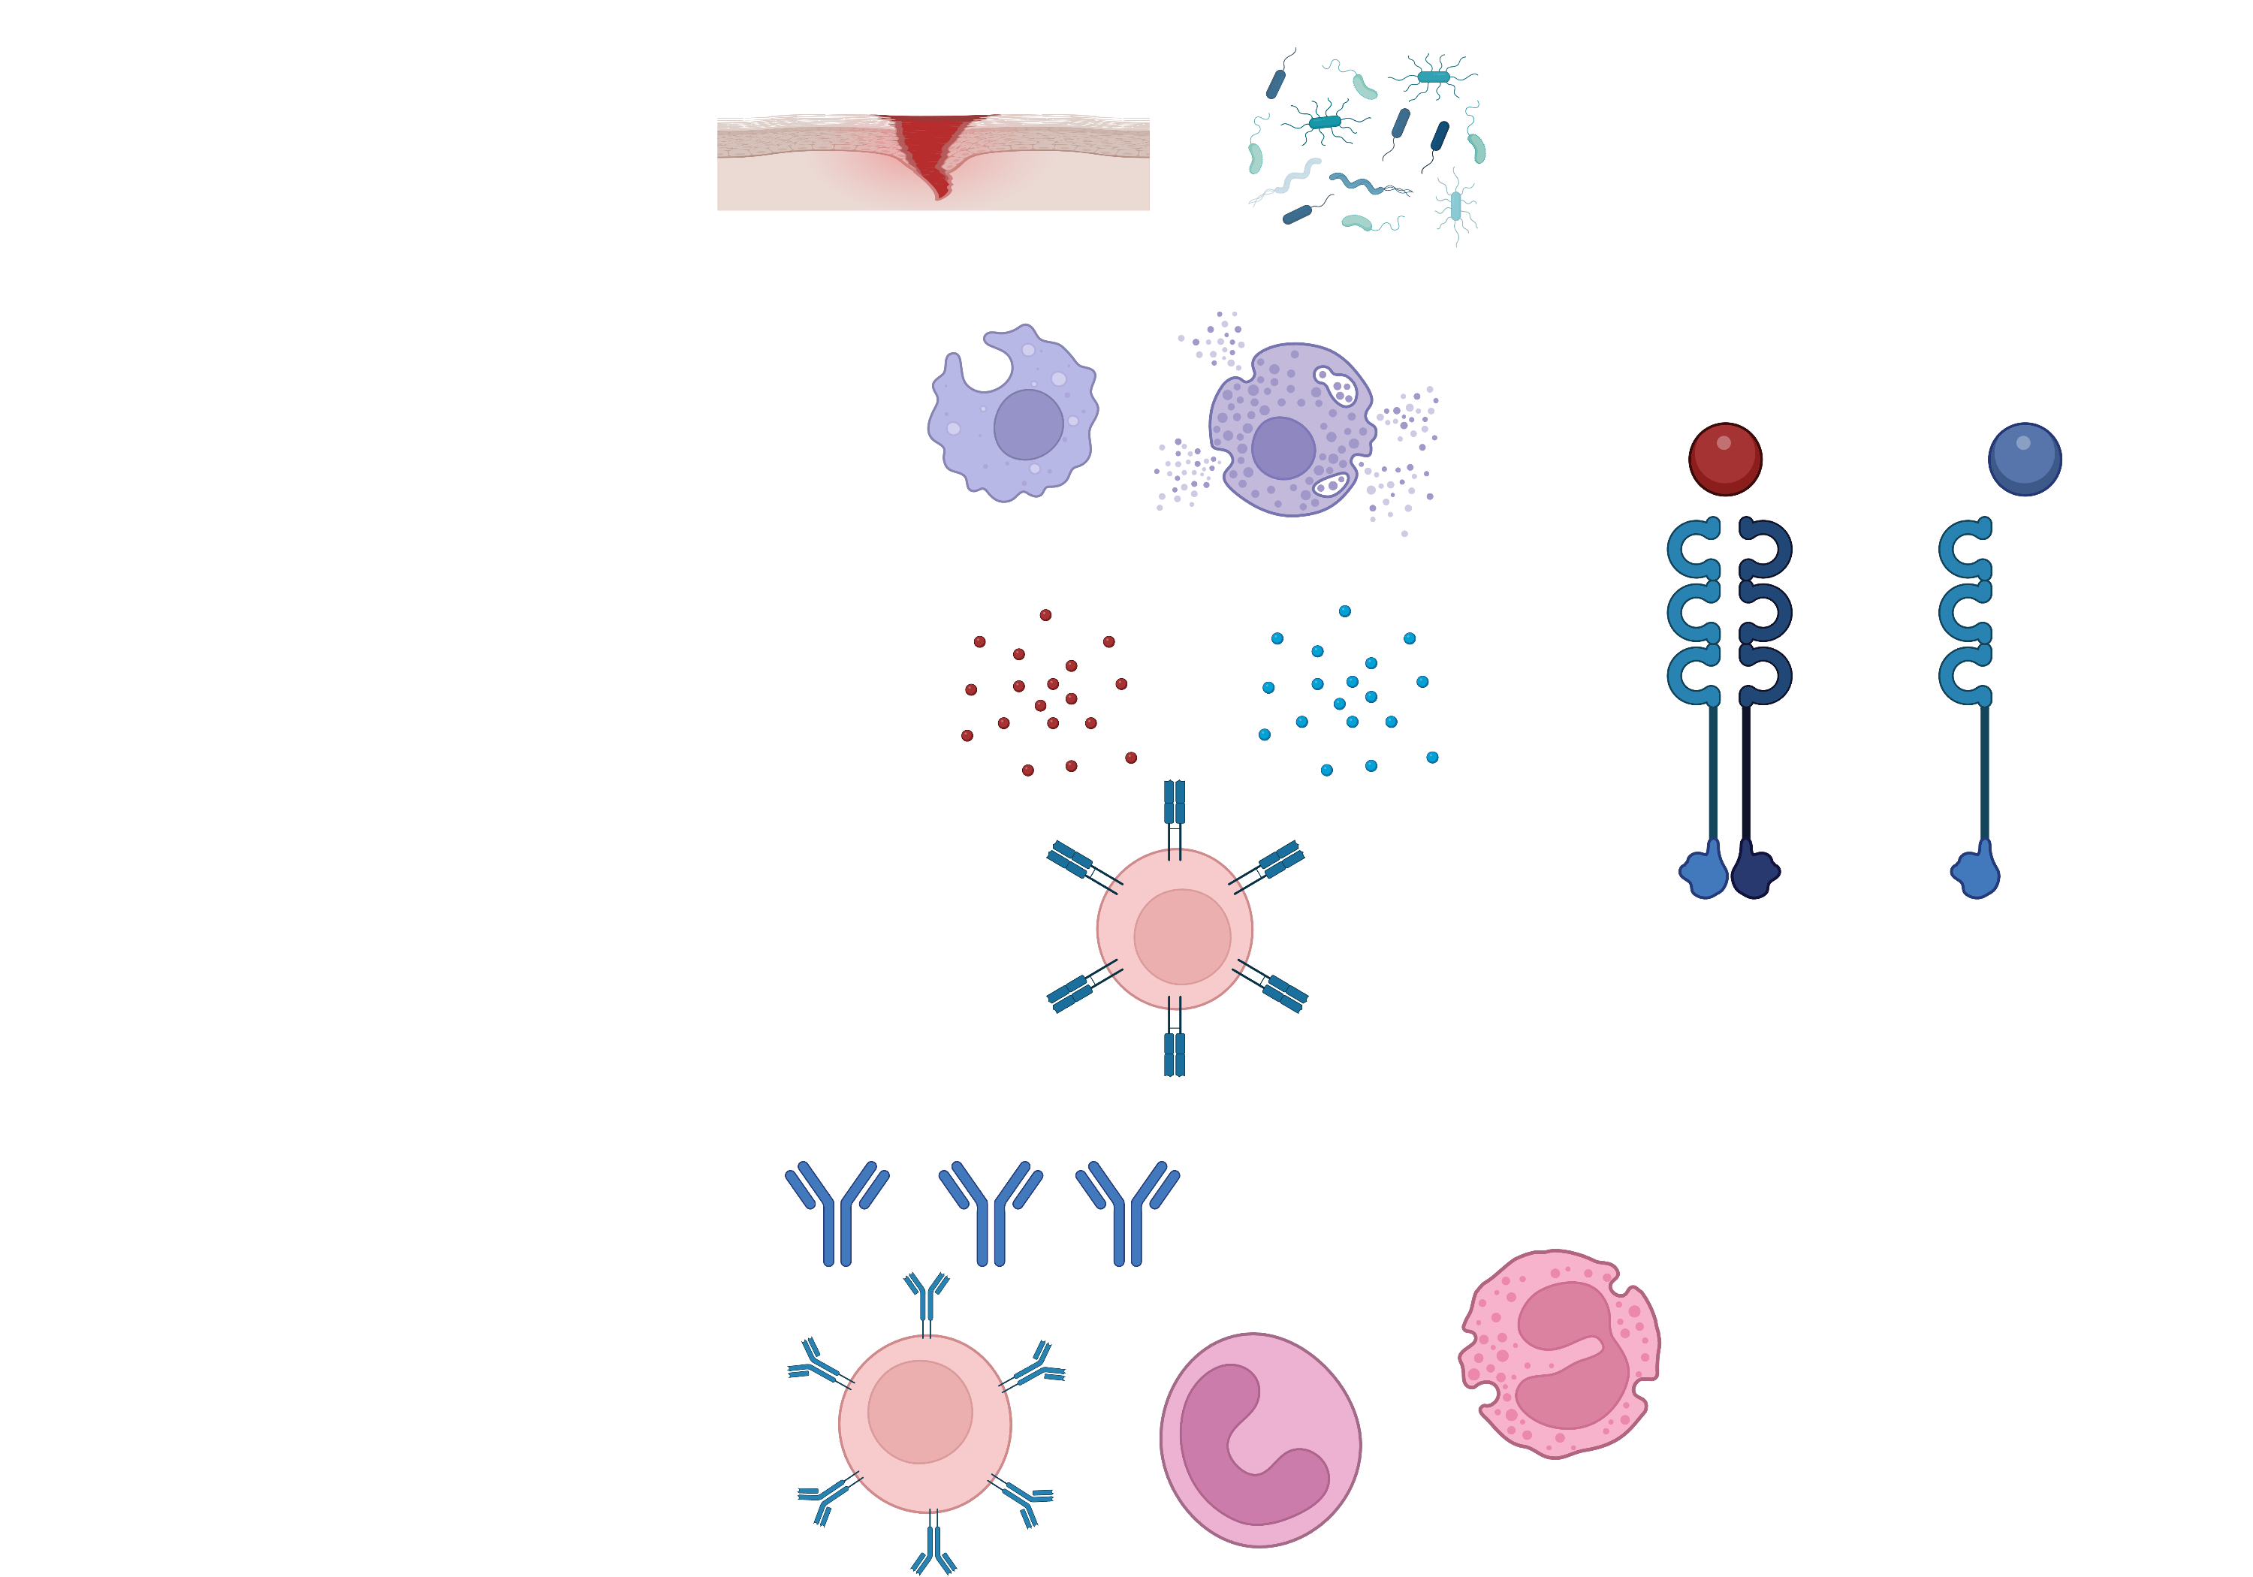
An active way to stop IL-1β-mediated inflammation: IL-1RN
IL-1β
IL-1RN
signal
No signal
PMN
B cells

Slide 10
IL-1RN can further activate the Treg program
IL-1RN
Th17 -> Treg (FOXP3)
No signal
IL-10
PMN
B cells

Slide 11
IL-1RN is the critical brake for IL-1β
Patients with IL-1RN deficiency suffer autoimmune diseases.
The treatment is to give IL-1RN (ANAKINARA)
The principle behind is IL-1RN can inhibit the IL-1β-mediated inflammation as well as repivoting the Th17 to Treg program.
Notes:
An Autoinflammatory Disease with Deficiency of the Interleukin-1–Receptor Antagonist. New England Journal of Medicine 360, no. 23 (June 4, 2009): 2426–37. https://doi.org/10.1056/NEJMoa0807865.
Excess IL-1 Signaling Enhances the Development of Th17 Cells by Downregulating TGF-β–Induced Foxp3 Expression. The Journal of Immunology 192, no. 4 (February 15, 2014): 1449–58. https://doi.org/10.4049/jimmunol.1300387.

Slide 12
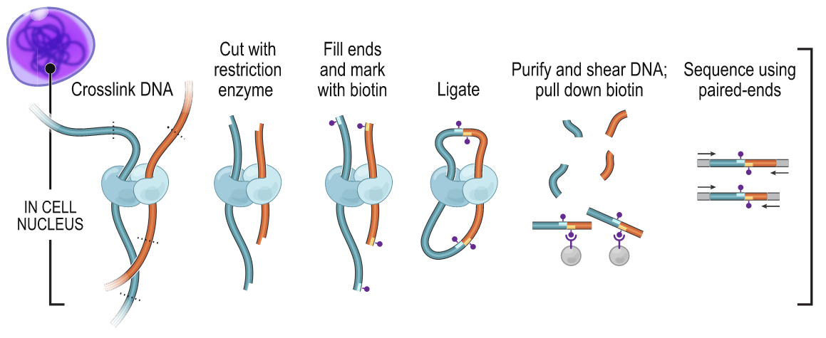
We use sequencing to capture the interaction between different chromosome regions
Lieberman-Aiden, Erez, Nynke L. van Berkum, Louise Williams, Maxim Imakaev, Tobias Ragoczy, Agnes Telling, Ido Amit, et al. Science 2009

Slide 13
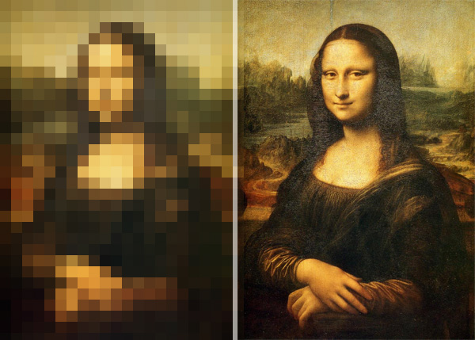
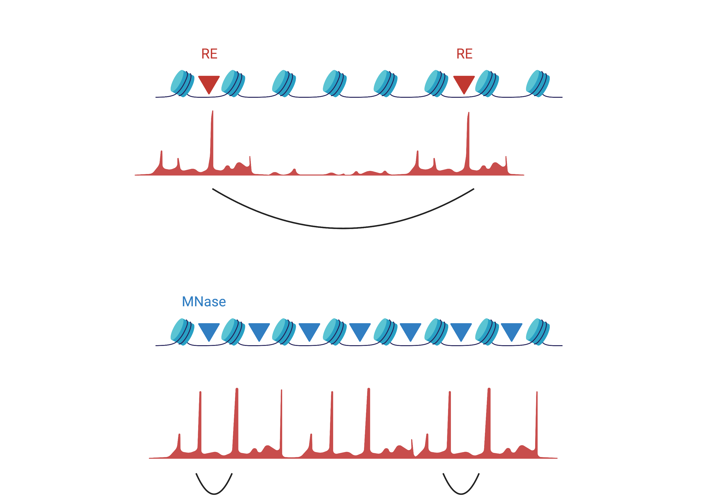
Micrococcal nuclease digestion provides interaction map single nucleosome resolution
HiC
5000 bp ~ 1MB
MicroC
146 bp ~ 1000 bp

Slide 14
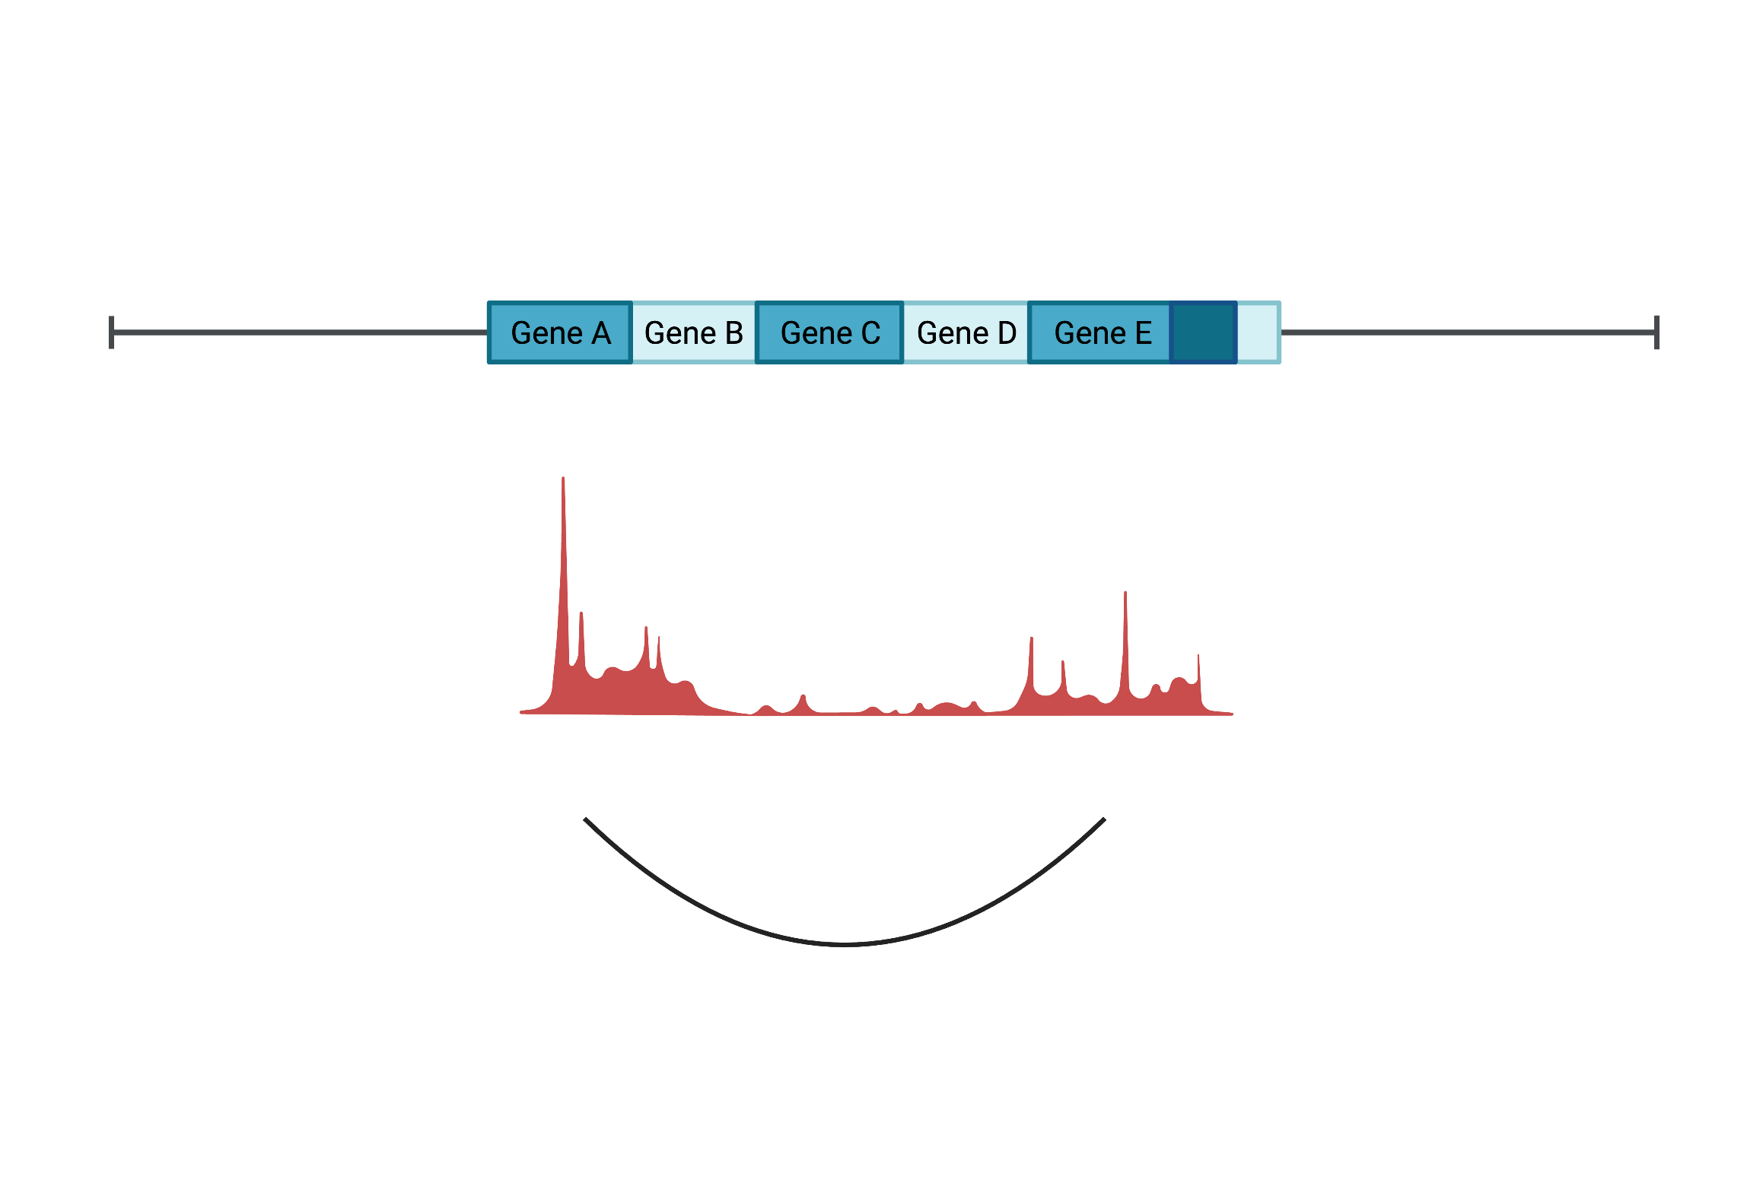
4C helps us to get the detailed interaction map within IL1B TAD

Slide 15
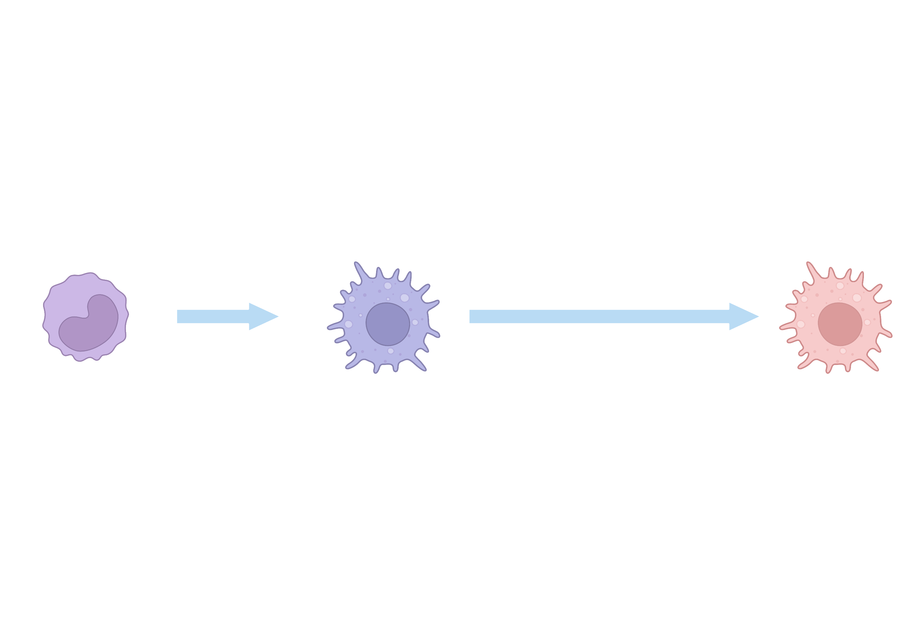
Goal: building the dynamic interaction map with various stimulus
Stimulatants
Monocytes
Macrophages
Trained macrophages

Slide 16
Experiment design for pilot study (THP-1)
Stimulatants:
LPS
Monocytes
Macrophages
Day 0
Day 1
MicroC
MicroC

Slide 17
Data

Slide 18
Future: experiment design for human monocytes (Single donor)
Stimulatants: Control (Medium) LPS
β-glucan LPG lysate
Monocytes
Macrophages
Trained macrophages
Day 0
Day 1
Day 6
MicroC
MicroC
MicroC

Slide 19
Appendix

Slide 20
Inflammation and anti-inflammation are mediated by different types of cells
Removal of inflammation agents
The depletion of inflammatory cytokines
Arise of T/B cells
Death of inflammatory T/B and innate immune cells
Sequential, balance between differential types of cells

Slide 21
Both inflammation and anti-inflammation could be mediated by a single type of cell
Regulatory T/B cells and other cells are not involved
Both the inflammatory and anti-inflammatory cytokines are expressed by the same cell
The genes encoding the inflammatory and anti-inflammatory cytokines locate close to each other
The expression of the inflammatory and anti-inflammatory cytokines are regulated through the changes of genomic architecture

Slide 22
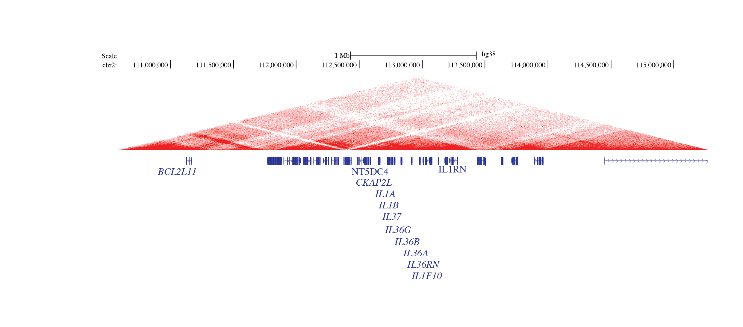
IL1 family members locate within a gene cluster and from one super TAD

Slide 23
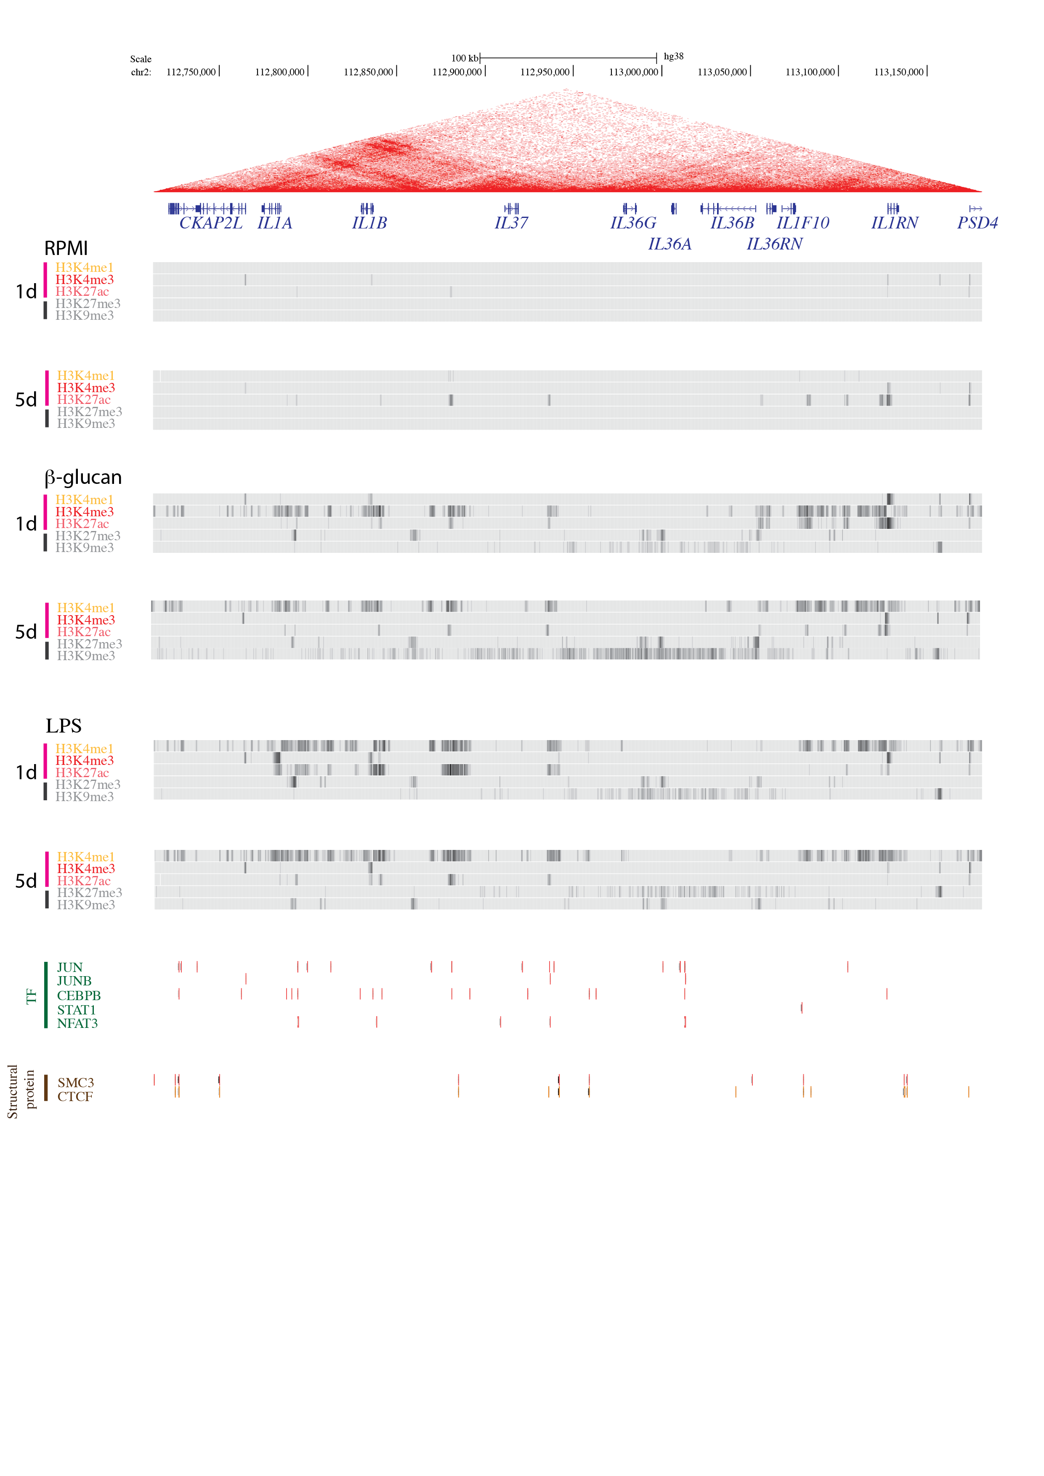
IL-1RN and IL-1B are co-regulated in epigenetic level
RPMI
H3K4me1
1
5
H3K4me3
1
5
H3K27Ac
1
5

Slide 24

IL-1RN and IL-1B are co-regulated in epigenetic level
LPS
H3K4me1
1
5
H3K4me3
1
5
H3K27Ac
1
5

Slide 25
The inflammation is stopped passively when there is less microbes / tissue injuries
Depletion of inflammatory cytokines
PMN
B cells

