Slide 1
MicroC updates
20240306
Winsen Wijaya & Tsunghan Hsieh

Slide 2
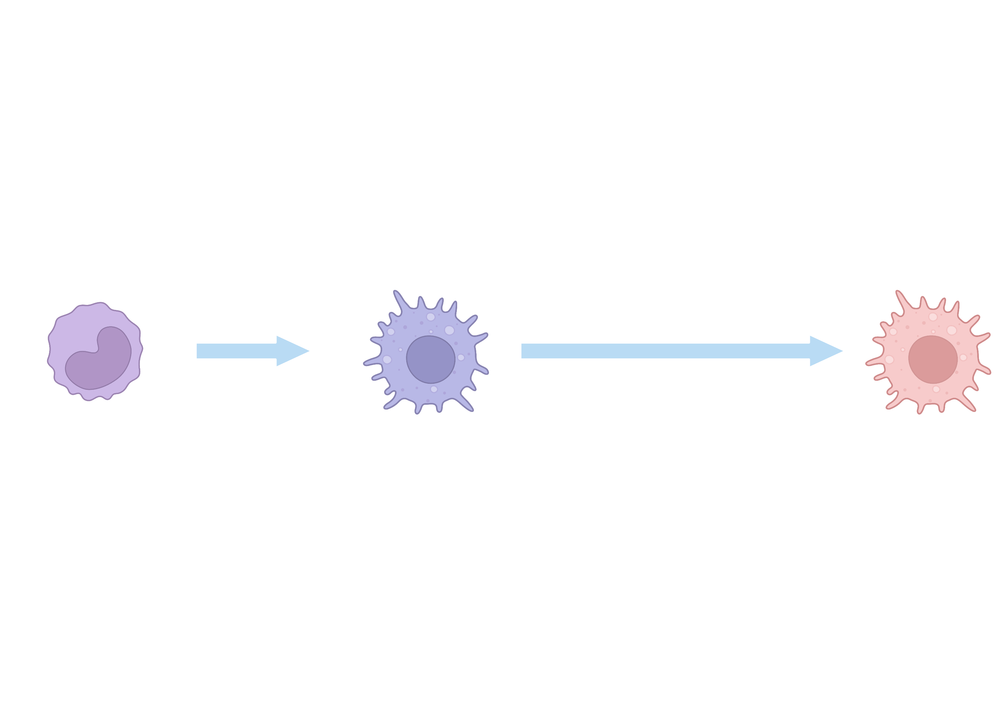
Experiment design
Stimulatants: β-glucan, LPS
1d
5d
Monocytes
Macrophages
Trained macrophages
MicroC
MicroC
MicroC
Only lysates,
did not process to library

Slide 3
Quality of MicroC data
Please make a table to show the QC results of our microC cata

Slide 4
Interaction maps
Please put the heatmap

Slide 5
Identification of differentially-interacted regions (DIRs)
Stimulations: β-glucan, LPS, BCG …
Stimulated-dependent interactions

Slide 6
DIRs in IL1B super TAD
In resolution of 5-kb:
LPS: 629
β-glucan: 929

Slide 7
Future works
Deeper sequencing to achieve higher resolutions
Annotation of DIRs (to nearest genes)

Slide 8
Sample matrix (microC)
Cell types | Stimulation | Time points (Day) | Donor | Progress
Monocytes | Medium | 0 | Donor A (2023-6-19) | Lysates
Monocytes | Medium | 0 | Donor A (2023-6-19) | Library
Monocytes | B-glucan | 5 | Donor A (2023-6-19) | Library
Monocytes | Medium | 5 | Donor C (2023-6-19) | Lysates
Monocytes | Medium | 0 | Donor C (2023-6-19) | Library
Monocytes | LPS | 5 | Donor C (2023-6-19) | Library

