Slide 1
Craze Diamond UI

Slide 3
Layout
Estop stays on all time
Title area
STOP ALL
Main area
Tabs bar
Settings here

Slide 4
System
Motion Platform V1.0 powered by Project Crazy Diamond
STOP ALL
Target resources (rpi: CPU/memory/disk usage and size; GPU usage if applicable)
Refreshed timely
Tabs bar
ROS2

Slide 5
Project Dashboard
Motion Platform V1.0 powered by Project Crazy Diamond
STOP ALL
Tabs bar

Slide 6
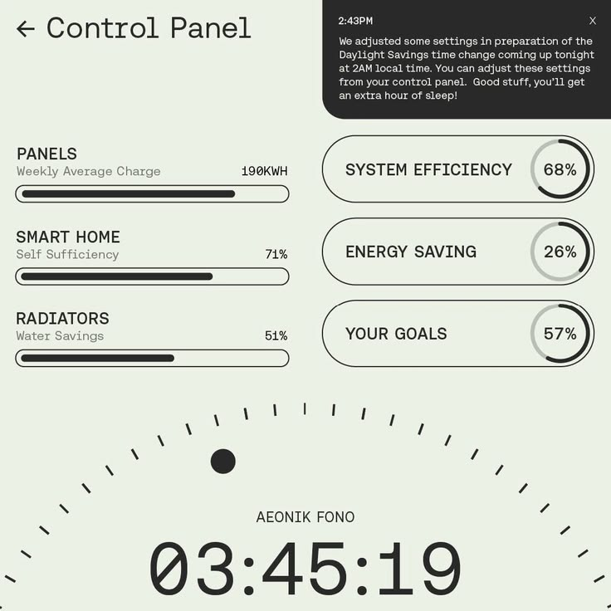

UI elements
Duty cycle, rpi resources progress bar, etc:
Progress bar:
Duty
Progress

