Slide 1
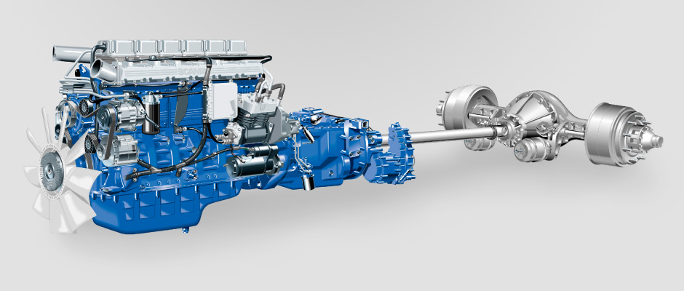
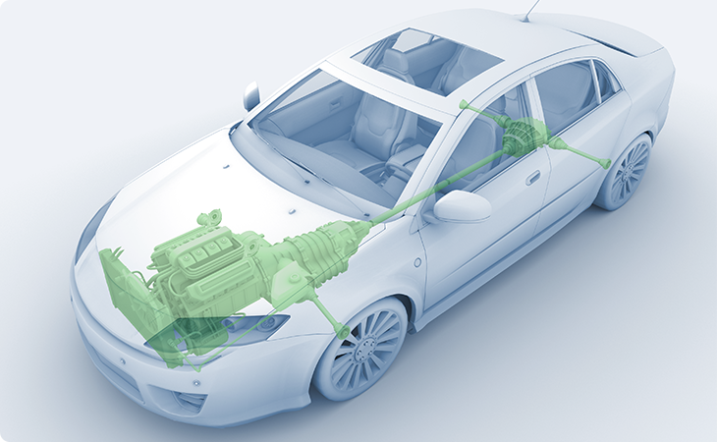
Powertrain
p(t)
input
Chassis
F(t)
v(t)
output

