Slide 1
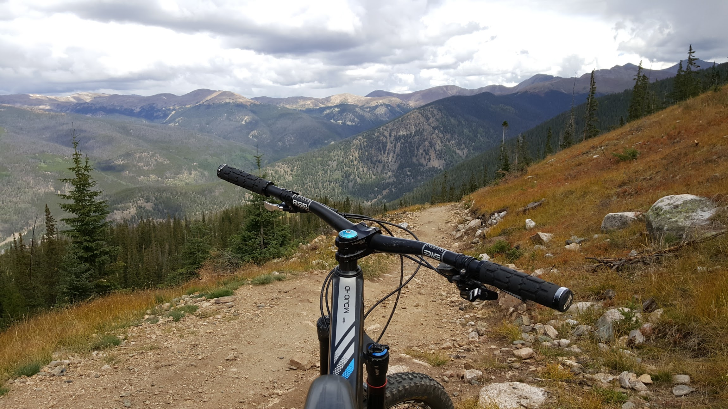
Where To MTB?
Give an address and a search radius and we’ll
find local bike trails with great riding conditions!
Address
20 miles
GO!

Slide 2
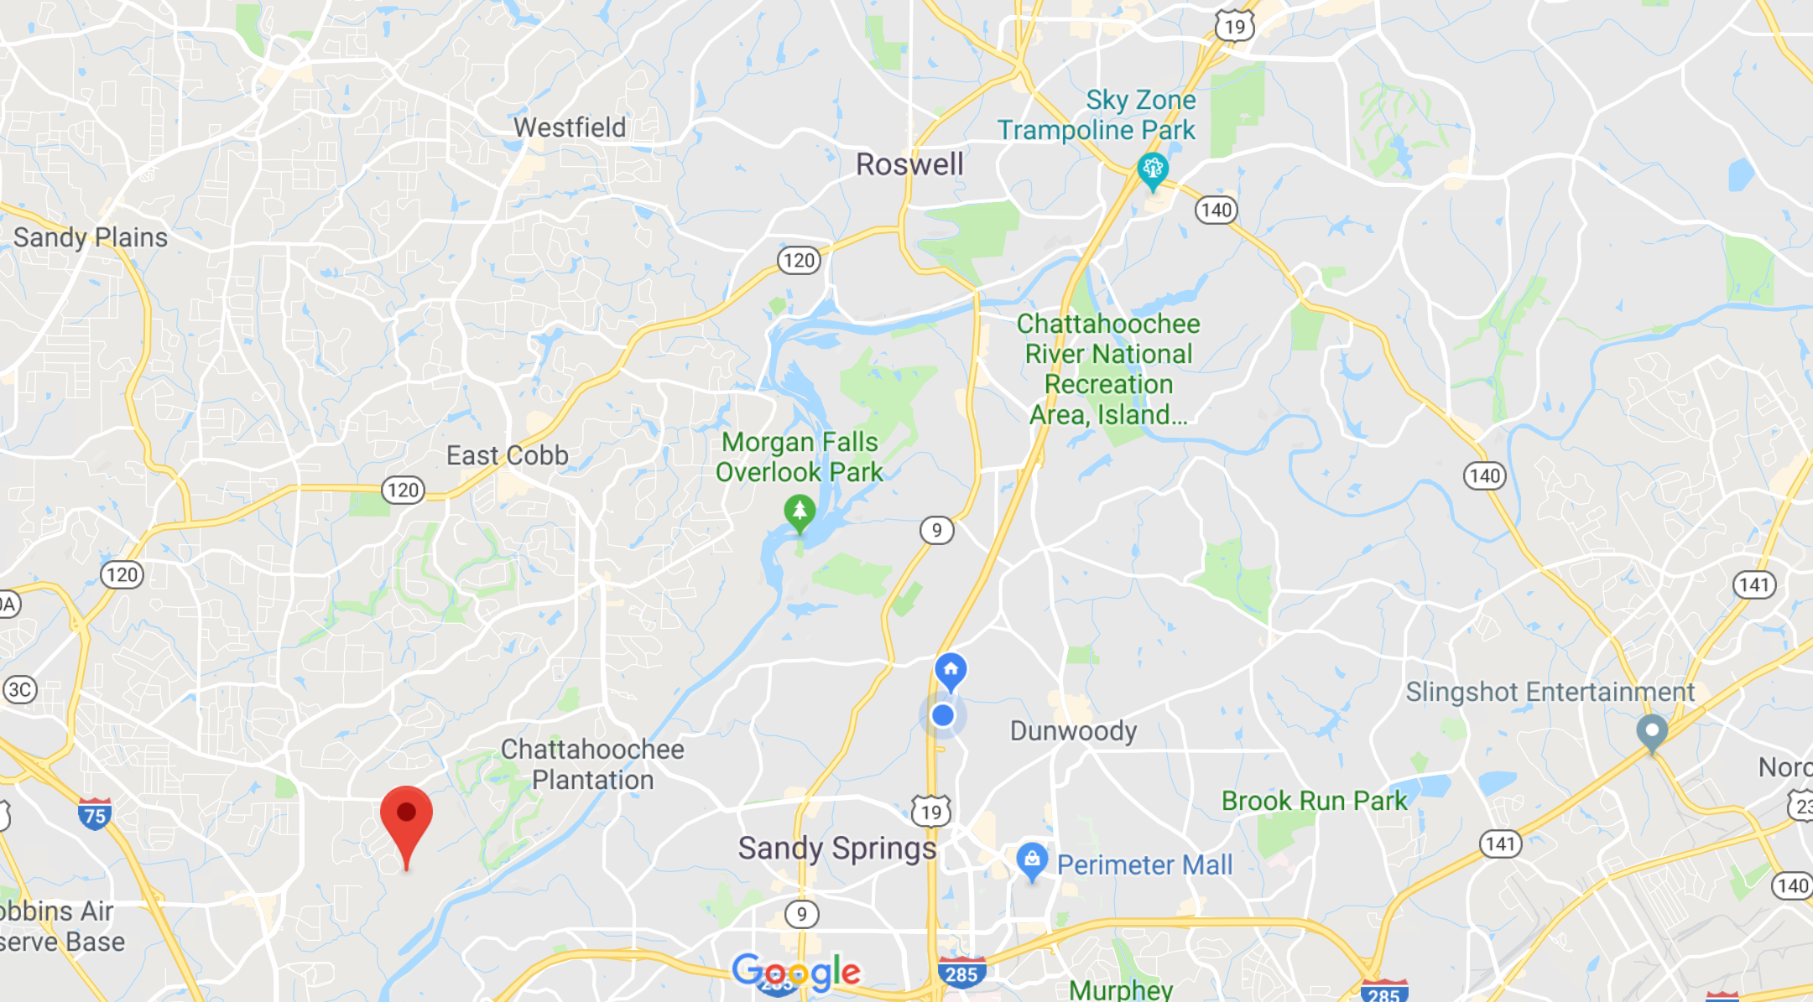
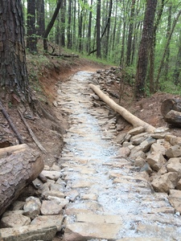
Sope Creek
Sope Creek has a few miles of gravel and some good, fun, flowy singletrack.
0 in.
Precipitation in
last 24 hours

Slide 3
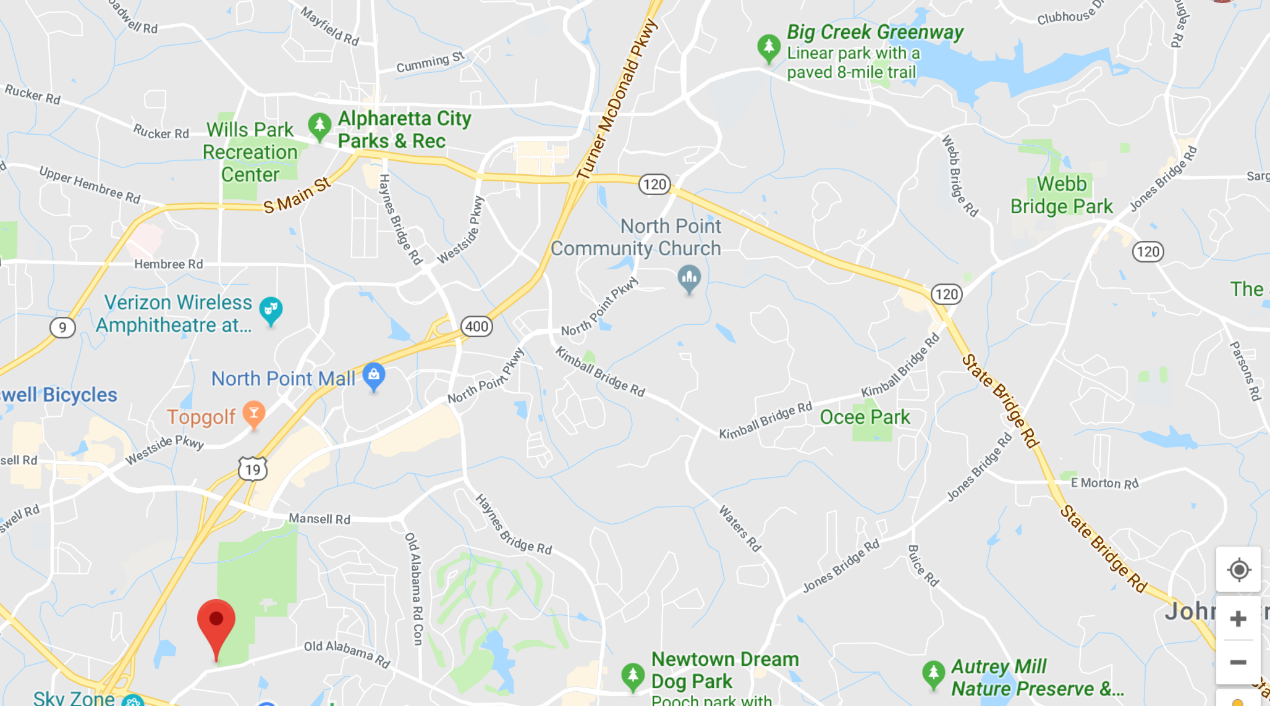

Big Creek
Big Creek has a few miles of gravel and some good, fun, flowy singletrack.
2 in.
Precipitation in
last 24 hours
AVOID!

